Slide 1

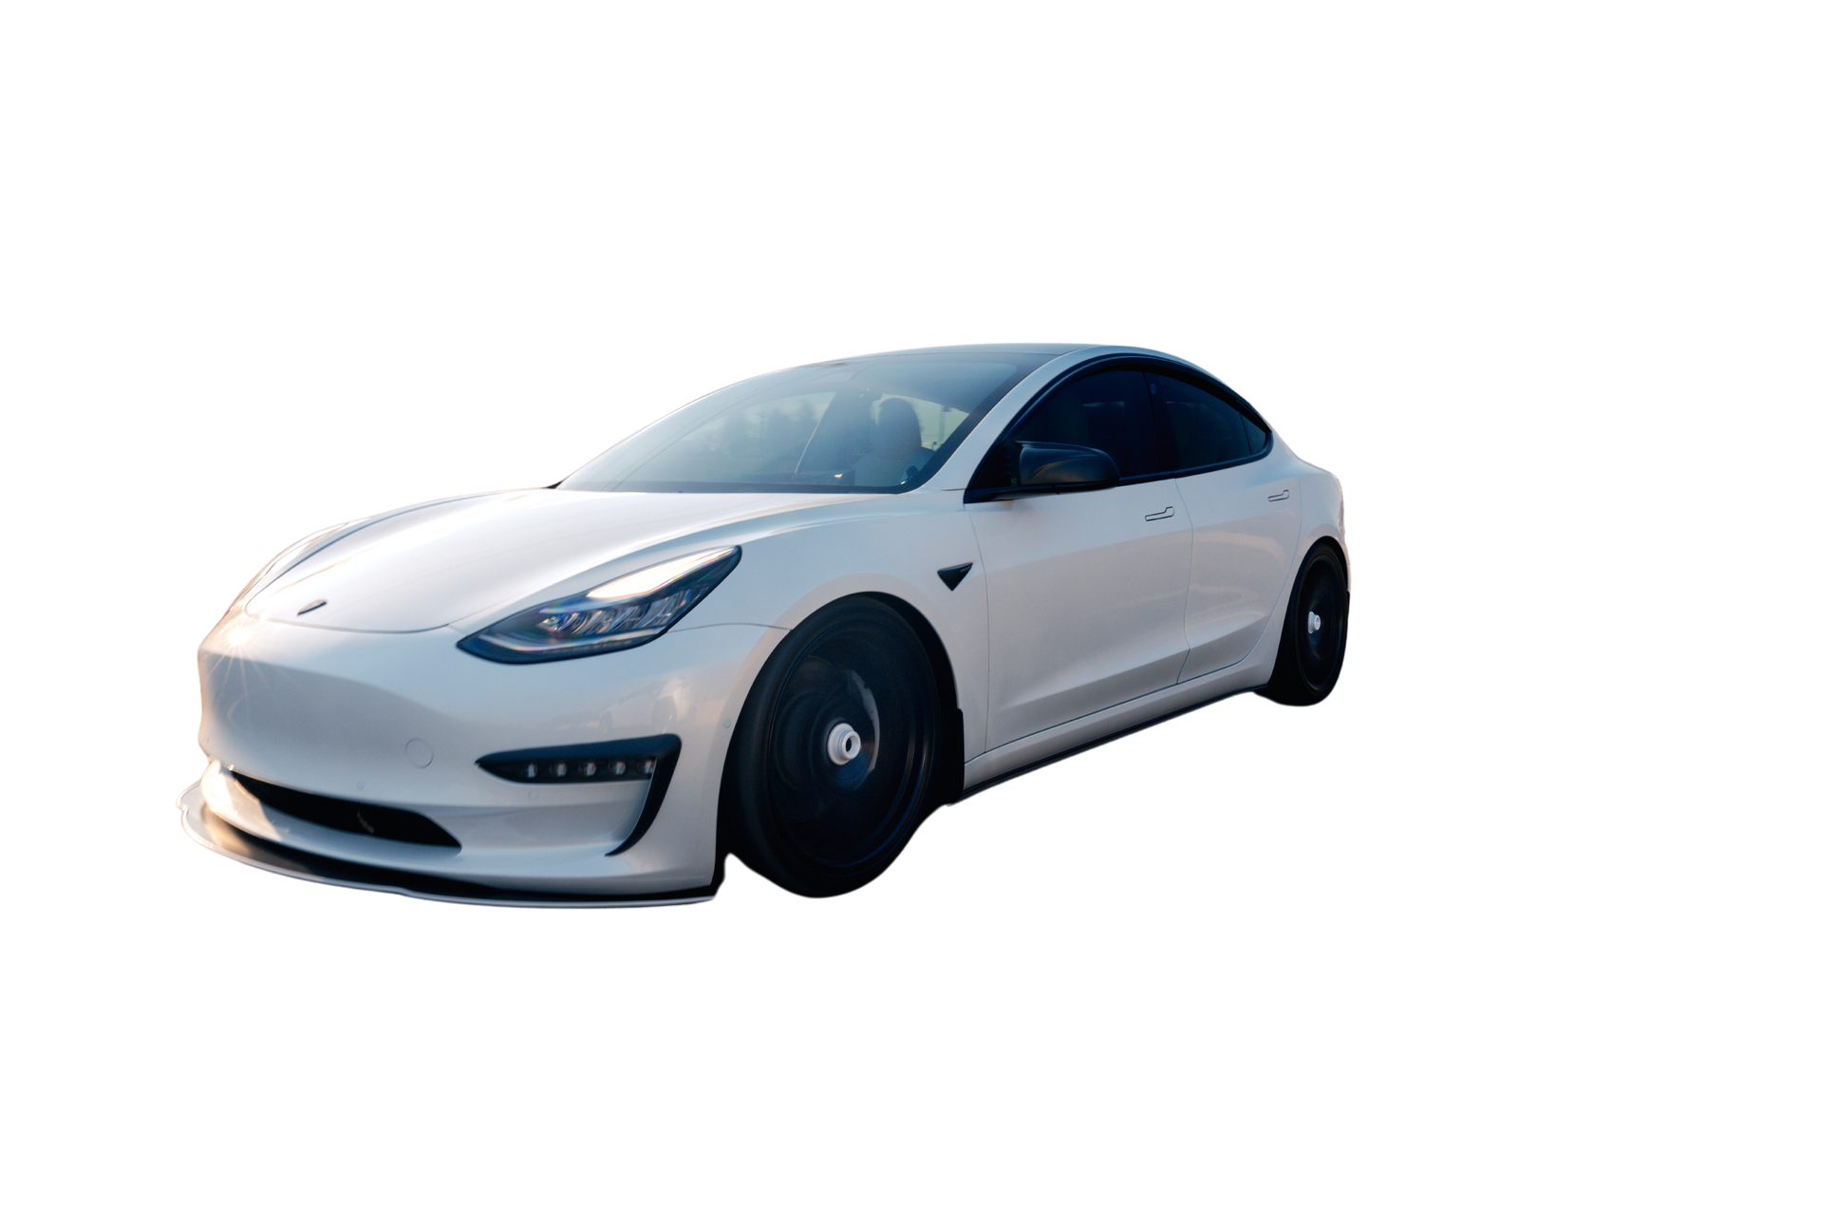

WEB CRAWLERS
USING CARLIST.MY
Group B - Data Drillers
THEVAN RAJU A/L JEGANATH (A22EC0286)
MULYANI BINTI SARIPUDDIN (A22EC0223)
ALIATUL IZZAH BINTI JASMAN (A22EC0136)
MUHAMMAD ANAS BIN MOHD PIKRI (A21SC0464)

Slide 2
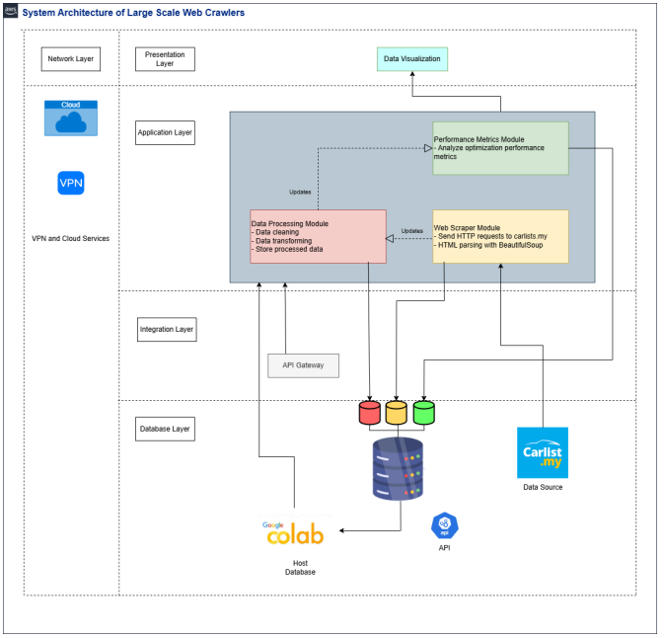
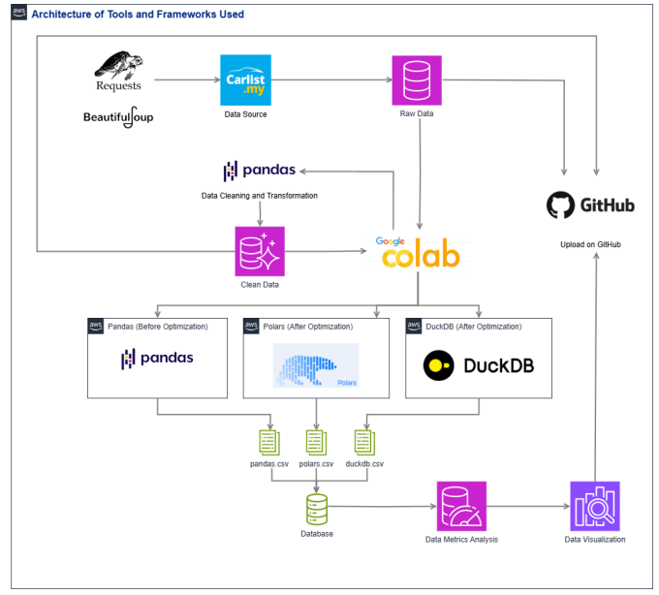
SYSTEM DESIGN AND ARCHITECTURE
SYSTEM ARCHITECTURE
TOOLS AND FRAMEWORKS

Slide 3





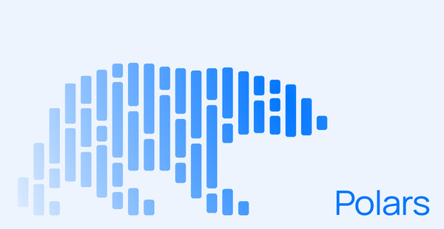
TOOLS AND FRAMEWORKS USED

Slide 4
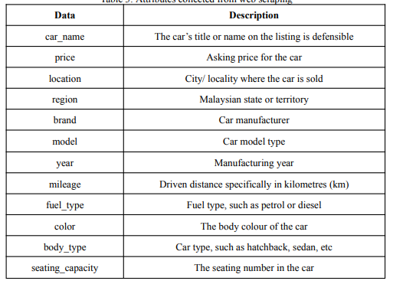
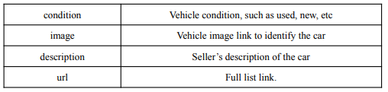
DATA COLLECTION & ENTITIES

Slide 5
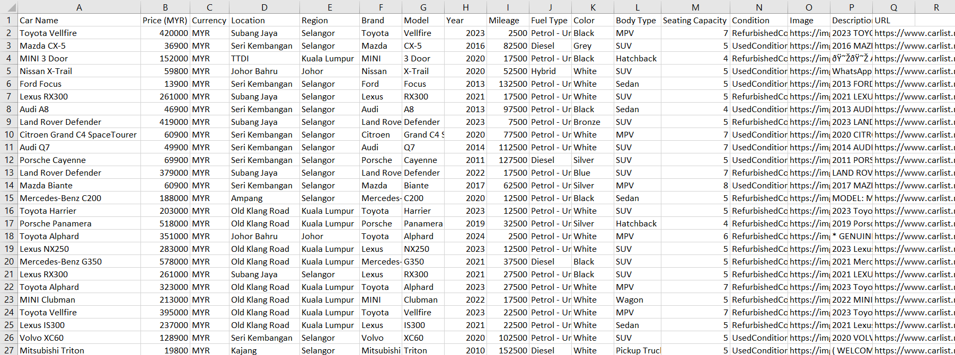
RAW DATA

Slide 6

SALFORD & CO.
HOME
ABOUT US
SERVICES
TEST DRIVE
CONTACT
DATA CLEANING
DROP UNNECESSARY COLUMN
CHECK FOR DUPLICATES
FIX ENCODING ISSUES
LOAD CSV FILE
STANDARDIZE & HANDLE MISSING VALUES
CHECK FOR MISSING VALUES
CHANGE DATA TYPE
DROP DUPLICATES
HANDLE CONDITION COLUMN
FINAL DATA INSPECTION
SAVE INTO CSV FILE

Slide 7
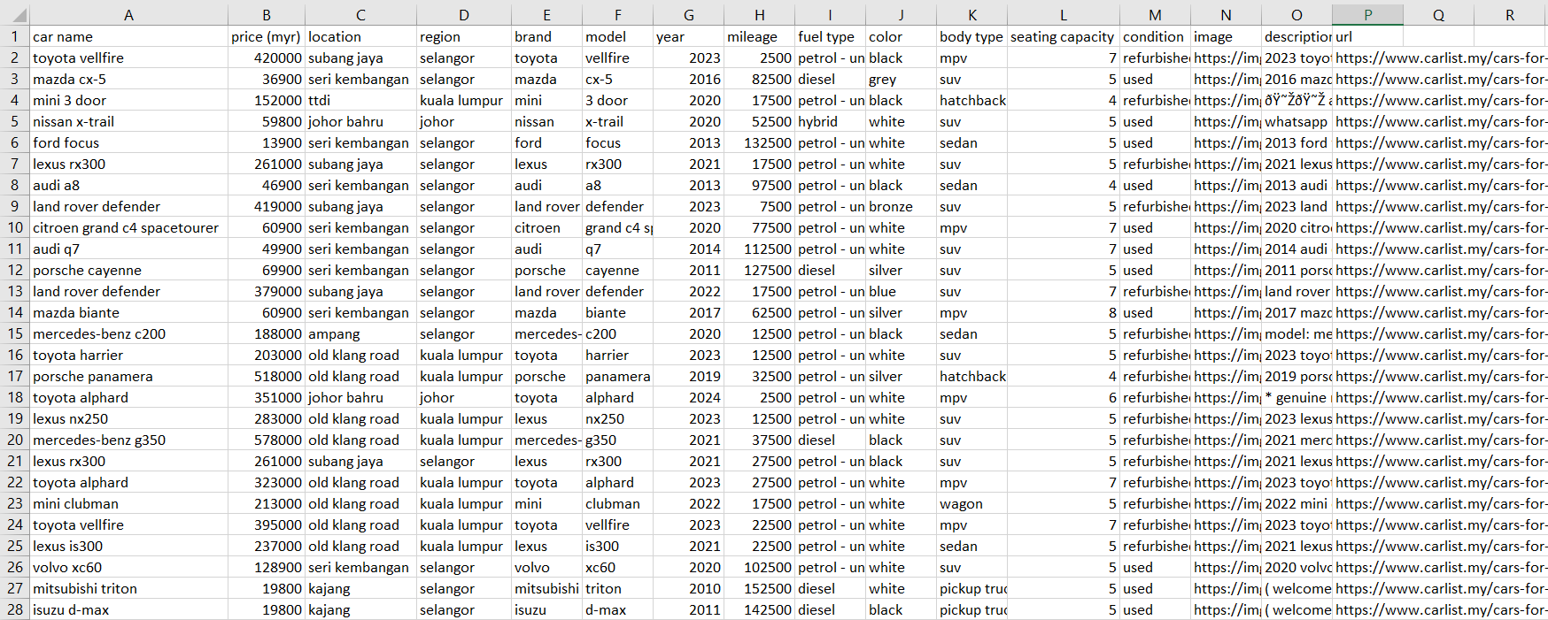
CLEANED DATA

Slide 8

DATA OPTIMIZATION
POLARS
DUCKDB
POLARS IS AN OPEN-SOURCE LIBRARY FOR DATA MANIPULATION, KNOWN FOR BEING ONE OF THE FASTEST DATA PROCESSING SOLUTIONS ON A SINGLE MACHINE. IT FEATURES A WELL-STRUCTURED, TYPED API THAT IS BOTH EXPRESSIVE AND EASY TO USE.
DUCKDB SERVES AS A POWERFUL ENGINE FOR ANALYZING AND TRANSFORMING DATA RESIDING IN VARIOUS FORMATS LIKE CSV, PARQUET, JSON, OR DATABASES SUCH AS POSTGRESQL AND SQLITE. IT CAN BE USED TRANSIENTLY FOR DATA MANIPULATION OR TO CREATE PERSISTENT TABLES FOR ANALYTICAL QUERIES.
PANDAS
PANDAS IS A POWERFUL, OPEN-SOURCE DATA ANALYSIS AND MANIPULATION LIBRARY FOR PYTHON. IT PROVIDES EASY-TO-USE DATA STRUCTURES AND TOOLS FOR WORKING WITH STRUCTURED DATA.

Slide 9
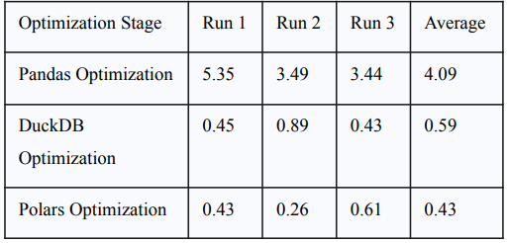
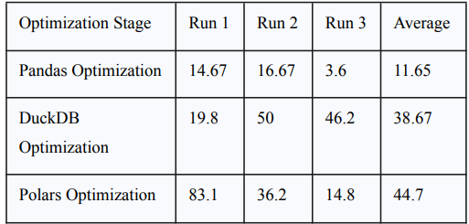
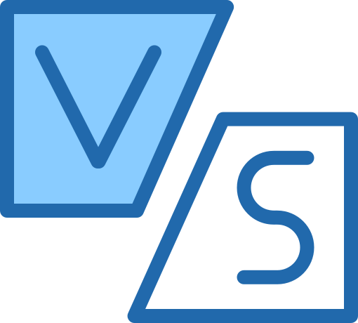
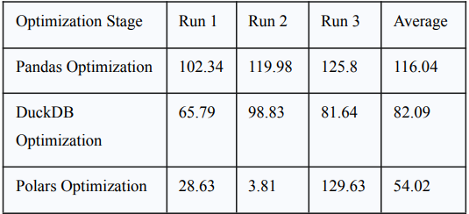
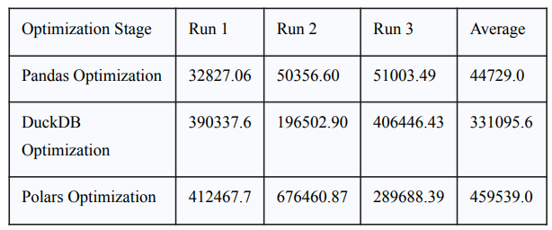
COMPARISON
TOTAL PROCESSING TIME (SECONDS)
CPU USAGE (%)
MEMORY USAGE (MB)
THROUGHPUT

Slide 10
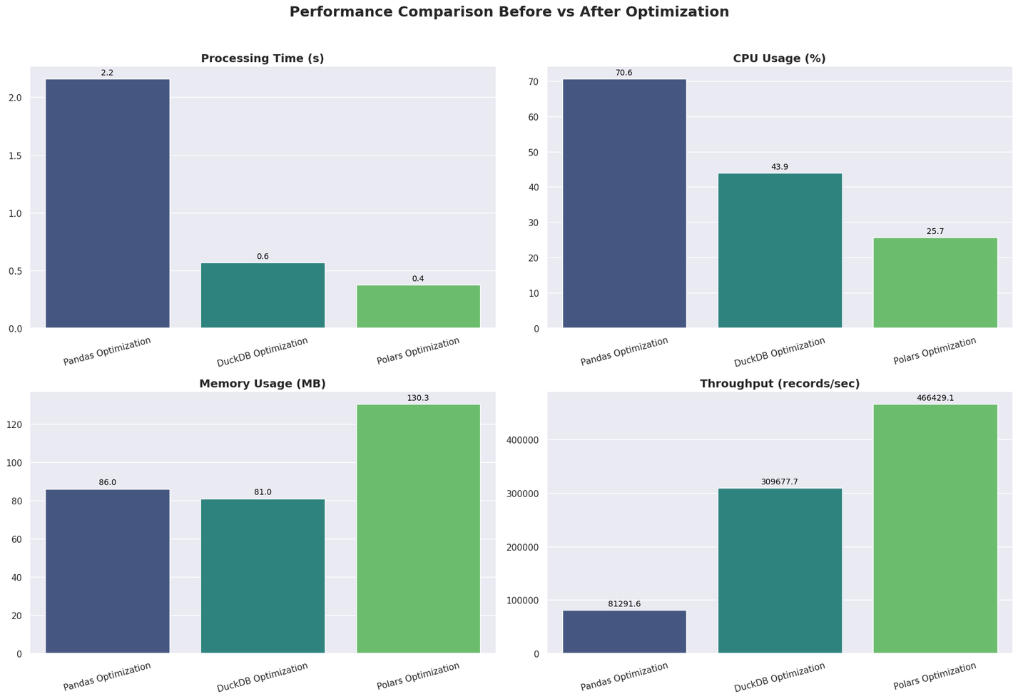

VISUALIZATION

Slide 11
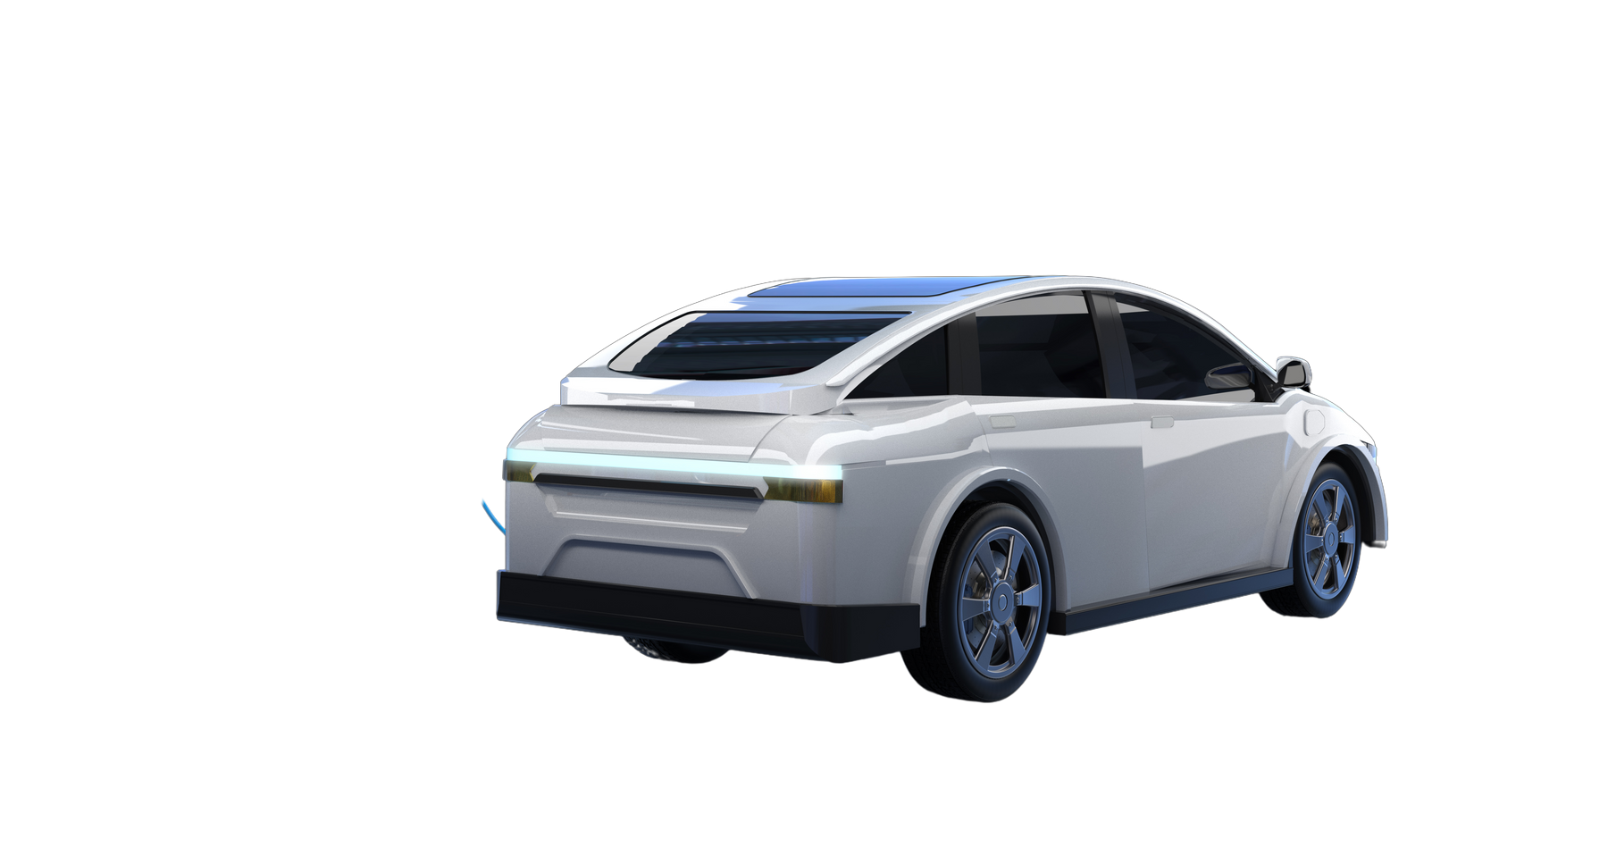
CHALLENGES AND LIMITATIONS
LONG DATA SCRAPING DURATION DURING EARLY PHASE
FINDING SUITAIBLE OPTIMIZATION LIBRARY
SUDDEN CHANGES AND RESTRICTIONS BY CARLISTS.MY

Slide 12
DATA DRILLERS
THANK YOU

