Slide 1



Sentiment Analysis of Ethereum on X(Twitter):
Insights from Social Media Trends
SUNYIHUI
MCS241024

Slide 2


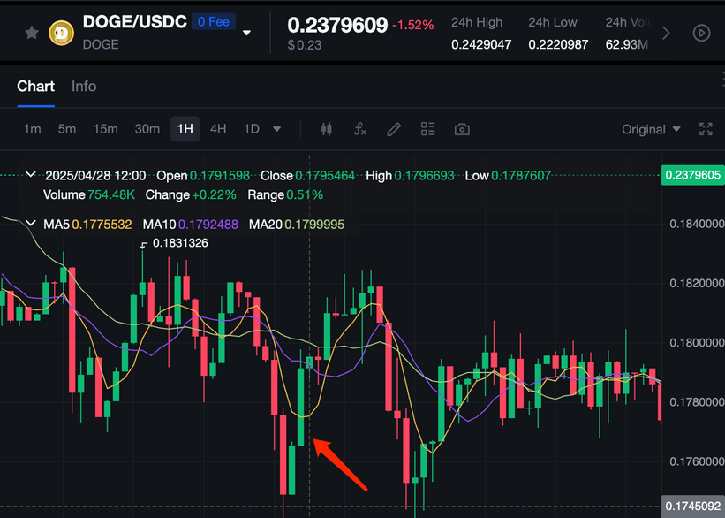
THE IMPACT OF SOCIAL MEDIA

Slide 3

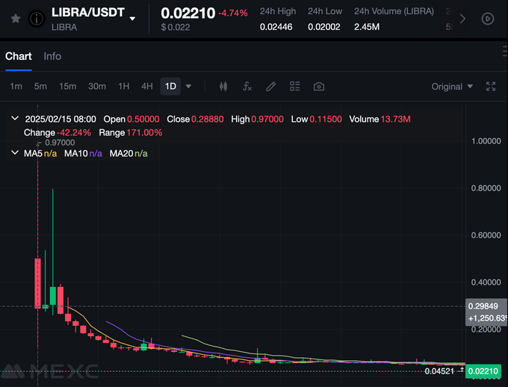
THE IMPACT OF SOCIAL MEDIA

Slide 4

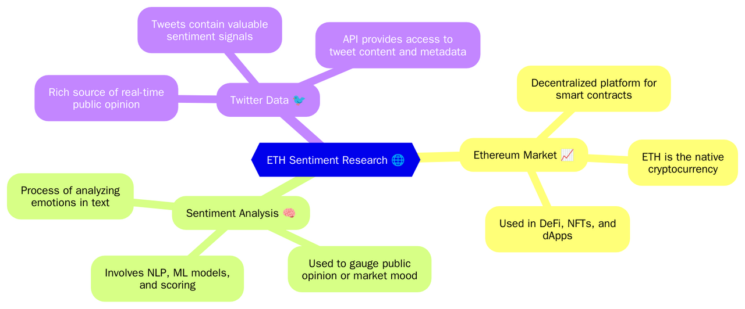

CONCEPTS IN ETHEREUM SENTIMENT ANALYSIS

Slide 5
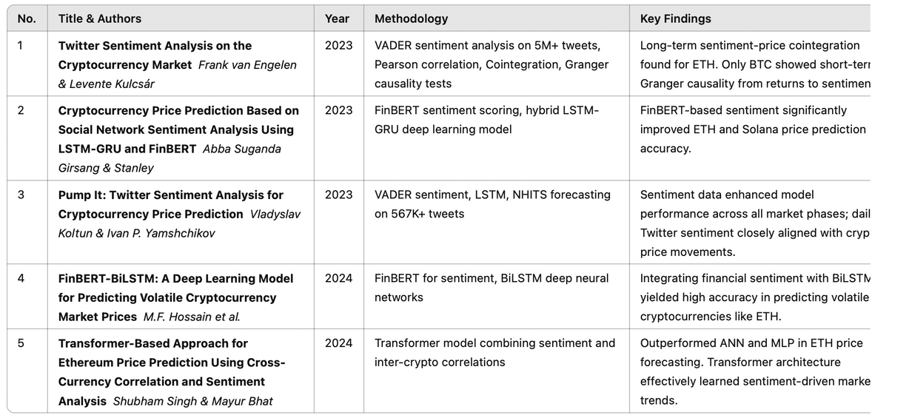

COMPARISON OF PREVIOUS RESEARCH
Assets
Liabilities
Cash, receivables, inventory, property
Short-term
debt, loans
Owner’s capital, retained earnings

Slide 6
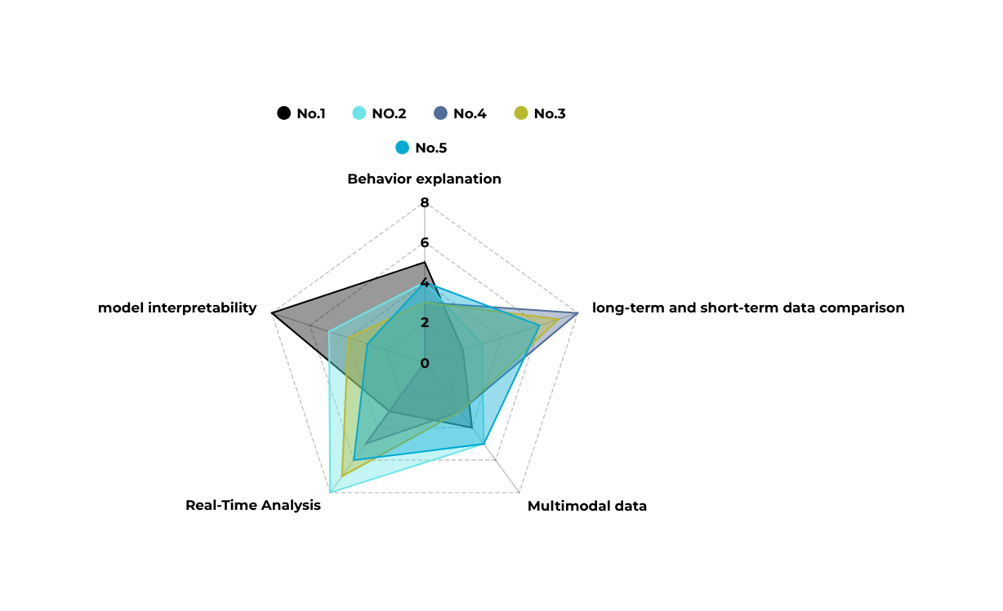
IDENTIFIED RESEARCH GAPS

Slide 7
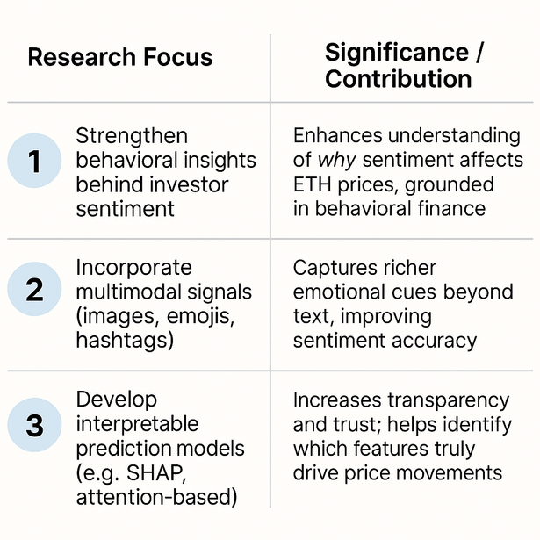
RESEARCH POSITIONING

Slide 8

DATA PREPROCESSING
Cash Flows from Investing Activities

Slide 9
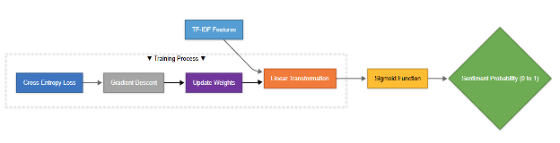
MODERL TRAINING
Logistic Regression
Cash Flows from Investing Activities

Slide 10
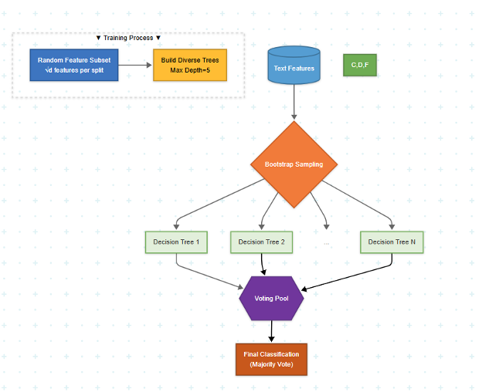
MODERL TRAINING
Random Forest
Cash Flows from Investing Activities

Slide 11
MODERL TRAINING
XGBoost+BERT
Cash Flows from Investing Activities

Slide 12
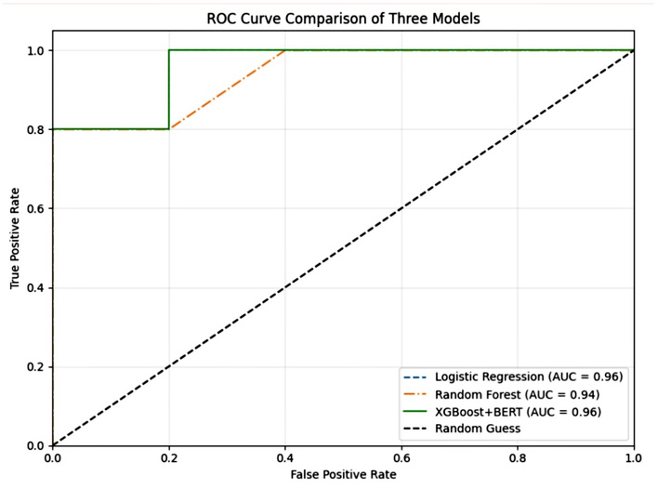
DATA EVALUATION

Slide 13
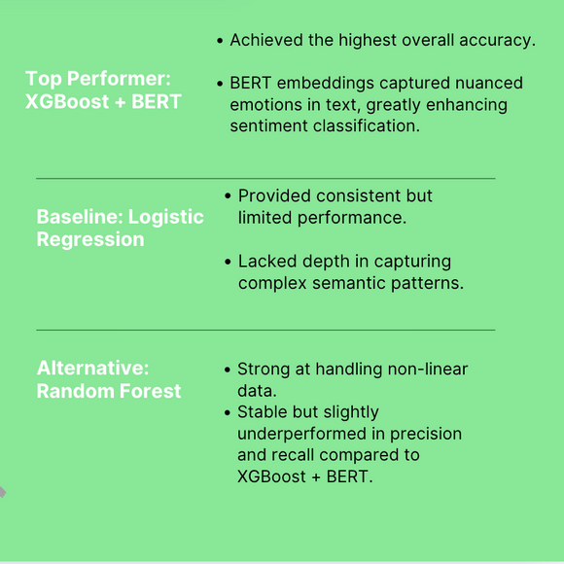
RESULTS AND FINDINGS

Slide 14
FUTURE WORK
Automated trading systems
Combining sentiment analysis with technical indicators
Real-time sentiment processing

Slide 15
THANK YOU!

