Slide 1
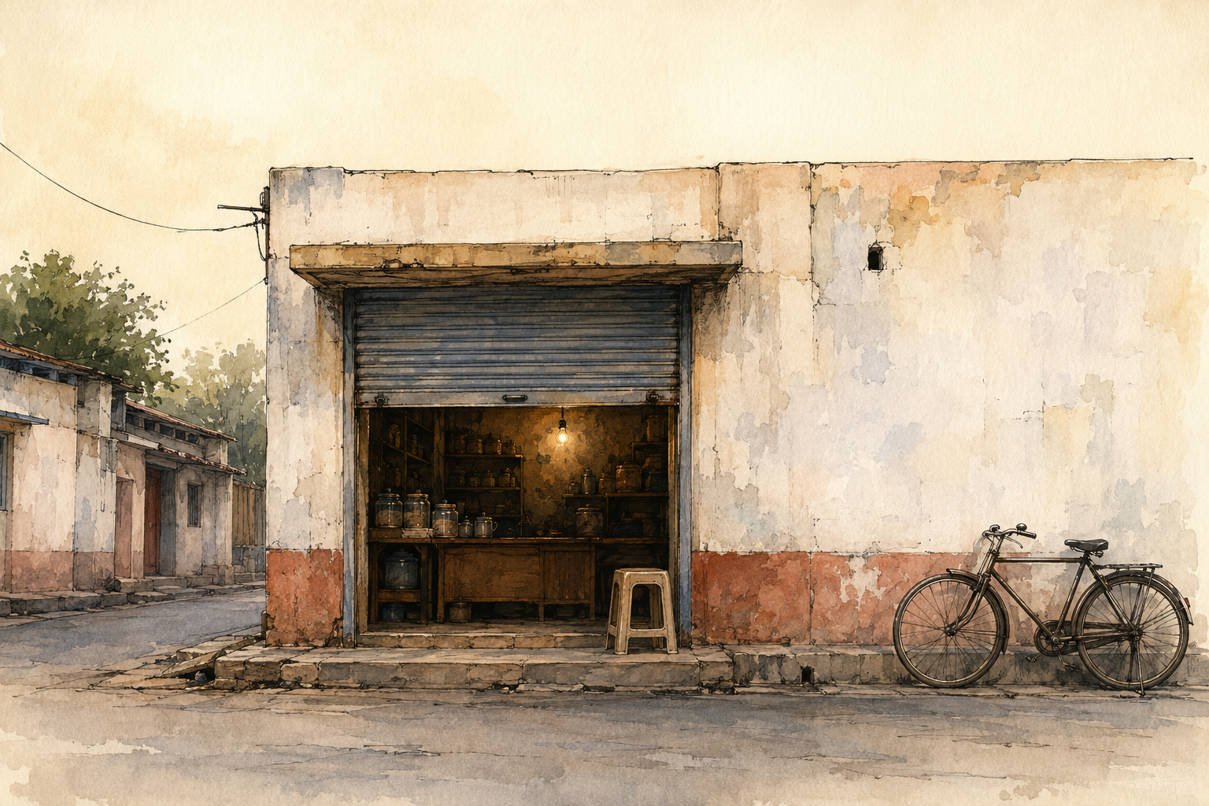
SESSION 01
What Creativity Is, and Why Your Ideas Get Stuck
Unit 1 · Foundations of Creativity and Innovation
120 minutes · studio · COs 109.1, 109.2
Notes:
Studio session. Warm-up: The Worst Possible Idea. Do not lecture past 15 minutes.

Slide 2
THE ONE IDEA
Creativity is having ideas. Innovation is an idea that actually reaches somebody. This course is about getting from the first to the second.
Notes:
Say it once. Do not elaborate on the slide — elaborate out loud.

Slide 3
WHY IT MATTERS
1
The distinction
A tea stall owner invents a new masala — that is creativity. Forty people a day buy it and come back — that is innovation.
2
Ideas have a lifecycle, and most die in the middle
Between "I thought of it" and "someone used it" there is a long gap.
Notes:
Four beats total across two slides. Fifteen minutes for all of it.

Slide 4
WHAT TO DO WITH IT
3
Four barriers, none about talent
Judging too early. Fear of looking foolish. "We have always done it this way." The expertise trap.
4
These are predictable, so they are beatable
That is the whole course.
Notes:
Four beats total across two slides. Fifteen minutes for all of it.

Slide 5
TODAY YOU WILL
Pick the one real business you are going to work on for the whole semester. Then write twenty questions you would need to ask its owner.
Marathi or Hindi · 60 minutes
Notes:
Leave this slide up for the whole making phase. It is the only slide that needs to stay visible.

Slide 6
TO CLOSE
Pitch
Three minutes. The person, the stuck, the idea, the picture, the ask.
Critique
I like… / I wish… / What if… — the idea, never the person.
Idea log
One page. Silent. Box 4 is the one you read again in week 15.
Notes:
If time runs short, cut the input — never the pitch. The pitch is how CO 109.2 is attained.

