Slide 1
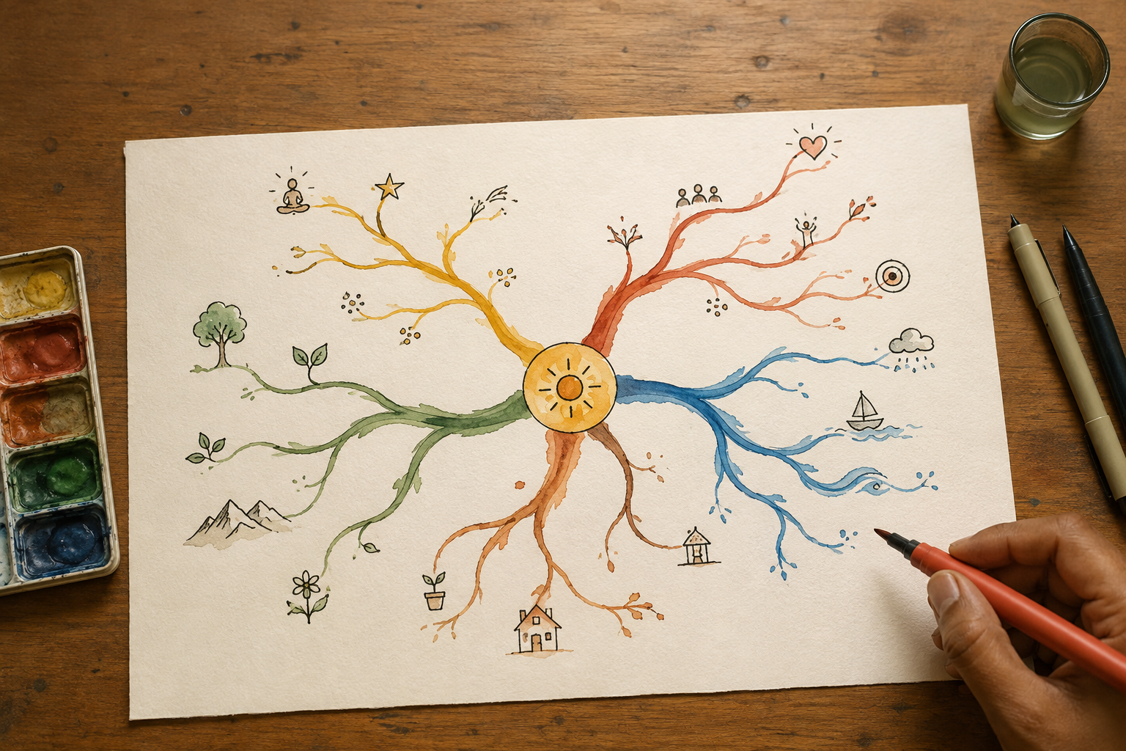
SESSION 06
Mind Mapping — Buzan's Laws
Unit 2 · Mind Mapping and Creative Thinking Techniques
120 minutes · studio · COs 109.4, 109.2
Notes:
Studio session. Warm-up: Map Your Morning — With No Rules. Do not lecture past 15 minutes.

Slide 2
THE ONE IDEA
A list hides relationships. A Buzan map shows them — and the laws are what make the difference between a map and a doodle.
Notes:
Say it once. Do not elaborate on the slide — elaborate out loud.

Slide 3
WHY IT MATTERS
1
Radiant thinking
The brain does not store in lines; it radiates from a centre. A map on paper copies that shape, which is why recall improves.
2
The laws of emphasis
A central image, not a word. Three colours minimum in that image. Branch thickness heaviest at the centre and thinning outward. Varying letter size.
Notes:
Four beats total across two slides. Fifteen minutes for all of it.

Slide 4
WHAT TO DO WITH IT
3
The laws of clarity
ONE key word per line. Print, do not join up. The word sits on the line. Line length equals word length. Curved branches, never straight rulered ones. Paper landscape.
4
Basic Ordering Ideas
The main branches off the centre are your BOIs — the four to seven big buckets. Get those right and the rest of the map organises itself.
Notes:
Four beats total across two slides. Fifteen minutes for all of it.

Slide 5
TODAY YOU WILL
Draw a Buzan-compliant map of your anchor enterprise, twice.
Marathi or Hindi · 60 minutes
Notes:
Leave this slide up for the whole making phase. It is the only slide that needs to stay visible.

Slide 6
TO CLOSE
Pitch
Three minutes. The person, the stuck, the idea, the picture, the ask.
Critique
I like… / I wish… / What if… — the idea, never the person.
Idea log
One page. Silent. Box 4 is the one you read again in week 15.
Notes:
If time runs short, cut the input — never the pitch. The pitch is how CO 109.2 is attained.

