Slide 1
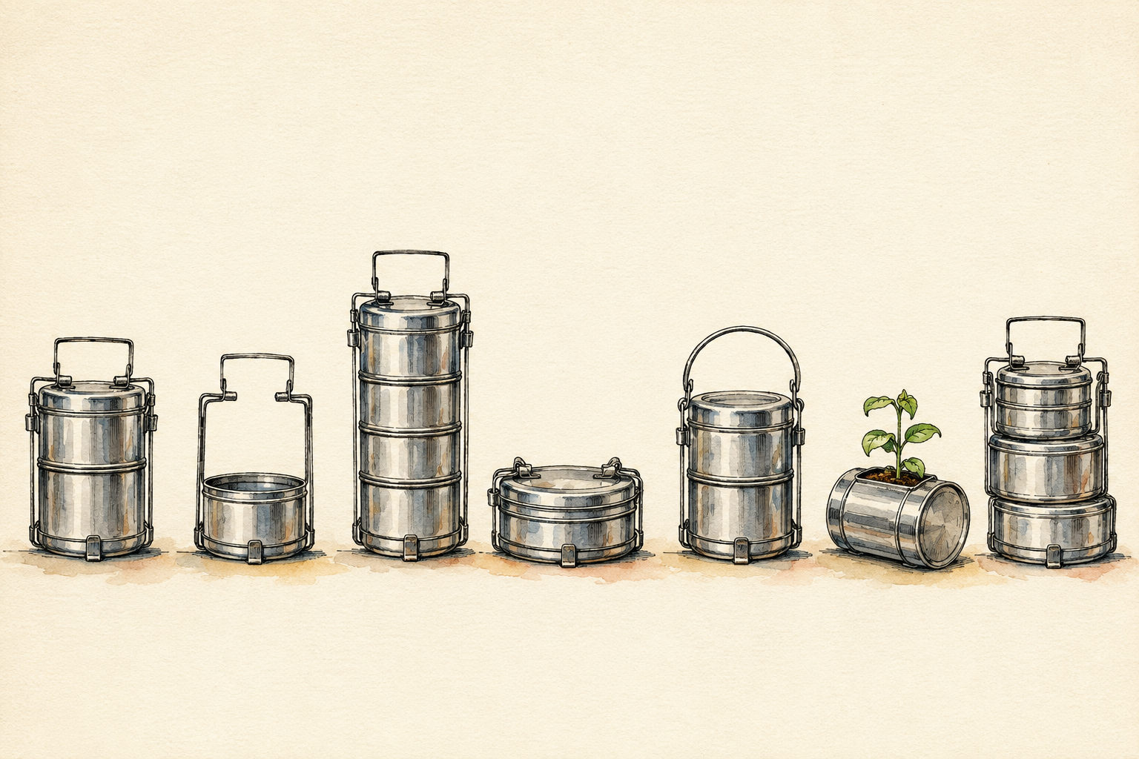
SESSION 11
SCAMPER — Seven Ways to Change a Thing
Unit 3 · SCAMPER Technique for Innovation
120 minutes · studio · COs 109.3, 109.2
Notes:
Studio session. Warm-up: Change the Chai. Do not lecture past 15 minutes.

Slide 2
THE ONE IDEA
SCAMPER is not inspiration. It is seven questions asked in order, and it works even on a day when you feel like you have no ideas.
Notes:
Say it once. Do not elaborate on the slide — elaborate out loud.

Slide 3
WHY IT MATTERS
1
The seven prompts
Substitute, Combine, Adapt, Modify, Put to another use, Eliminate, Rearrange.
2
Order matters less than completeness
Running all seven badly beats running two well — the value is in coverage.
Notes:
Four beats total across two slides. Fifteen minutes for all of it.

Slide 4
WHAT TO DO WITH IT
3
Eliminate is the most productive and the least used
People add. Removing is where the surprises are.
4
Write before you judge
Fill all seven rows first. Evaluate afterwards, never during.
Notes:
Four beats total across two slides. Fifteen minutes for all of it.

Slide 5
TODAY YOU WILL
Run all seven prompts on a physical object in this room, then on one you chose.
Marathi or Hindi · 60 minutes
Notes:
Leave this slide up for the whole making phase. It is the only slide that needs to stay visible.

Slide 6
TO CLOSE
Pitch
Three minutes. The person, the stuck, the idea, the picture, the ask.
Critique
I like… / I wish… / What if… — the idea, never the person.
Idea log
One page. Silent. Box 4 is the one you read again in week 15.
Notes:
If time runs short, cut the input — never the pitch. The pitch is how CO 109.2 is attained.

