Slide 1
Reading in data
Copyright McGraw Hill, Rosen, Discrete Mathematics and its Applications

Slide 2
Initial data tasks
Read in data from file
Parse and store in internal data structure
Select rows and/or columns
Sort data
Find values that match a target pattern
Aggregate values
Transform values, construct features

Slide 3
Introduction to PANDAS
PANDAS is a Python data analysis library
Uses data frames like R
Can read and parse CSV and JSON easily, XML is a little more difficult

Slide 4
Data frames
Data frames are a data structure used for storing tabular data
Used in Pandas and R (statistical package)
2-dimensional labeled data structure, organized into rows and columns
Each row corresponds to an example
Each column contains data for a specific variable
Can access a row, column, cell, or subset

Slide 5
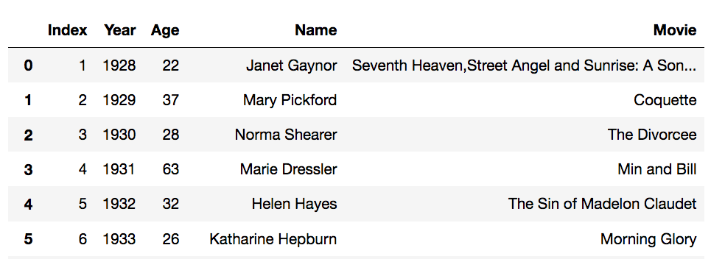
PANDAS: Read in data
import pandas as pd
# read in data in csv format (sep=',' is default)
data = pd.read_csv(“oscar_age_female.csv")
# print data
data

Slide 6
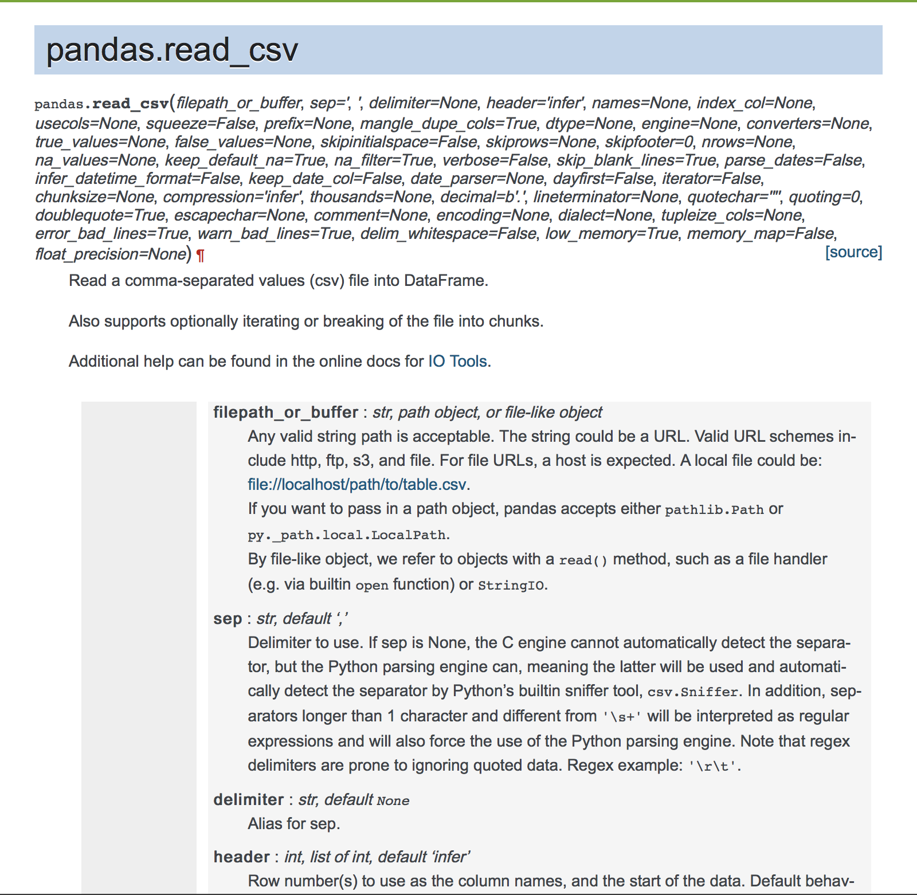
Pandas.read_CSV

Slide 7
Reading in CSV files
PANDAS.read_csv function takes a separator (sep) as an argument
Default is sep=“,” because comma separated files are most common
Other choices include tab (“\t”), space (“ “) and semi-colon (“;”)
Delimiters in text fields
Sometimes separator characters will appear in longer text fields
To treat those characters as part of the text value rather than a separator, the fields should be delimited with a quote character (e.g., quotechar=‘“‘)
E.g.,
1,1928,22,"Janet Gaynor","Seventh Heaven,Street Angel and Sunrise: A Song of Two Humans"

Slide 8
File locations
Pandas.read_csv looks for the file argument that is given to the function (e.g., “oscar_age_female.csv”) in the current working directory, unless a path is explicitly specified
The working directory is typically the directory that you started your Jupyter notebook from
When specifying file names with paths, you can use either absolute or relative paths
A relative path specifies the path to the file starting from your current working directory, e.g., “data/movies/oscar_age_female.csv”
An absolute path specifies the complete path from the base of your file system to the file, e.g., “/Users/neville/data/movies/oscar_age_female.csv”

Slide 9
PANDAS: Accessing data
# get numbers of rows
len(data)
89
# get names of columns
data.columns
Index(['Index', 'Year', 'Age', 'Name', 'Movie'], dtype='object')
# columns can be accessed by name
data[‘Age']
data.Age

Slide 10
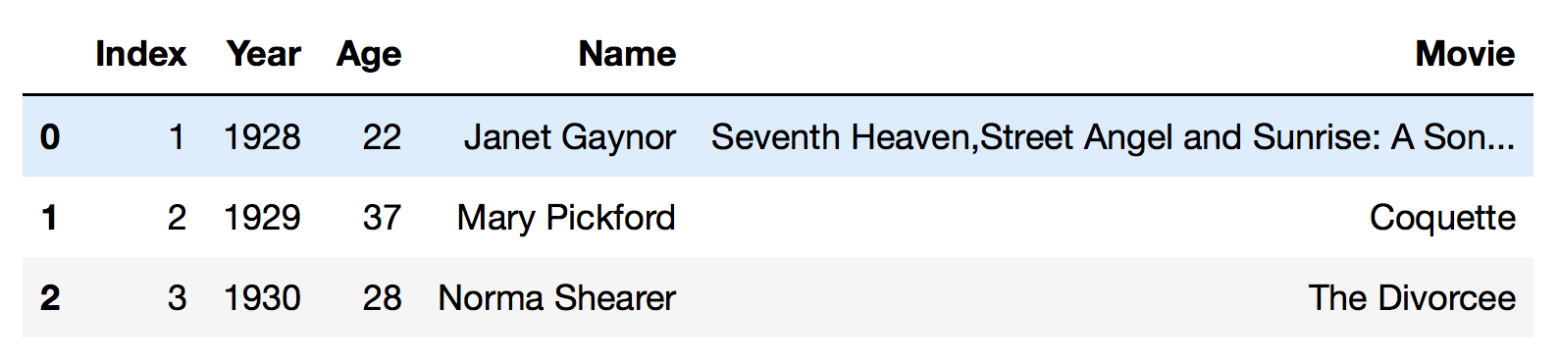
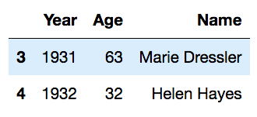
PANDAS: Accessing data
# head and tail return first/last k rows of column
data.Name.head(5)
0 Janet Gaynor
1 Mary Pickford
2 Norma Shearer
3 Marie Dressler
4 Helen Hayes
Name: Name, dtype: object
# use [] to select via slices
data[:3] #first three rows
# select by position with iloc
data.iloc[3:5,1:4] #row slice, column slice

Slide 11
PANDAS: Accessing data
data.Age.head(5)
0 22
1 37
2 28
3 63
4 32
# sort results
data.Age.sort_values().head(5)
59 21
0 22
85 22
25 24
13 24

Slide 12
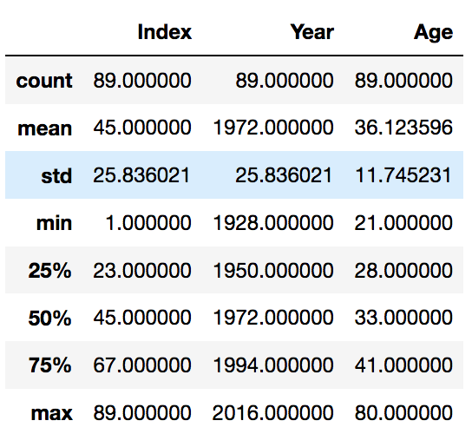
PANDAS: Accessing data
# summarize the data
data.describe()
data.Age.mean()
data.Year.sum()
36.12359550561798
175508

Slide 13
PANDAS: Accessing data in a loop
for i in range(10): # loop over first ten rows of data frame
tmpyr = data.iloc[i,1]
tmpage = data.iloc[i,2]
tmpname = data.iloc[i,3]
print(tmpname + ": current age (if still alive) =" + str(2019-tmpyr+tmpage))
Janet Gaynor: current age (if still alive) = 113
Mary Pickford: current age (if still alive) = 127
Norma Shearer: current age (if still alive) = 117
Marie Dressler: current age (if still alive) = 151
Helen Hayes: current age (if still alive) = 119
Katharine Hepburn: current age (if still alive) = 112
Claudette Colbert: current age (if still alive) = 116
Bette Davis: current age (if still alive) = 111
Luise Rainer: current age (if still alive) = 110
Luise Rainer: current age (if still alive) = 110

Slide 14
PANDAS: Write data out to file
# getting data out of pandas, output to csv file
data.to_csv('oscar_age_female_mod.csv', sep=',')

