Slide 1
Working with data
Copyright McGraw Hill, Rosen, Discrete Mathematics and its Applications

Slide 2
Data wrangling
Loosely refers to the tasks needed to preprocess data, including:
Augmentation (e.g., adding features/rows)
Subsetting (e.g., filtering and selecting)
Cleaning (e.g., find missing values/errors to correct)
Aggregating (e.g., grouping by values and summarizing)
Transforming (e.g., scaling attribute values)

Slide 3
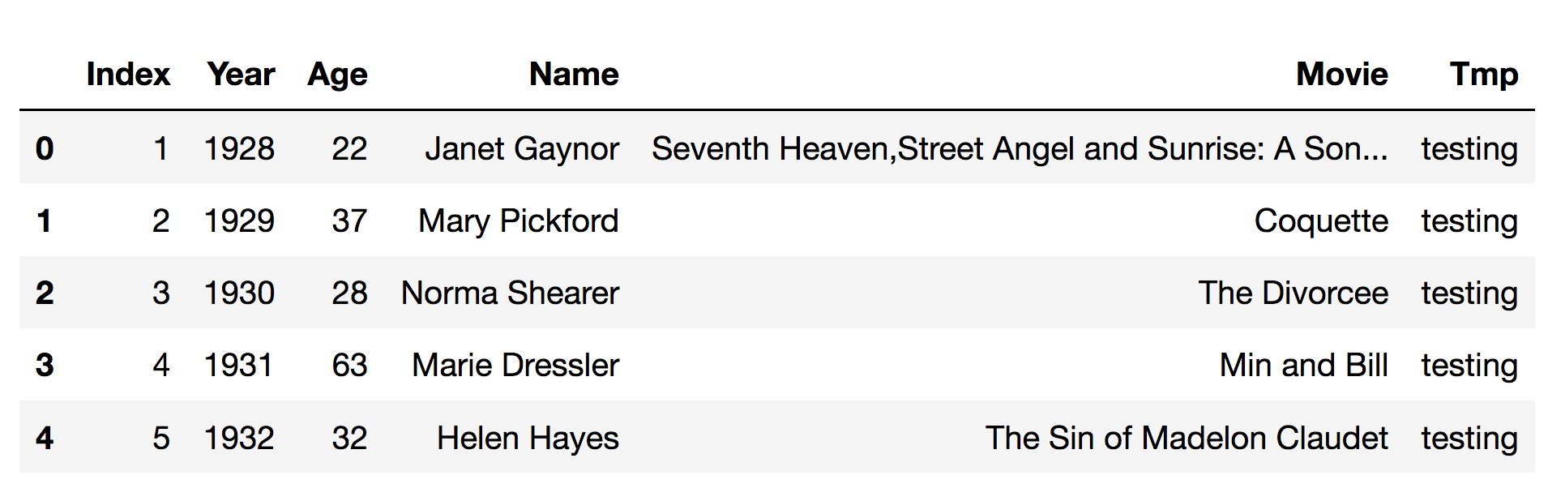
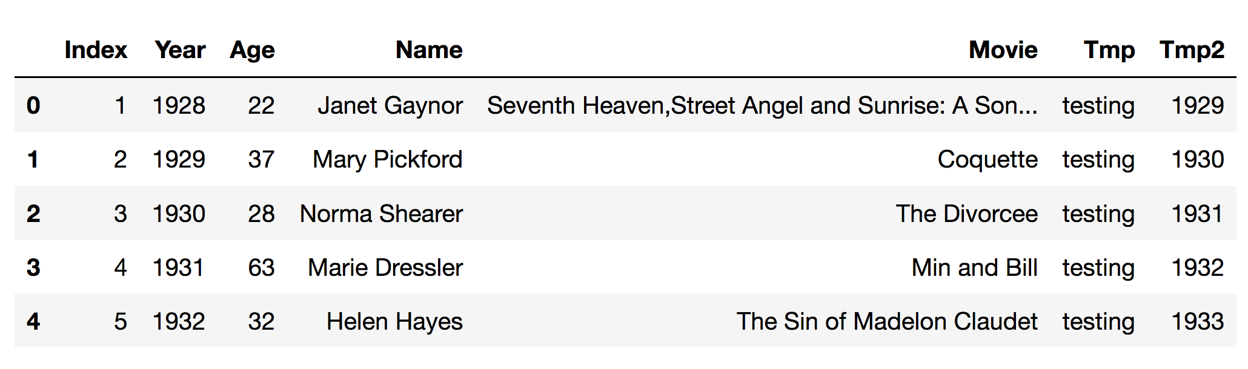
Augmenting: Adding columns
# add a column to a data frame with a constant value
data['Tmp'] = 'testing'
# add a column with a value calculated from other column
data['Tmp2']=data.Year+1
data.head()

Slide 4
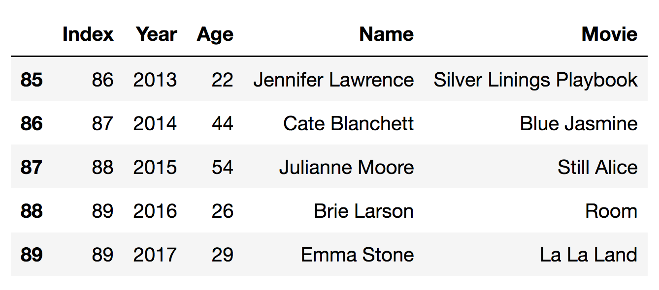
Augmenting: Adding rows
# construct new example as a Series object (labeled array able to hold any type of data)
newData = [89, 2017, 29, 'Emma Stone', 'La La Land']
newExample = pd.Series(newData, index=list(data.columns))
print(newExample)
Index 89
Year 2017
Age 29
Name Emma Stone
Movie La La Land
dtype: object
# add rows by appending Data Frame or Data Series
# returns new object
data2 = data.append(newExample, ignore_index=True)
data2.tail()

Slide 5
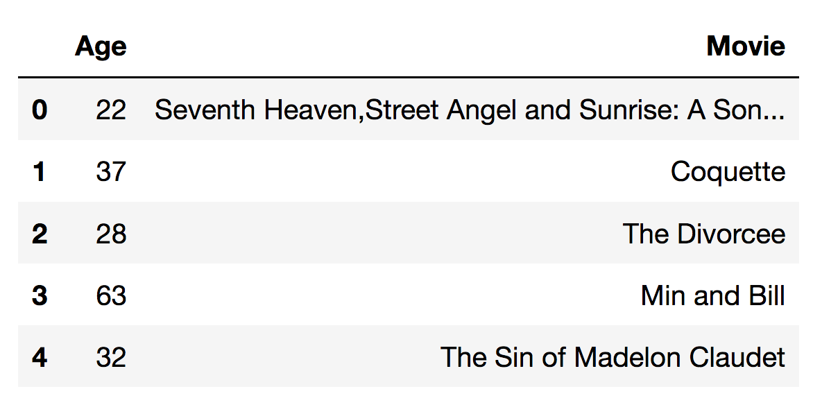
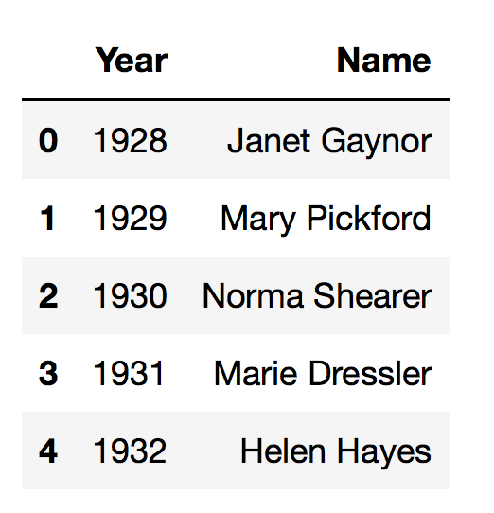
Subsetting: Selecting columns by name
# select a subset of columns by name
data[['Age','Movie']]
# another way to select columns by name
data.filter(items=['Year', 'Name'])

Slide 6
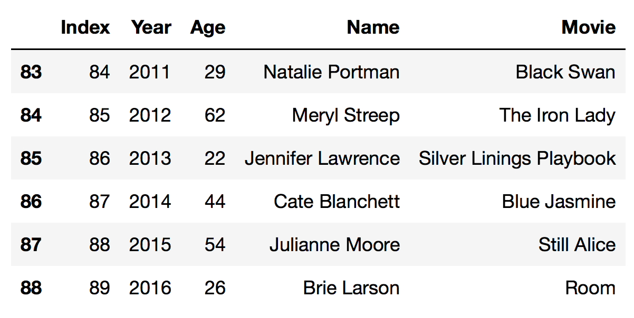
Subsetting: Filtering by condition
# select rows that match condition in []
data[data.Year > 2010]

Slide 7
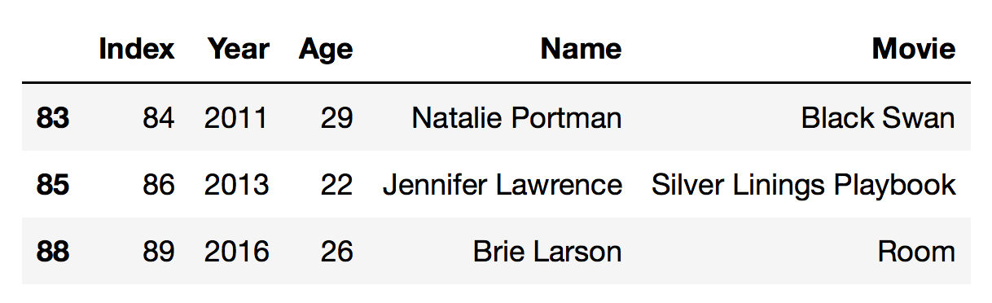
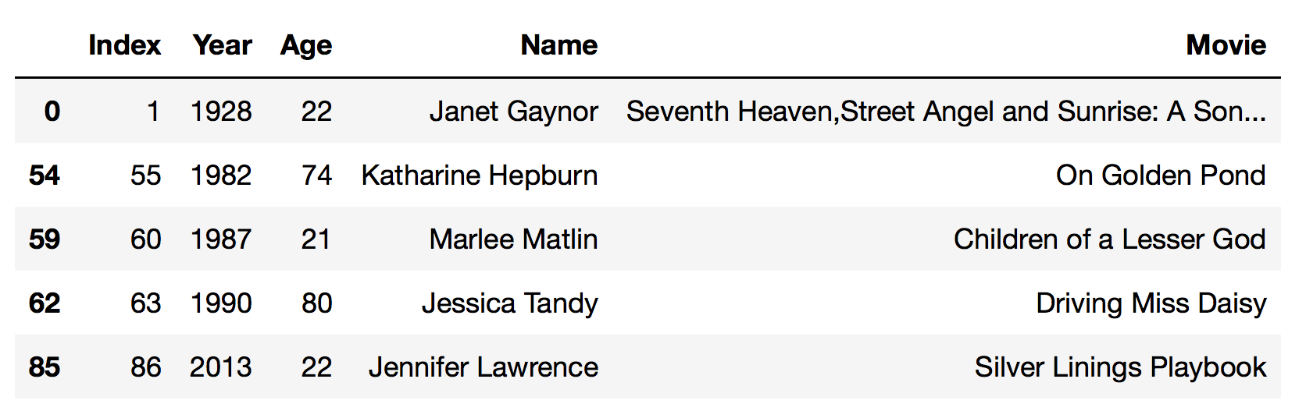
Subsetting: Filtering by condition
# select rows that match condition in []
data[(data.Year > 2010) & (data.Age < 30)]
data[(data.Age < 25) | (data.Age > 70)]

Slide 8
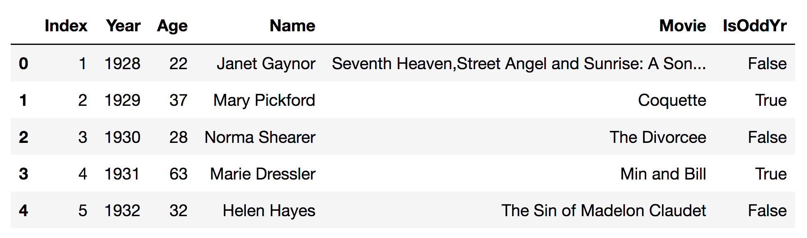
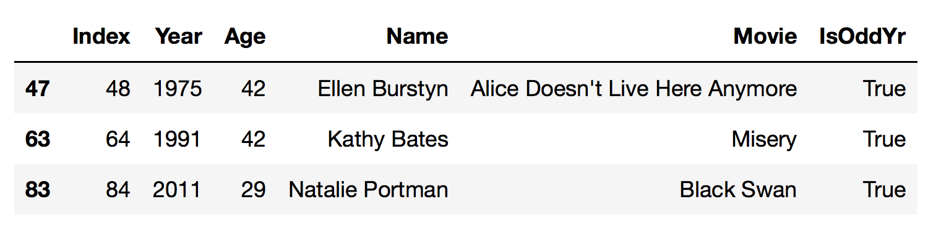
Subsetting: Filtering by condition
# make new attribute that is True for all movies in even years
data['IsOddYr'] = data.Year%2==1
data.head()
# select based on Boolean conditions
data[(data.IsOddYr) & ((data.Age==29)|(data.Age==42))]

Slide 9
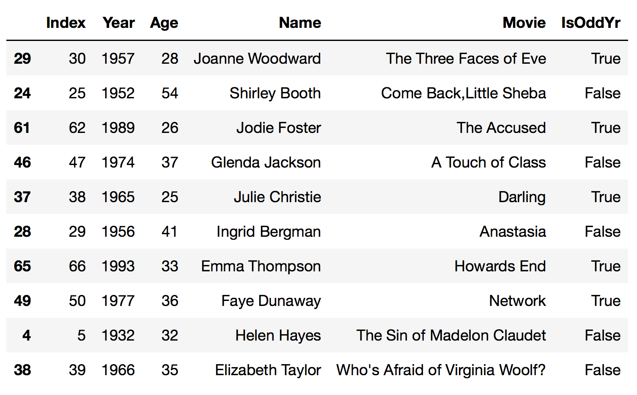
Subsetting: Selecting rows
# get a random sample of ten rows
data.sample(10)

Slide 10
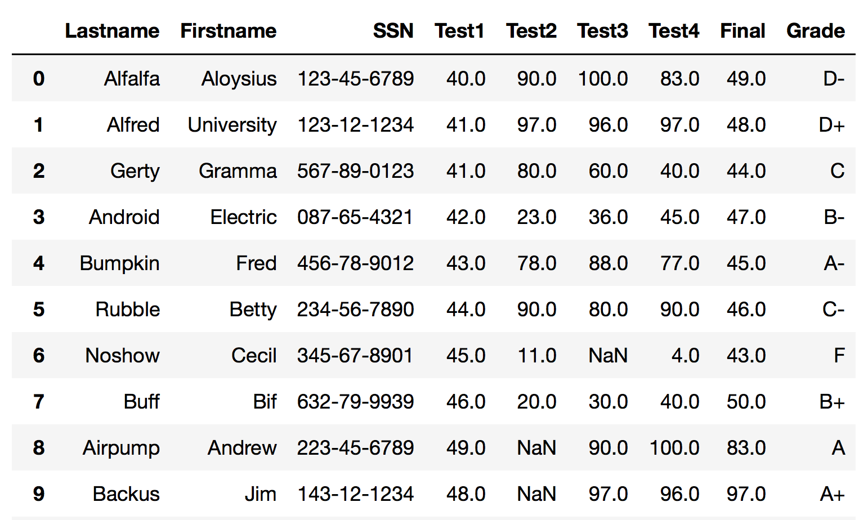
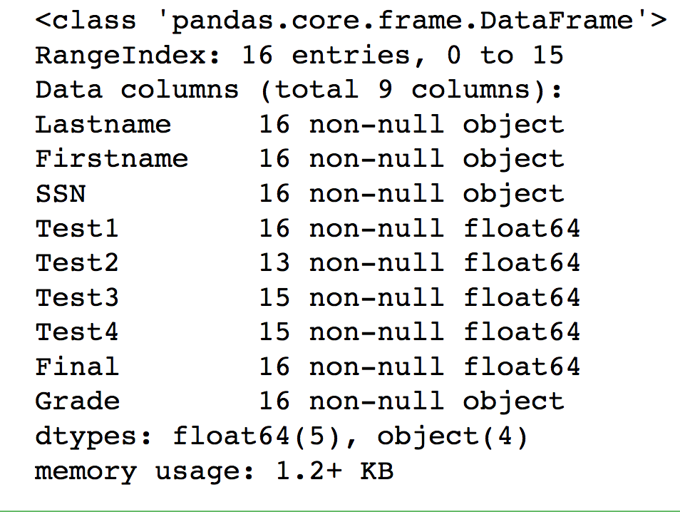
Cleaning: Find missing values
# read in grades data file
data2 = pd.read_csv("grades.csv")
# find missing values via non-null counts
data2.info()

Slide 11
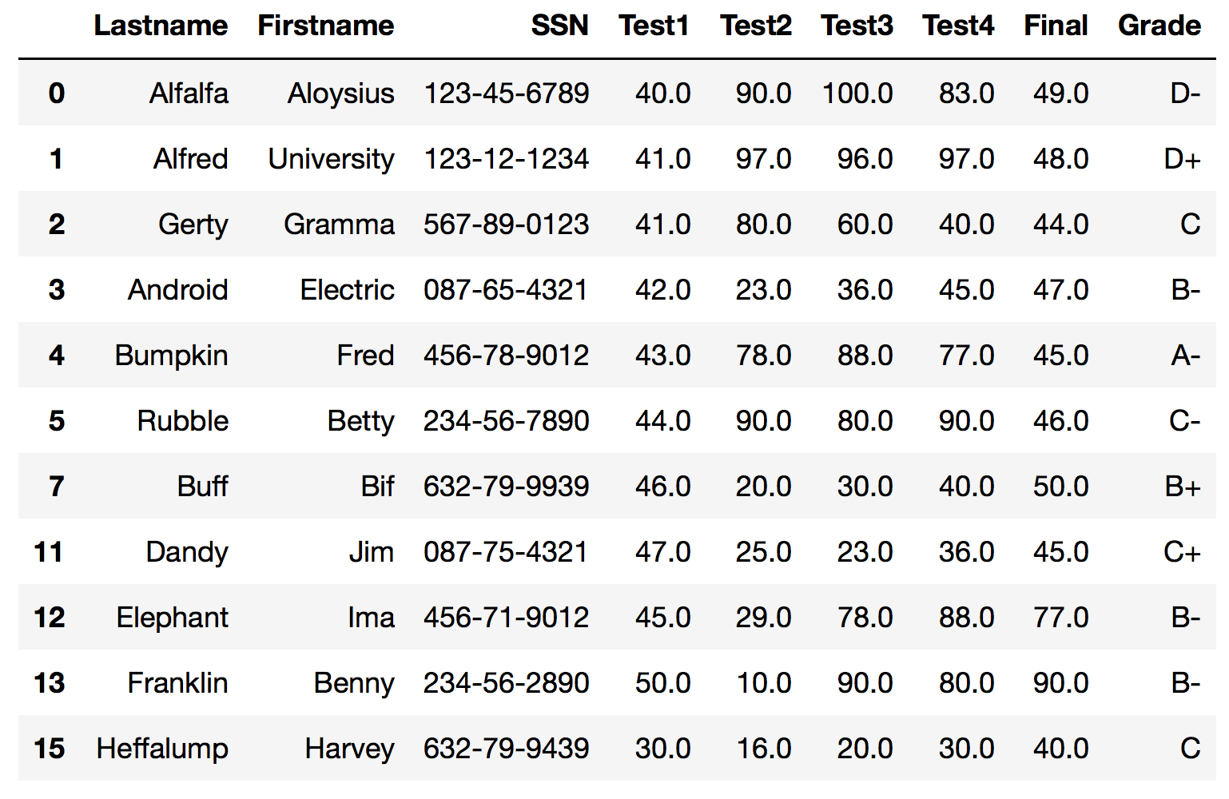
Cleaning: Drop missing values
# drop all rows with missing values
data2.dropna()

Slide 12
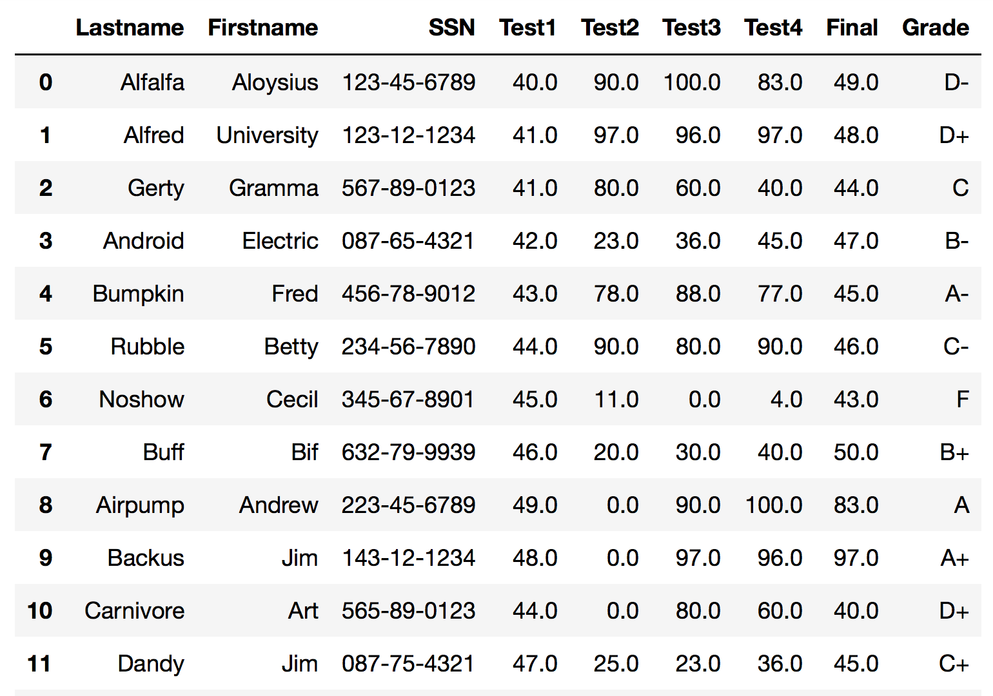
Cleaning: Fill in missing values
# fill missing values in with a particular value
data2.fillna(0)

Slide 13
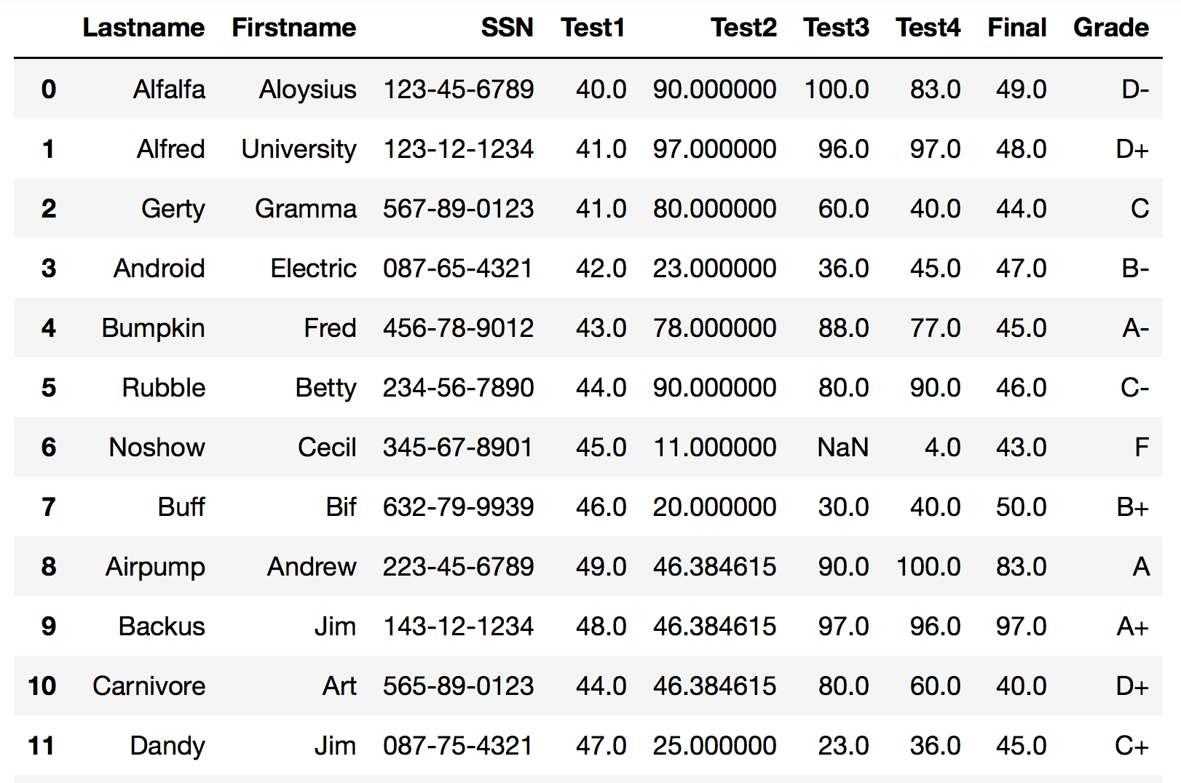
Cleaning: Fill in missing values
# fill in missing values with average score
test2avg = data2.Test2.mean()
data2.Test2 = data2.Test2.fillna(test2avg)

Slide 14
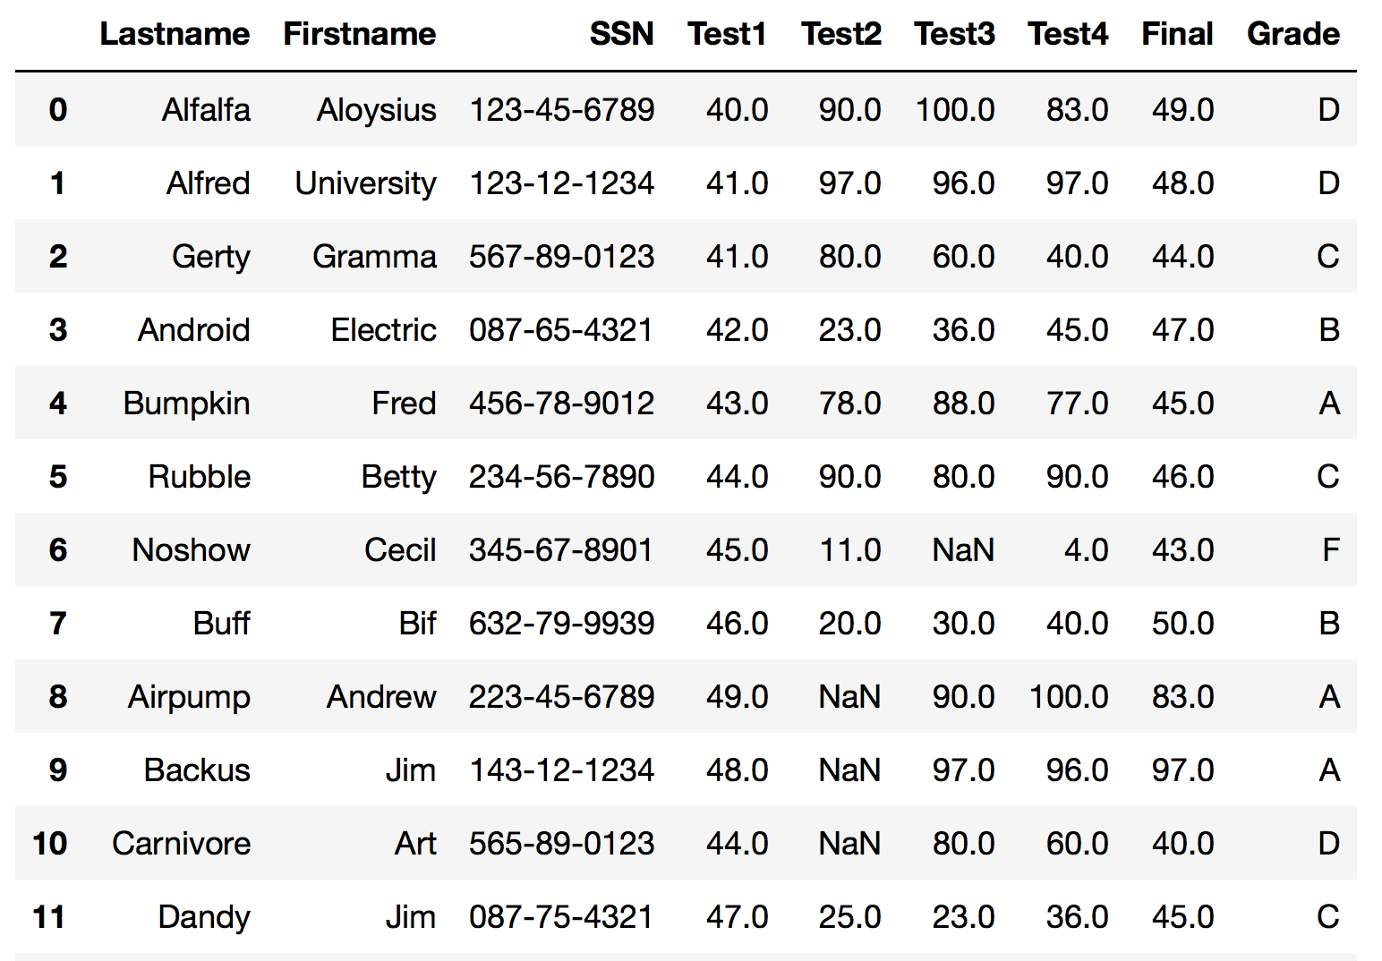
Aggregating: Group by
# drop +/- from grades
tmp = data2.Grade
tmp2 = tmp.str.replace('-','')
tmp3 = tmp2.str.replace('+','')
data2.Grade = tmp3
# find unique values
data2.Grade.unique()
array(['D', 'C', 'B', 'A', 'F'], dtype=object)

Slide 15
Aggregating: Group by
When you iterate over the results of a groupby, each result is a tuple:
First element is a unique value
Second element is a DataFrame filtered by that value
# group by final grade and calculate avg Test1 score
for grade, grade_data in data2.groupby("Grade"):
print(grade, grade_data.Test1.mean())
A 46.666666666666664
B 44.6
C 40.5
D 41.666666666666664
F 45.0

Slide 16
Aggregating: Group by
# group by Test1 scores and count number of students with that score
for grade, grade_data in data2.groupby("Test1"):
print(grade, grade_data.Lastname.count())
30.0 1
40.0 2
41.0 2
42.0 1
43.0 1
44.0 2
45.0 2
46.0 1
47.0 1
48.0 1
49.0 1
50.0 1

Slide 17
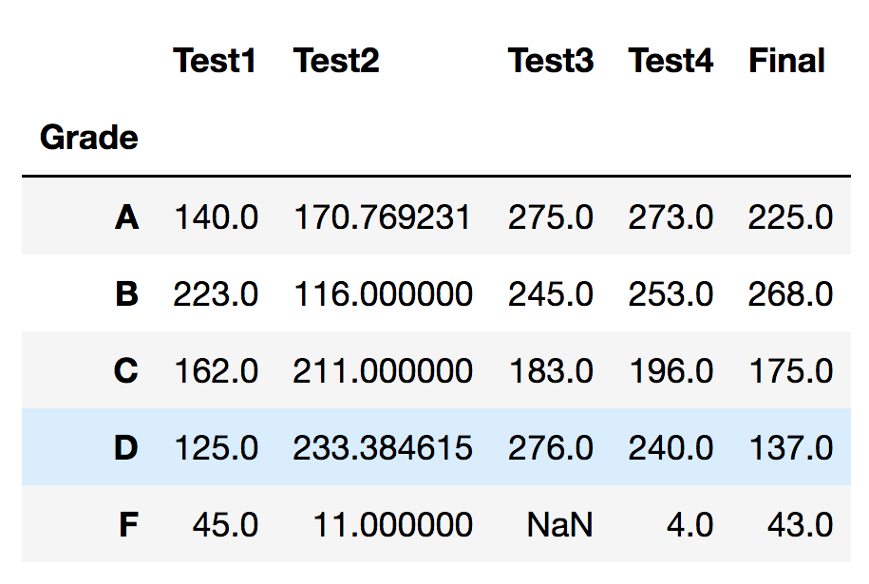
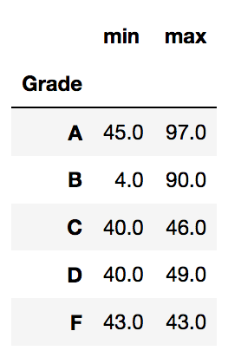
Aggregating: Group by
# can also aggregate directly over group object
groups = data2.groupby("Grade")
groups.agg('sum')
# applying multiple aggregators
groups.Final.agg(['min', 'max'])

Slide 18
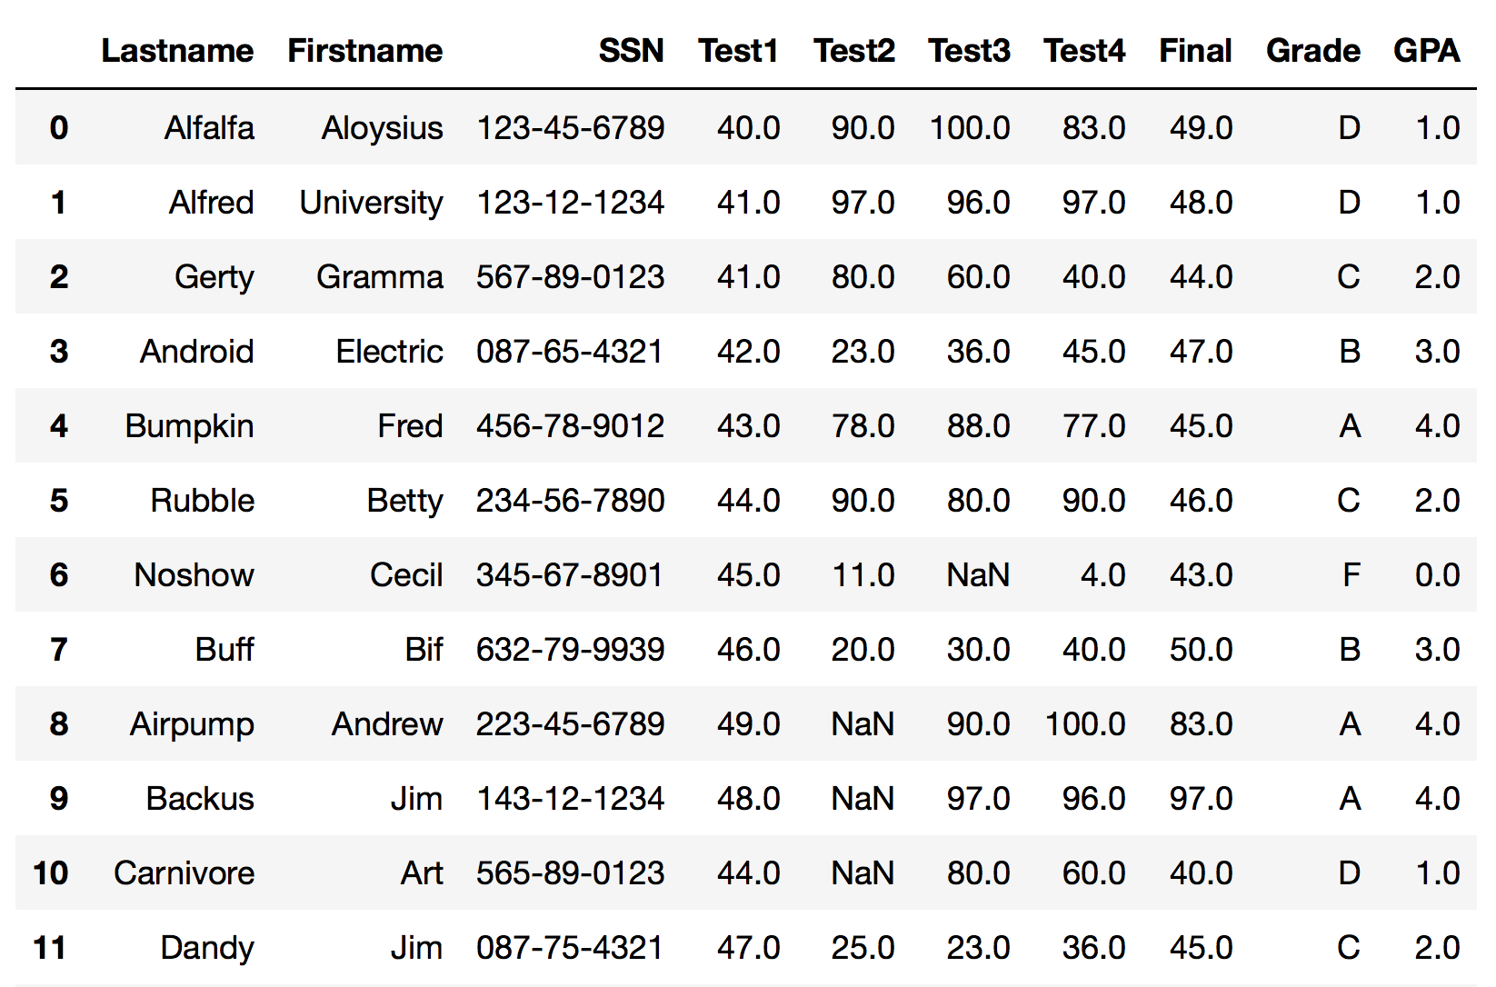
Transforming: Map
# map() maps values of Series according to input correspondence (defined by dict) or function
data2['gpa'] = data2.Grade.map({'A':4.0, 'B':3.0, 'C':2.0, 'D':1.0, 'F':0.0})

Slide 19
LAMBDA functions
Lambda functions are functions without names, for use in situations where the function will be discarded and not used again
Example: lambda x: x > 0
The term lambda makes the temporary function, x is the parameter name, and the code after : denotes what to do
Often used in map( ) or apply( ) when transforming data

Slide 20
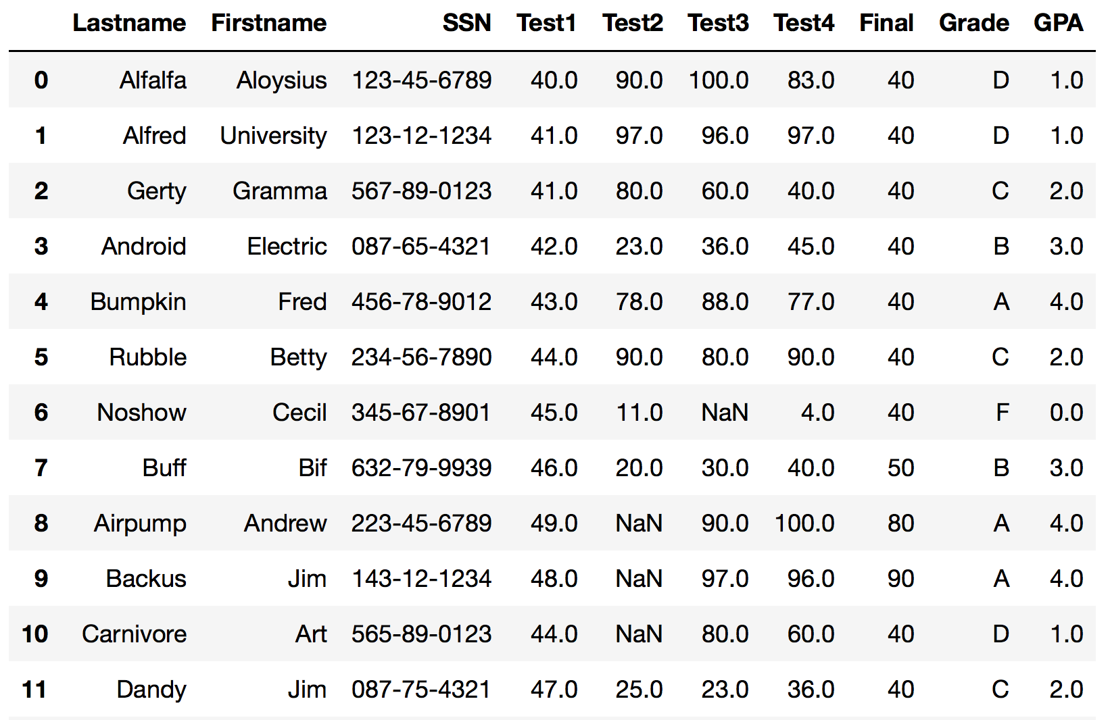
Transforming: Map
# create a rounding function, apply to each value in Final
rndGrade = lambda x: int(x / 10) * 10
data2.Final.map(rndGrade)

Slide 21
Transforming: Apply
# apply() is used to apply a function to every row in given dataframe
data2.Test4.apply(‘sum')
966.0
# use apply() with axis=1 to send entire row to function
data2.fillna(0).apply(lambda row: row[3] + row[4] + row[5] + row[6], axis=1)
0 313.0
1 331.0
2 221.0
3 146.0
4 286.0
5 304.0
6 60.0
. . .

Slide 22
Transforming: Scaling attribute values
# standardize Final grade by subtracting mean and dividing by stdev
avgFinal = data2.Final.mean()
stdFinal = data2.Final.std()
data2.Final.map(lambda x: (x - avgFinal)/stdFinal)
0 -0.379480
1 -0.379480
2 -0.379480
3 -0.379480
4 -0.379480
5 -0.379480
6 -0.379480
7 0.054211
8 1.355284
. . .

