Slide 1
Visualizing data
Copyright McGraw Hill, Rosen, Discrete Mathematics and its Applications

Slide 2
Exploratory data analysis
Maximize insight into data
Uncover underlying structure
Identify important variables
Detect outliers and anomalies
Test underlying modeling assumptions
Generate hypotheses from data

Slide 3
Methods to summarize and visualize
Low-dimensional data
Summarizing data with simple statistics
Plotting raw data (1D, 2D, 3D)
Higher-dimensional data
Principal component analysis
Multidimensional scaling

Slide 4
Data summarization
Measures of location
Mean, median, quartiles, mode
Measures of dispersion or variability
Variance, standard deviation, range, skew

Slide 5
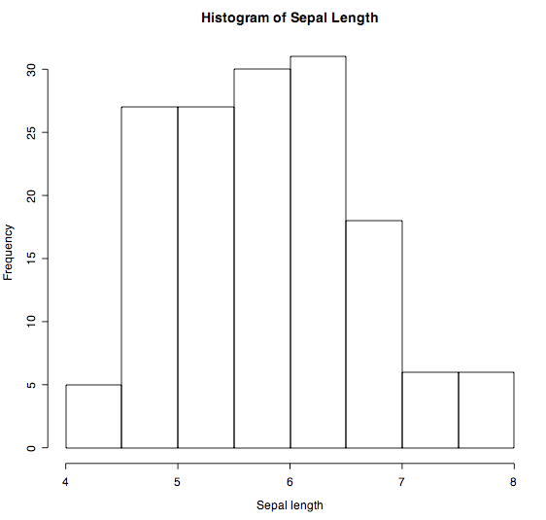
Histograms (1D)
Most common plot for univariate data
Split data range into equal-sized bins, count number of data points that fall into each bin
Graphically shows:
Center (location)
Spread (scale)
Skew
Outliers
Multiple modes

Slide 6
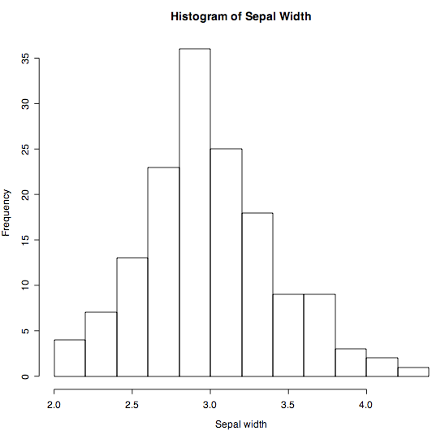
Example histogram
# import python plotting library
import matplotlib.pyplot as plt
plt.hist(data[‘sepal-width'])
Useful arguments:
bins: number of bins to use, default is equally spaced breaks
density: if True, y-axis will reflect probability instead of frequency counts

Slide 7
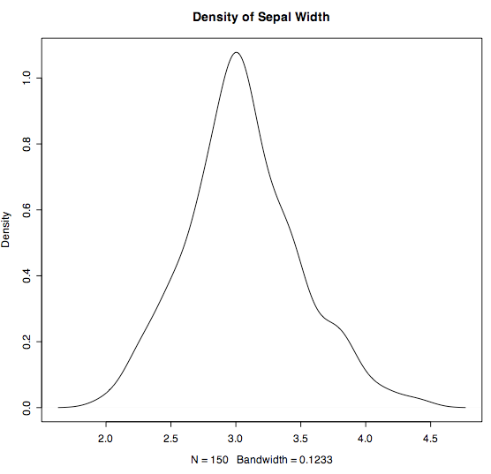
Histogram limitations
Histograms can be misleading for small datasets
Slight changes in the data or binning approach can result in different histograms
Smoothed density plots may be a better choice
# pandas.DataFrame has plot functions too
data['sepal-width'].plot.kde()

Slide 8
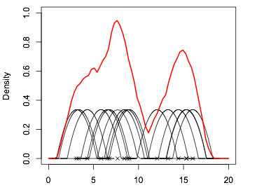

Density plots
Density from sum of kernels
Density function estimates a continuous function from a discrete set of observations by:
Using a kernel function to estimate density at each point x,
Then pooling the information from neighboring points to estimate density
Estimated density is:
Parameters: Kernel function K, bandwidth h
Kernel over data point
Data point

Slide 9
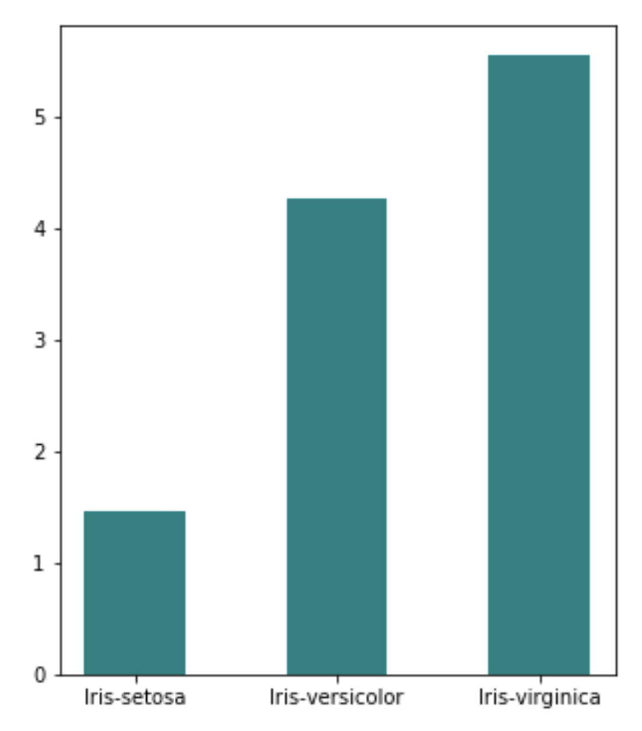
Bar plots
x1 = data[data.category=='Iris-setosa'][['petal-length']].mean()[0]
x2 = data[data.category=='Iris-versicolor'][['petal-length']].mean()[0]
x3 = data[data.category=='Iris-virginica'][['petal-length']].mean()[0]
barlabels = ['Iris-setosa','Iris-versicolor','Iris-virginica']
barvals = [x1,x2,x3]
plt.bar(barlabels, barvals)

Slide 10
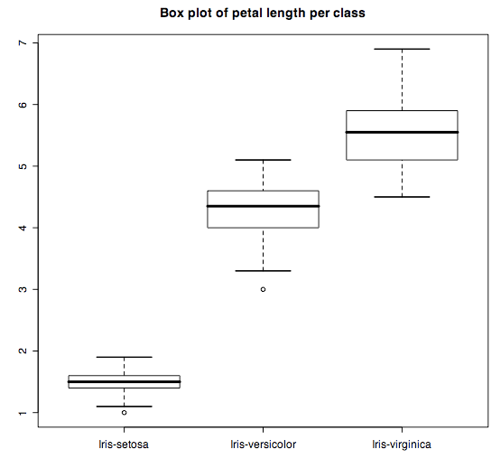
Box plots (2D)
Display relationship between discrete and continuous variables
For each discrete value X, calculate quartiles and range of associated Y values
Max
Median
}
IQR
# boxplot takes a list of data vectors # the distribution of values in vector # is summarized by a box in the plot
plt.boxplot(dataGrps)
Min
Outlier more than 1.5 IQR above /below box

Slide 11
Scatterplot (2D)
Most common plot for bivariate data
Horizontal X axis: the suspected independent variable
Vertical Y axis: the suspected dependent variable
Graphically shows:
If X and Y are related; Linear or non-linear relationship
If the variation in Y depends on X
Outliers
plt.scatter(data[‘sepal-length'],data['sepal-width'])

Slide 12
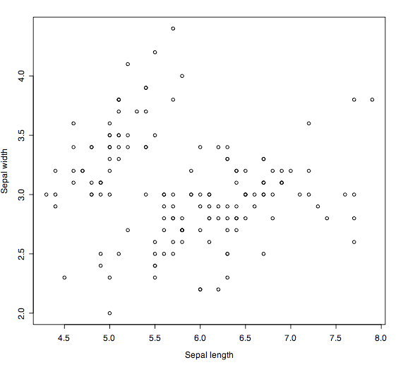
No relationship

Slide 13
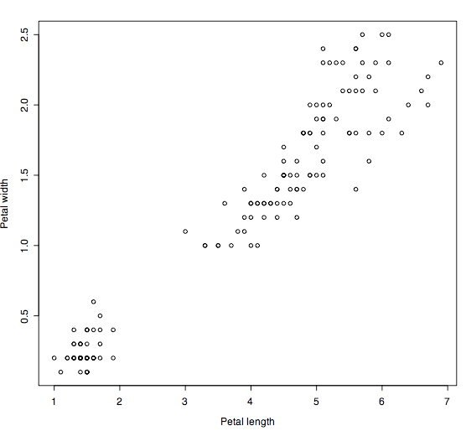
Linear relationship

Slide 14
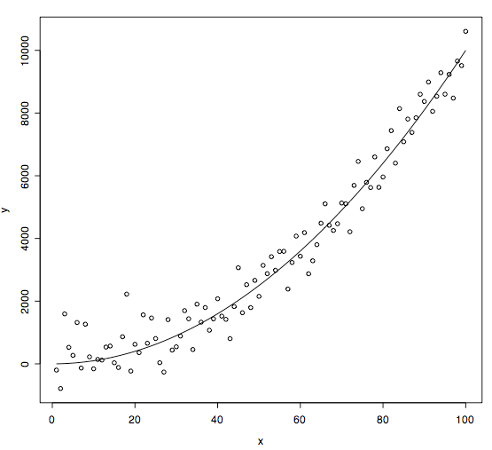
Non-linear relationship

Slide 15
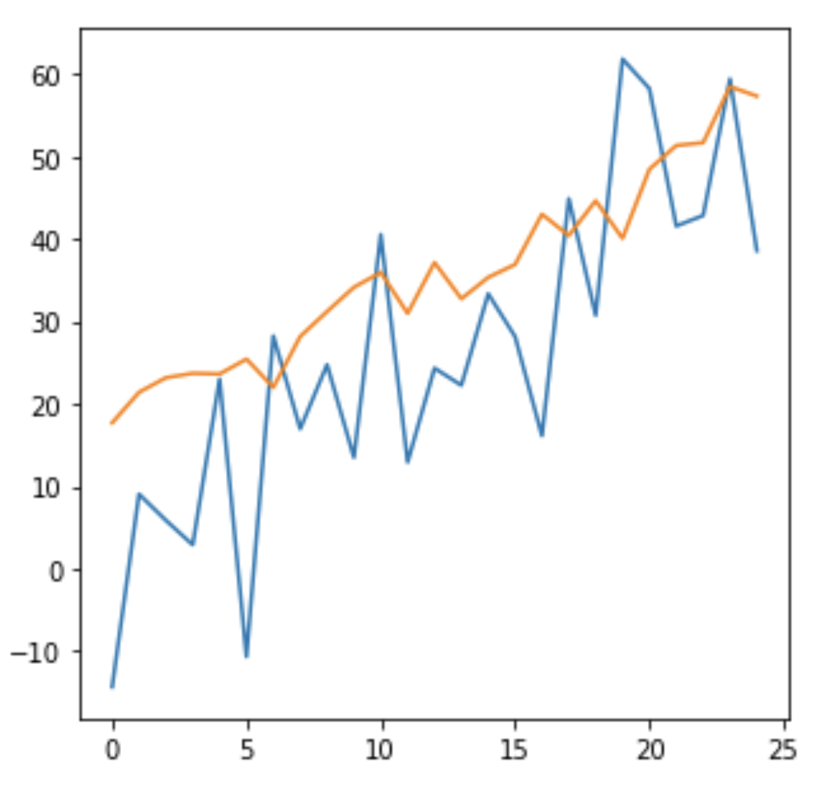
Line graph (2D)
Plot command can be used to make line graphs as well
# create data
import numpy as np
x = []
for i in range(25):
x.append(i)
y = np.add(np.power(x,1.25),np.random.normal(0,10,25))
y2 = np.add(np.power(x,1.1) + 20,np.random.normal(0,3,25))
# plot line chart
plt.plot(x,y)
# overlay second line on same plot
plt.plot(x,y2)

Slide 16
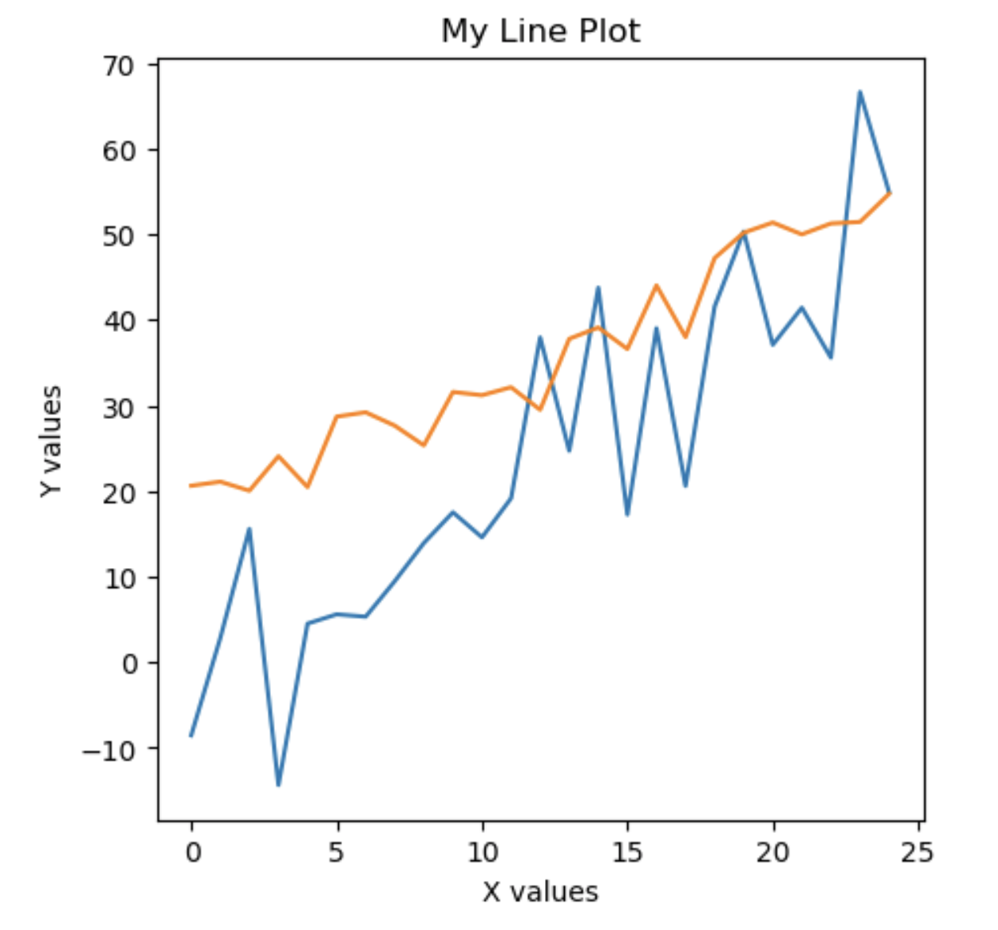
Formatting plots
Subplot command returns figure and axes objects that can be modified
fig, ax = plt.subplots()
fig.set_figheight(5)
fig.set_figwidth(5)
ax.set_title("My Line Plot")
ax.set_xlabel("X values")
ax.set_ylabel("Y values")
ax.plot(x,y)
ax.plot(x,y2)

Slide 17
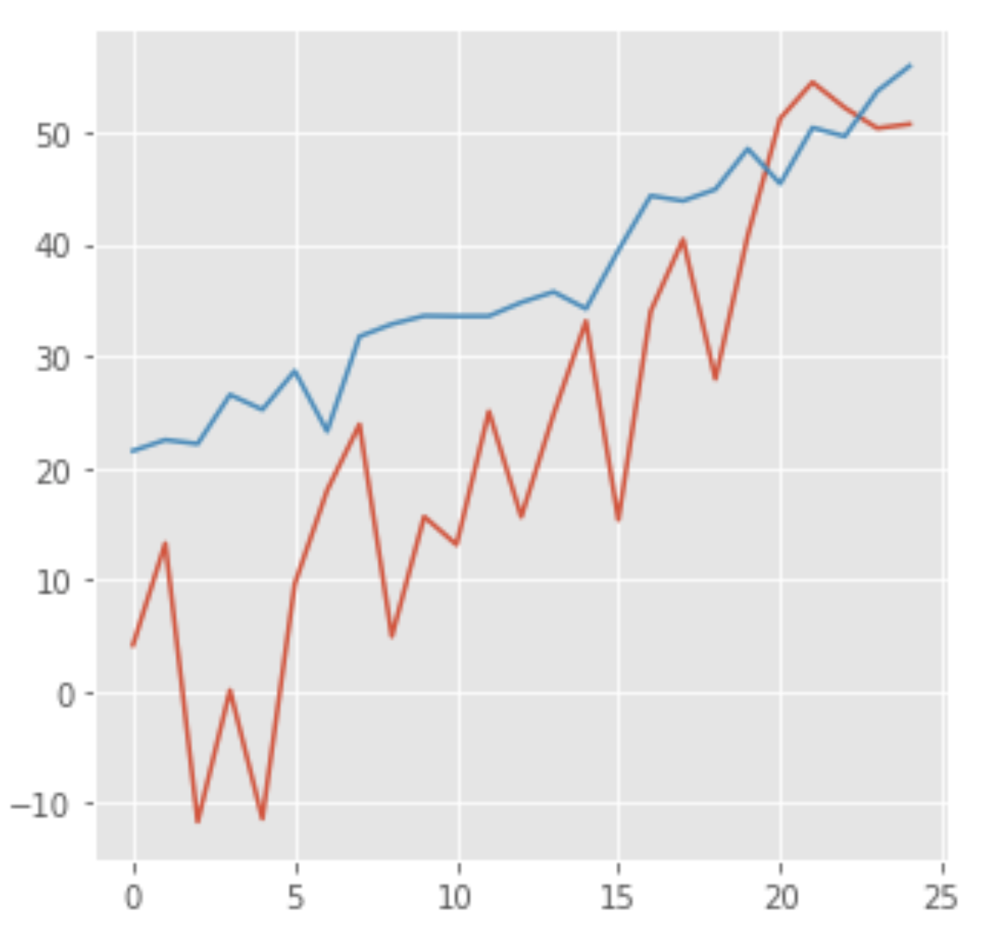
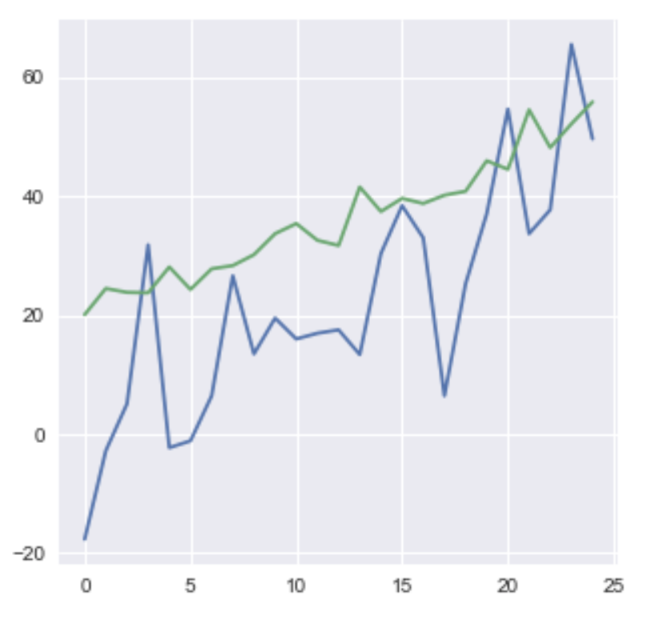
Formatting plots with style sheets
import matplotlib.pyplot as plt
plt.style.use(‘ggplot')
ggplot
seaborn

