Slide 1
Data processing for analysis
Copyright McGraw Hill, Rosen, Discrete Mathematics and its Applications

Slide 2
Processing data for analysis
Sampling
Attribute transformations
Feature construction and selection

Slide 3
Sampling
Sampling is main technique employed for data selection
It is often used for both preliminary investigations of the data and final data analysis
Reasons to sample
Obtaining the entire set of data of interest is too expensive or time consuming
Processing the entire set of data of interest is too expensive or time consuming
Note: Even if you use an entire dataset for analysis, you should be aware of the sampling method that was used to gather the dataset

Slide 4
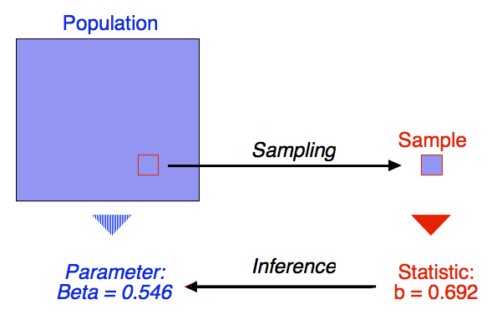
Analysis with samples
The key principle for effective sampling is the following:
Using a sample will work almost as well as using the entire data set, if the sample is representative of the overall data
A sample is representative if it has approximately the same property (of interest) as the target population

Slide 5
Populations and samples
Elementary units:
Entities (e.g., persons, objects, events) that meet a set of specified criteria
Example: All people who’ve purchased something from Walmart in the past month
Population:
Aggregate set of elementary units (i.e, all items of interest)
Sampling:
Sub-group of the population
Serves as a reference group for estimating characteristics about the population and drawing conclusions

Slide 6
Sampling Methods
SAMPLING METHODS
Probability Sampling
Non-probability Sampling
Simple random sampling
Systematic sampling
Stratified sampling
Cluster sampling
Multi-stage sampling
Convenience sampling
Quota sampling
Snowball sampling
Judgement sampling
Notes:
Non-probability
Selection of samples is made by nonrandom methods i.e not based on chance
No way to accurately estimate chance of inclusion/degree of sampling error
Is convenient and economical

Slide 7
Types of probability sampling
Simple random sampling
There is an equal probability of selecting any particular item
Sampling without replacement
As each item is selected, it is removed from the population
Sampling with replacement
Items are not removed from the population as they are selected for the sample; the same item can be picked up more than once
Stratified sampling
Split the data into several partitions; then draw random samples from each partition

Slide 8
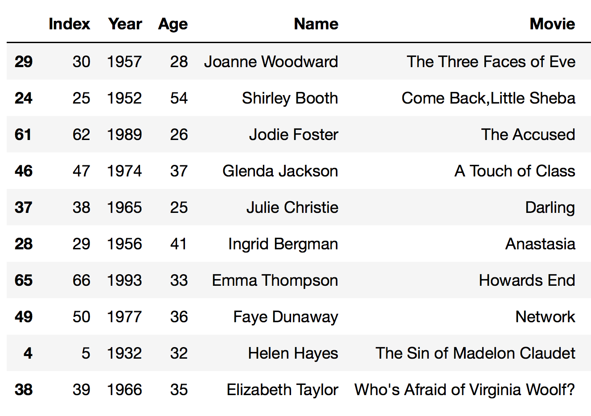
Pandas: sample without replacement
# get a random sample of ten rows
data.sample(10)

Slide 9
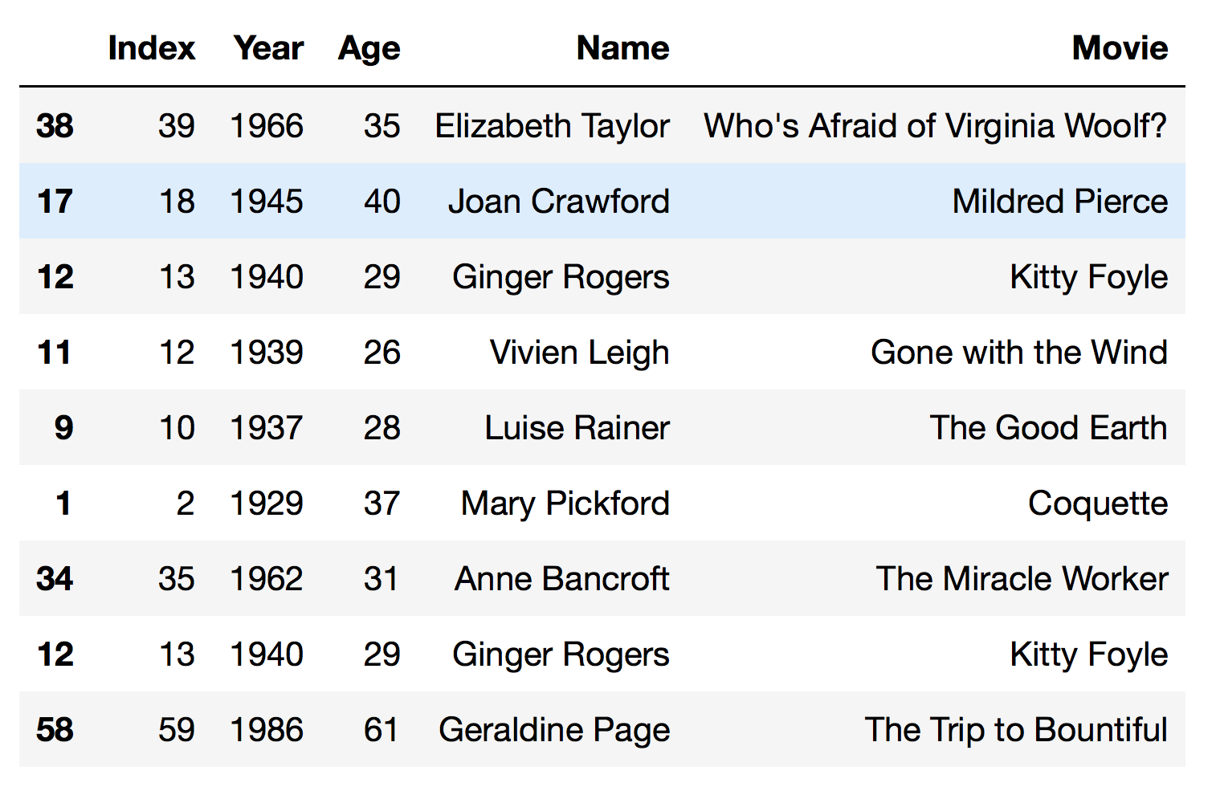
Pandas: sample with replacement
# get a 10% random sample, with replacement
data.sample(frac=0.1,replace=True)

Slide 10
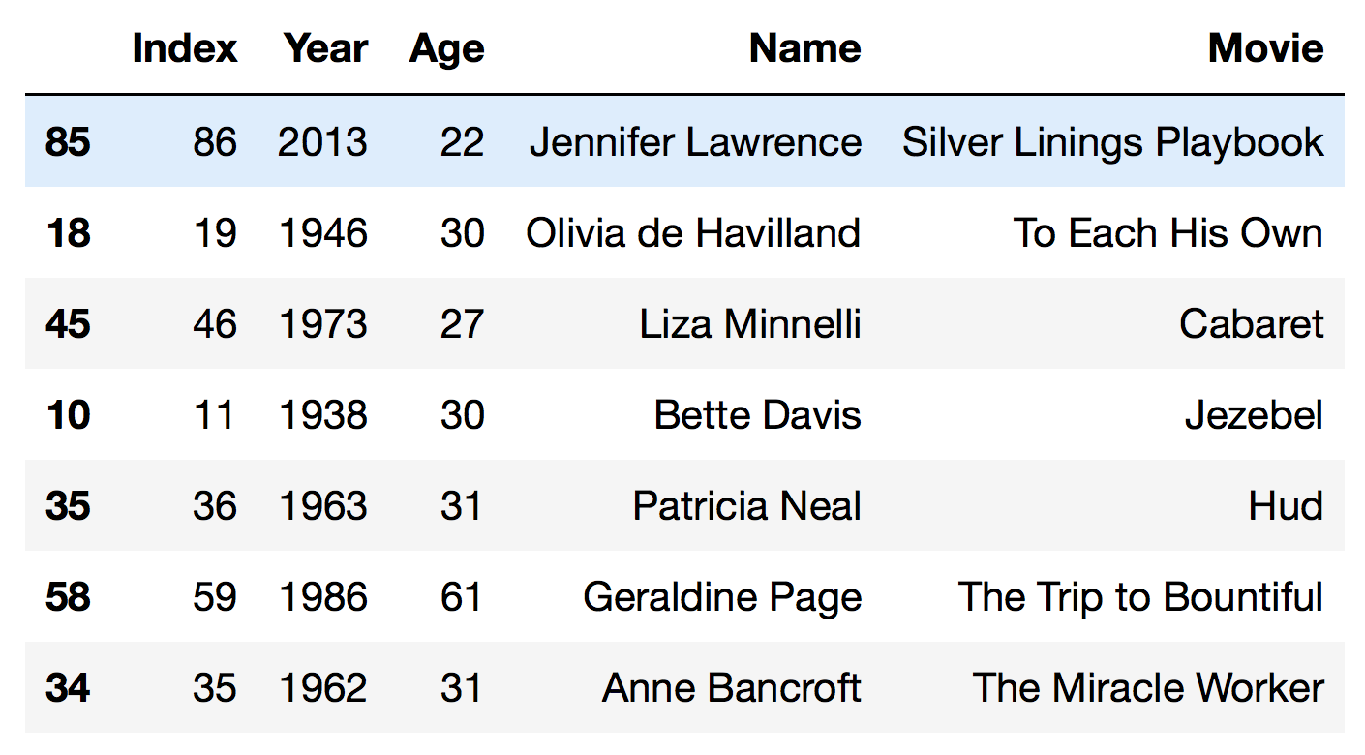
Pandas: sampling w/repeatability
# get a 7.5% random sample, without replacement, with specified random seed
data.sample(frac=0.075, random_state=999)

Slide 11
Attribute transformations
Reasons to transform variables before analysis
Different scale/range may be more convenient for interpretation of patterns
Visualization can be more effective if skew is reduced
Many machine learning methods work better if the variables have roughly the same scale and/or are normally distributed

Slide 12
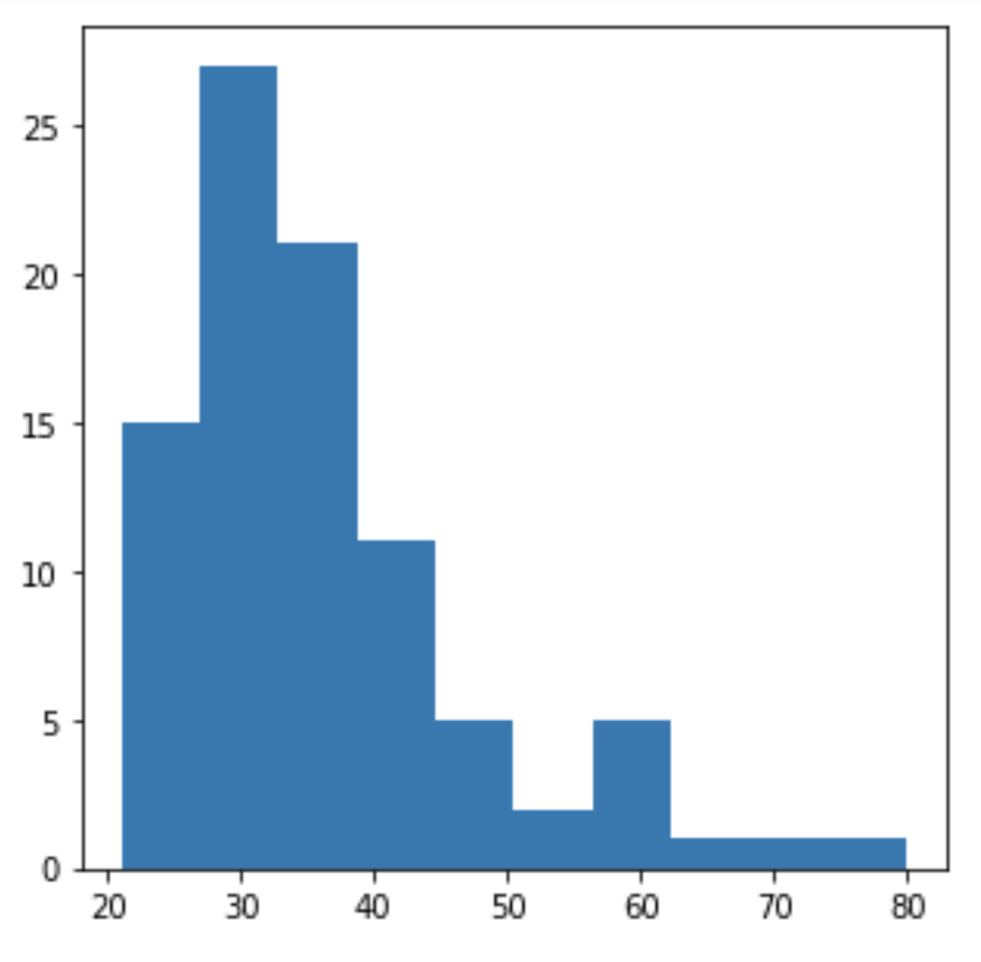
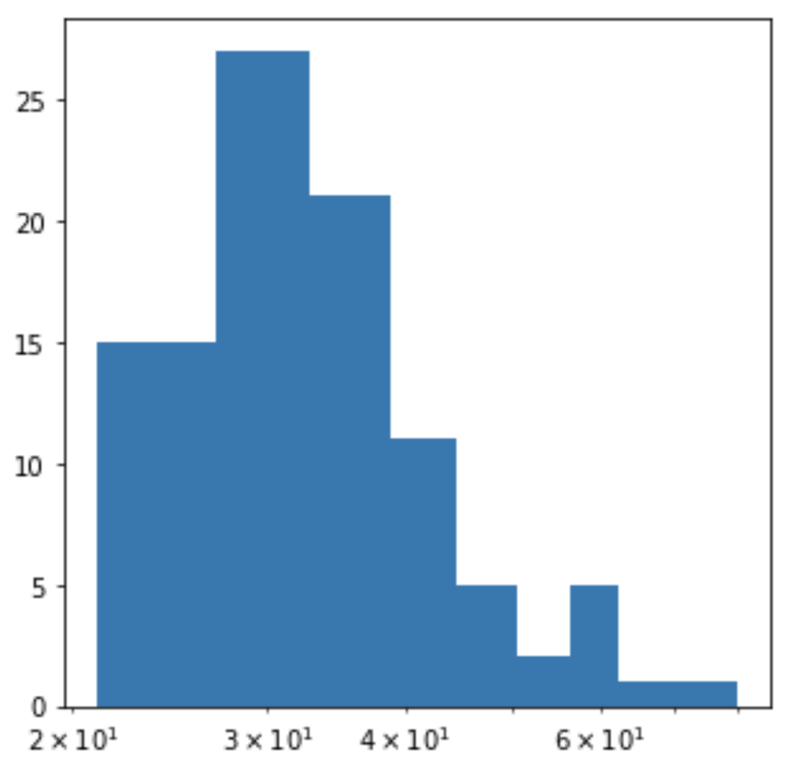
Transform during visualization
fig = plt.figure()
ax = plt.axes()
ax.hist(data.Age)
fig = plt.figure()
ax = plt.axes()
ax.hist(data.Age)
plt.xscale('log')

Slide 13
Reducing skewness
A distribution that is nearly symmetric is often easier to handle and interpret than a skewed distribution
To reduce right skewness, take roots or logarithms or reciprocals
To reduce left skewness, take squares or cubes or higher powers

Slide 14
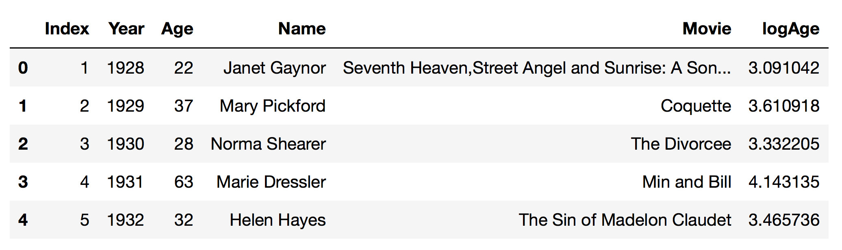
Transform variables in data frame
# pandas transform function is like map
data['logAge'] = data.Age.transform(func='log')
data.head()

Slide 15
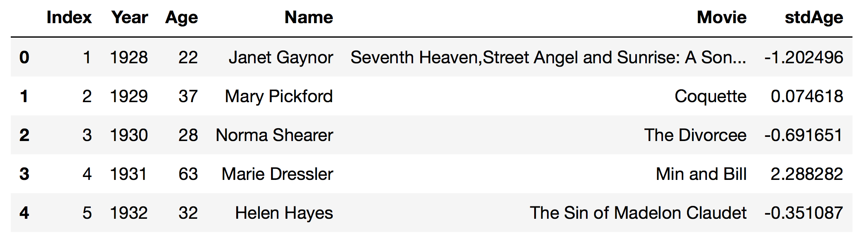
Standardize variables in data frame
# standardize Age values to have mean=0 and std=1
avgAge = data.Age.mean()
stdAge = data.Age.std()
data['stdAge'] = data.Age.map(lambda x: (x - avgAge)/stdAge)
data.head()

Slide 16
Scale variables in data frame
# scale Age values to have range [0,1]
ageMin = data.Age.min()
ageRange = data.Age.max() - ageMin
data['maxNormAge'] = data.Age.transform(lambda x: (x - ageMin)/ageRange)
data.maxNormAge.describe()
count 89.000000
mean 0.256332
std 0.199072
min 0.000000
25% 0.118644
50% 0.203390
75% 0.338983
max 1.000000
Name: maxNormAge, dtype: float64

Slide 17
Other python transformation libraries
There are also attribute transformation methods in scikit-learn, e.g.:
sklearn.preprocessing.MinMaxScaler
sklearn.preprocessing.StandardScaler
These functions work on numpy arrays/matrices.
To use, you will need to convert your Pandas data frame to a numpy representation using DataFrame.values
Then you will need to convert the results back into a data frame, eg. pd.DataFrame(scaled_features, index=df.index, columns=df.columns)

Slide 18
Distance measures
If objects have the same fixed set of numeric attributes, then the data objects can be thought of as points in a multi-dimensional space, where each dimension represents a distinct attribute
Many machine learning methods use proximity between objects as a measure of similarity/dissimilarity
Euclidean distance is the most commonly used distance measure for continuous data Here p is the number of attributes/columns
Hamming distance or matching coefficient is often used for bit vectors and discrete data

Slide 19
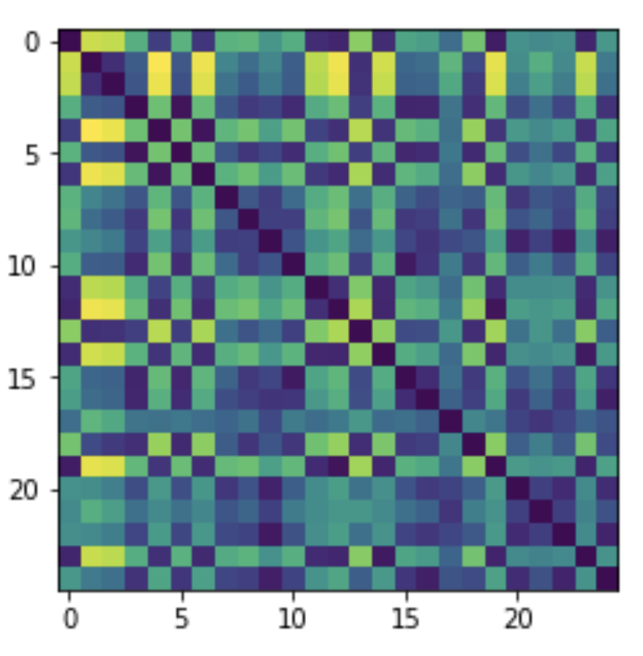
Calculating pairwise distances
import numpy as np
import math
data2 = data.sample(25)
dists = np.zeros((len(data2),len(data2)))
for i in range(len(data2)):
ivalues = data2.iloc[[i]].values[0]
for j in range(len(data2)):
if i != j:
jvalues = data2.iloc[[j]].values[0]
tmpdist = 0
for k in range(4):
tmpdist = tmpdist + (ivalues[k] - jvalues[k])**2
dists[i,j] = math.sqrt(tmpdist)
plt.imshow(dists)

Slide 20
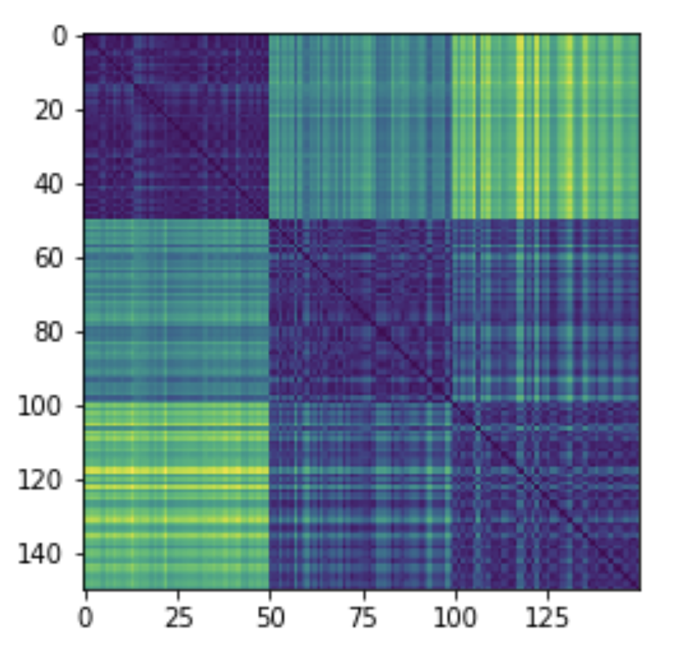
Calculating pairwise distances
from sklearn.metrics.pairwise import euclidean_distances
dists = euclidean_distances(data.iloc[:,0:4].values)
plt.imshow(dists)

