Slide 1

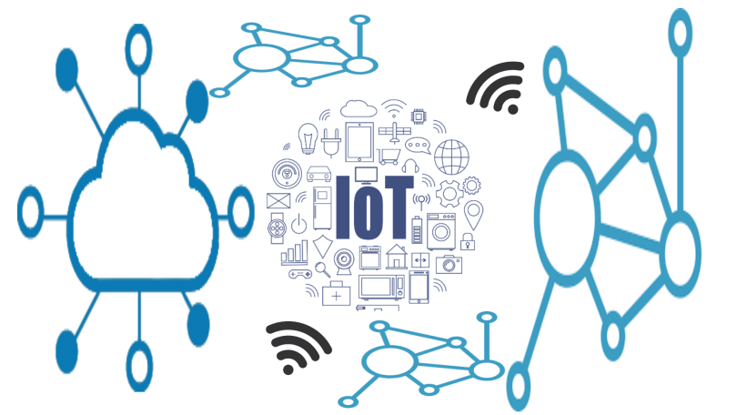

Smart Fence
IoT-Based Farm Surveillance System
Subject : Minor Degree Project
Prepared By
Vasani Darshan G.
Maniya Darshil G.
Jivani Drashti S.
Guided By
Dr. Geetali Saha
EC, GCET

Slide 2






OUTLINES
ABSTRACT
MOTIVATION
GOALS
SYSTEM OVERVIEW
SENSORS & TECHNOLOGIES
FUTURE EXPANSION

Slide 3
ABSTRACT
A farm surveillance system encompasses a range of technologies and measures aimed at safeguarding agricultural assets.
These systems typically integrate surveillance cameras, motion sensors, sound generator and rotationally access control mechanisms for farmer to provide comprehensive security coverage for farms and agricultural facilities.
Modern farm security systems leverage advancements in technology, such as IoT, to offer remote monitoring and real-time alerts, enabling proactive responses to security incidents and contributing to sustainable and profitable agriculture..

Slide 4
MOTIVATION
Farmers work hard to grow crops, but they face a big challenge: protecting their farms from animals like dogs, cows, and pigs.
These animals can eat or damage crops, causing farmers to lose money. That's why farmers need to install a farm security system.
In the year 2022-23, a staggering 68.56 lakh hectares (6.8 million hectares) of crop damage was reported, with the percentage reaching 30-40%.
It's like putting up a fence to keep animals out. With a system like the IoT-Based Farm Surveillance System , farmers can feel more confident that their farms are safe from unwanted intruders.
It's about protecting their hard work and ensuring that their farms can continue to thrive for years to come.

Slide 5
GOALS
The primary goal of the IoT-Based Farm Surveillance System is to protect agricultural assets from animal intrusion and minimize crop damage.
Specifically, the system aims to detect and deter animals, such as animal from entering farm premises through real-time monitoring and proactive response mechanisms.
Additionally, the system seeks to empower farmers with actionable insights and timely alerts, enabling them to take preventive measures and mitigate potential threats posed by animal intrusion.

Slide 6

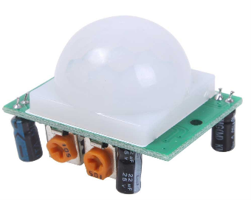
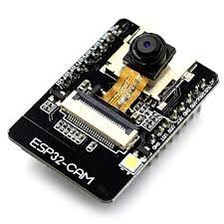
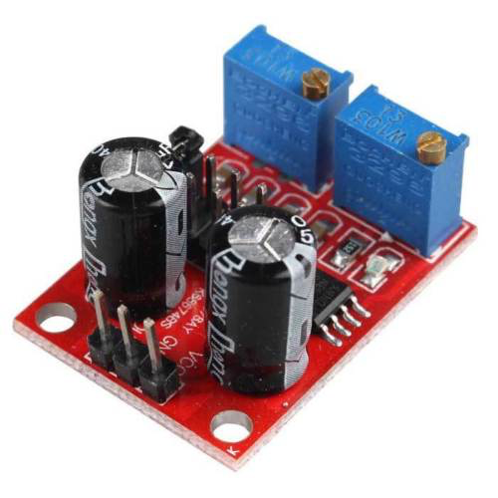
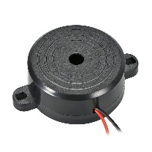
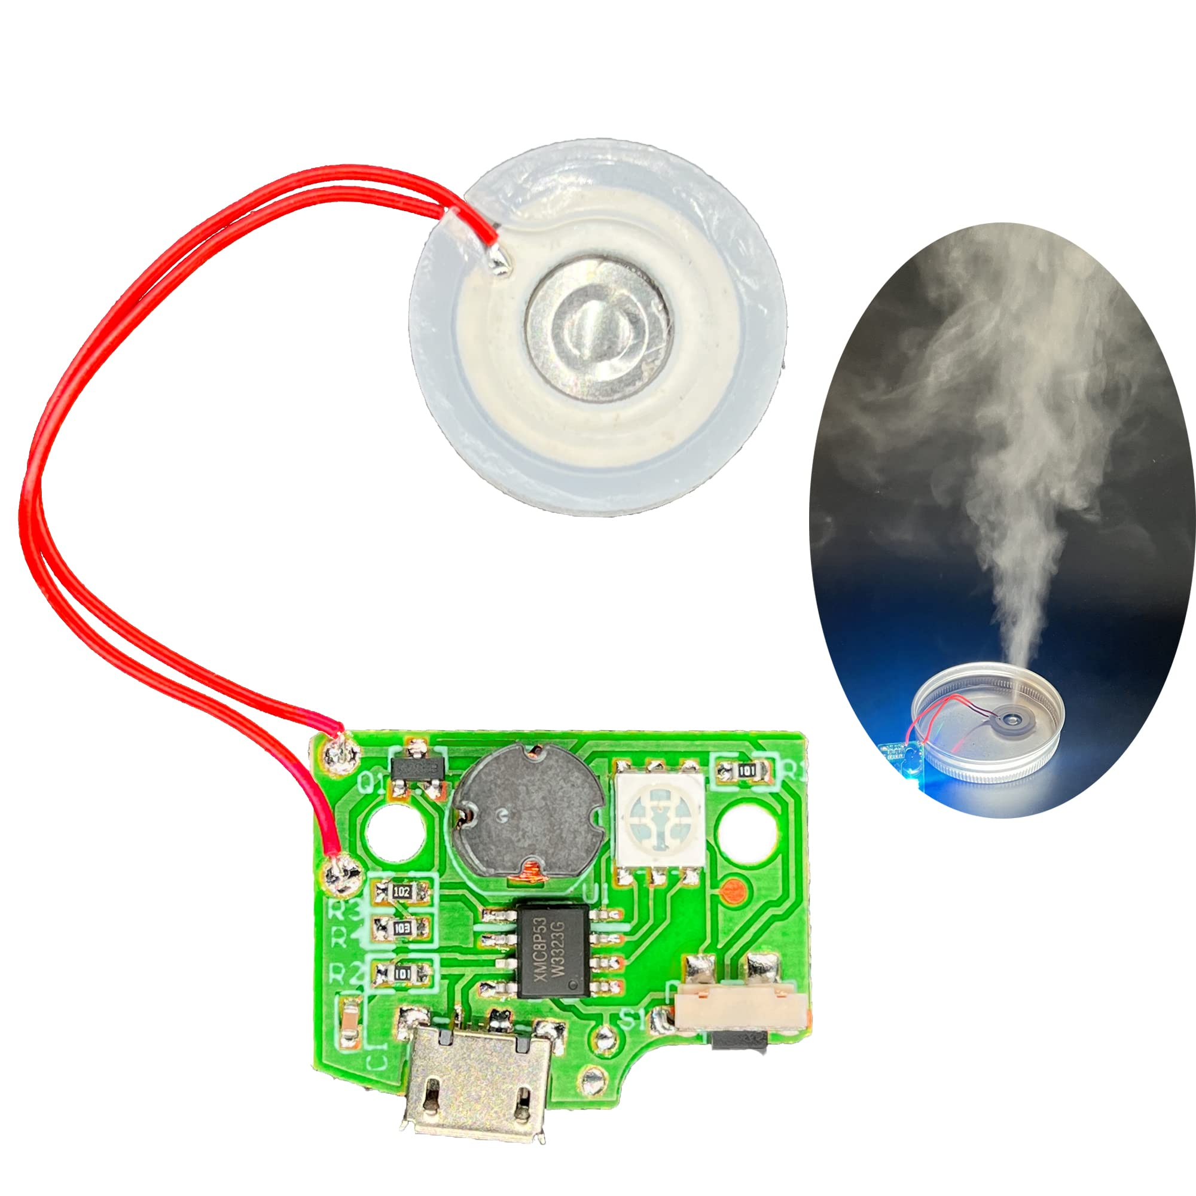
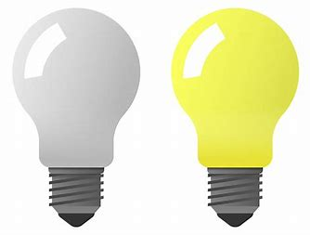

SYSTEM OVERVIEW
Motion Detection
Send Signal
Check Time
Deterrent animals
Image Capture and Send
At Day
At Night
Generate
the Sound
Mist Senor
LED Strip
Mist Senor

Slide 7
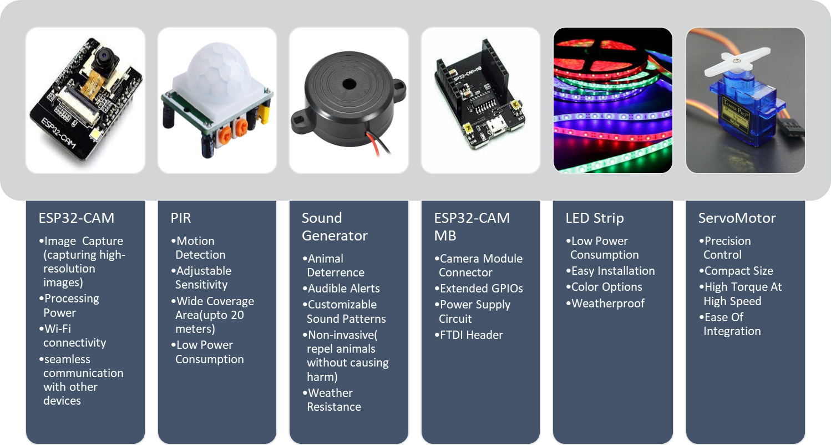
Sensors

Slide 8
FUTURE EXPANSION
Automation and Control(automated irrigation systems, remote-controlled gates or barriers, and robotic pest control devices)
Biometric Identification(such as facial recognition or animal tracking )
Intrusion detection for home surveillance system

Slide 9
EXPENSES
COMPONENTS | COST(Rs.)
ESP32 CAM | 450
MB Board | 300
PIR Sensor | 70
Servo Motor | 220
Bread Board | 100
Led Strip | 120 Per meter
Speaker | 100
Servo Motor | 70
Total | 1430

Slide 10
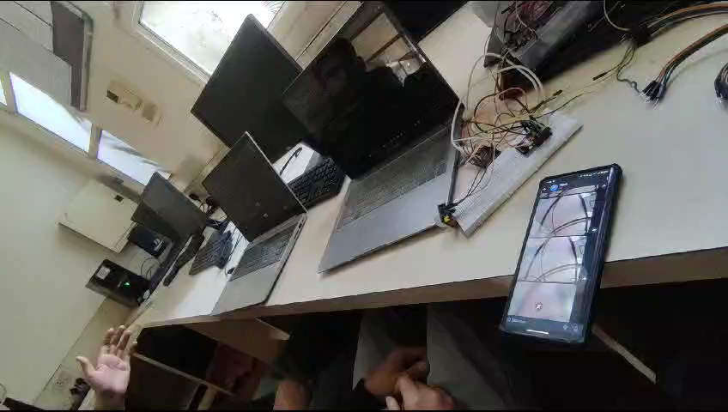
DEMO

Slide 11
CONCLUSION
The IoT-Based Farm Surveillance System represents a pioneering solution at the intersection of agriculture and technology, offering farmers a powerful tool to safeguard their livelihoods and assets.
Through the integration of cutting-edge technologies such as IoT, image processing, and remote monitoring, the system empowers farmers with real-time insights and proactive security measures.
As we continue to innovate and expand the capabilities of the ESP32-CAM Farm Surveillance System, we envision a future where smart farming technologies play a central role in sustainable agriculture practices.

Slide 12


