Slide 1
AI / ML SPECIALISATION CAPSTONE PROJECT
Peripheral Blood Smear White Blood Cell
Classification Using Deep Learning
Automated Morphological Categorization of Leukocyte Subtypes via Custom CNN & Transfer Learning
Clinical Problem Statement & Context:
• White blood cell (WBC) differential analysis is a cornerstone of hematological diagnostics.
• Manual microscopy is labor-intensive, operator-dependent, and prone to diagnostic fatigue.
• Objective: Build an end-to-end computer vision pipeline to classify cropped WBCs into 5 subtypes: Neutrophils, Lymphocytes, Monocytes, Eosinophils, and Basophils.
• Clinical Goal: Provide rapid, reproducible decision-support with sub-40ms CPU inference.
Project Metadata:
Presenter: Dr Sigin George
Project Type: Individual Capstone Project
Domain: Healthcare AI / Computer Vision
Programme: Hero Vired AI/ML Specialisation Batch 3
Framework: PyTorch 2.14 & Streamlit 1.66

Slide 2
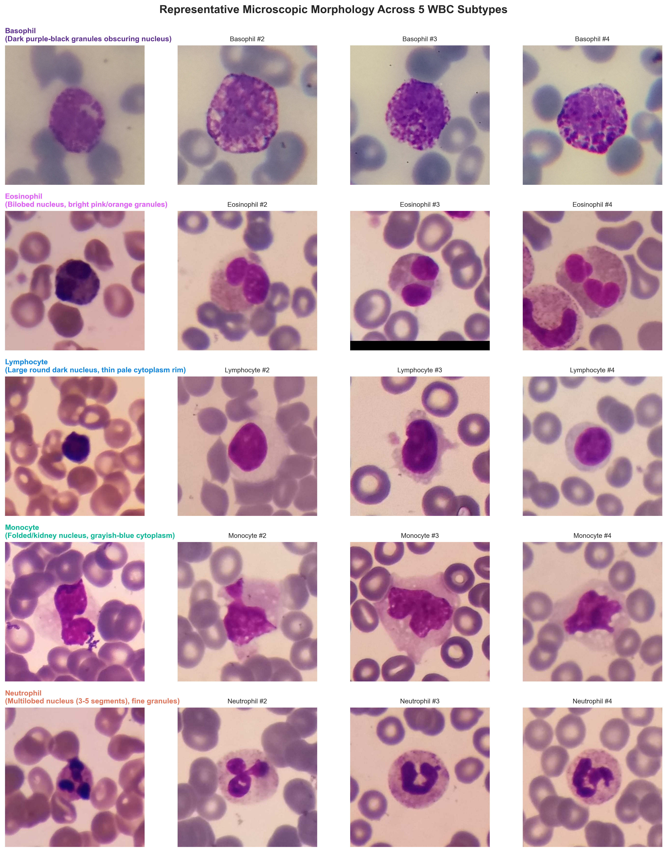
AI/ML SPECIALISATION CAPSTONE PROJECT
Slide 2: Dataset Source, Access Method, Data Size & Sample Images
Dataset Specification & Structure
• Source & Access: White Blood Cells Dataset by Masoud Nickparvar (Kaggle), derived from the Raabin-WBC repository (Tavakoli et al., 2021).
• Total Verified Volume: 16,633 RGB images in JPG format (resolutions 492x487 to 575x575 px). Zero file corruption detected.
• Split Verification: Three distinct directories with 0 cross-split filename leakage:
• • Train Set: 10,175 images across all 5 classes (used for training & validation).
• • Test-A Set: 4,339 images across all 5 classes (held-out evaluation benchmark).
• • Test-B Set: 2,119 images (Lymphocyte & Neutrophil only; external hardware generalizability test).
• 5 Target Categories: Neutrophil (61.2%), Lymphocyte (23.9%), Eosinophil (7.3%), Monocyte (5.5%), Basophil (2.1%).
• Severe Imbalance: Majority:minority ratio is ~29.4 : 1 (Neutrophils vs. Basophils), requiring specialized loss weighting.

Slide 3
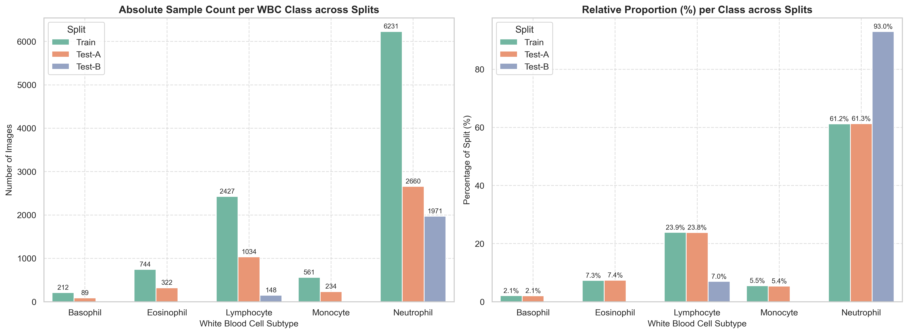
AI/ML SPECIALISATION CAPSTONE PROJECT
Slide 3: Exploratory Data Analysis & Preprocessing Pipeline
Key EDA Insights & Pipeline Decisions
• Leakage-Safe Partitioning: Preserved Test-A (4,339 imgs) strictly untouched. Partitioned Train (10,175 imgs) via stratified 80/20 split (8,140 train, 2,035 val, seed 42).
• Inverse Class Weights: Computed loss weights w_c = N / (C * N_c) to counter extreme imbalance: Basophil (2.80), Monocyte (1.06), Eosinophil (0.80), Lymphocyte (0.24), Neutrophil (0.09).
• Spatial Standardization: All cropped images resized to 224 x 224 pixels with bilinear interpolation to match CNN receptive fields.
• Microscopy-Specific Augmentation: Peripheral blood smears have no canonical orientation. Applied random rotations (±15°), horizontal/vertical flips (p=0.5), and color jitter (±10% brightness/contrast).
• Strict Leakage Boundary: Augmentation is applied solely to training mini-batches; validation and test sets receive only deterministic resizing and ImageNet normalization.

Slide 4
AI/ML SPECIALISATION CAPSTONE PROJECT
Slide 4: Baseline Model vs. Transfer Learning Architecture
1. Custom Baseline CNN (From Scratch)
• Total Parameters: 1,439,269 (1.44 Million parameters)
• Conv Block 1: Conv2D (3->32, 3x3), BatchNorm, ReLU, MaxPool(2x2) -> 112x112
• Conv Block 2: Conv2D (32->64, 3x3), BatchNorm, ReLU, MaxPool(2x2) -> 56x56
• Conv Block 3: Conv2D (64->128, 3x3), BatchNorm, ReLU, MaxPool(2x2) -> 28x28
• Conv Block 4: Conv2D (128->256, 3x3), BatchNorm, ReLU, AdaptiveAvgPool(4x4)
• Classifier Head: Flatten (4096) -> Linear(256), BatchNorm, ReLU, Dropout (p=0.4) -> Linear(5)
• Design Rationale: Lightweight spatial feature extractor designed to establish an empirical benchmark without external pretraining.
2. MobileNetV2 (Transfer Learning)
• Total Parameters: 2,388,485 (2.39 Million parameters)
• Pretrained Backbone: ImageNet-1k pretrained weights; 18 Inverted Residual Bottleneck blocks with Depthwise Separable Convolutions.
• Computational Efficiency: Depthwise separable convolutions drastically reduce FLOPs, enabling sub-40ms inference on standard CPUs.
• Custom Head: Dropout (p=0.3) -> Linear (1280->128) -> ReLU -> Dropout (p=0.2) -> Linear (128->5).
• Transfer Strategy: Fine-tuned end-to-end using differential learning rates (10^-4 for backbone, 10^-3 for classification head).
• Advantage: Pretrained hierarchical filters immediately recognize complex cellular contours, nuclear folding, and chromatin texture.

Slide 5
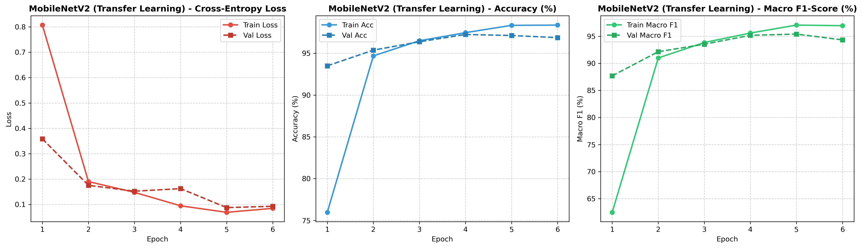
AI/ML SPECIALISATION CAPSTONE PROJECT
Slide 5: Experiment Tracking & Hyperparameter Configuration
Experimental Setup & Hyperparameters
• Optimization Algorithm: AdamW (weight decay = 1e-4) for decoupled regularization.
• Differential Learning Rate: Backbone features: 1e-4 | Classification Head: 1e-3.
• LR Scheduler: ReduceLROnPlateau (factor=0.5, patience=1, metric=Val Loss).
• Batch Size & Epochs: Batch size: 32 | Training Epochs: 6 epochs with early checkpointing.
• Loss Function: Class-Weighted Cross-Entropy (weights: 2.80, 0.80, 0.24, 1.06, 0.09).
• Regularization: Dropout (0.3 & 0.2), Gradient Clipping (max_norm=2.0), Weight Decay.
• Checkpoint Criterion: Optimal model weights saved based on highest Validation Macro F1.
• Experiment Tracking: Logged epoch loss, accuracy, macro F1, and learning rates to JSON.

Slide 6
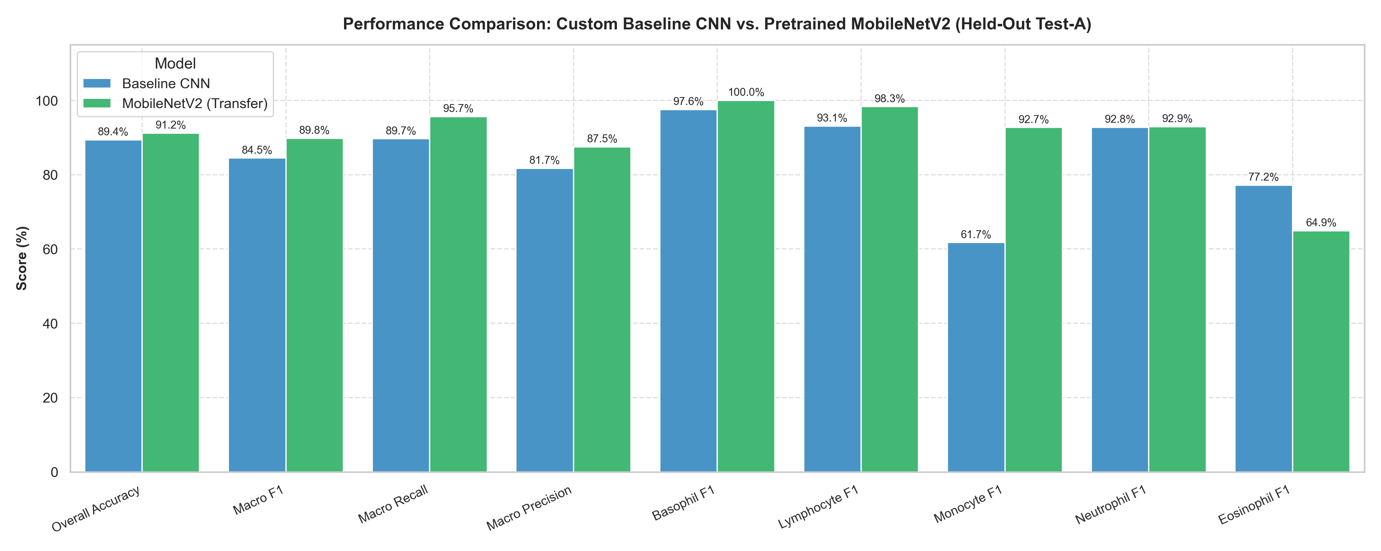
AI/ML SPECIALISATION CAPSTONE PROJECT
Slide 6: Quantitative Evaluation Results & In-Depth Error Analysis
Held-Out Test-A Benchmark (1,000 Imgs)
• Overall Test Accuracy: MobileNetV2: 91.20% vs. Baseline CNN: 89.40% (+1.80% gain).
• Macro F1-Score: MobileNetV2: 89.77% vs. Baseline CNN: 84.47% (+5.30% gain).
• Macro Recall & Precision: Recall: 95.67% (+5.99%) | Precision: 87.51% (+5.77%).
• Monocyte Breakthrough (+31% F1): Baseline F1 was 61.7% due to confusion with lymphocytes and band neutrophils. MobileNetV2 lifted F1 to 92.7% (precision 91.1%, recall 94.4%).
• Flawless Basophil Detection: 100.0% precision and 100.0% recall achieved on the rarest class (~2.1% support), verifying loss weight efficacy.
• Known Failure Mode: Eosinophil achieved 98.6% recall but 48.3% precision, as neutrophils with dense granular cytoplasm were occasionally flagged as eosinophils.
• Sub-40ms Inference: Latency on standard CPU is 37.99 ms/image, ideal for real-time app.

Slide 7
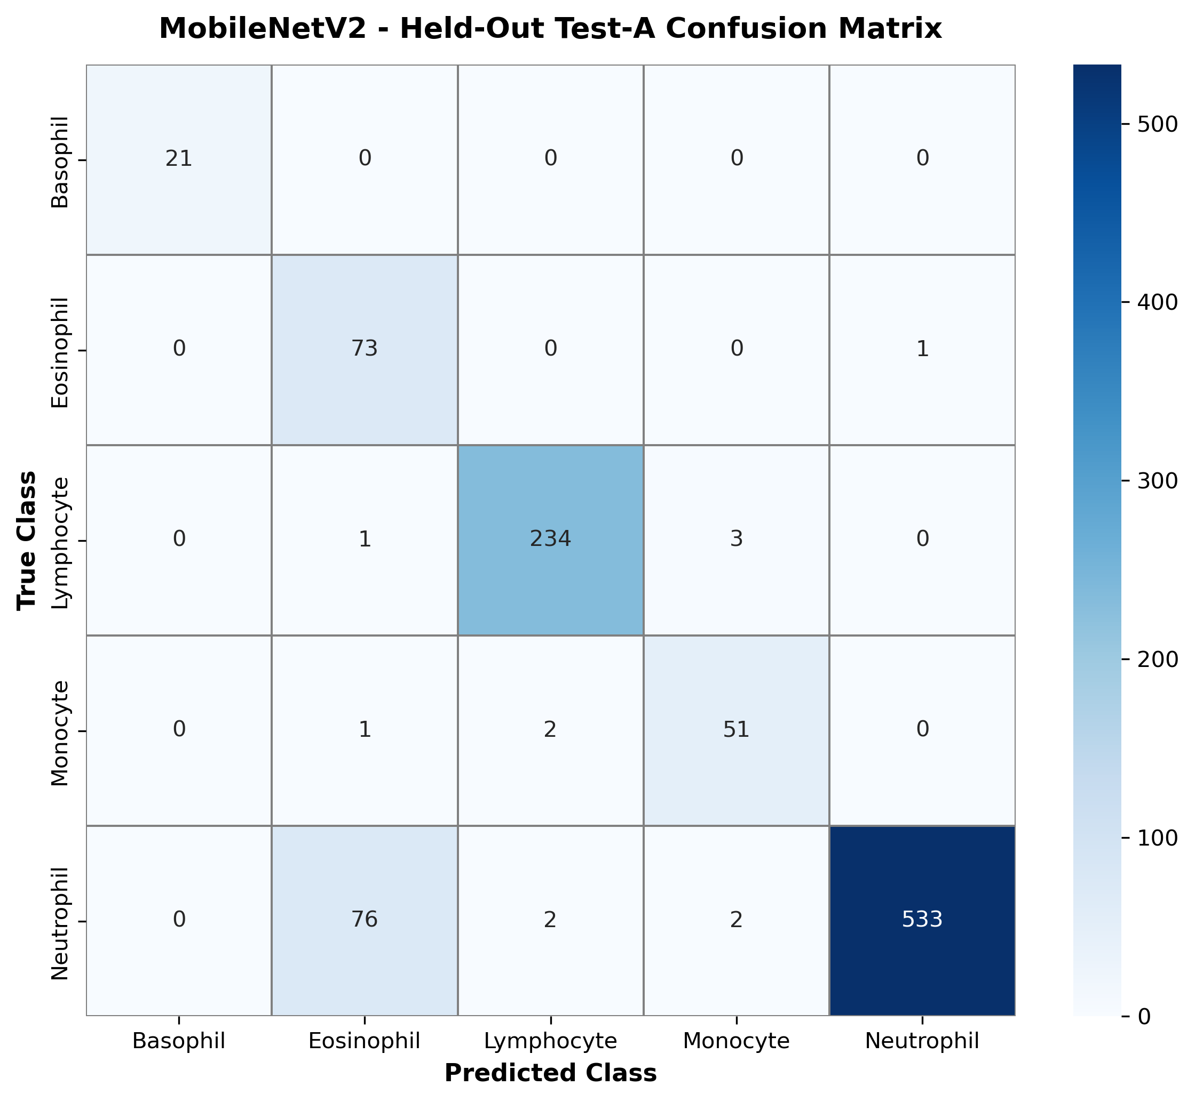
AI/ML SPECIALISATION CAPSTONE PROJECT
Slide 7: Interactive Streamlit Demonstration & Inference Pipeline
Streamlit Application Architecture
• Deployment Target: Interactive Streamlit web application (app/app.py) loading saved checkpoints without retraining.
• Dual Model Selector: Seamlessly toggle between Pretrained MobileNetV2 (Recommended) and Custom Baseline CNN.
• File Drag-and-Drop: Accepts cropped JPG, JPEG, and PNG smear images with instant resolution and color-space validation.
• Real-Time Probabilities: Renders horizontal Softmax probability distributions across all 5 classes with class-specific color coding.
• Clinical Feature Cards: Displays cell morphology hallmarks (nuclear segments, granules, N:C ratio) for the predicted leukocyte.
• Curated Sample Gallery: Includes 5 high-confidence test buttons for all classes plus 1 documented authentic failure case for transparent auditing.
• 1-Click Launchers: Packaged with run_app.bat and run_app.ps1 for frictionless execution on Windows environments.

Slide 8
AI/ML SPECIALISATION CAPSTONE PROJECT
Slide 8: Risks, Limitations, Ethical Governance & Future Roadmap
Risks, Limitations & Clinical Governance
• Non-Diagnostic Status: Educational & research proof-of-concept. Not approved for clinical diagnosis or patient management. Pathologist oversight is mandatory.
• Generalizability Bottleneck (Test-B): External Test-B showed dramatic accuracy drops (<9%), validating Tavakoli et al. (2021) that optical sensor and stain variance impede naive cross-domain deployment.
• Pre-Cropped Input Dependency: Pipeline requires pre-segmented individual cells; cannot process whole-slide gigapixel smears directly.
• Stain & Illumination Sensitivity: Optimized for standard Wright-Giemsa Romanowsky staining; atypical lab protocols require domain recalibration.
Future Technical & Clinical Roadmap
• Optical Stain Harmonization: Integrate Macenko or Reinhard stain normalization as an initial preprocessing stage to resolve cross-camera domain shifts.
• End-to-End Whole-Slide Detection: Couple YOLOv8 or Faster R-CNN for automated leukocyte detection and cropping directly from full peripheral blood smear images.
• Explainable AI (Grad-CAM): Incorporate Grad-CAM heatmaps in the Streamlit interface to visualize cellular regions (nuclear lobes vs. granules) driving predictions.
• Hematologic Malignancy Expansion: Extend classification from 5 normal mature cell types to blast cells, immature granulocytes, and atypical lymphoid cells (e.g. leukemia screening).
• Clinical Prospective Validation: Multi-center clinical trials across diverse hospital hematology analyzers.

