Slide 1


Genetic Algorithm with Self-Adaptive Mutation Controlled by
Chromosome Similarity
Daniel Smullen, Jonathan Gillett, Joseph Heron,
Shahryar Rahnamayan

Slide 2
Introduction
Undergraduate students from Ontario, Canada.
3rd year Artificial Intelligence course: create a Java-based GA that solves N-Queens.
While we were working, we noticed something interesting…

Slide 3
Introduction and Background
GA are great for solving complex or large combinatorial problems.
Performance objectives:
Speed
  Number of generations required to solve/find solution.
Fitness
  Find better solutions overall.

Slide 4
Introduction and Background
Goals:
Improve diversity.
Improve general GA performance.
Minimize the amount of required a priori knowledge to solve effectively.

Slide 5
Introduction and Background
New idea:
Use the mutation operator to control similarity.
Diversity has diminishing returns:
Too much similarity.
  Can’t find new solutions.
  Exploring one small part of the massive landscape.
Too little similarity.
  Random walk.

Slide 6
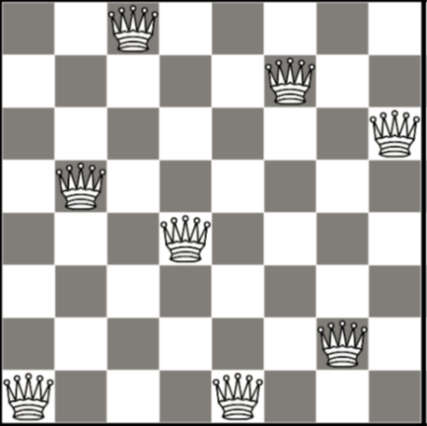
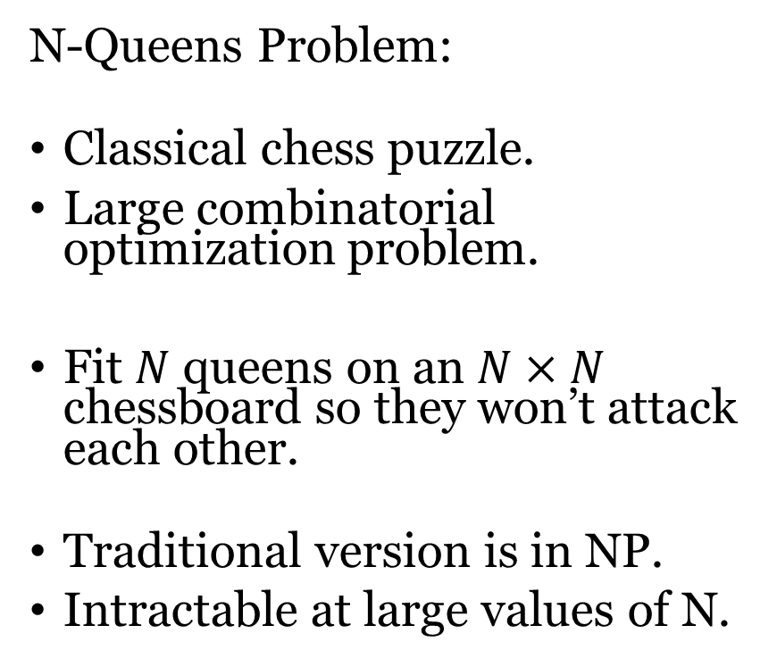
Problem Background
N-Queens Problem:
Classical chess puzzle.
Large combinatorial optimization problem.
Fit $N$ queens on an $N×N$ chessboard so they won’t attack each other.
Traditional version is in NP.
Intractable at large values of N.
OK

Slide 7
Game Rules
Fitness is based on how many queens will attack each other.
  Highly multi-modal.
We don’t count the same solution twice, they’re the same chess board.
Each unique solution can create further distinct solutions by rotating, reflecting the chess board (due to symmetry).

Slide 8
Objective A:
Find the most unique solutions, with a fixed budget.
Objective B:
Find the first distinct solution, as quickly as possible.

Slide 9
Determining Fitness
Calculated the same way for traditional and new approaches.
Evaluate the number of collisions on the board, per each queen.
  If two queens can attach each other, 2 collisions result.
  Queens can’t attack themselves.

Slide 10
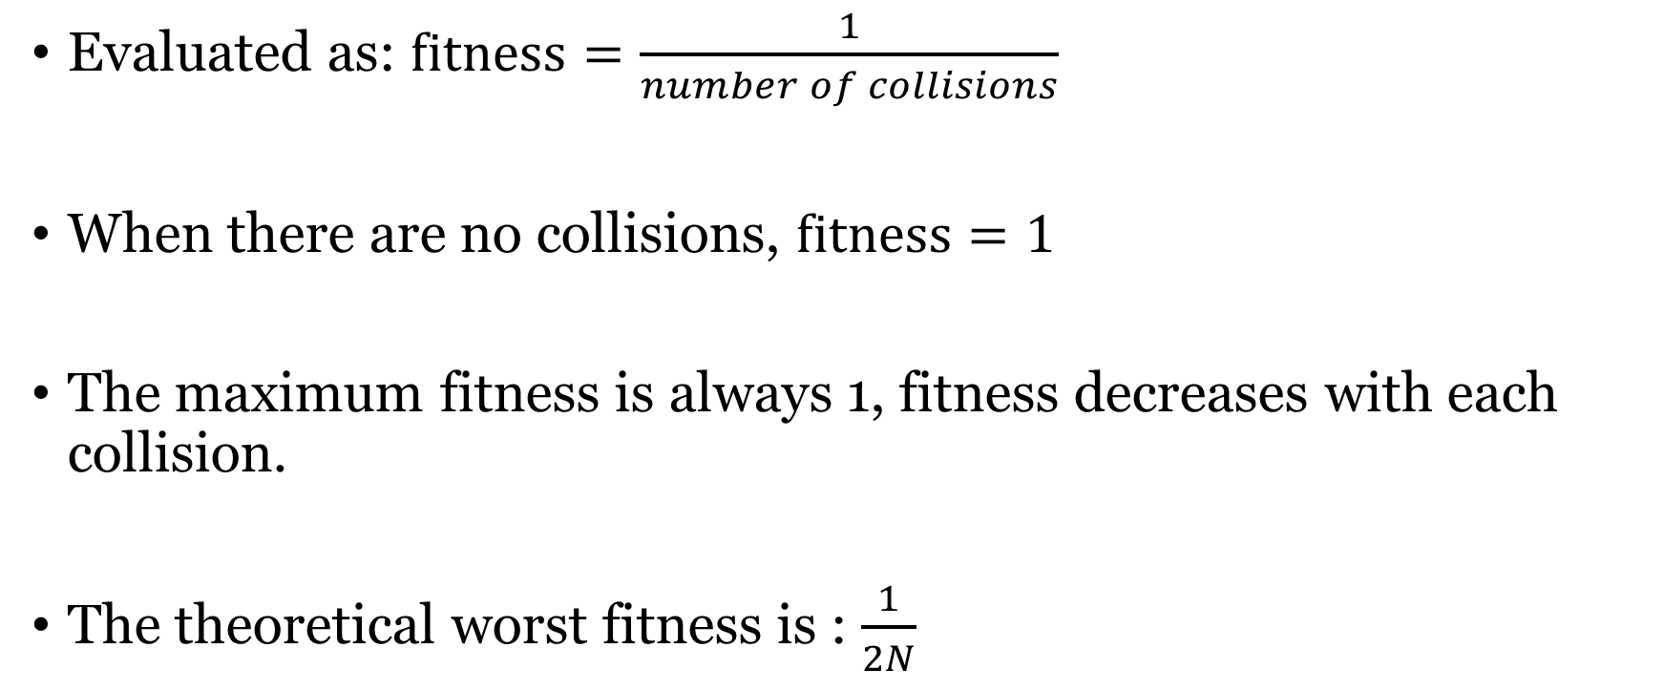
Determining Fitness
Evaluated as: $fitness=\frac{1}{number of collisions}$
When there are no collisions, $fitness=1$
The maximum fitness is always 1, fitness decreases with each collision.
The theoretical worst fitness is : $\frac{1}{2N}$

Slide 11
Modality
40228 Sub-Optimal Candidates
Many configurations of queens which aren’t optimal.
These aren’t solutions to the puzzle.
Fitness is based on collisions; only zero-collision boards are acceptable.
92 Optimal Solutions
8-Queens Problem Collisions Histogram, Showing Distribution
Based on Fitness Values

Slide 12
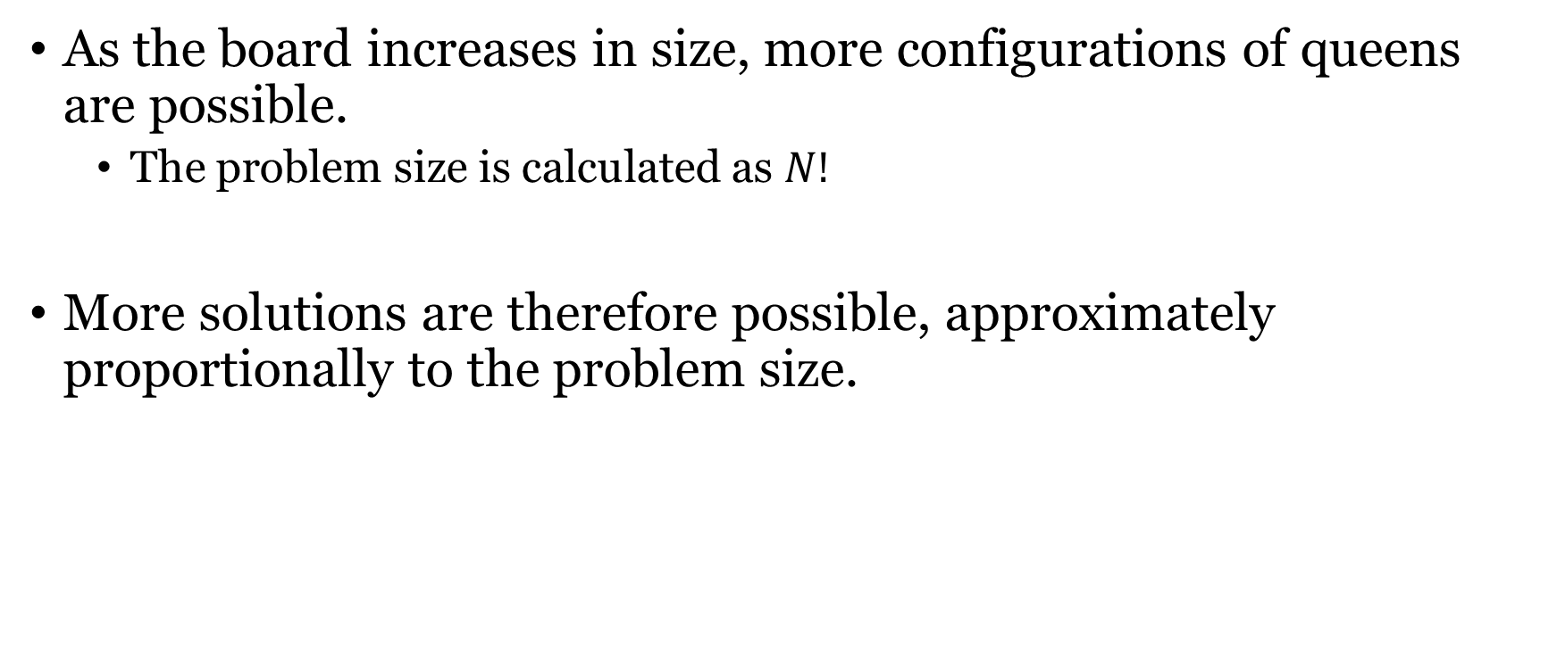
Problem Size
As the board increases in size, more configurations of queens are possible.
  The problem size is calculated as $N!$
More solutions are therefore possible, approximately proportionally to the problem size.

Slide 14
Related/Previous Work
N-Queens problem has been fully solved up to N=26 using deterministic methods.
  Deterministic methods work best for small problem sizes (N ≤ 8)
For N≥26, number of optimal solutions is unknown, but we do know how big the problem is.
Since the problem starts to get huge at big values of N, finding solutions of any kind lends itself to stochastic approaches.

Slide 15
Related/Previous Work
Most GA techniques generally fit into a few archetypes or a combination thereof:
Adapt mutation probability for different modes (exploitation, and exploration)*.
‘Tuning up’ GA operators using a priori knowledge about the problem.
Specify genetic operators per phenotype.
* This is the archetype our approach fits into.

Slide 16
Our New Approach
In nature, genetically similar beasts tend to undergo strange mutations – for better or for worse.
Dog breeds are a classic example.
  Many pure-bred dogs have serious genetic defects that have been amplified by overly selective breeding.
Genetically dissimilar beasts sometimes produce more ‘successful’ offspring.
  Genetic diversity, natural selection breeds out problematic traits, which enhances fitness.

Slide 17
Our New Approach
Use adaptive GA based on chromosome similarity to increase the diversity of candidates.
With N-Queens, more diversity means more (different, potentially unique) solutions.
How do we adapt? By controlling the mutation probability operator.
  Increase mutation probability in high similarity (inbred) conditions.
  Decrease mutation probability in low similarity (diverse) conditions.

Slide 18
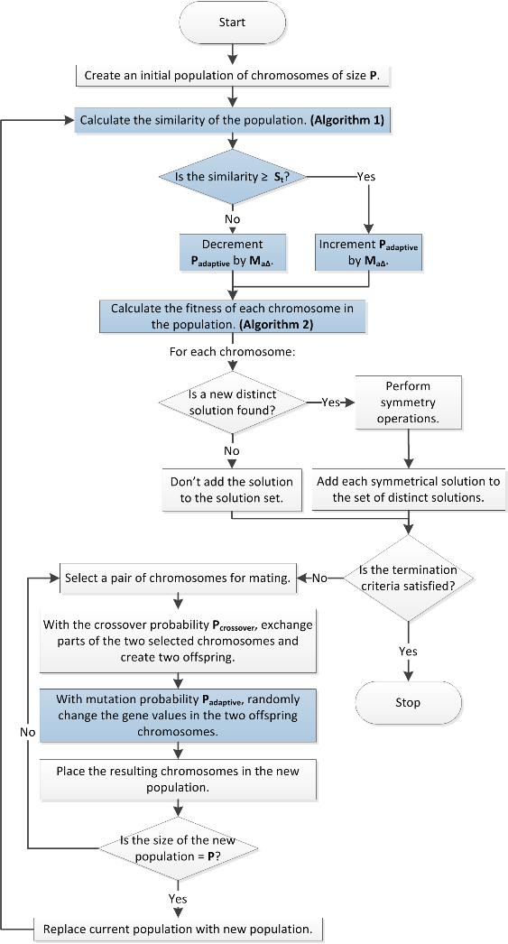

Slide 19
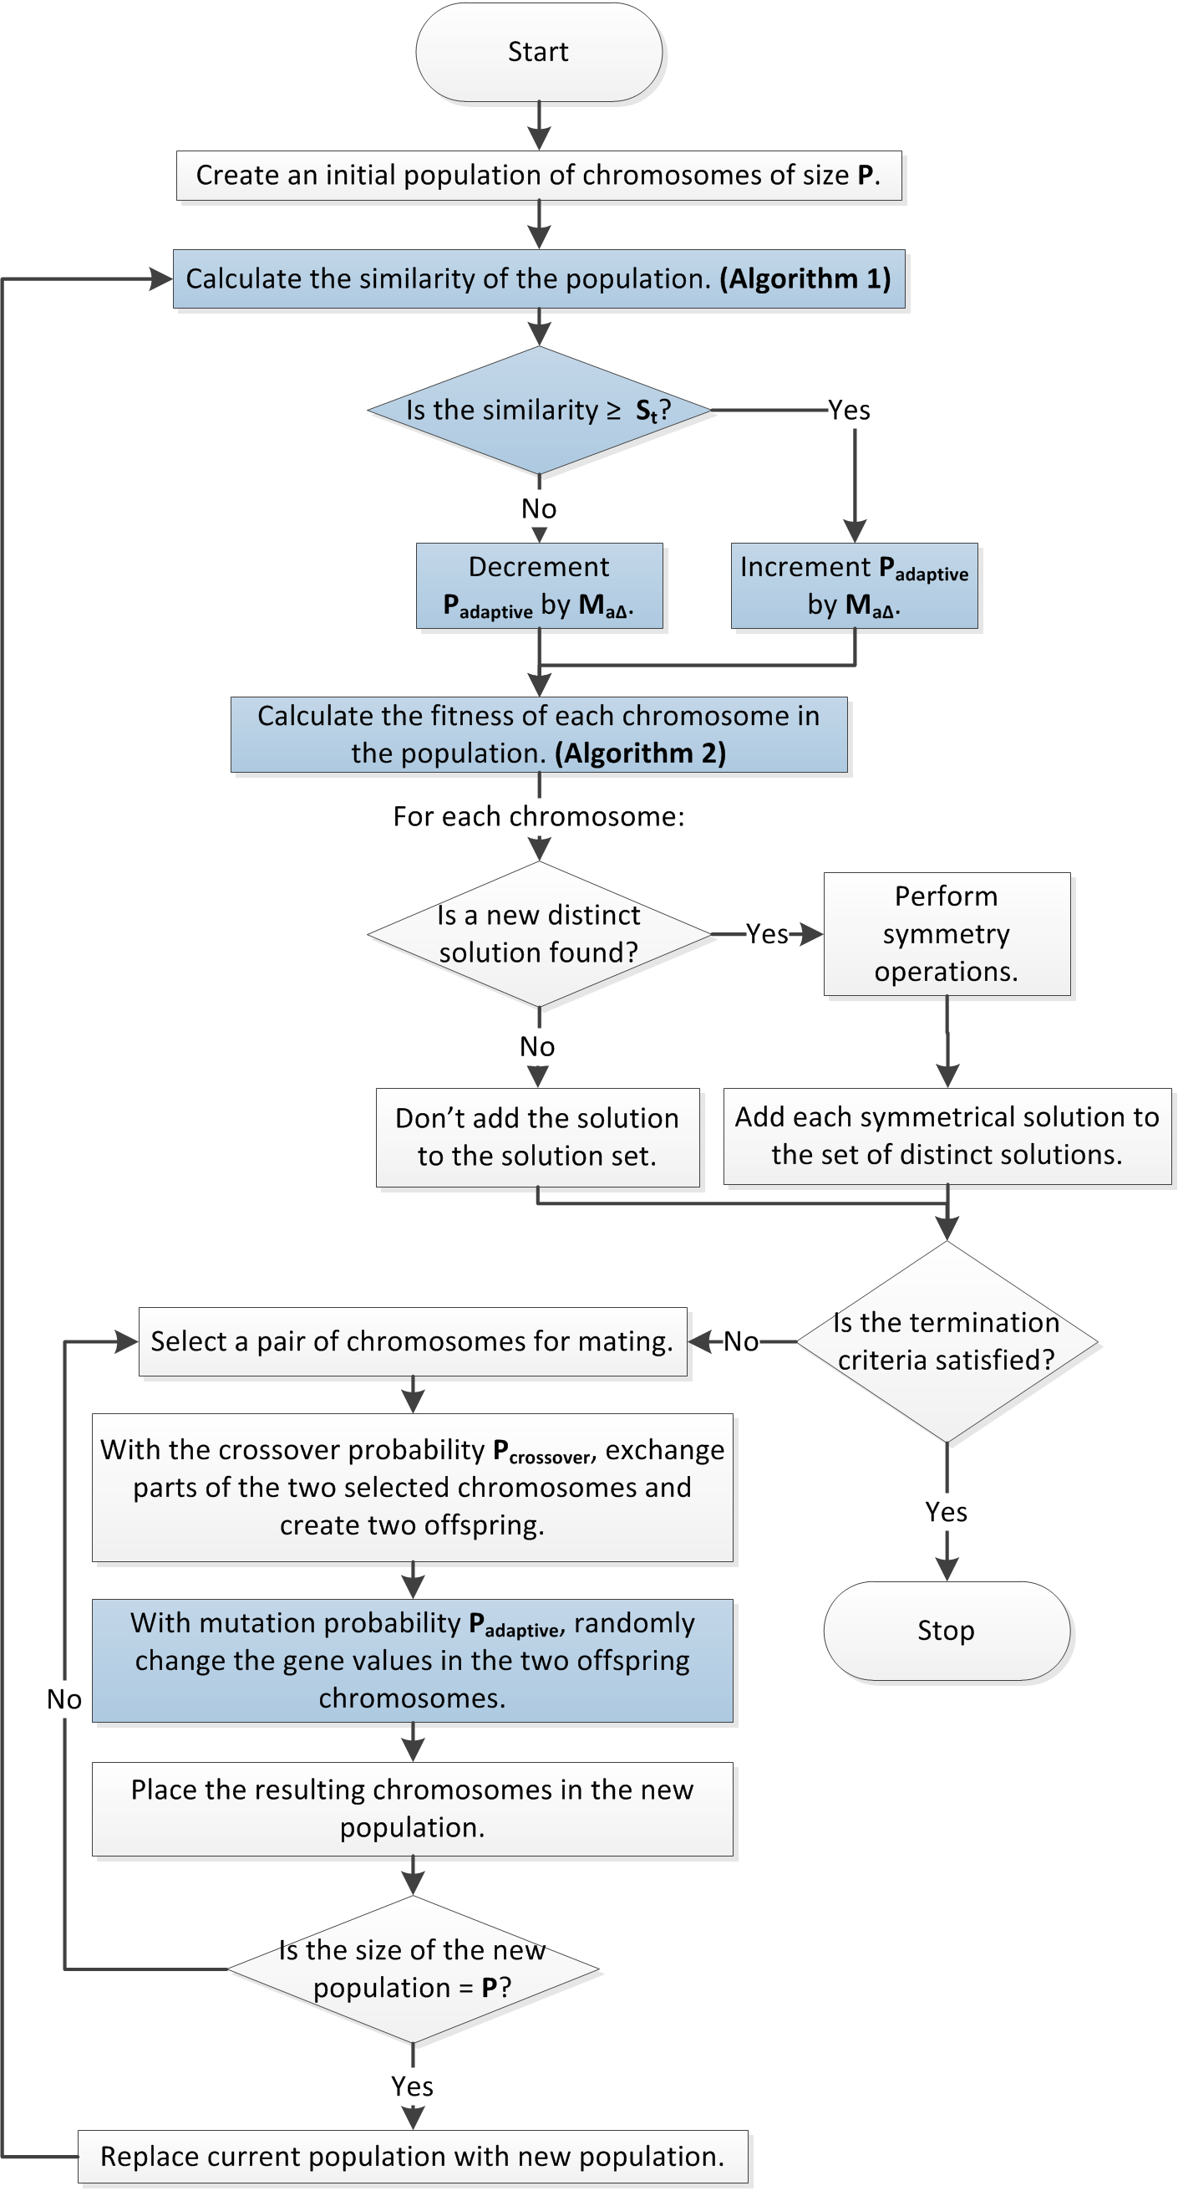

Slide 20
Note
An unfair challenge was made against our new approach.
Traditional GA requires a priori knowledge about the problem to select the optimal mutation probability (M_{c}).
We experimentally determined the optimal M_{c} for each N-Queens problem, and pitted it against the self-adaptive approach.

Slide 21
Results – Most Distinct Solutions (Objective A)
N
The number of queens (which N-Queens puzzle).
Best M_{c}
This was the best experimentally determined value for the mutation operator. This M_{c} found the most solutions for a given N.
M_{c} refers to the mutation operator for classical GA.
M_{c} Solutions
This was the number of solutions generated using the best experimentally determined mutation operator, with classical GA.
Self-Adaptive Solutions
This was the number of solutions generated with our approach.
% Difference*
This is the percentage difference between the Best M_{c} result for each N, versus the self-adaptive approach.
*Percentage difference is calculated with respect to the self-adaptive approach.

Slide 22
Results – Most Distinct Solutions (Objective A)
N | Best M_{c} | M_{c} Solutions | Self-Adaptive Solutions | % Difference
8 | 0.95 | 92 | 92 | 0
9 | 0.95 | 352 | 352 | 0
10 | 0.9 | 724 | 724 | 0
11 | 0.85 | 2,680 | 2,680 | 0
12 | 0.85 | 13,690 | 11,986 | -12.45
13 | 0.8 | 32,128 | 26,308 | -18.12
14 | 0.8 | 41,520 | 29,520 | -28.9
15 | 0.8 | 30,356 | 30,324 | -0.11
Traditional GA approach performs marginally better for 11 < N ≤ 15.
For N < 12, deterministic approaches are better than both traditional GA and the self-adaptive approach.
  The performance is virtually identical between both GA methods here.

Slide 23
Results – Most Distinct Solutions (Objective A)
N | Best M_{c} | M_{c} Solutions | Self-Adaptive Solutions | % Difference
12 | 0.85 | 13,690 | 11,986 | -12.45
13 | 0.8 | 32,128 | 26,308 | -18.12
14 | 0.8 | 41,520 | 29,520 | -28.9
15 | 0.8 | 30,356 | 30,324 | -0.11
15 | 0.8 | 30,356 | 30,324 | -0.11
16 | 0.8 | 15,016 | 30,132 | 100.67
18 | 0.75 | 16,392 | 27,120 | 65.45
20 | 0.75 | 7,872 | 25,608 | 225.3
22 | 0.7 | 6,008 | 25,376 | 322.37
24 | 0.7 | 6,440 | 24,560 | 281.37
26 | 0.7 | 6,280 | 23,008 | 266.37
32 | 0.65 | 15,216 | 104,080 | 584.02

Slide 24
Results – Most Distinct Solutions (Objective A)
N | Best M_{c} | M_{c} Solutions | Self-Adaptive Solutions | % Difference
15 | 0.8 | 30,356 | 30,324 | -0.11
16 | 0.8 | 15,016 | 30,132 | +100.67
18 | 0.75 | 16,392 | 27,120 | +65.45
20 | 0.75 | 7,872 | 25,608 | +225.3
22 | 0.7 | 6,008 | 25,376 | +322.37
24 | 0.7 | 6,440 | 24,560 | +281.37
26 | 0.7 | 6,280 | 23,008 | +266.37
32 | 0.65 | 15,216 | 104,080 | +584.02
The self-adaptive method performs significantly better than traditional GA for N ≥ 15.

Slide 25
Results – Most Distinct Solutions (Objective A)
Here we have plotted the percentage difference for each value of N.
As N increases, the self-adaptive approach provides increasingly better results.
All values above 0% (N ≥ 15) indicate that our self-adaptive approach beat the most optimal fixed mutation value in traditional GA.

Slide 26
Results – First Distinct Solution (Objective B)
N
Fastest M_{c}
Fastest M_{c} Generations
Self-Adaptive Generations
% Difference
The number of queens (which N-Queens puzzle).
This was the best experimentally determined value for the mutation operator. This M_{c} value found the solution fastest.
M_{c} refers to the mutation operator for classical GA.
This was the number of generations required to find the first solution for a given N, using the fastest experimentally determined M_{c}.
This was the number of generations required to find the first solution for a given N, using the self-adaptive approach.
This is the percentage difference between the fastest M_{c} result for each N, versus the self-adaptive approach.
*Percentage difference is calculated with respect to the self-adaptive approach.

Slide 27
Results – First Distinct Solution (Objective B)
N | Fastest M_{c} | Fastest M_{c} Generations | Self-Adaptive Generations | % Difference
8 | 0.75 | 45 | 91 | -50.55
9 | 0.8 | 121 | 186 | -34.95
10 | 0.8 | 261 | 417 | -37.41
11 | 0.7 | 444 | 364 | 21.98
12 | 0.65 | 457 | 463 | -1.3
13 | 0.7 | 448 | 582 | -23.02
14 | 0.65 | 494 | 609 | -18.88
15 | 0.65 | 598 | 513 | 16.57
16 | 0.65 | 662 | 606 | 9.24
18 | 0.65 | 911 | 688 | 32.41
20 | 0.55 | 889 | 862 | 3.13
22 | 0.5 | 1,234 | 1,211 | 1.9
24 | 0.4 | 1,209 | 1,182 | 2.28
26 | 0.45 | 1,599 | 942 | 69.75
32 | 0.5 | 2,298 | 1,995 | 15.19

Slide 28
Results – First Distinct Solution (Objective B)
N | Fastest M_{c} | Fastest M_{c} Generations | Self-Adaptive Generations | % Difference
8 | 0.75 | 45 | 91 | -50.55
9 | 0.8 | 121 | 186 | -34.95
10 | 0.8 | 261 | 417 | -37.41
11 | 0.7 | 444 | 364 | 21.98
12 | 0.65 | 457 | 463 | -1.3
13 | 0.7 | 448 | 582 | -23.02
14 | 0.65 | 494 | 609 | -18.88
15 | 0.65 | 598 | 513 | 16.57
Traditional GA approach performs marginally better for most values of N < 15.

Slide 29
Results – First Distinct Solution (Objective B)
N | Fastest M_{c} | Fastest M_{c} Generations | Self-Adaptive Generations | % Difference
15 | 0.65 | 598 | 513 | 16.57
16 | 0.65 | 662 | 606 | 9.24
18 | 0.65 | 911 | 688 | 32.41
20 | 0.55 | 889 | 862 | 3.13
22 | 0.5 | 1,234 | 1,211 | 1.9
24 | 0.4 | 1,209 | 1,182 | 2.28
26 | 0.45 | 1,599 | 942 | 69.75
32 | 0.5 | 2,298 | 1,995 | 15.19
The self-adaptive method performs better than traditional GA for all values N > 14.

Slide 30
Results – First Distinct Solution (Objective B)
The results here are far more variable.
The self-adaptive approach still wins in the second unfair challenge in 8/15 tests.
  Remember: the self-adaptive approach has already beaten traditional GA in one unfair challenge - with continual improvement as N increases.

Slide 31
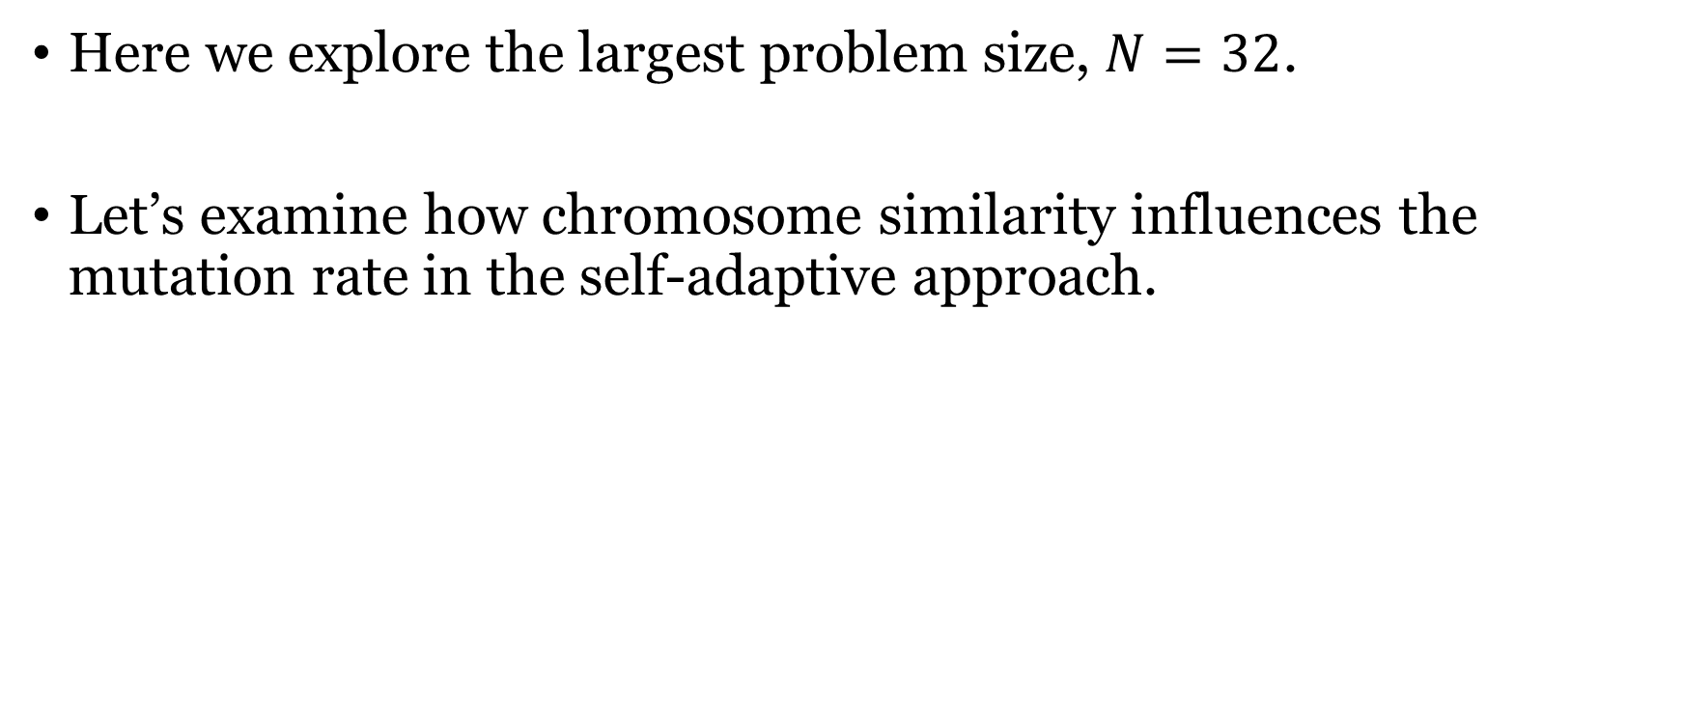
Examining Adaptation
Here we explore the largest problem size, $N=32$.
Let’s examine how chromosome similarity influences the mutation rate in the self-adaptive approach.

Slide 32
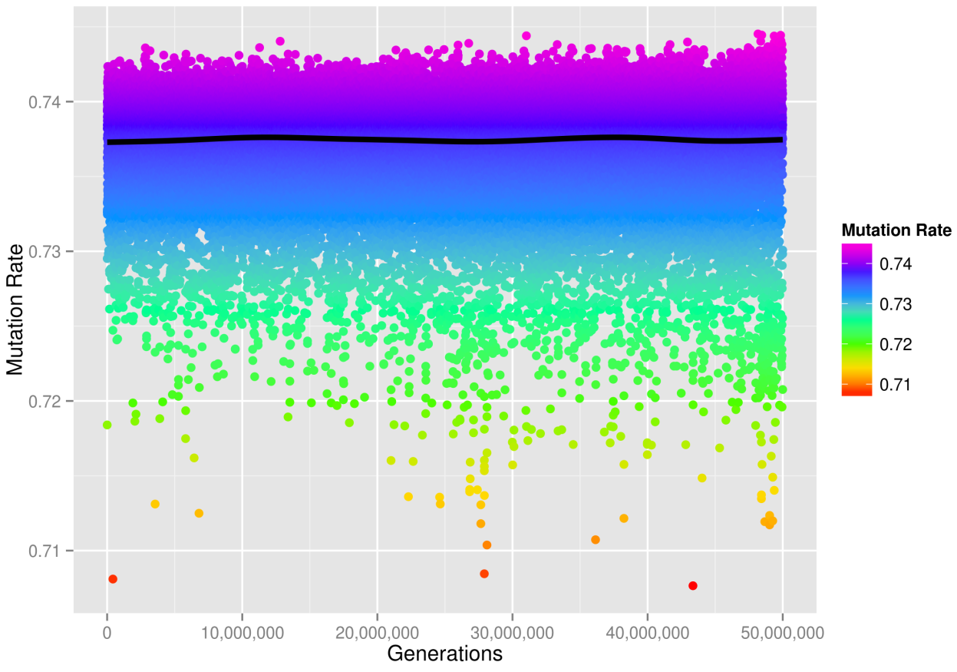
Influence of Chromosome Similarity on Mutation Rate
Here we see self-adaptation occurring.
Changes in the mutation rate influence the diversity over generations.
The mutation rate changes based on the chromosome similarity;
The similarity converges towards the specified threshold (S_{t} = 15%)…

Slide 33


Slide 34
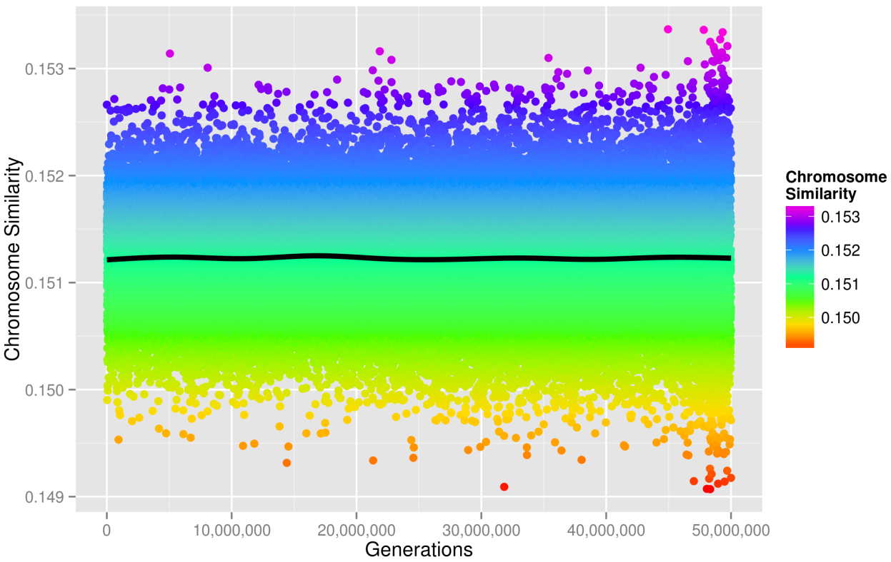
Effect of Adaptive Mutation on Chromosome Similarity
The adaptive mutation operator is applied to the chromosomes, and they approach S_{t} = 15% over generations.
Why isn’t the similarity consistently adapted to exactly 0.15?
  In new generations similarity fluctuates as new offspring are produced.
Notes:
Shows how the similarity of the chromosomes changes as a result of the mutation operator being applied

Slide 35


Slide 36
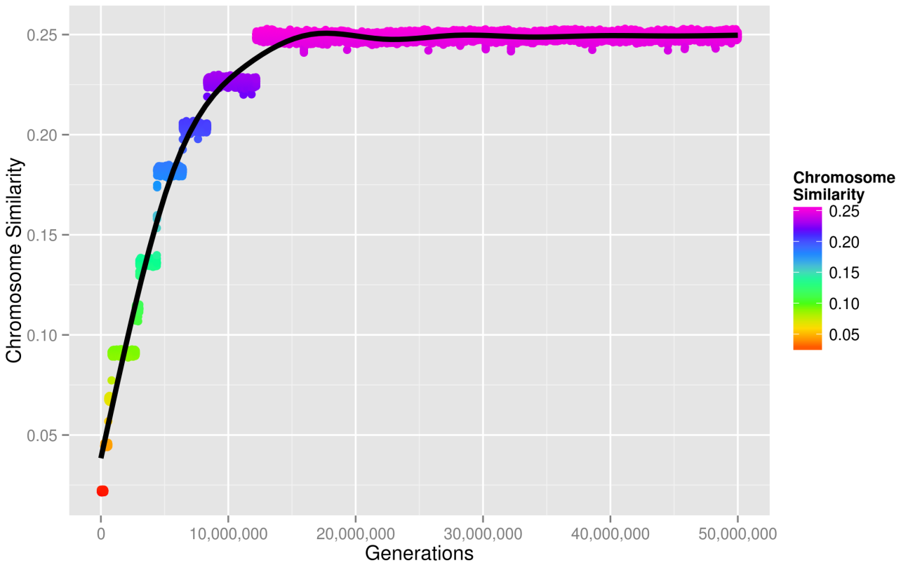
Exploring Fixed Mutation (Traditional GA) and Chromosome Similarity
The similarity over generations of the most optimal fixed mutation rate, M_{c} = 0.65, is shown.
Similarity is not controlled here.
Over generations, similarity tends toward 25% ± 1% in this example.

Slide 37


Slide 38
Conclusions
Controlling chromosome similarity strikes a balance between convergence, exploration and exploitation.
Evidence: self-adaptive method performs consistently better for both Objective A and Objective B, for N ≥ 15.
Controlling similarity allows GA to produce better results, faster – especially with larger problem sizes.

Slide 39
Conclusions
As the problem size increases, controlling similarity produces more results overall;
Traditional GA seems to either get ‘stuck’ (low M_{c}), or randomly walk the landscape (high M_{c}).
  Low Mc results in too low diversity, consistently high similarity.
  High Mc results in too high diversity, consistently low similarity.
Controlling similarity allows us to have a more consistent traversal of the problem landscape, with more optimal mutation characteristics overall.

Slide 40
Special Thanks
Dr. Shahryar Rahnamayan
Canadian Shared Hierarchal Academic Research Computing Network (SHARCNET)
  Provided high performance computing facility for our research.

Slide 41
Question and Answer Period

Slide 42
Thank you.

Slide 43
GA Parameters
Variable | Value
Similarity Threshold (S_{t}) | 15%
Adaptive Mutation Bounds (M_{a}) | [1,99]
Adaptive Mutation Increment/Generation (M_{aΔ}) | 1
Crossover Probability (P_{crossover}) | 70%
Cloning Probability (P_{cloning}) | 30%
Adaptive Mutation Probability (P_{adaptive}) | Variable
Population Size (P) | 64
Self-adaptive GA parameters are highlighted in yellow.

