Slide 1
Automated Marking System (AMS)
Joseph Heron, Jonathan Gillett, Khalil Fazal, Daniel Smullen

Slide 2
Client/Problem Definition
Dr. Eyhab Al-Masri
  Frustrated, looking for an alternative to MarkUs.
For UOIT early-year programming courses.
  Can also be used for more advanced courses, provided the assignment requirements are simple input/output tasks.
Need a system that works with C/C++.
  Extensible to other languages.
Large classrooms, many assignments, frequent submissions.
Perfect opportunity for software as a service.

Slide 3
The Competition (Why MarkUs is Terrible)
Slow
  Basic queries take >1min to execute. Unacceptable!
Convoluted
  Grades output is unsorted, does not include student names, missing important data.
  Takes hours to manually sort and re-input this data into Blackboard.
  Wastes professors’ and TA’s time.
Bloated Features
  Subversion storage back-end? Nobody uses this.
  Forming groups? Nobody uses this.
  Subversion client commits for upper-year courses, disabling web upload? Insane!
Unfixed Bugs
  Assignment code output as un-escaped text directly in the page? Rookie Mistake!
  Screwy deadlines and submission dates.
Ported (poorly) from TurboGears/Python
30+ contributors, totally fragmented, totally disorganized.
But at least it’s open source…

Slide 4
What is AMS?
Direct competitor to MarkUs for UOIT.
Built from scratch with Rails.
Allows professors to disseminate C++ programming assignments to students.
  Automatic cheating detection.
  Validation and code quality analysis.
  Lets professors set their own parameters for marking, and the system does the rest.
Allows students to submit assignments for grading.
  Built in unit testing framework pre-submission.
  Instant feedback.
  Useful feedback.
Simple, fast, easy to use.

Slide 5
AMS Main System Components
Frontend
Rails
Views
Controllers
Twitter Bootstrap
jQuery
Backend
g++
CPPcheck
sim_c
AppArmor
SQLite 3
Assignment Code Compilation
Static Code Analysis
Cheating Detection
Protected Environment for Dynamic Analysis
Database
jQuery-File-Upload
Font-Awesome
Glyphicons

Slide 6
AMS General Workflow
Assignment Creation
Professors:
Assignment Dissemination
Students:
Automated Marking
Students:
Assignment Descriptions
Unit Tests
Evaluation Tests
Marking Parameters
Get feedback from unit tests.
Submit assignments.
Feedback and Administration
Students:
Get feedback from unit tests, analysis.
Professors:
Grades, class statistics
Cheating Detection
Work on assignments.

Slide 7
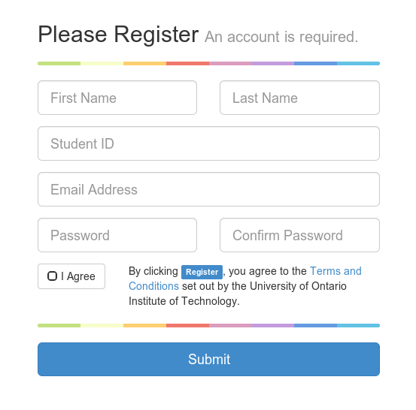
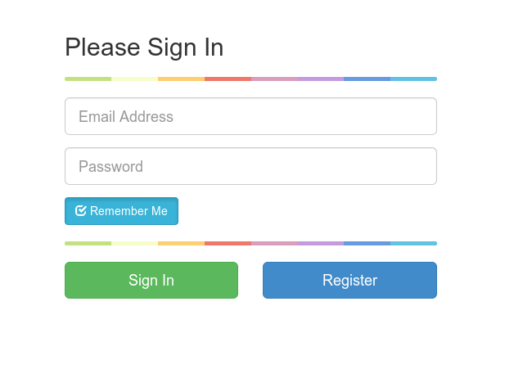
Logging In

Slide 8
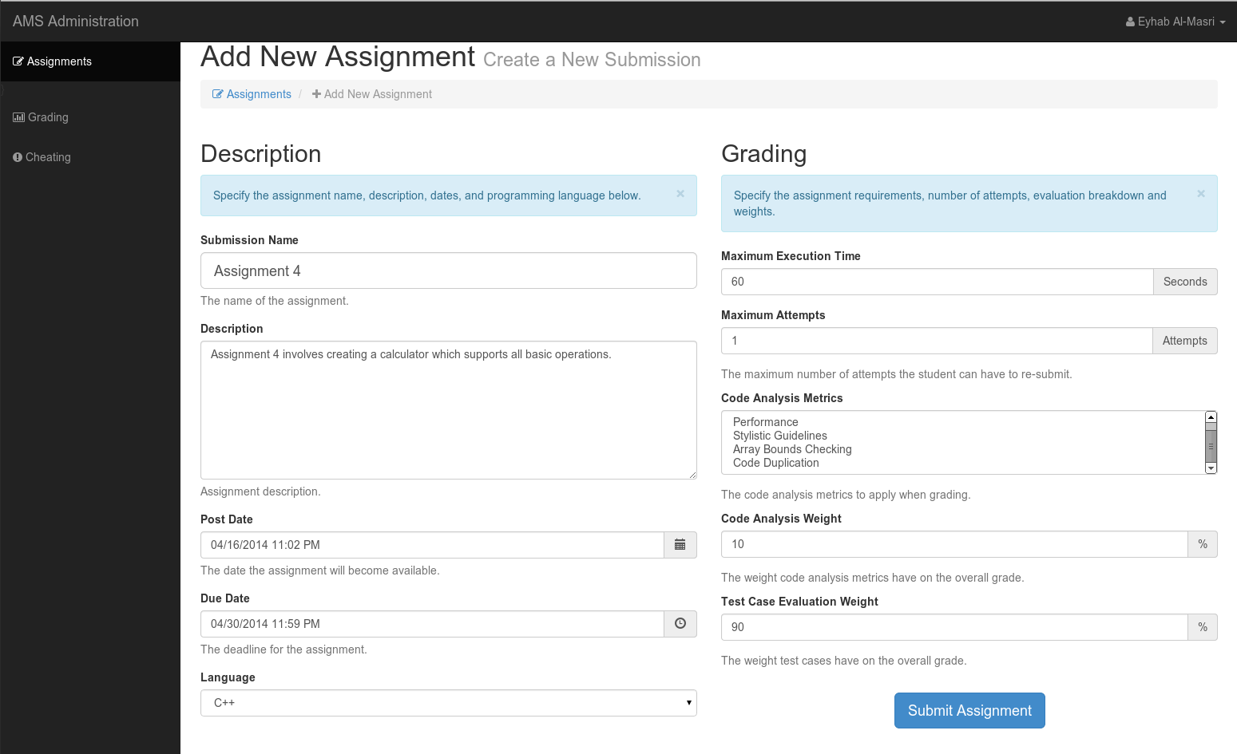
Assignment Creation

Slide 9
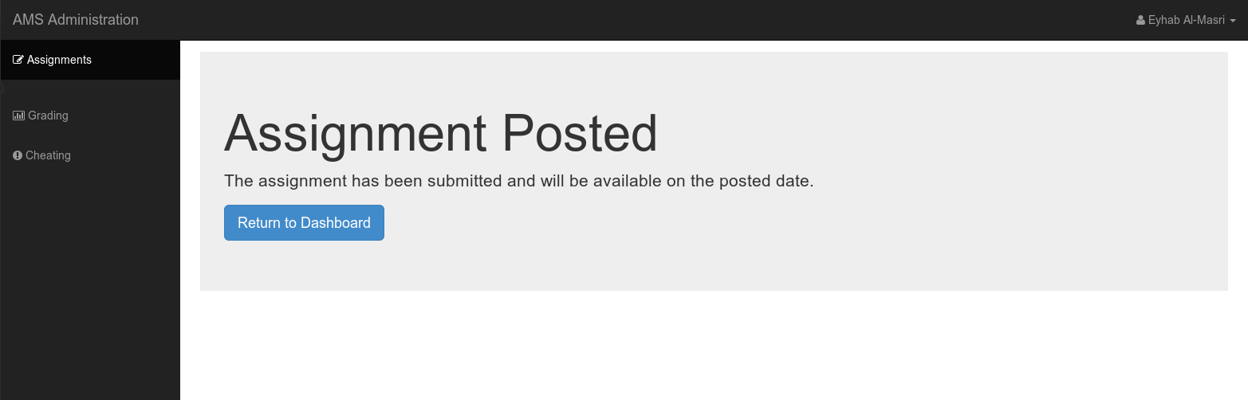
Assignment Dissemination

Slide 10
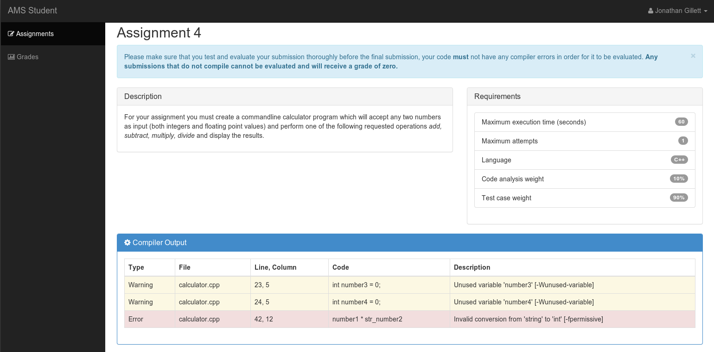
Automated Marking

Slide 11
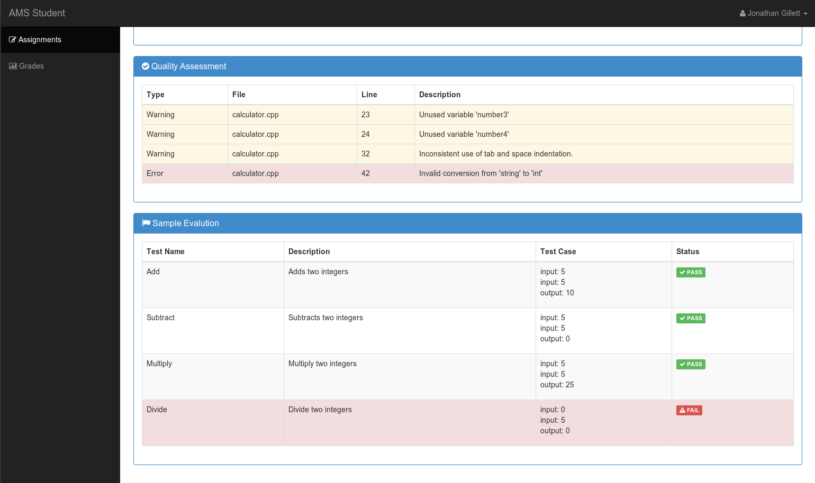

Slide 12
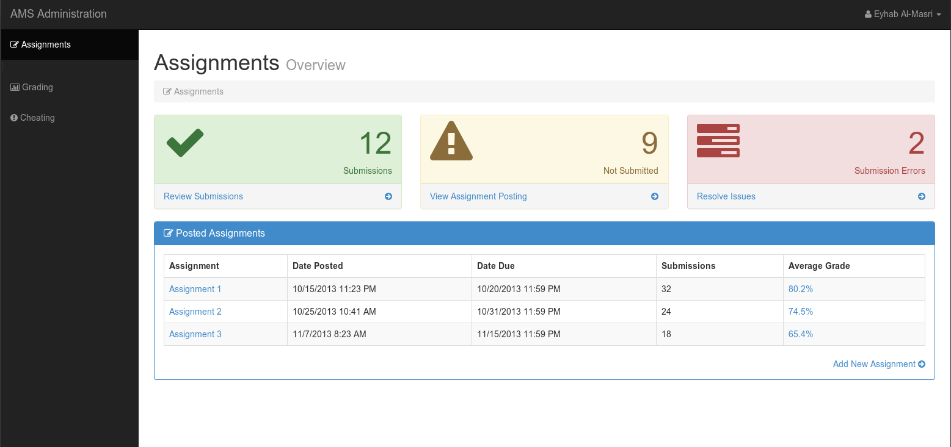
Feedback and Administration

Slide 13
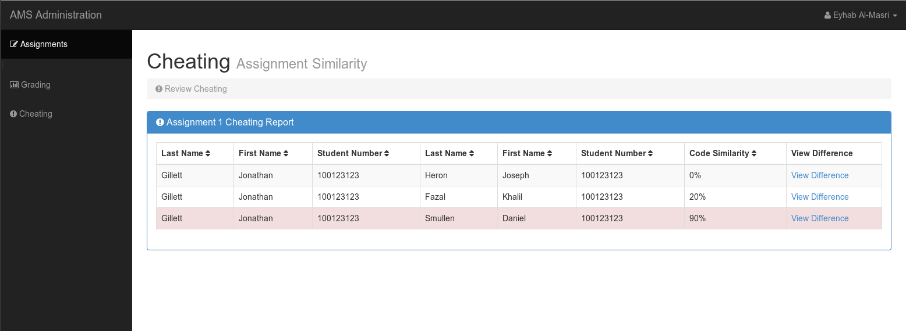
Feedback and Administration

Slide 14
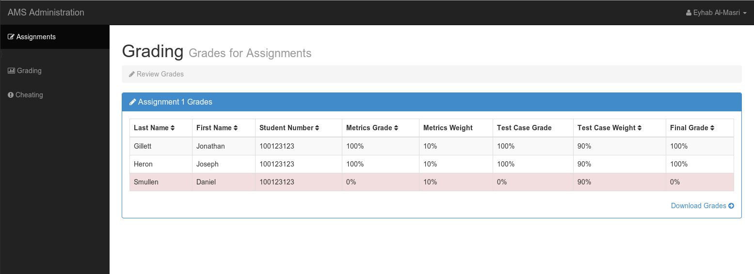
Feedback and Administration

Slide 15
Technical FAQ

Slide 16
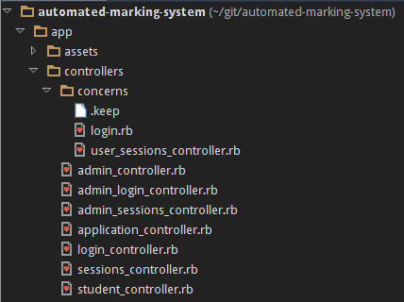
How did we get Rails to use each directory?
Controllers Folder
  Contains controller classes.
  Their methods are called according to config/router.rb

Slide 17
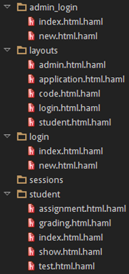
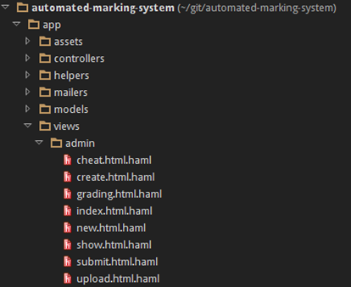
How did we get Rails to use each directory?
Views Folder
  Contains HAML files.
  On page load, they are compiled into HTML files.

Slide 18
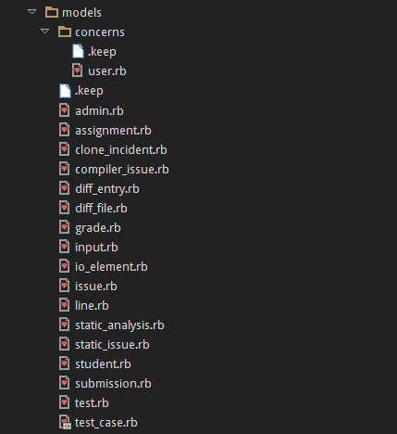
How did we get Rails to use each directory?
Models Folder
  Contains model classes.
  An interface used to generalize common behaviors of persistent storage.
  Each model corresponds to a table in the SQLite database.

Slide 19

Which parts of the Rails framework were modified to fit with AMS?
We didn’t modify any part of the Rails framework, we just used it as-is.
We used Rails to manage our own custom controllers, helpers, models, and views.

Slide 20
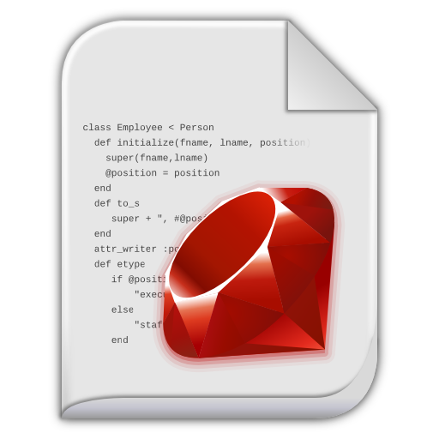
Were any new routes added?
Yes, each new method we added corresponds to an entry in the routes file.

Slide 21
What actions (methods) were added to the controllers file?
How were CRUD operations used?
Default login logic for non-administrative users.
Two main routes:
  Load default login page, captured by login#index
  Create a new user account, captured by login#new then login#create for the account creation.
CRUD:
  Read, to check credentials.
  Create, to generate new accounts.
Login

Slide 22
What actions (methods) were added to the controllers file?
How were CRUD operations used?
Same underlying logic as default login page, but handles administrators instead of ordinary users.
Two main routes:
  Load default login page, captured by admin_login#index
  Create a new user account, captured by admin_login#new then admin_login#create for the account creation.
CRUD:
  Read, to check credentials.
  Create, to generate new accounts.
Administrative Login

Slide 23
What actions (methods) were added to the controllers file?
How were CRUD operations used?
Handles regular users’ login session cookies.
  Login is captured by sessions#create.
  Logout is captured by sessions#destroy.
Same logic for administrative users.
  Login is captured by admin_sessions#create.
  Logout is captured by admin_sessions#destroy.
CRUD:
  Delete, when destroying sessions on logout.
Session Handling

Slide 24
What actions (methods) were added to the controllers file?
How were CRUD operations used?
After login, students can see their main submission dashboard.
Display is captured by student#index.
CRUD:
  Read, to read previous assignments’ data from the database.
Main Student Dashboard

Slide 25
What actions (methods) were added to the controllers file?
How were CRUD operations used?
After a submission has been uploaded, this enables students to review the submission contents.
Captured by student#show.
CRUD:
  Read, to read and show the submission data.
Showing a Submission’s Code File

Slide 26
What actions (methods) were added to the controllers file?
How were CRUD operations used?
When an assignment is selected from the listed assignments, this shows the information about it.
Captured by student#assignment.
CRUD:
  Read, to read assignment data from the database.
Assignment Dashboard

Slide 27
What actions (methods) were added to the controllers file?
How were CRUD operations used?
When a student clicks the upload button to upload the submission, this uploads the submission contents to the server.
Captured by student#submission.
CRUD:
  Create, to upload submission contents to a new row in the database.
Submission Upload

Slide 28
What actions (methods) were added to the controllers file?
How were CRUD operations used?
When an assignment is selected, this shows the student's grades.
Captured by student#grading.
CRUD:
  Read, to read stored grades from the database.
Grading Display

Slide 29
What actions (methods) were added to the controllers file?
How were CRUD operations used?
When a student submits their assignment for unit testing, this shows the test output.
Captured by student#test.
CRUD:
  Create, if the unit tests have never been run on this assignment. We will create a new row and store the results.
  Update, if the unit tests have been already run.
Unit Testing

Slide 30
What actions (methods) were added to the controllers file?
How were CRUD operations used?
When a student clicks the submit button after reviewing their submission, this executes the submission process.
Captured by student#submit.
CRUD:
  Create, to create a new entry for the assignment on the database.
Submitting an Assignment

Slide 31
What actions (methods) were added to the controllers file?
How were CRUD operations used?
After logging in, administrators are shown the main AMS dashboard.
Captured by admin#index.
CRUD:
  Read, to read the previously posted assignments’ data from the database.
Administrator Dashboard

Slide 32
What actions (methods) were added to the controllers file?
How were CRUD operations used?
When an administrator chooses to create a new assignment, this brings up the creation forms.
Captured by admin#new.
CRUD:
  Nothing to speak of. This is just displaying a form.
New Assignment Creation

Slide 33
What actions (methods) were added to the controllers file?
How were CRUD operations used?
When an administrator chooses to view the grade breakdown for a specific assignment, the corresponding assignment information is displayed.
Captured by admin#grading.
CRUD:
  Read, reads the class’ grades from the database.
Reviewing Class Grades Breakdown

Slide 34
What actions (methods) were added to the controllers file?
How were CRUD operations used?
When an administrator chooses to display the table of detected cheating statistics, the statistics breakdown is shown.
Shows the probability/likelihood of cheating, for each student, for each assignment.
Captured by admin#cheat.
CRUD:
  Read, reads computed cheating statistics from the database.
Reviewing Detected Cheating Instances

Slide 35
What actions (methods) were added to the controllers file?
How were CRUD operations used?
When an administrator chooses to review an assignment that has been posted previously, the details are displayed.
Captured by admin#show.
CRUD:
  Read, reads previously posted assignment data from the database, based on it’s ID.
Showing Previously Posted Assignments

Slide 36
What actions (methods) were added to the controllers file?
How were CRUD operations used?
Used for adding a new assignment to the database.
Captured by admin#create.
CRUD:
  Create, creates a new assignment entry in the database to store the assignment data.
Posting a New Assignment

Slide 37
What actions (methods) were added to the controllers file?
How were CRUD operations used?
Used for bulk uploading test cases, in YAML, to the database.
Captured by admin#upload.
CRUD:
  Create, uploads the YAML file to the database for parsing and retrieval later.
Uploading Test Cases

Slide 38
What actions (methods) were added to the controllers file?
How were CRUD operations used?
Used to generate a new assignment and disseminate it to students by uploading it to the database.
Captured by admin#submit.
CRUD:
  Create, uploads the submission form contents to the database and stores it.
Submitting an Assignment for Students to Access

Slide 39
How were Events and Callbacks used in AMS?
admin.js
student.js
Event handlers and callbacks.
  File uploading operations.
  Display the YAML help and documentation.
Event handlers and callbacks.
  Provide a confirmation dialog when students are submitting assignments for unit testing.
  Provide a confirmation dialog when students are submitting assignments for final submission.

Slide 40
How did we use AJAX in AMS?
Uses AJAX
Used to upload files.
  Assignment Submissions
  Test Cases
File Upload widget with multiple file selection, drag & drop support and progress bar for jQuery.
Supports cross-domain, chunked, and stop/resume file uploads.
Works with any server-side platform (PHP, Python, Ruby on Rails, Java, Node.js, Go etc.) that supports standard HTML form file uploads.
jQuery-File-Upload

Slide 41

What additional tools/technologies were used?
Twitter Bootstrap
  Shiny user interface.
  Apache License v2.0
Font-Awesome
  Shiny fonts.
  Designed for Bootstrap.
  MIT License
Glyphicons
  Monochromatic icons and symbols.
  CC-BY 3.0 License
jQuery-File-Upload
  MIT License

Slide 42
Q&A Period

