Slide 1

What Sequence objects are (and Are Not)
Louis Davidson
louis@drsql.org

Slide 2
A Candidate for the prize for the World’s Longest Presentation (on the world’s Smallest Topic)
Louis Davidson
louis@drsql.org

Slide 3
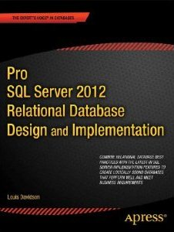
Who is this guy?
Been in IT for over 17 years
Microsoft MVP For 7 Years
Written five books on database design
Ok, so they were all versions of the same book. They at least had slightly different titles each time
Worked for Christian Broadcasting Network for nearly 15 years.
Notes:
These two quote kind of sum up my philosophies. The first one in a bad way, the second in a good way.
When I program in a foreign language, like VB.NET, I am a hacker. So I go for the simplest solution and don’t care. If the solution seems right, it is in my opinion. But when I see well written VB code, it is beautiful. I have pretty much only written a few CLR functions over the past year, and an app to imitate SQLCMD in some ways for handling long string output. The habits I am forming with VB coding are passive in nature. I barely notice that I have any habits, much less attempt to build proper VB.
On the other hand, with SQL, I actively care about my design, and my code, and I try to share my ideas with others. I learned quickly that in order to have a chance of my non standard view of being accepted, I had to understand the standards (like using identities for keys, an oft debated topic.). Now I am no PHD in CS, but I researched and have a couple of books on the subject now in my quest for practical understanding.

Slide 4
Sequence Objects are:
Whole Number Generators
Additive progression next value = current value + factor
Objects
They are schema owned objects.
They have standard permissions (GRANT UPDATE)
Guaranteed to generate a value in order
With cycles if desired 0, 1, 2, 3, 0, 1, 2, 3, 0, …

Slide 5
Sequence Objects are:
Far less limited in their use as opposed to identities
In a table, identity property limited to 1 column, you can have > 1 column with a default using a sequence
Identity property applicable only to table column
A reasonable replacement for identity generated values
Far more flexible
Can be added to column after creation, and removed from column anytime
Column values will are updatable
Tunable – knobs available to tune how values are cached

Slide 6
Sequence Objects are not:
Usable exactly like identity property
No way to get the last one used in scope
Doesn’t automatically skip defaulted column in INSERT
“Naked” insert - INSERT tablename VALUES (1,2)
The table metadata will not know about the sequence
No special syntax for working with identity column in a table ( SELECT IDENTITYCOL FROM tablename )
A direct replacement for:
A numbers table
ROW_NUMBER() windowing function

Slide 7
Sequence Objects are not:
Available as a temporary object
Subject to “Normal” Transactions
Uses locks for concurrency, but not held in any isolation level beyond allocating next value
Allows for highly concurrent usage
Every value generated is lost even if ROLLBACK
Exception: ALTER SEQUENCE in transaction will block:
Users of that sequence
Other SEQUENCE creates/alters too
Slower than identity generated values
Performance characteristics directly tied to caching and need to persist metadata

Slide 8
Identity syntax and management overview

Slide 9
CREATE TABLE <tableName> (
<columname> int NOT NULL IDENTITY(<start>,<increment>)
All parameters set at table create (or when adding an identity column using ALTER TABLE)
Management tied directly to the table
Get recently entered value using one of the following
SCOPE_IDENTITY() – Within current execution scope
@@IDENTITY – In current session
IDENT_CURRENT('tablename’) – On any session (even someone else’s)
To insert values manually, need: SET IDENTITY_INSERT <tablename> ON …. SET IDENTITY_INSERT <tablename> OFF

Slide 10
Identity management
IDENT_INCR('<tablename>‘) gets increment
IDENT_SEED('<tablename>') gets the original seed
IDENT_CURRENT('<tablename>') gets the current identity value across connections
$IDENTITY can be used in query instead of identity column name
Removing data from table
DELETE leaves identity value alone
TRUNCATE TABLE resets the value to the original seed
DBCC CHECKIDENT to reset/fix values
Cannot change the increment without dropping and recreating column

Slide 11
Sequence syntax and management overview

Slide 12
CREATE SEQUENCE [schema_name . ] sequence_name [ AS DATATYPE] [ START WITH <constant> ] [ INCREMENT BY <constant> ] [ { MINVALUE [ <constant> ] } | { NO MINVALUE } ] [ { MAXVALUE [ <constant> ] } | { NO MAXVALUE } ] [ CYCLE | { NO CYCLE } ] [ { CACHE [ <constant> ] } | { NO CACHE } ]
All parameters must be constants
No variables
Frustrating, but can use dynamic SQL

Slide 13
CREATE SEQUENCE [schema_name . ] sequence_name [ AS DATATYPE] [ START WITH <constant> ] [ INCREMENT BY <constant> ] [ { MINVALUE [ <constant> ] } | { NO MINVALUE } ] [ { MAXVALUE [ <constant> ] } | { NO MAXVALUE } ] [ CYCLE | { NO CYCLE } ] [ { CACHE [ <constant> ] } | { NO CACHE } ]
DATATYPE
Bigint, Int, SmallInt, TinyInt, Numeric(N,0)
For numeric, must have scale of 0
Can also be an alias type that is based on one of these types
Datatype by default is bigint

Slide 14
CREATE SEQUENCE [schema_name . ] sequence_name [ AS DATATYPE]
[ START WITH <constant> ] [ INCREMENT BY <constant> ] [ { MINVALUE [ <constant> ] } | { NO MINVALUE } ] [ { MAXVALUE [ <constant> ] } | { NO MAXVALUE } ] [ CYCLE | { NO CYCLE } ] [ { CACHE [ <constant> ] } | { NO CACHE } ]
START WITH
Tells the sequence where to start
Default is to start with the minimum value for datatype (includes negative values)
Note for column compression, min/max datatype values compress less than small numbers

Slide 15
CREATE SEQUENCE [schema_name . ] sequence_name [ AS DATATYPE] [ START WITH <constant> ] [ INCREMENT BY <constant> ] [ { MINVALUE [ <constant> ] } | { NO MINVALUE } ] [ { MAXVALUE [ <constant> ] } | { NO MAXVALUE } ] [ CYCLE | { NO CYCLE } ] [ { CACHE [ <constant> ] } | { NO CACHE } ]
INCREMENT BY
Tells the sequence how much to add to value to get next value
Positive or negative values allowed

Slide 16
CREATE SEQUENCE [schema_name . ] sequence_name [ AS DATATYPE] [ START WITH <constant> ] [ INCREMENT BY <constant> ] [ { MINVALUE [ <constant> ] } | { NO MINVALUE } ] [ { MAXVALUE [ <constant> ] } | { NO MAXVALUE } ] [ CYCLE | { NO CYCLE } ] [ { CACHE [ <constant> ] } | { NO CACHE } ]
MINVALUE and MAXVALUE
Defines lowest and highest values allowed
Default values of NO MINVALUE or NO MAXVALUE is the minimum and maximum values for the datatype
This is independent of the STARTWITH value, if specified.
When MINVALUE or MAXVALUE is reached, how this is handled is dependent on CYCLE setting

Slide 17
CREATE SEQUENCE [schema_name . ] sequence_name [ AS DATATYPE] [ START WITH <constant> ] [ INCREMENT BY <constant> ] [ { MINVALUE [ <constant> ] } | { NO MINVALUE } ] [ { MAXVALUE [ <constant> ] } | { NO MAXVALUE } ] [ CYCLE | { NO CYCLE } ] [ { CACHE [ <constant> ] } | { NO CACHE } ]
CYCLE
CYCLE indicates that when MAXVALUE (or MINVALUE for negative INCREMENT BY value) is reached, it will loop back to the min or max value, depending on the INCREMENT BY VALUE

Slide 18
CREATE SEQUENCE [schema_name . ] sequence_name [ AS DATATYPE]
[ START WITH <constant> ] [ INCREMENT BY <constant> ] [ { MINVALUE [ <constant> ] } | { NO MINVALUE } ] [ { MAXVALUE [ <constant> ] } | { NO MAXVALUE } ] [ CYCLE | { NO CYCLE } ] [ { CACHE [ <constant> ] } | { NO CACHE } ]
CACHE
Allows you to performance tune the number of pre-calculated values to make available
Can make a large difference
Default does caching, amount controlled by SQL Server
One value (the next un-cached value) is stored to disk, all other values persisted in ram. Value will be restored during a restore of a backup.
Next slide shows extended event for capturing when metadata flushed

Slide 19
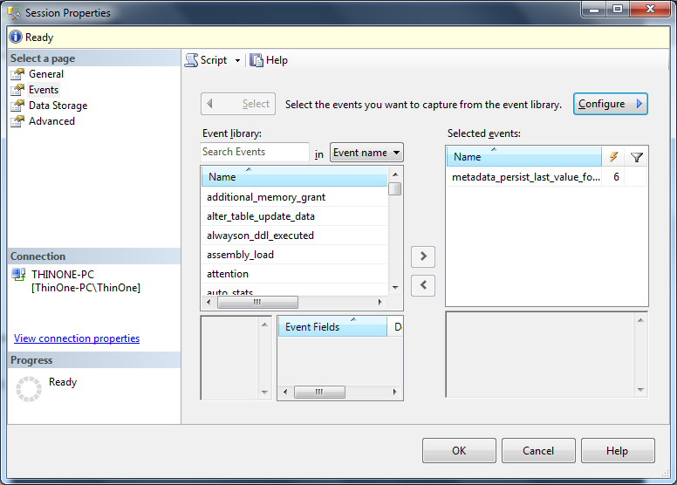
Extended Events: Metadata Writes

Slide 20
Naming
Sequences are schema bound objects
Eg. Mustn't be named the same as any table, view, procedure, function, etc. in the same schema
My naming standard is to name them: [<object>]_[purpose]_SEQUENCE
Example: For surrogate key of table "Fred“: Fred_SEQUENCE, Fred_NotKey_SEQUENCE, WholeSystemOrderingValue_SEQUENCE
SELECT * FROM sys.objects WHERE type_desc = 'SEQUENCE_OBJECT'
SELECT * --objects columns plus FROM sys.sequences

Slide 21
Fetching value from Sequence OBJECT
NEXT VALUE FOR function
Example:
SELECT NEXT VALUE FOR SchemaS.Sequence FROM SchemaT.Table
Evaluated once per row
Limited usage … No usage in:
Queries with SET operators: UNION, UNION ALL
CASE Expressions
Queries with ORDER BY without OVER clause on NEXT VALUE FOR call
Etc.
Can be used in a function call:
SchemaF.FunctionName(NEXT VALUE FOR SchemaS.Sequence)

Slide 22
ALTER SEQUENCE [schema_name . ] sequence_name [ AS [ built_in_integer_type | user-defined_integer_type ] ] [ RESTART [ WITH <constant> ] ] [ INCREMENT BY <constant> ] [ { MINVALUE [ <constant> ] } | { NO MINVALUE } ] [ { MAXVALUE [ <constant> ] } | { NO MAXVALUE } ] [ CYCLE | { NO CYCLE } ] [ { CACHE [ <constant> ] } | { NO CACHE } ]
Pretty much the exact same syntax as the CREATE SEQUENCE statement
Tons of control over settings even after object is creating

Slide 23
ALTER SEQUENCE [schema_name . ] sequence_name [ AS [ built_in_integer_type | user-defined_integer_type ] ] [ RESTART [ WITH <constant> ] ] [ INCREMENT BY <constant> ] [ { MINVALUE [ <constant> ] } | { NO MINVALUE } ] [ { MAXVALUE [ <constant> ] } | { NO MAXVALUE } ] [ CYCLE | { NO CYCLE } ] [ { CACHE [ <constant> ] } | { NO CACHE } ]
RESTART lets you reset the sequence, starting at a given point.
If WITH is left off, goes back to value it was started with (or last restart value)

Slide 24
Inserting large numbers of rows
You can allocate multiple rows at a time
Use sp_sequence_get_range
EXEC sp_sequence_get_range @sequence_name = N'Demo.SalesOrder_SEQUENCE' , @range_size = Number , @range_first_value = @range_first_value OUTPUT , @range_last_value = @range_last_value OUTPUT , @sequence_increment = @sequence_increment OUTPUT;
Be careful with the math.. Remember increment if trying to match singleton usage

Slide 25
Typical Usage Patterns

Slide 26
Typical Usage patterns
Surrogate key generation (#1 by far!)
Simply instead of identity
Allows client to gen their own numbers
Great for data warehouse loads
Hash bucket (using multiple sequences in same statement/table)
Basis for generating complex identifiers
Multiple tables with the same value
Database wide version number
Numbering “actions” (not as surrogate)
Can fill gaps later before processing
“Interesting” progression of values
1,-1,2,-2,3,-3, …

Slide 27
Artificial/Surrogate Key Generation
Most (not all!) usage will be to create an artificial surrogate key for a table, for performance purposes
When used this way the goal should be to hide the value of the key from the user.
Gaps should be ignored
It is a very widely used pattern that almost every table gets a one column surrogate key.
I feel it necessary to caution you that the meaning of “surrogate” is a stand in, not a replacement
All tables should have some form of natural key (more or less a value that has meaning to the user)

Slide 28
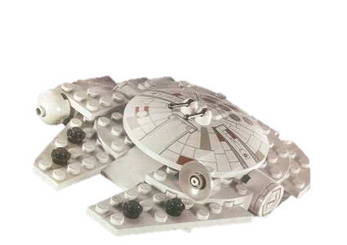
Artificial Key Generation
Requirement: Table of Lego Sets
Always find some other key to protect against duplicate data so you don’t end up with
~~~~~~~~~~~
LegoSetId Name =========== ----------- 1 M Falcon 4567 M Falcon 979796 M Falcon
Scale -----------
Minifig Micro Minifig
SetNumber -----------
7965 4488 10179
LegoSetId Name Scale SetNumber =========== ----------- ------------ ------------- 1 M Falcon Minifig 4488 4567 M Falcon Minifig 4488 979796 M Falcon Minifig 4488

Slide 29
Typical Coding Patterns
Identity and sequences have slightly different usage patterns making usage slightly different
With sequences if you want to know the value inserted, you generate the value manually and use it in the INSERT clause
For identities, we ask afterwards

Slide 30
Identity Usage Patterns
INSERT TableName (NonIdentityColumns) VALUES ('Some Value'); DECLARE @NewValue int = SCOPE_IDENTITY(); INSERT RelatedTableName (TableNameId) VALUES (@NewValue);

Slide 31
Sequence Usage Pattern
DECLARE @NewValue int = (NEXT VALUE FOR Seq);
INSERT TableName (TableNameId, NonIdentityColumns) VALUES (@NewValue, 'Some Value'); INSERT RelatedTableName (TableNameId) VALUES (@NewValue);

Slide 32
“Safe” Method
DECLARE @AltKeyValue CHAR(6) = 'VALUE1'
INSERT TableName (AltKeyValue, NonIdentityColumns) VALUES (@AltKeyValue, 'Some Value');
DECLARE @NewValue int =
(SELECT TableNameId FROM TableName WHERE AltKeyValue = @AltKeyValue)
INSERT RelatedTableName (TableNameId) VALUES (@NewValue);

Slide 33
Output Clause Works for both
Assuming your table qualifies, can get the new values from INSERT statement directly
However, there are limitations that make the output clause less desirable due to changes in structures causing issues. (http://msdn.microsoft.com/en-us/library/ms177564.aspx).
Examples: in the DML statement:
The target table 'Demo.InvoiceLineItem' of the DML statement cannot have any enabled triggers
You can’t reference local partitioned views, distributed partitioned views, or remote tables.
You can’t have subqueries or user-defined functions that perform user or system data access, or are assumed to perform such access. User-defined functions are assumed to perform data access if they are not schema-bound.

Slide 34
Demos Some I will do, and more for you to play with later! Download Latest Slides and Code http://www.drsql.org/Pages/Presentations.aspx

