Slide 1


Foundations: The Language of Anatomy and Body Organization
FOCUS: HUMAN ANATOMY
The anatomy portion of the course. In a combined class, this pairs with the physiology unit. Dr. Sharilyn Rennie
Scan for the interactive page
Download the .pptx and accessible PDF from Canvas or the course repo.

Slide 2
Definitions and Framing
Part 1
Anatomy gives us the words; physiology is what those structures do. Change the structure and you change the function.

Slide 3
How an anatomist thinks
FOCUS: HUMAN ANATOMY · FOUNDATIONS
Anatomy is the study of structure: what a part is, where it sits, and what it connects to.
Physiology is the study of function: what that structure does and how it works.
Core idea: structure determines function. When anatomy changes, physiology changes with it.

Slide 4
From structure to the clinic
FOCUS: HUMAN ANATOMY · FOUNDATIONS
Disease: a defined process with a known mechanism.
Disorder: a disruption of normal function; mechanism not always single or known.
Sign: objective, measurable by someone else (fever, swelling, a lab value).
Symptom: subjective, reported by the patient (pain, nausea, fatigue).
Exam findings: what the clinician sees, feels, or hears.
Labs and imaging: structure and function measured directly.

Slide 5
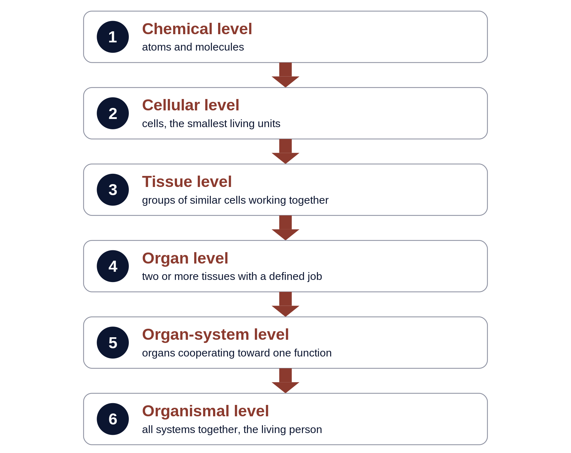
Levels of structural organization
FOCUS: HUMAN ANATOMY · FOUNDATIONS

Slide 6
Body Regions, Position, and Direction
Part 2
One agreed starting position, one set of planes, and paired directional terms let any two people describe the same spot the same way.

Slide 7
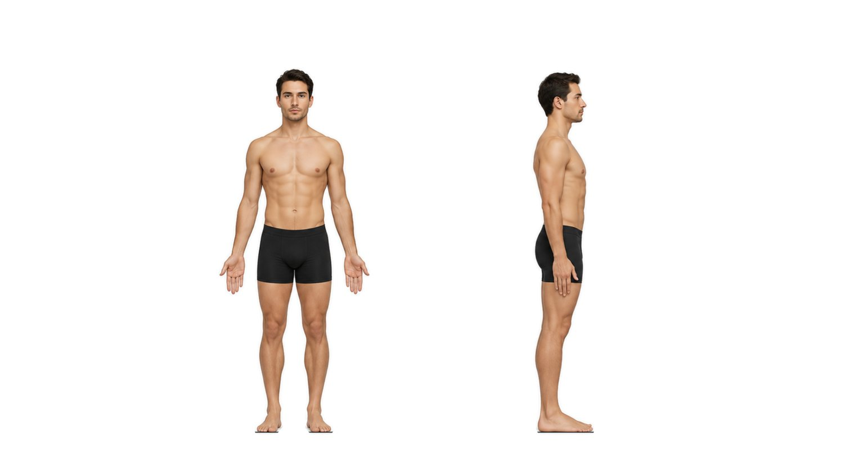
Anatomical position
FOCUS: HUMAN ANATOMY · FOUNDATIONS
Anatomical position: body erect, feet flat and slightly apart, head and eyes forward, arms at the sides, palms forward.
Why it matters: every directional term assumes this position.
Supine: lying face up. Prone: lying face down.

Slide 8
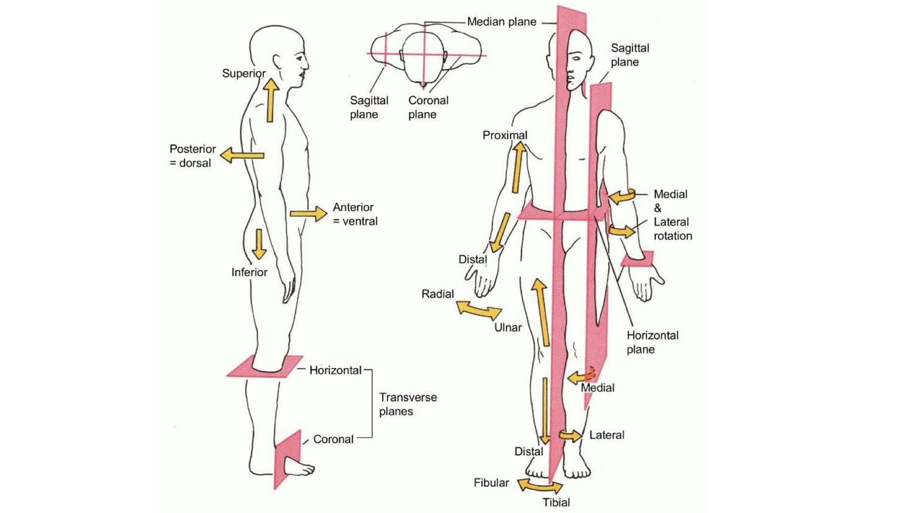
Body planes and sections
FOCUS: HUMAN ANATOMY · FOUNDATIONS
Sagittal: right and left parts; midsagittal gives equal halves.
Frontal (coronal): anterior and posterior parts.
Transverse (horizontal): superior and inferior parts.
Oblique: any angle other than 90 degrees.

Slide 9
Directional terms come in pairs
FOCUS: HUMAN ANATOMY · FOUNDATIONS
Superior / Inferior: above versus below.
Anterior (ventral) / Posterior (dorsal): front versus back.
Medial / Lateral: toward versus away from the midline.
Proximal / Distal: nearer versus farther from the trunk.
Superficial / Deep: toward versus away from the surface.
Ipsilateral / Contralateral: same versus opposite side.

Slide 10
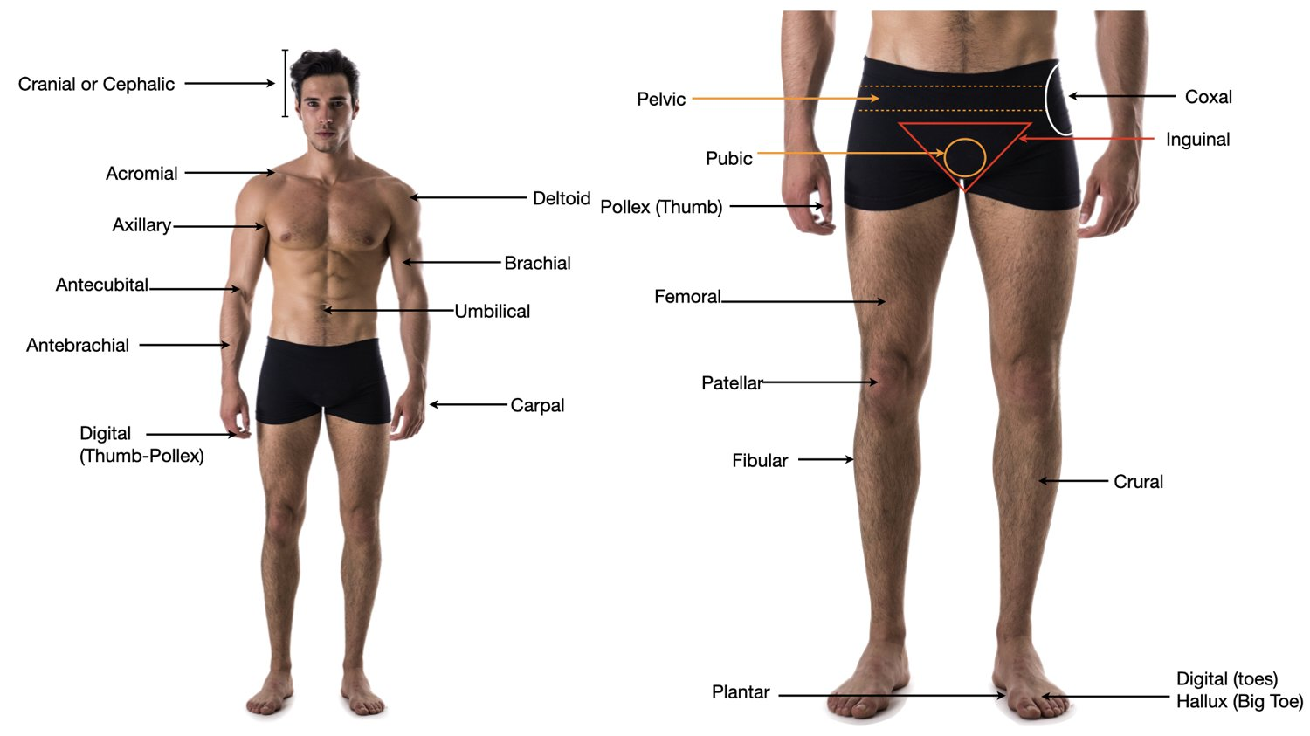
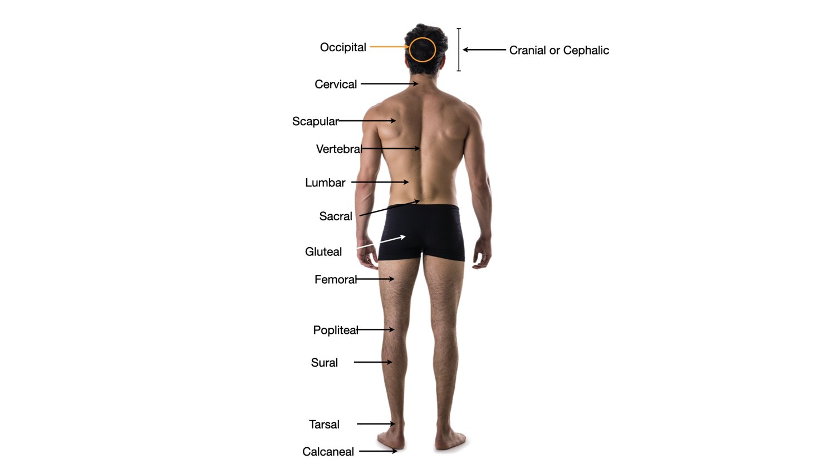
Regional terms: anterior and posterior
FOCUS: HUMAN ANATOMY · FOUNDATIONS

Slide 11
Sorting regions: axial vs appendicular
FOCUS: HUMAN ANATOMY · FOUNDATIONS
Axial (head, neck, trunk): cephalic, cervical, thoracic, sternal, abdominal, umbilical, vertebral, lumbar, sacral, gluteal.
Appendicular (limbs): acromial, brachial, antecubital, antebrachial, carpal, digital, coxal, femoral, patellar, crural, sural, tarsal.
Sort every regional term into one of these two buckets.

Slide 12
Body Cavities and Abdominopelvic Quadrants
Part 3
The organs live inside enclosed spaces. Name the space and you have narrowed down what can go wrong there.

Slide 13
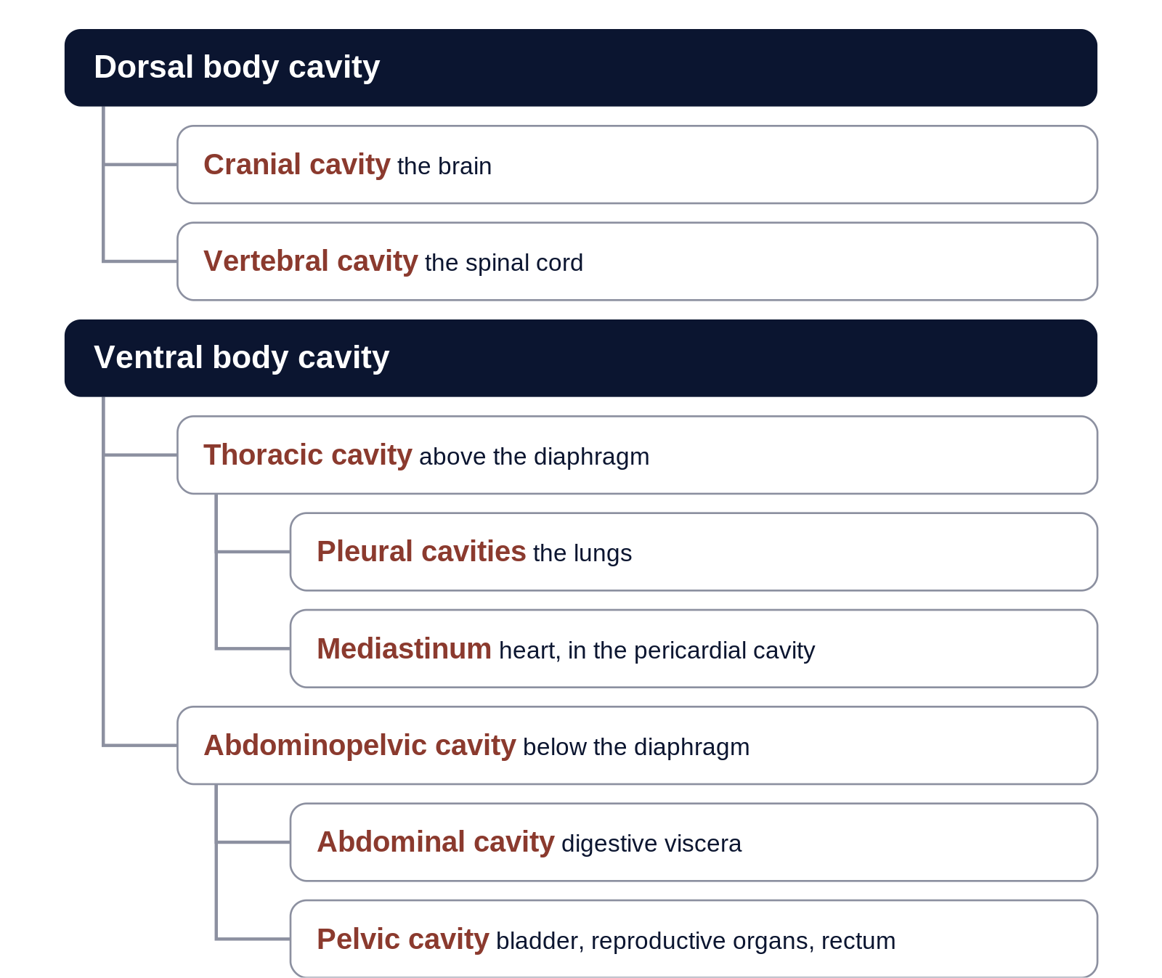
The body cavities
FOCUS: HUMAN ANATOMY · FOUNDATIONS
Dorsal body cavity: cranial cavity (brain) and vertebral cavity (spinal cord).
Ventral body cavity: thoracic and abdominopelvic cavities, split by the diaphragm.
Thorax: two pleural cavities plus the mediastinum; pericardial cavity (heart) within it.
Abdominopelvic: abdominal cavity (digestive viscera) and pelvic cavity (bladder, reproductive, rectum).

Slide 14
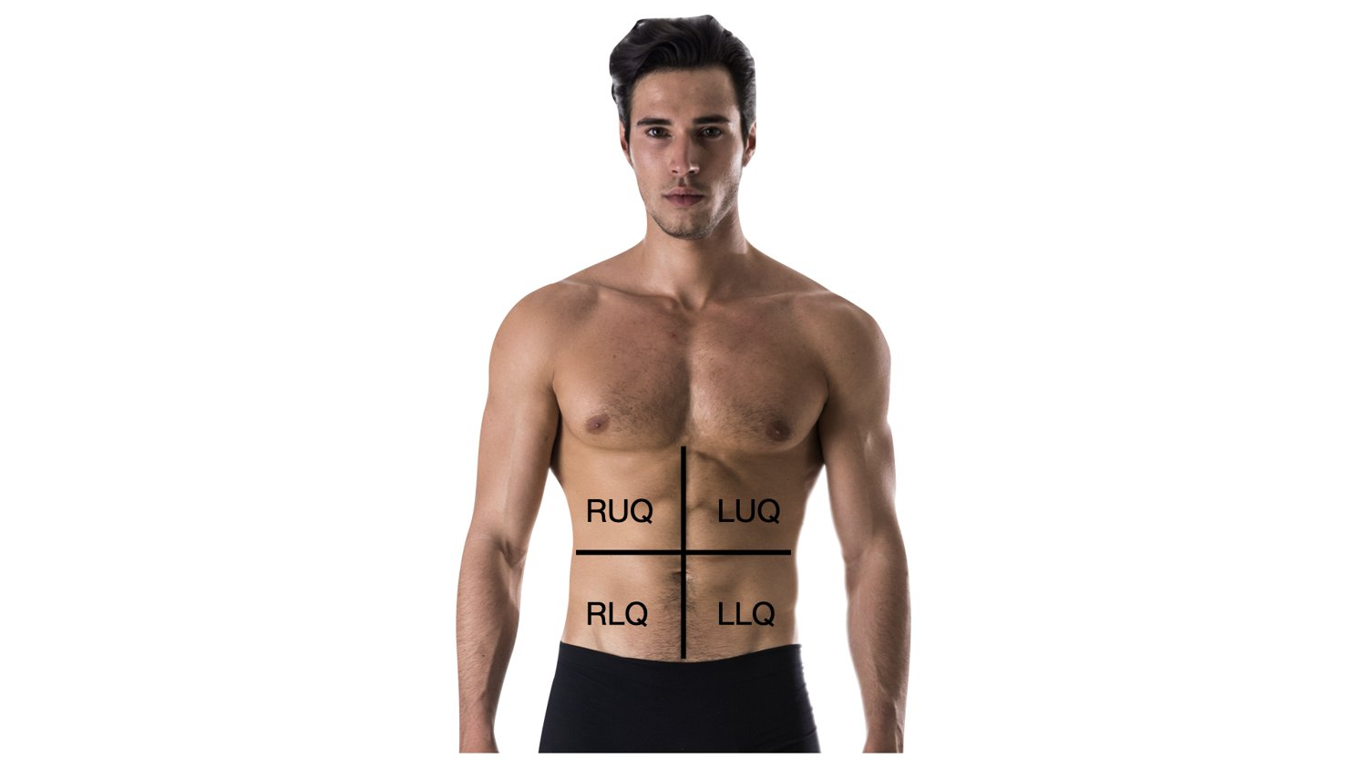
Abdominopelvic quadrants
FOCUS: HUMAN ANATOMY · FOUNDATIONS
Four quadrants through the navel: RUQ, LUQ, RLQ, LLQ. Where it hurts points to the organs there.
RUQ: liver, gallbladder, right kidney, head of pancreas.
LUQ: stomach, spleen, left kidney, tail of pancreas.
RLQ: appendix, cecum, right ovary and ureter.
LLQ: sigmoid and descending colon, left ovary and ureter.

Slide 15
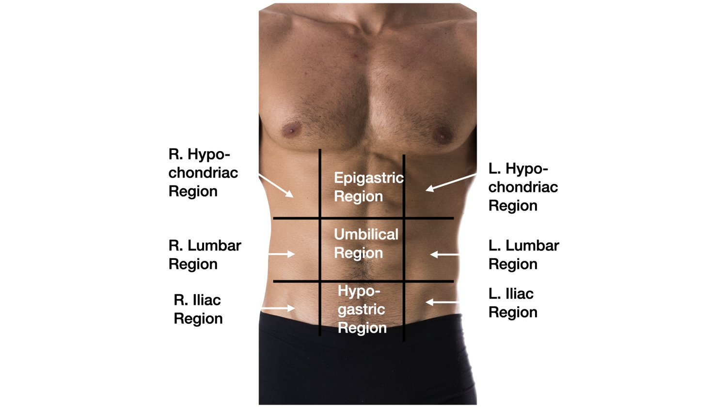
Abdominopelvic regions (nine)
FOCUS: HUMAN ANATOMY · FOUNDATIONS
Top row: right hypochondriac, epigastric, left hypochondriac.
Middle row: right lumbar, umbilical, left lumbar.
Bottom row: right iliac (inguinal), hypogastric (pubic), left iliac (inguinal).
Use when you need to localize more tightly than a quadrant.

Slide 16
The Mediastinum
Part 4
The central compartment of the thorax, between the two lungs.

Slide 17
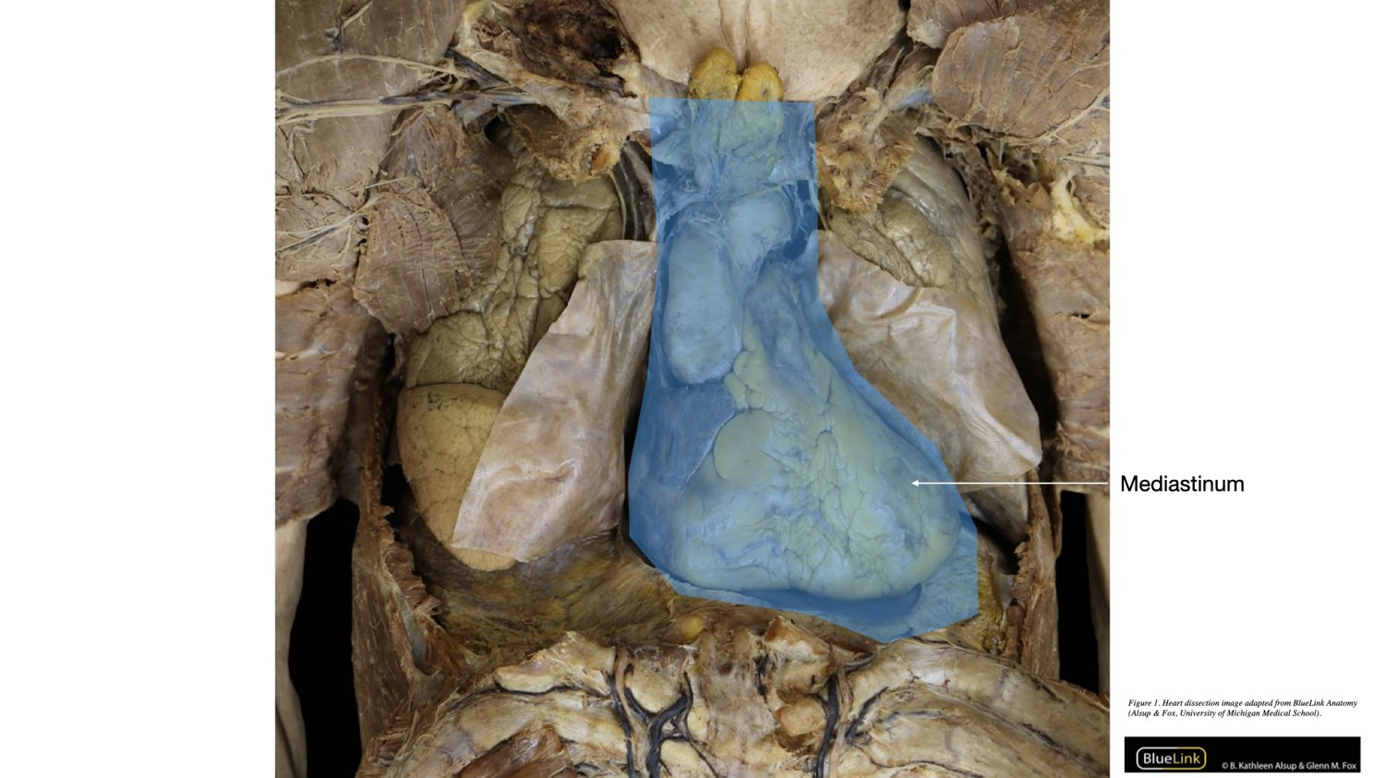
Borders and contents of the mediastinum
FOCUS: HUMAN ANATOMY · FOUNDATIONS
Superior: the thoracic inlet, at the level of the first rib.
Inferior: the diaphragm.
Anterior: the sternum. Posterior: the vertebral column.
Lateral: the mediastinal pleura, a lung on each side.
Contents: heart (in its pericardium), great vessels, trachea, esophagus, thymus, phrenic and vagus nerves, thoracic duct, lymph nodes.

Slide 18
The Retroperitoneum
Part 5
Some organs sit behind the lining of the abdominal cavity rather than inside it.

Slide 19
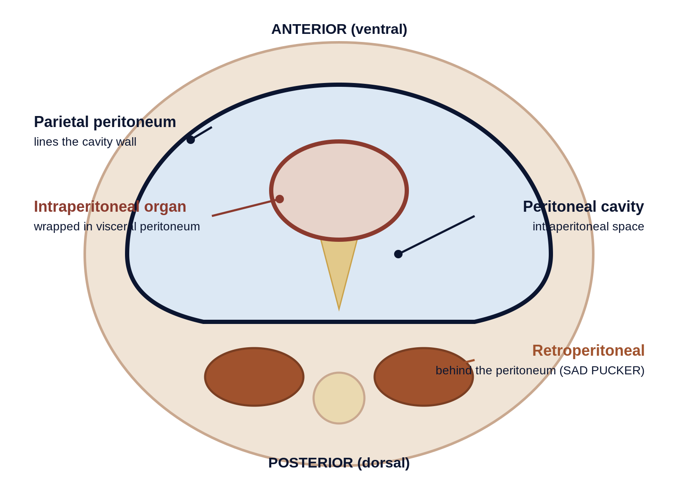
Behind the peritoneum
FOCUS: HUMAN ANATOMY · FOUNDATIONS
Definition: the space behind the parietal peritoneum, against the posterior wall.
Intraperitoneal: organs wrapped in peritoneum inside the cavity (stomach, most small intestine, liver, spleen).
Retroperitoneal: organs behind it, covered by peritoneum only in front.
SAD PUCKER: Suprarenal, Aorta/IVC, Duodenum, Pancreas, Ureters, Colon (asc/desc), Kidneys, Esophagus, Rectum.

Slide 20
Membranes: Mucous and Serous
Part 6
Serous membranes wrap the heart, lungs, and abdominal organs.

Slide 21
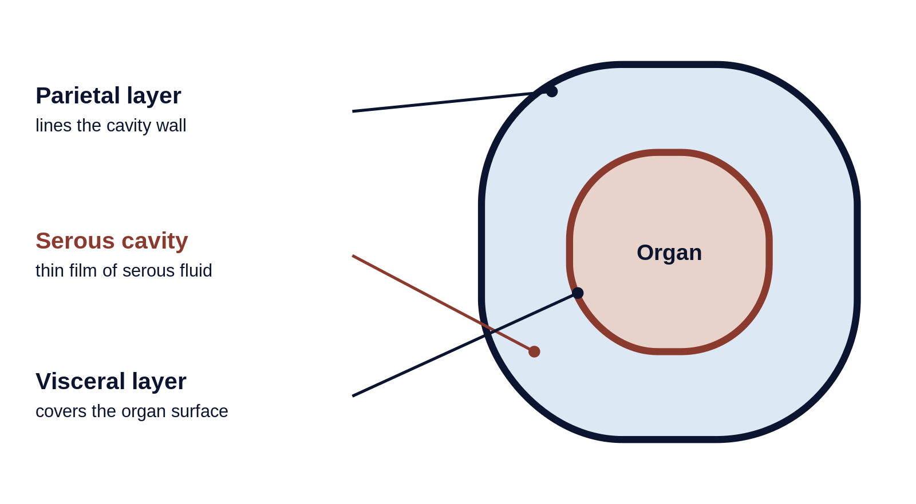
Two membrane types to separate
FOCUS: HUMAN ANATOMY · FOUNDATIONS
Mucous membranes line cavities open to the outside; they secrete mucus.
Serous membranes line closed cavities and cover the organs; they secrete serous fluid.
Two layers: parietal (lines the wall) and visceral (covers the organ), with a fluid-filled serous cavity between.

Slide 22
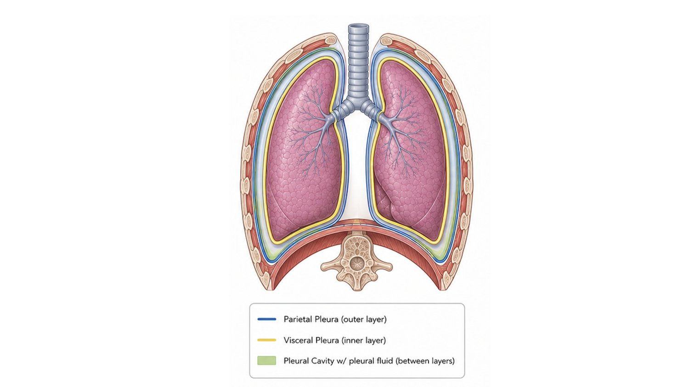
Pleura: around the lungs
FOCUS: HUMAN ANATOMY · FOUNDATIONS
Parietal pleura lines the thoracic wall; visceral pleura covers the lung.
Between them is the pleural cavity with pleural fluid.
Inflammation is pleuritis; air in the cavity is a pneumothorax.

Slide 23
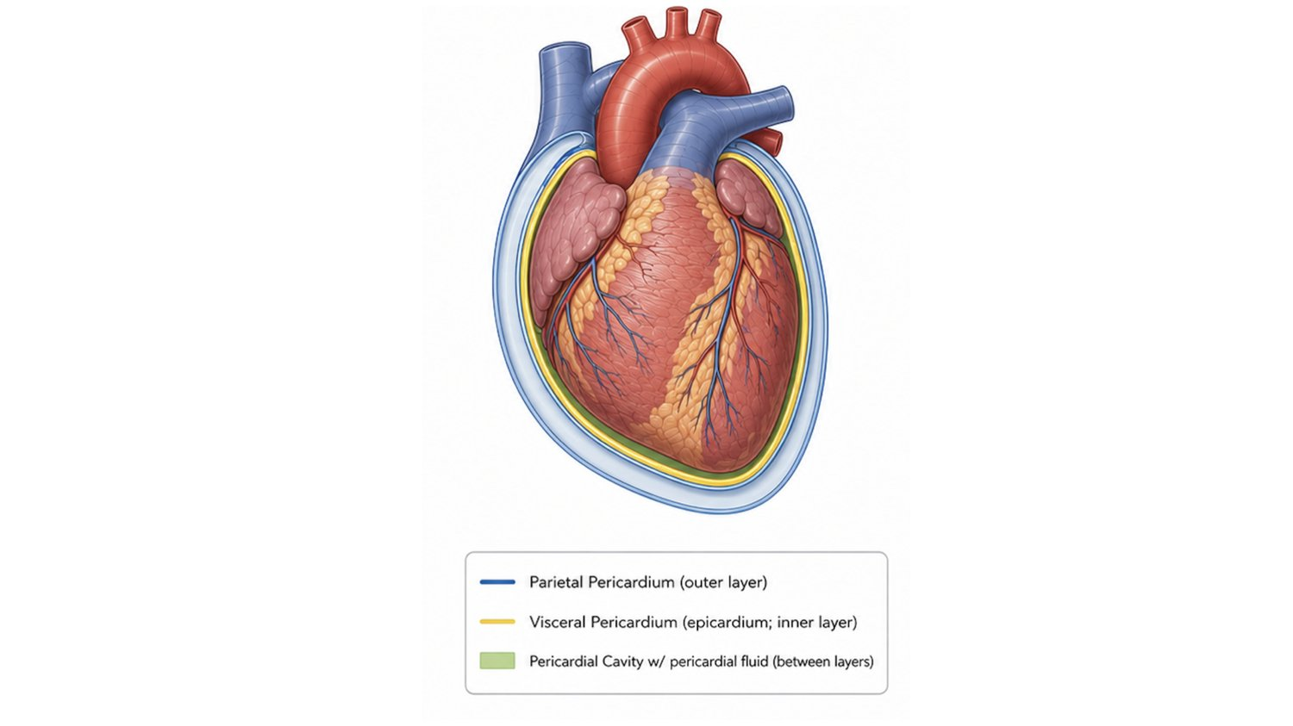
Pericardium: around the heart
FOCUS: HUMAN ANATOMY · FOUNDATIONS
Parietal pericardium lines the fibrous sac; visceral pericardium (epicardium) covers the heart.
Between them is the pericardial cavity with pericardial fluid.
Fluid build-up can compress the heart: cardiac tamponade.

Slide 24
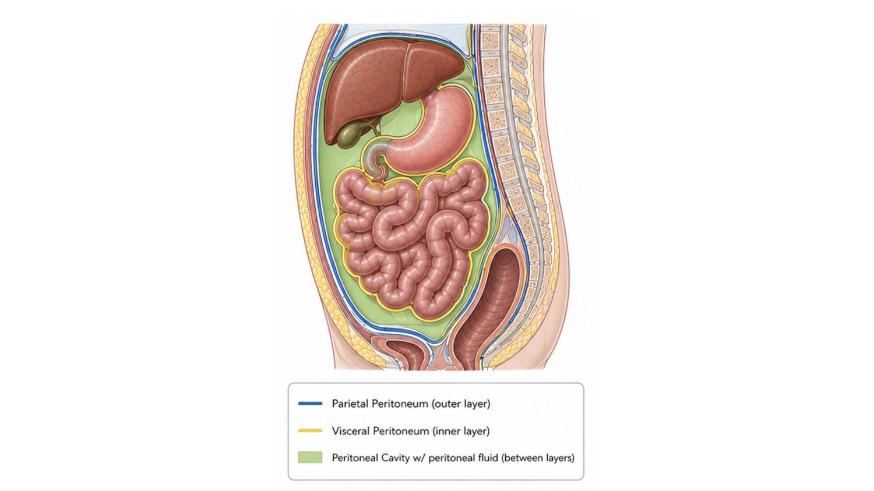
Peritoneum: around the abdominal organs
FOCUS: HUMAN ANATOMY · FOUNDATIONS
Parietal peritoneum lines the abdominal wall; visceral peritoneum covers the organs.
Between them is the peritoneal cavity with peritoneal fluid.
Inflammation is peritonitis; retroperitoneal organs sit behind this cavity.

Slide 25
Problem Solving with the Terminology
Part 7
Locate, predict, and interpret, the same skills a clinician uses every day.

Slide 26
Recall: name it (DOK 1)
DOK 1 · RECALL
Recall asks you to state a fact or term directly.
Q. The wrist is ______ to the elbow. (Proximal / Distal / Superficial)
Answer: Distal, farther from the trunk than the elbow.

Slide 27
Apply: use the concept (DOK 2)
DOK 2 · SKILL / CONCEPT
Apply asks you to use a concept or classify, not just recall.
Q. Right-lower-quadrant tenderness most directly raises which organ? (Gallbladder / Appendix / Spleen)
Answer: Appendix, which sits in the RLQ.

Slide 28
Reason: put it together (DOK 3)
DOK 3 · STRATEGIC REASONING
Reason asks you to connect several ideas and justify.
Q. A note reads: free fluid in the pleural cavity, right side. Between which structures is it, and what is it called?
Answer: Between the parietal and visceral pleura, around the right lung, a pleural effusion.

Slide 29
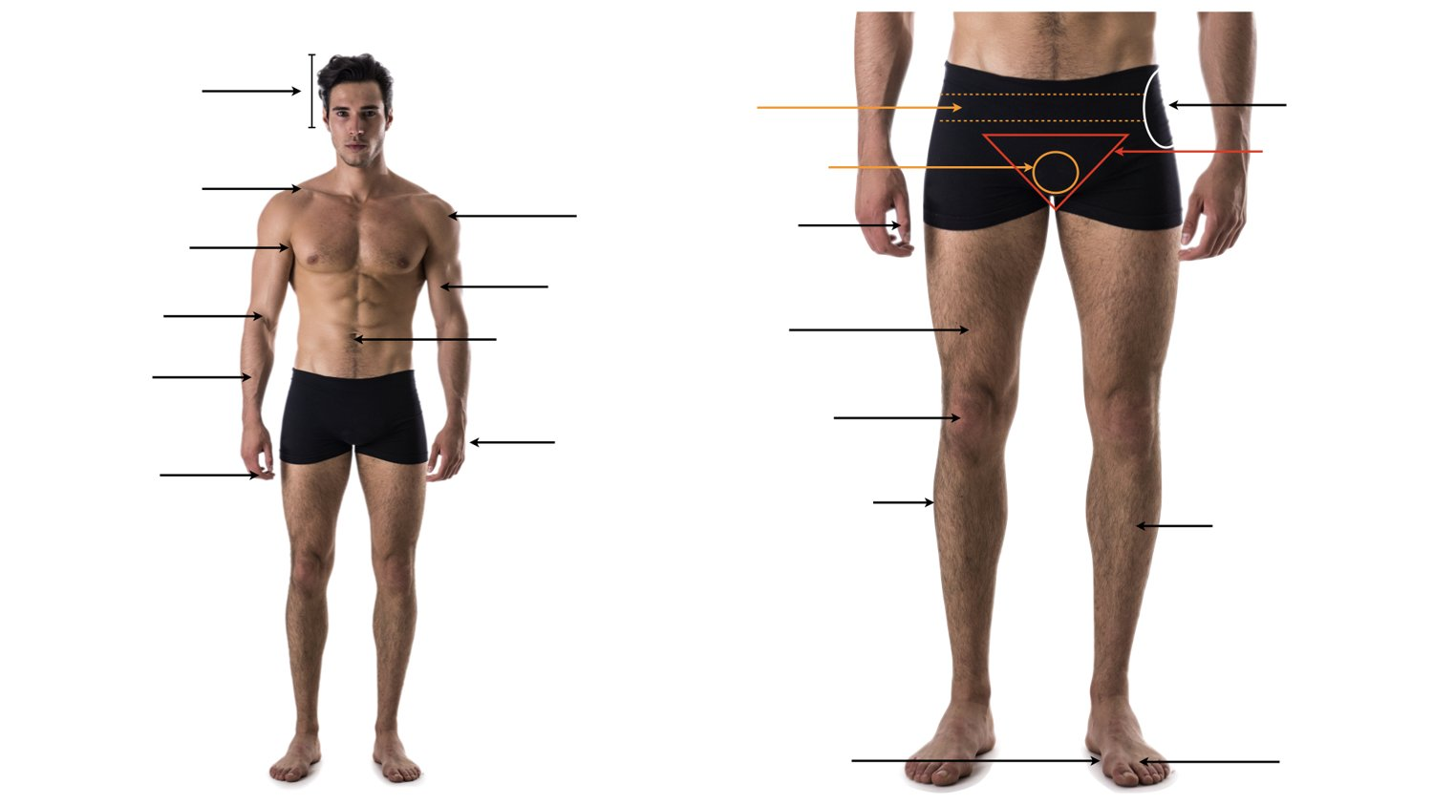
Label it from memory
FOCUS: HUMAN ANATOMY · FOUNDATIONS
Cover the labeled slide. Name every arrow on this blank diagram.
Then sort each region as axial or appendicular.
Draw the four planes through the figure and say what each divides.

Slide 30
Foundations in five lines
KEY TAKEAWAYS
• Structure determines function; anatomy is the vocabulary, physiology is what it does.
• Anatomical position is the fixed reference; planes cut the body; directional terms come in pairs.
• Sort regional terms as axial or appendicular.
• Cavities and quadrants localize organs; mediastinum central, retroperitoneum behind the peritoneum.
• Serous membraneseach have a parietal and visceral layer with fluid between.

