Slide 1
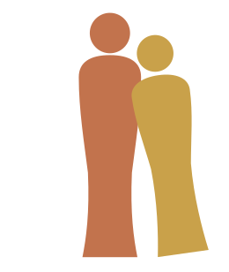

The Cell: Anatomy and Histology
FOCUS: HUMAN ANATOMY
The smallest living unit of the body, and the foundation for the histology that follows. In a combined class this anatomy unit pairs with the cell physiology unit. Dr. Sharilyn Rennie
Scan for the interactive page
Download the .pptx and accessible PDF from Canvas or the course repo.

Slide 2
The Cell & the Plasma Membrane
Part 1
Every body cell shares three regions: a plasma membrane, the cytoplasm, and the nucleus. Start with the boundary that defines the cell.

Slide 3
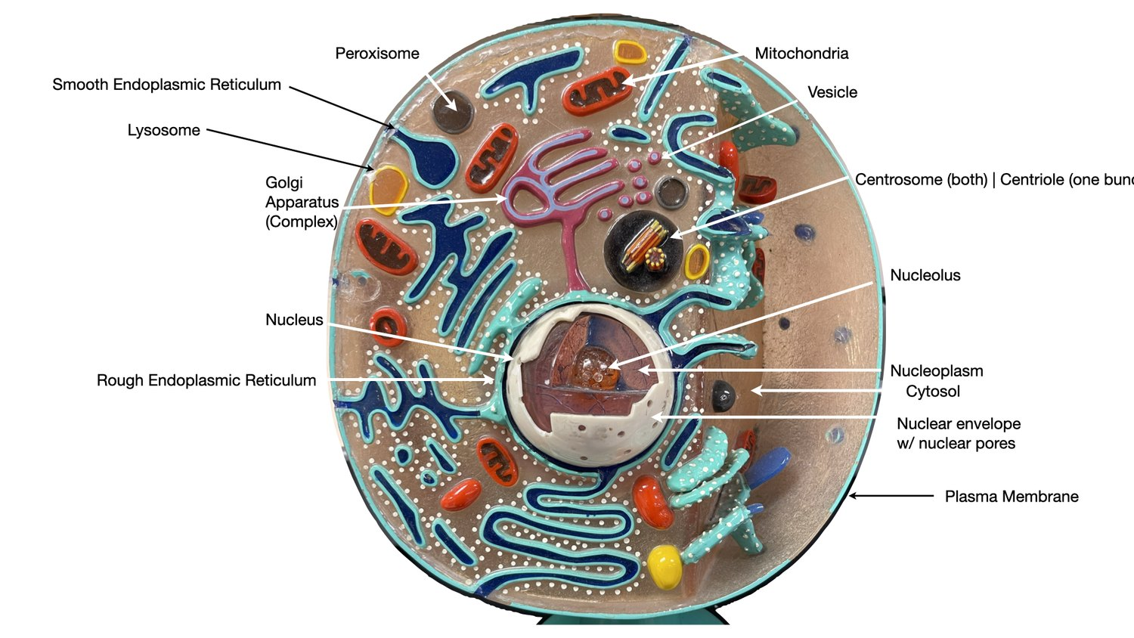
Three regions of the cell
FOCUS: HUMAN ANATOMY · THE CELL
Generalized cell: a composite model of features shared by most body cells.
Plasma membrane: the outer boundary that encloses the cell.
Cytoplasm: everything between the membrane and the nucleus, the cytosol plus the organelles.
Cytosol: the gel-like intracellular fluid the organelles sit in; mostly water with dissolved ions, nutrients, and proteins.
Nucleus: the control center, usually the largest structure in the cell.
Round cell model (lab exam labels).

Slide 4
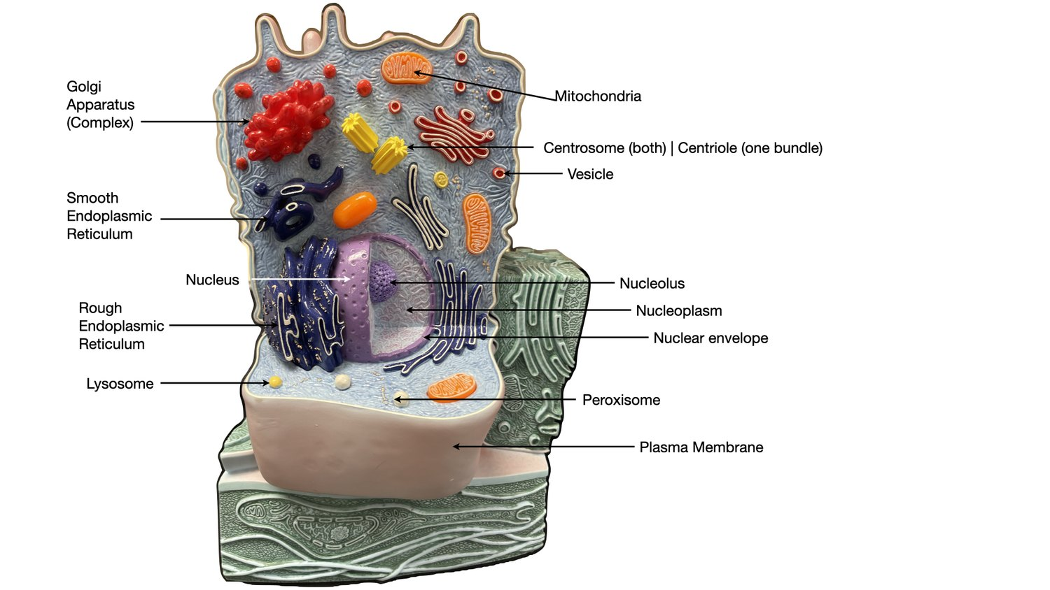
The cell model you will label
FOCUS: HUMAN ANATOMY · THE CELL
Same structures, different model body. Learn the parts, not one picture.
Anchor first: find the nucleus, nucleolus, and nuclear envelope.
Endomembrane set: rough ER, smooth ER, Golgi apparatus, vesicles, lysosome, peroxisome.
Finish with mitochondria and the centrosome / centriole.
White cell model (same labels, different model).

Slide 5
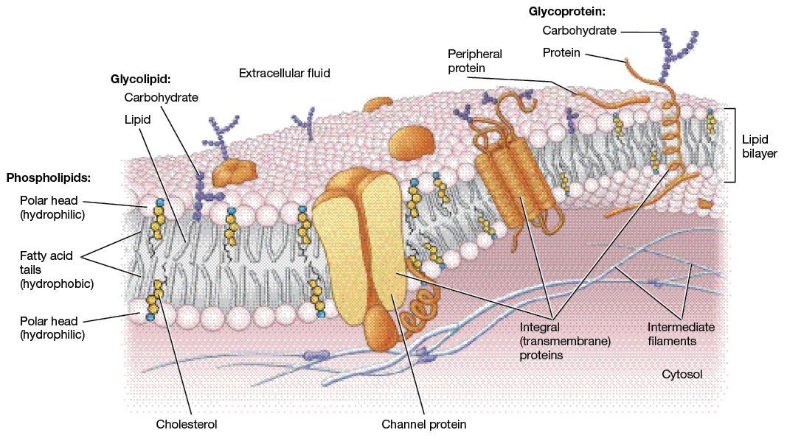
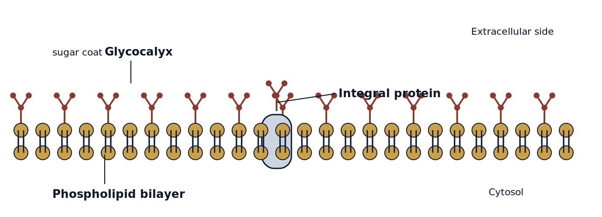
The plasma membrane
FOCUS: HUMAN ANATOMY · THE CELL
Phospholipid bilayer: the basic fabric. The fluid mosaic model describes proteins drifting within it.
Integral proteins span the bilayer as transmembrane channels, carriers, and receptors.
Peripheral proteins attach loosely to one face; enzymes and shape bracing.
Cholesterol stabilizes the membrane and keeps it fluid.
Glycocalyx: the external glycoprotein coat, the cell's identity badge.
Fluid mosaic model of the membrane.
Histology image: LeBoffe histology, adapted by Rowley. Used with permission.
Glycocalyx: the sugar coat on the membrane (diagram).

Slide 6
Cell Surfaces & Junctions
Part 2
Cells specialize their apical surface for absorption and movement, and join neighbors at their lateral surfaces. The proteins that build these are testable.

Slide 7
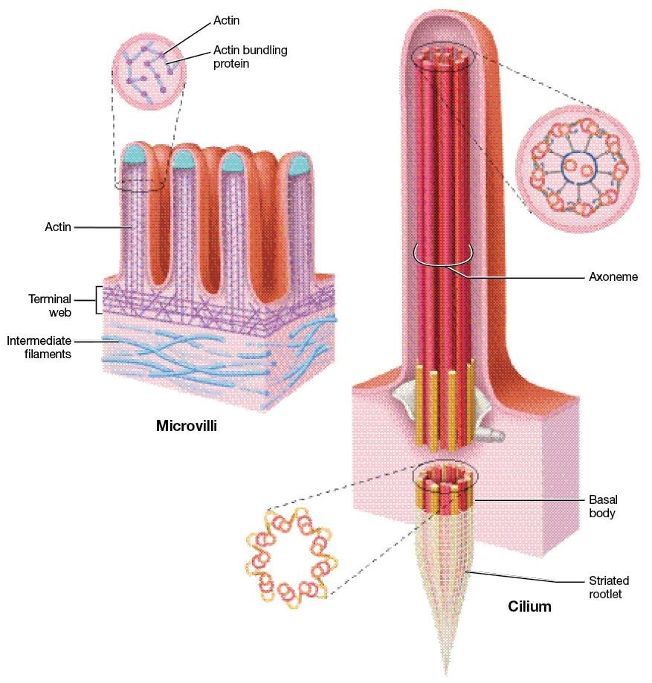
Surface specializations
FOCUS: HUMAN ANATOMY · THE CELL
Microvilli: finger-like extensions that increase surface area for absorption; core of bundled actin.
Cilia: short hair-like extensions that sweep substances; built on a 9+2 axoneme.
Flagellum: a single long extension, same 9+2 core; the only human example is the sperm tail.
Basal body: a modified centriole (9+0 triplets) that anchors each cilium and organizes its axoneme.
Microvilli, cilium, and the basal body.
Histology image: LeBoffe histology, adapted by Rowley. Used with permission.

Slide 8
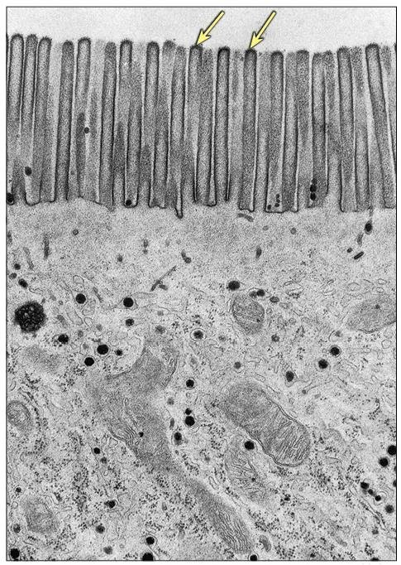
Microvilli as a brush border
FOCUS: HUMAN ANATOMY · THE CELL
More microvilli means more membrane means more absorption: the brush border (TEM).
Histology image: LeBoffe histology, adapted by Rowley. Used with permission.

Slide 9
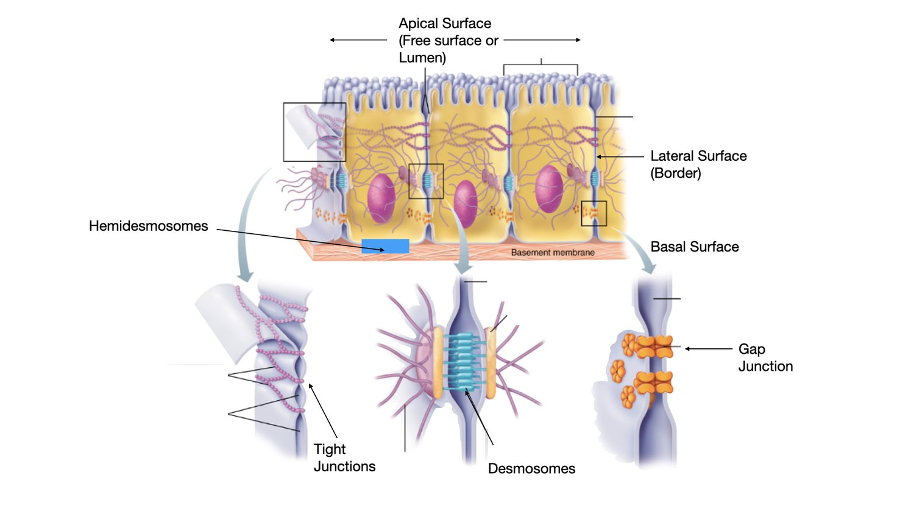
How cells join: junctions and their proteins
FOCUS: HUMAN ANATOMY · THE CELL
Tight junctions seal the gap between cells. Built from claudins and occludins.
Desmosomes rivet cells against pulling; link cadherins to intermediate filaments.
Hemidesmosomes anchor a cell to the basement membrane using integrins.
Gap junctions are channels for ions and small molecules; built from connexins forming a connexon.
Cell junctions at the apical, lateral, and basal surfaces.

Slide 10
The Nucleus
Part 3
The control center: it stores the genetic code and controls what crosses in and out through its pores.

Slide 11
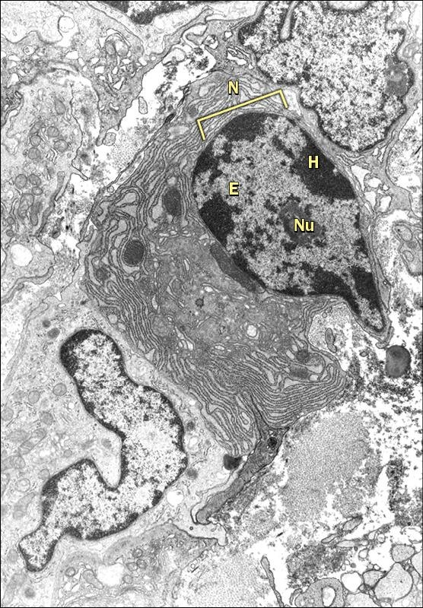
The nucleus
FOCUS: HUMAN ANATOMY · THE CELL
Nuclear envelope: the double membrane; its outer membrane is continuous with the rough ER.
Nuclear pores: channels that regulate two-way traffic. mRNA and ribosomal subunits out; proteins in.
Nucleoplasm: the fluid suspending the nuclear contents.
Nucleolus: where ribosomal subunits are assembled.
Chromatin is loose threadlike DNA; chromosomes are its coiled form, seen in division.
The nucleus in section (TEM).
Histology image: LeBoffe histology, adapted by Rowley. Used with permission.

Slide 12
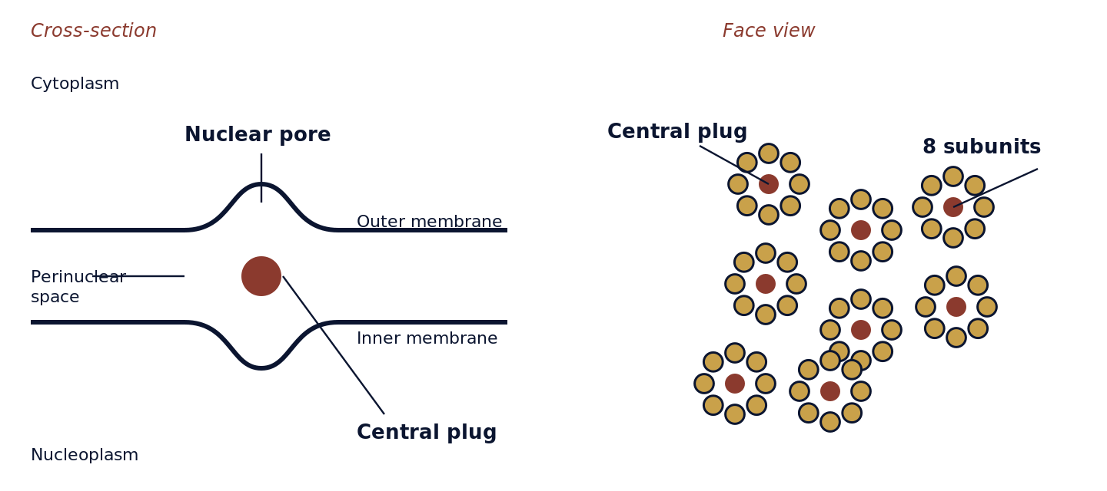
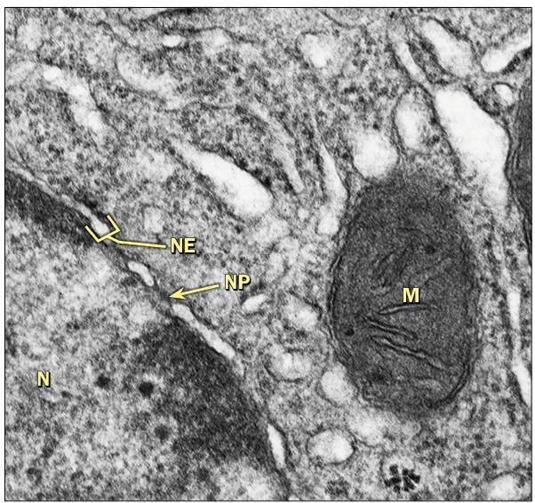
Nuclear pores control the traffic
FOCUS: HUMAN ANATOMY · THE CELL
Not a sealed wall: nuclear pores perforate the envelope and choose what crosses.
Nuclear pore complex: eight subunits ring a central plug, giving the face view its star shape.
Out: messenger RNA and ribosomal subunits, headed for protein synthesis.
In: proteins built in the cytoplasm but needed inside the nucleus.
Continuity: the outer membrane flows into the rough ER.
Nuclear pore complex: cross-section and eight-subunit face view (diagram).
Real TEM: nuclear envelope (NE), nuclear pores (NP), mitochondrion (M).
Histology image: LeBoffe histology, adapted by Rowley. Used with permission.

Slide 13
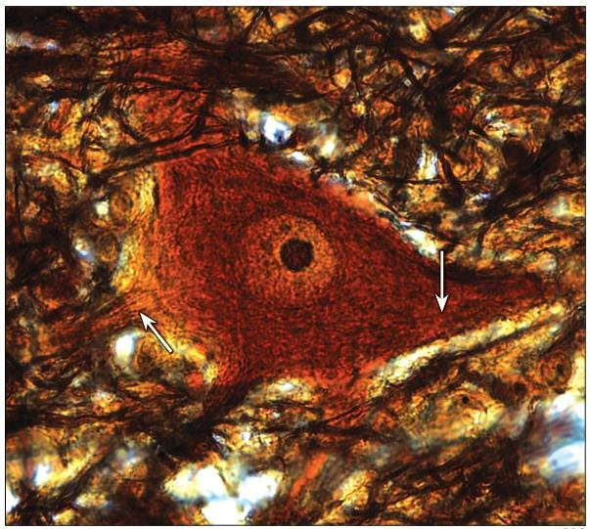
The nucleolus and busy cells
FOCUS: HUMAN ANATOMY · THE CELL
A prominent nucleolus signals a cell making large amounts of protein; it is the ribosome factory.
Neurons are a classic example: a large pale nucleus with one dark, obvious nucleolus.
Read it backward: a big nucleolus on a slide predicts heavy protein output.
A neuron's prominent nucleolus marks heavy protein output.
Histology image: LeBoffe histology, adapted by Rowley. Used with permission.

Slide 14
The Endomembrane System
Part 4
One connected route: nuclear envelope, ER, Golgi, vesicles, and lysosomes. Follow a product from where it is made to where it leaves.

Slide 15
Membranous organelles
FOCUS: HUMAN ANATOMY · THE CELL
Rough ER: ribosome-studded network; makes and packages proteins.
Smooth ER: no ribosomes; makes lipids and stores calcium.
Golgi apparatus: sorts, packages, and ships cell products.
Lysosomes: digestive enzyme sacs; break down worn parts and debris.
Peroxisomes: neutralize toxins and free radicals.
Mitochondria and vesicles round out the membrane-bound set.
Membranous organelles on the lab model.

Slide 16
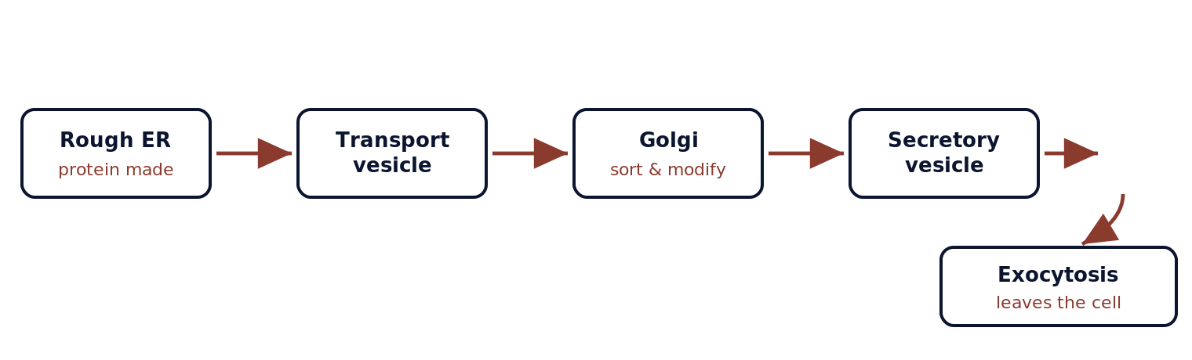
The secretory pathway
FOCUS: HUMAN ANATOMY · THE CELL
The numbered route a secreted protein follows, in order. The mechanism belongs to physiology; here we trace the anatomy of the path.
Reverse it: endocytosis brings material in; microtubules are the tracks vesicles follow; nuclear pores are the gateway where mRNA first exits.

Slide 17
Cytoskeleton, Power & Storage
Part 5
The non-membranous structures: ribosomes, the cytoskeleton, the centrosome, and the powerhouse that supplies them all.

Slide 18
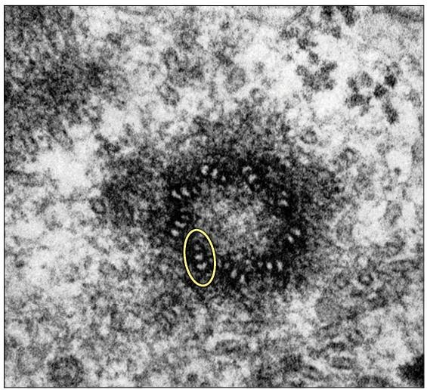
Non-membranous organelles
FOCUS: HUMAN ANATOMY · THE CELL
Ribosomes: RNA-and-protein particles, free in the cytosol or on the rough ER; build proteins.
Cytoskeleton: an internal protein framework for shape and movement.
Three fibers: microfilaments (actin, thinnest), intermediate filaments (rope-like, resist pulling), microtubules (thickest, hollow transport tracks).
Centrosome: organizes microtubules; its paired centrioles (9+0 triplets) organize the spindle in division.
Centriole in cross-section: nine triplets (9+0) in a pinwheel.
Histology image: LeBoffe histology, adapted by Rowley. Used with permission.

Slide 19
Cytosol and cellular inclusions
FOCUS: HUMAN ANATOMY · THE CELL
The fluid the organelles live in, and the materials the cell stores in it.
Cytosol: the gel-like intracellular fluid, about half the cell's volume; mostly water with dissolved ions, nutrients, sugars, amino acids, and proteins.
Medium and reactions: it suspends the organelles and the cytoskeleton and is the site of many of the cell's chemical reactions.
Cellular inclusions: stored, non-living substances in the cytosol, not membrane-bound organelles.
Examples: glycogen granules (liver, muscle) store sugar; lipid droplets (adipocytes) store fat; pigments such as melanin and lipofuscin collect in some cells.
Cytosol vs cytoplasm: the cytosol is the fluid only; the cytoplasm is the cytosol plus the organelles and inclusions in it.

Slide 20
Mitochondria supply the energy
FOCUS: HUMAN ANATOMY · THE CELL
Mitochondria are double-membraned organelles that produce most of the cell's ATP.
Cristae: inner-membrane folds that pack in surface area for energy production.
Heavy demand: cardiac and skeletal muscle, kidney tubules carry many of them.
Own DNA: mitochondrial disorders follow a distinctive maternal inheritance pattern.
A mitochondrion (M) beside the nuclear envelope (TEM).
Histology image: LeBoffe histology, adapted by Rowley. Used with permission.

Slide 21
Cells Under the Microscope
Part 6
Histology is how we read cells on a slide. Stains make the nucleus dark and the cytoplasm pale, and a cell's shape reveals its job.

Slide 22
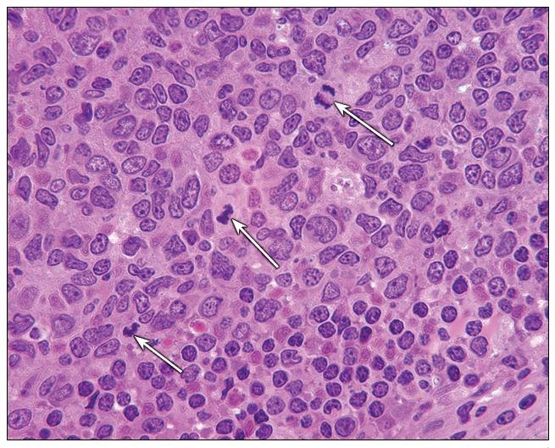
What histology shows you
FOCUS: HUMAN ANATOMY · THE CELL
H&E staining turns nuclei dark purple-blue and cytoplasm pink, so you first see where the nuclei are.
Count, shape, packing of nuclei tells you the tissue.
Lab practical: you identify cells by these features, not just on a model.
Bridge to the next module, where cells are organized into the four tissue types.
H&E: dark nuclei against pale cytoplasm.
Histology image: LeBoffe histology, adapted by Rowley. Used with permission.

Slide 23
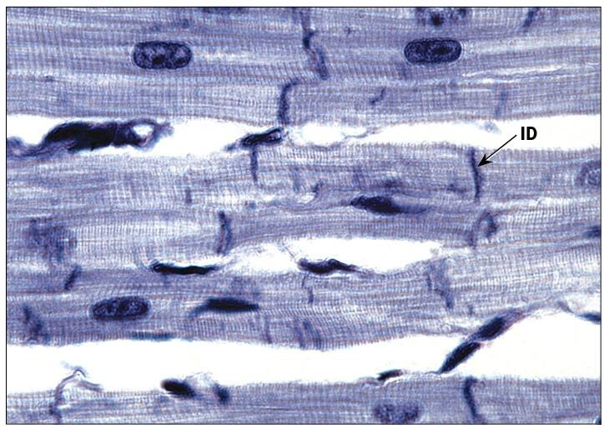
A cell's shape matches its job
FOCUS: HUMAN ANATOMY · THE CELL
Muscle cell: long and packed with mitochondria; cardiac cells join end to end at intercalated discs (gap junctions plus desmosomes).
Red blood cell: loses its nucleus and organelles to carry oxygen.
White blood cell: changes shape to squeeze between cells to an infection.
Rule: structure follows job; a cell carries the organelles its task needs.
Cardiac muscle joined at intercalated discs (ID).
Histology image: LeBoffe histology, adapted by Rowley. Used with permission.

Slide 24
The organelle points to the disease
FOCUS: HUMAN ANATOMY · THE CELL
When you know what an organelle does, you can predict what fails when it is defective.
Lysosomes that cannot break down their contents cause lysosomal storage diseases, such as Tay-Sachs.
Cilia that do not form correctly cause primary ciliary dyskinesia: the airways cannot clear mucus.
Mitochondria carry their own DNA, so mitochondrial disorders follow a distinctive maternal inheritance pattern.

Slide 25
Check Your Understanding
Part 7
Three questions, increasing in depth. Use these to teach yourself, not just to score.

Slide 26
Recall: name the structure
DOK 1 · RECALL
Recall asks you to state a fact directly.
Q. Which organelle assembles ribosomal subunits? (Golgi / Nucleolus / Lysosome / Smooth ER)
Answer: Nucleolus, the dense body inside the nucleus.

Slide 27
Match structure to protein
DOK 2 · SKILL / CONCEPT
Apply asks you to use a concept, not just recall.
Q. A junction lets ions pass directly cell to cell. Which protein builds it? (Claudin / Cadherin / Connexin / Integrin)
Answer: Connexin, which assembles into a connexon channel at the gap junction.

Slide 28
Predict from structure
DOK 3 · STRATEGIC REASONING
Reason asks you to connect several ideas.
Q. A biopsy cell shows a dense brush border and many mitochondria. What is it built to do?
Answer: Absorb material across its surface. The brush border maximizes surface area; abundant mitochondria supply the ATP active uptake demands (e.g., kidney tubule or intestinal lining cell).

Slide 29
Label it
FOCUS: HUMAN ANATOMY · THE CELL
Cover the labels and name every structure on both models before lab.

Slide 30
The cell in seven lines
KEY TAKEAWAYS
• Every cell has three regions; plasma membrane, cytoplasm, nucleus.
• The membrane is a fluid mosaic; bilayer plus integral and peripheral proteins, cholesterol, glycocalyx.
• Surfaces specialize; microvilli (actin) absorb, cilia (9+2 on a basal body) sweep.
• Junctions have proteins; tight (claudins), desmosome (cadherins), hemidesmosome (integrins), gap (connexins).
• The nucleus stores DNAand controls traffic through nuclear pores; the nucleolus builds ribosomes.
• The endomembrane route; rough ER, vesicle, Golgi, secretory vesicle, exocytosis.
• Form follows function; on a slide the dark nucleus is where you start reading the cell.

