Slide 1
Chapter 1—Introduction

Slide 2
Chapter Outline
What is histology?
Why study histology?
Histological techniques—Microscopy
Histological techniques—Specimen preparation
Strategies for studying histology

Slide 3
What is histology?
Histology is the study of tissues
Histos = tissue; logos = treatise
Tissues = collections of cells with similar structure and function
Four major tissue types in adults
Epithelial tissue
Connective tissue
Muscle tissue
Nervous tissue

Slide 4
Why study histology?
Histology is the bridge between structure and function
Studying histology allows you to better understand
microscopic organization of tissues/organs
organ function at the smallest levels, working up to the larger anatomical levels

Slide 5
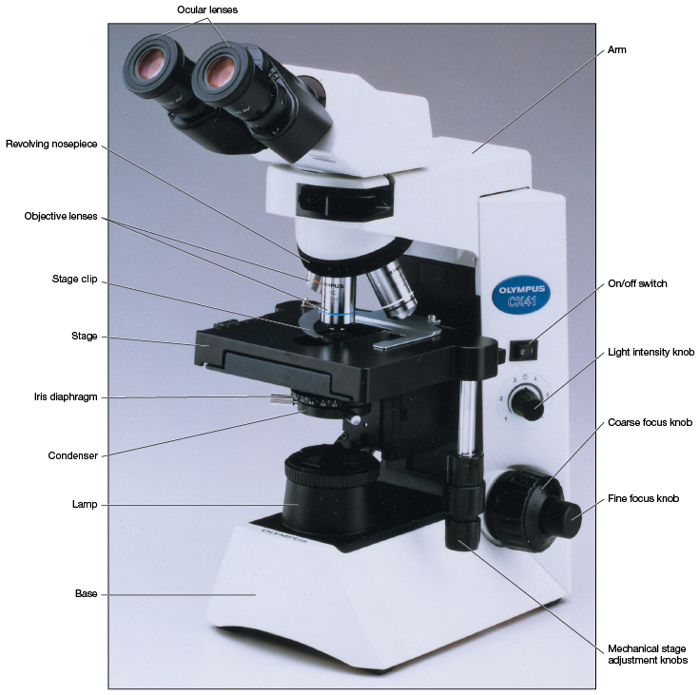
Histological techniques—Microscopy
A light microscope is used to examine specimens by shining a light through them
Mechanical components include
Focus adjustments
Mechanical stage
Light source

Slide 6
Histological techniques—Microscopy
A light microscope is used to examine specimens by shining a light through them
Optical components include
Condenser
Objective lenses
Ocular lenses

Slide 7
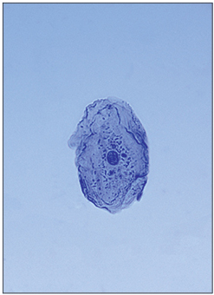
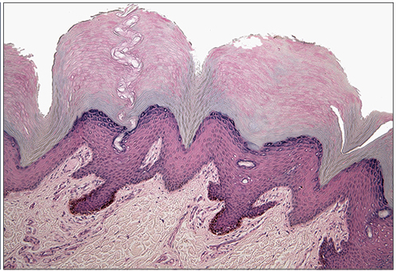
Histological techniques—Microscopy
How does it work?
Condenser: concentrates light through the specimen
Objective lens: bends (refracts) light to produce a magnified image
Ocular lens: further magnifies image

Slide 8
Histological techniques—Microscopy
How does it work?
Total magnification = product of power of objective and ocular lenses
Example: 40x objective x 10x ocular = 400x total
Resolution = ability of a lens to reveal two individual points as being separate
The closer two points can be, yet still be seen as separate, the better the resolution is overall
Limit of resolution for most light microscropes is about 0.1 µm

Slide 9
Histological techniques—Microscopy
Electron microscopes
Use an electron beam instead of light to create an image
Realistic resolution down to 2 nm
Maximum magnification of 150,000x
Two basic types
Transmission electron microscope (TEM)
Scanning electron microscope (SEM)

Slide 10
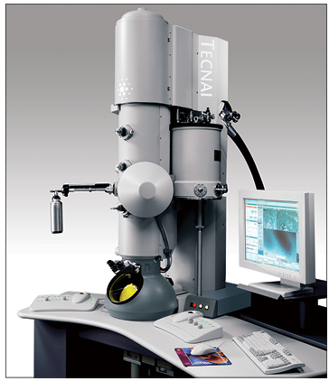
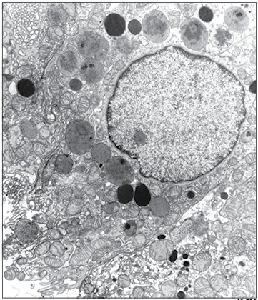
Histological techniques—Microscopy
Transmission electron microscopes
Produce 2D image of an ultrathin section by capturing electrons that have passed through it
Fluorescent plate used to collect electrons/create image
Useful for studying a cell’s interior
Requires heavy metal staining/shadowing
Can be time-consuming and labor-intensive

Slide 11
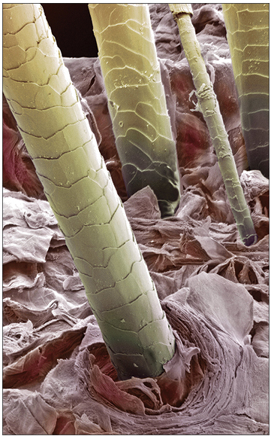
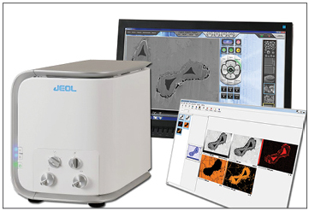
Histological techniques—Microscopy
Scanning electron microscopes
Used to create a 3D image of a specimen’s surface
Focused beam of electrons is passed over a specimen’s gold-coated surface
Some electrons are scattered, while others are emitted from the coating
Collected electrons are used to create a 3D image by computer software

Slide 12
Histological techniques—Specimen preparation
Most staining requires a series of steps
Fixation—preserves the specimen and slows its deterioration
Dehydration—bathing the specimen in alcohol to remove water (making it easier to stain and preserve long term)
Clearing—treating specimen with xylene to make it more transparent

Slide 13
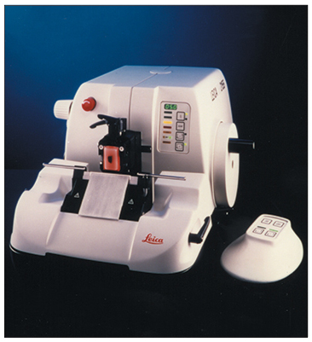
Histological techniques—Specimen preparation
Most staining requires a series of steps
Embedding—infiltrating the specimen with paraffin or plastic to give it support when sliced very thinly
Sectioning—very thin slicing of specimen (5–10 µm sections) on a special machine called a microtome

Slide 14
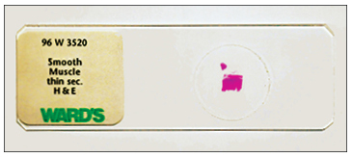
Histological techniques—Specimen preparation
Most staining requires a series of steps
Mounting—placing each section on a glass slide
Staining—colorizing a specimen to provide contrast

Slide 15
Histological techniques—Specimen preparation
Most staining requires a series of steps
Electron microscopy steps are similar
Fixation with glutaraldehyde and osmium tetroxide
Often embedded in plastic
Allows for thinner sections (app. 100 nm)
Uranyl acetate, lead citrate, osmium tetroxide used as stains (electron-dense materials)
Gold coating often used for scanning electron microscopy

Slide 16
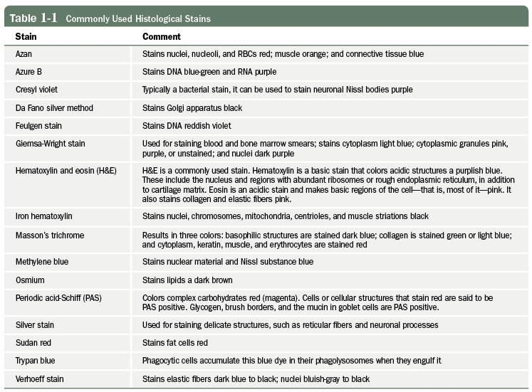
Histological techniques—Specimen preparation
Commonly used histological stains

Slide 17
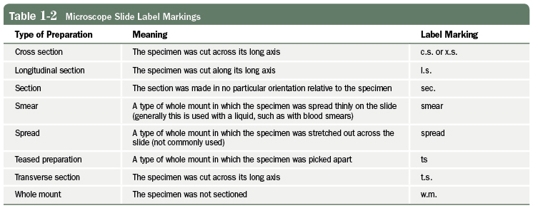
Strategies for studying histology
Some general tips to help you succeed
Read the slide’s label
Realize that most slides have more than what is just written on the label—the trick is to find the “correct” part of the specimen

Slide 18
Strategies for studying histology
Some general tips to help you succeed
Get used to looking at a slide without a microscope first to get a rough feel for the section
Always begin microscopic examination at low power, then move to higher power
Don’t overilluminate specimens—you’ll lose detail!
Look at several slides of similar tissue—don’t stop after just one look!
Don’t overestimate slide quality.
Textbook examples are often very, very good. Actual slide quality may vary considerably.

Slide 19
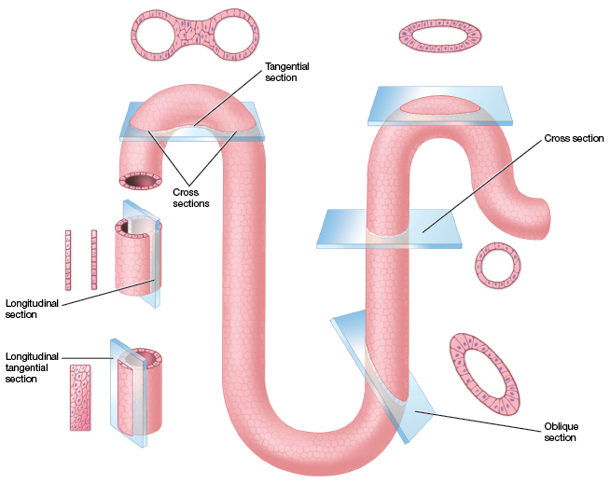
Strategies for studying histology
Some general tips to help you succeed
Remember—you’re visualizing a 2D image, but think of it in 3D form. Try to think about how the section was
cut and what
it means.

Slide 20
Take-home message:
Histology is an interesting field that bridges basic anatomy and the molecular functions of tissues/organs
Tools of histology include several different microscopes and the methods used to create stained tissue section slides
Examining tissue section slides gives us a 2D image of how organs are put together, but it’s important to think in 3D.

Slide 21
Recap Quiz—Question 1.1
What is the basic meaning of resolution?
How many times larger the created image is versus the real image
How far apart two points can be yet still be observed as separate
How close together two points can be yet still be observed as separate

Slide 22
Recap Quiz—Question 1.1
What is the basic meaning of resolution?
How many times larger the created image is versus the real image
How far apart two points can be yet still be observed as separate
How close together two points can be yet still be observed as separate

Slide 23
Recap Quiz—Question 1.2
Which part of the light microscope focuses the light onto/through the specimen?
Condenser
Objective lens
Ocular lens
Stage

Slide 24
Recap Quiz—Question 1.2
Which part of the light microscope focuses the light onto/through the specimen?
Condenser
Objective lens
Ocular lens
Stage

Slide 25
Recap Quiz—Question 1.3
True or false: A TEM has a higher resolution AND magnification factor than a light microscope.

Slide 26
Recap Quiz—Question 1.3
True or false: A TEM has a higher resolution AND magnification factor than a light microscope.
True

Slide 27
Recap Quiz—Question 1.4
During the process of preparing tissue for histological examination, which one of the following steps helps to slow the deterioration of the specimen?
Fixation
Clearing
Embedding
Sectioning

Slide 28
Recap Quiz—Question 1.4
During the process of preparing tissue for histological examination, which one of the following steps helps to slow the deterioration of the specimen?
Fixation
Clearing
Embedding
Sectioning

Slide 29
Recap Quiz—Question 1.5
Which one of the following is the tool used to create very thin sections of tissues?
TEM
SEM
Condenser
Dehydrator
Microtome

Slide 30
Recap Quiz—Question 1.5
Which one of the following is the tool used to create very thin sections of tissues?
TEM
SEM
Condenser
Dehydrator
Microtome

