Slide 1

DATA MODELLING USING MACHINE LEARNING TECHNIQUES
Presented by
J Harsha Chandana
N Sandhya Rani
Samreen
P Nagaraju
S Sai Priyanka
K James Alexander
B Jyothi

Slide 2

A CASE STUDY ON LIVER DISEASE PREDICTION USING R

Slide 3

Data Model
A data model is an abstract model that organizes elements of data and standardizes how they relate to one another and to properties of the real world entities
Before Machine Learning came into use humans manually derived rules and built models from analyzing large amounts of data.

Slide 4
Artificial Intelligence
Artificial intelligence (AI) is an area of computer science that emphasizes the creation of intelligence system that work and react like humans. Some of the activities computers with artificial intelligence are designed for include:
Learning
Speech recognition
In the second half of the twentieth century, machine learning evolved as a subset of artificial intelligence that involved the development of self-learning algorithms to gain knowledge from that data in order to make predictions.

Slide 5

Machine Learning
Machine learning is an application of artificial intelligence (AI) that provides systems the ability to automatically learn and improve from experience without being explicitly programmed.
The primary aim is to allow the computers learn automatically without human intervention or assistance and adjust actions accordingly.

Slide 6
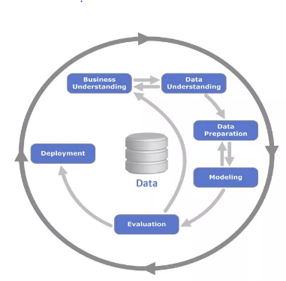
Data Modelling Technique Crisp-Dm
Stages
Business Understanding
Data Understanding
Data preparation
Data Modelling
Evaluation
Deployment

Slide 7
Business Understanding
Identifying the requirements of a business and translating it into an Analytical Project.
Our Data
The problem is related to classifying a person whether he has liver disease or not, using the various diagnostic values of liver functional components in blood.

Slide 8
The attributes like proteins and enzymes control the condition of the liver
Based on the attributes we need to come up with an appropriate classification model for classifying whether a patient has liver disease or not.
When a new data(input) is given, we use the model obtained and predict whether the person needs to be diagnosed or not.

Slide 9
Data Understanding
Data understanding process includes collecting and exploring the data.
The data we have collected consists of 1169 observations with 10 attributes. The attributes are:
Age
Gender
Total Bilirubin
Direct Bilirubin
Alkaline Phosphate
Alamine Aminotransferase
Aspartate Aminotransferase

Slide 10

Total Proteins
Albumin
Albumin to Globulin Ratio
Label in our data: Liver Disease (ldisease)
1 - represents presence of liver disease
2 - represents absence of liver disease

Slide 11
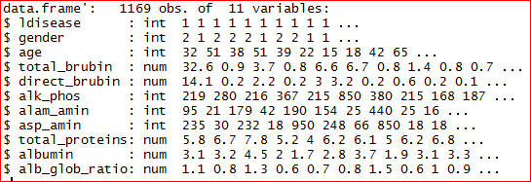
Data Preparation
In this stage we clean and format the data
Correcting data types:
Scales-Nominal, ordinal , interval, ratio
As we can see from the above table, ldisease and gender which are categorical in nature are read as integer. So, we converted these attributes ldisease and gender from integer to factor (categorical).

Slide 12
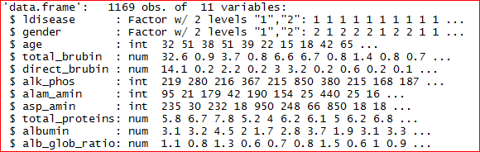
Understanding data using Descriptive Statistics:
Measures of Central Tendency
Measures of Dispersion
Visual description

Slide 13
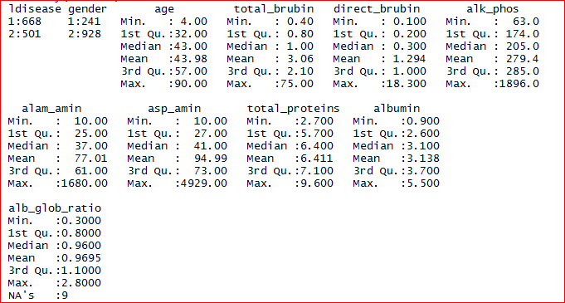
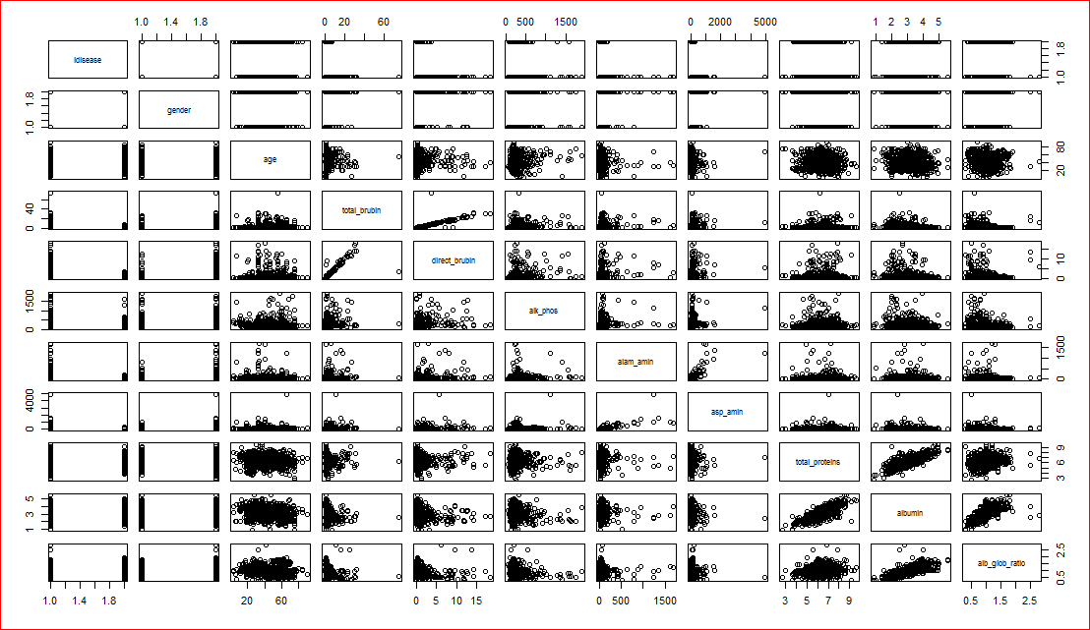
Understanding data visually

Slide 14


Checking for missing Values:
Impact
causes
Treatment
Deletion, Imputation, prediction
We also need to check if the data contains any missing values, which can be done as below
There are 0.7698888% i.e., 9 missing values in alb_glob_ratio.

Slide 15
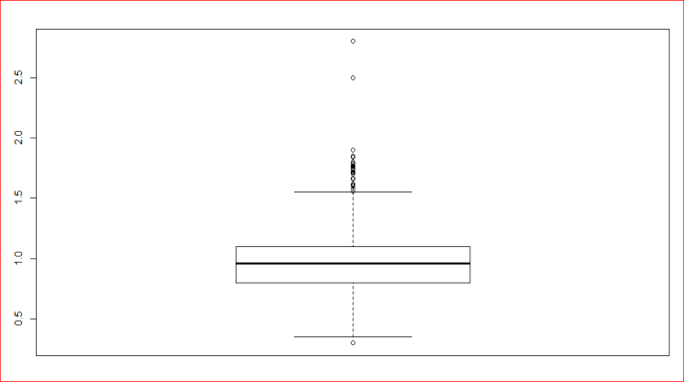
Outliers
Checking for Outliers:
We used Box-plots to check for Outliers in each
of the continuous variables
Boxplot for alb_glob_ratio
Treatment:
Deleting,
imputing,
binning,
transformation,
capping.

Slide 16
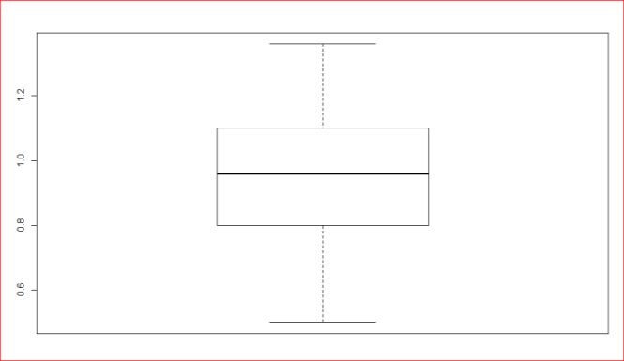
After capping the boxplot is
For all the attributes we plot boxplots and treat by capping

Slide 17
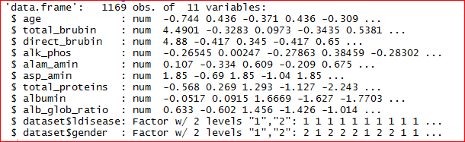
Data Preparation
Format or transformation of data
Normalising the Continuous variables:
As our input data is in different units, we have to, ideally do normalisation. Hence, we normalized all the continuous variables with mean 0 and variance 1.

Slide 18
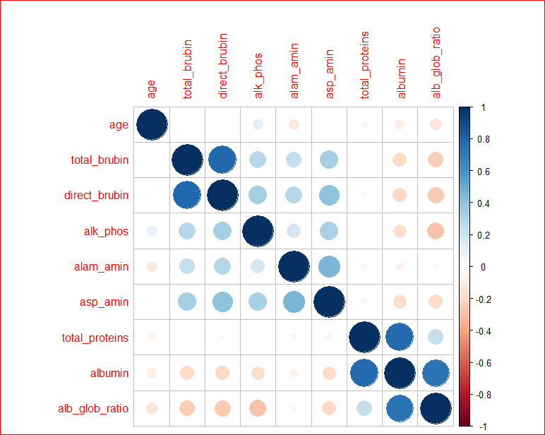
Understanding relationship b/w variables
For the continuous variables, we will look at the Correlation plots to understand the relationships between variables.

Slide 19
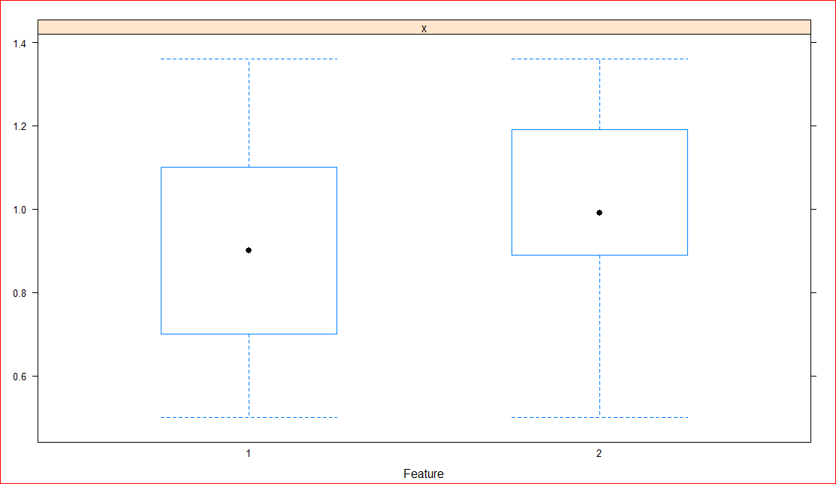
Feature plots:
For the continuous Vs categorical variable, we will look at Feature plots to understand the relationships between variables.
alb_glob_ratio vs ldisease
Slight differences in distributions of disease and non disease patients is observed in total proteins, asp_amin, albumin

Slide 20
Feature selection
Filter method
Wrapper
Embedded
dimensionality reduction

Slide 21
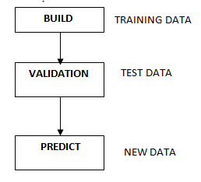
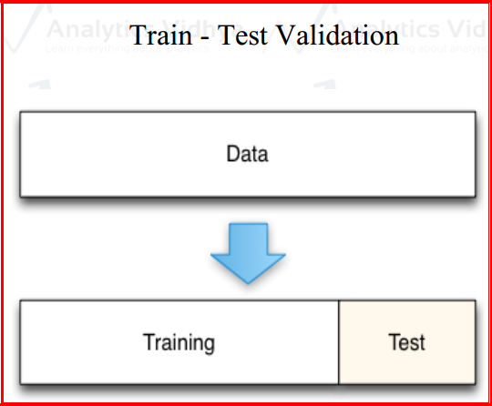
Modelling
Need of validation
Cross Validation:
It is a technique used to split the
data
Methods of cross validation:
validation set approach

Slide 22
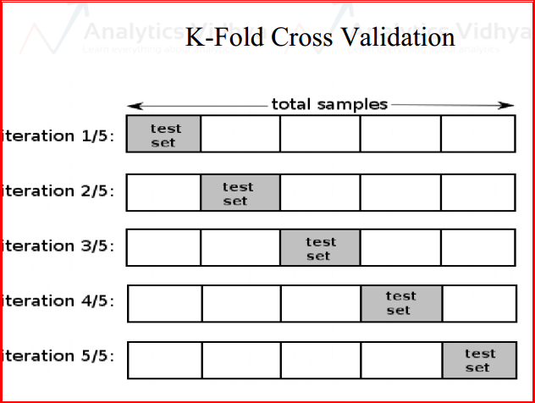
K-fold cross validations
Stratified k fold cross validation
Leave- P- out cross validation
Leave one out cross validation

Slide 23

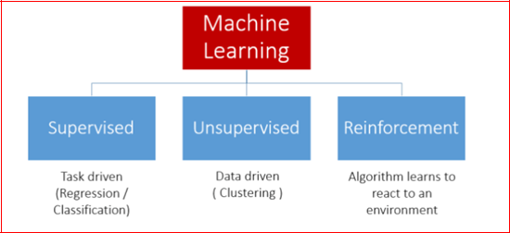
OUR DATA:
Here we use 10 fold classification
And, the dimensions of the train and test data are:
Modelling using ML techniques:

Slide 24
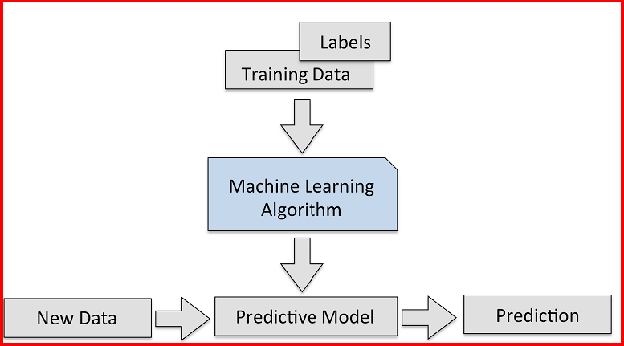
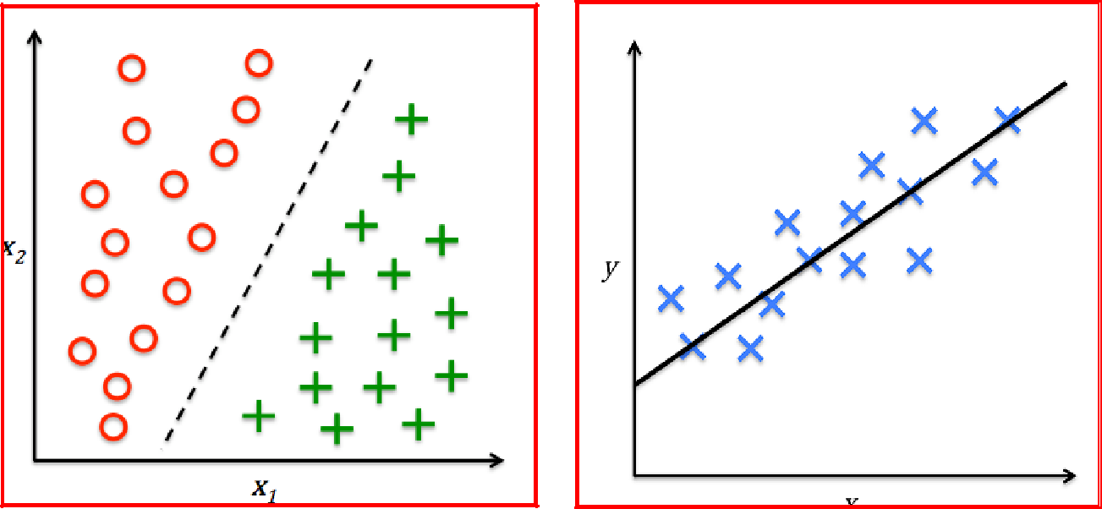
Supervised Learning
2 types of supervised learning
classification Regression

Slide 25
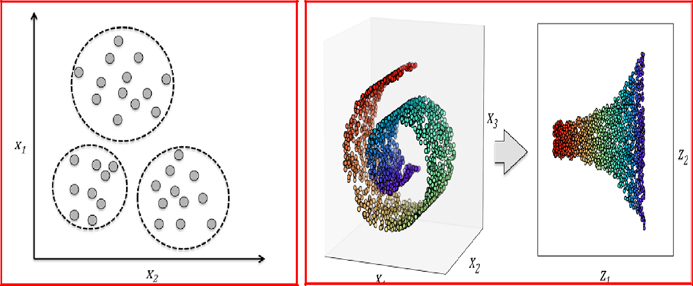
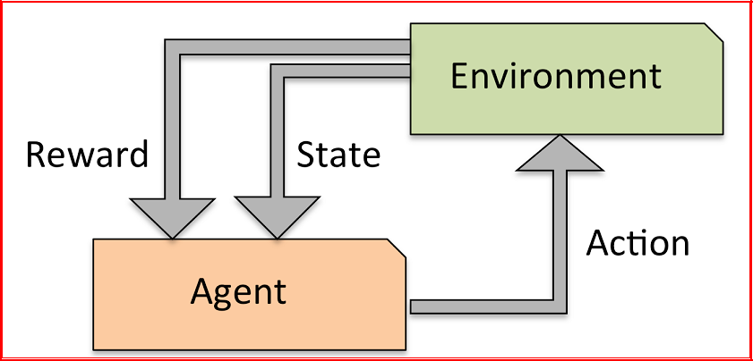
Unsupervised Learning-No Labels
clustering Dimensionality Reduction
Reinforcement Learning

Slide 26
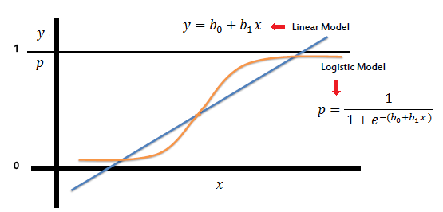
Since our data has both dependent(label) and independent variables we use supervised technique
Our label is categorical so we use classification algorithm.
Running Pipeline using k-fold validation:
Logistic Regression/Classification:-

Slide 27
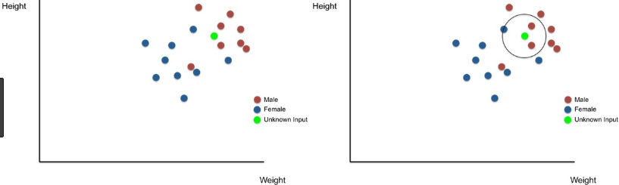
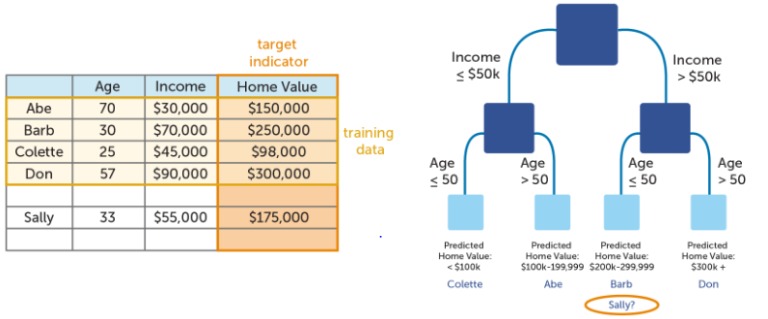
K-Nearest Neighbours
Decision Tree

Slide 28
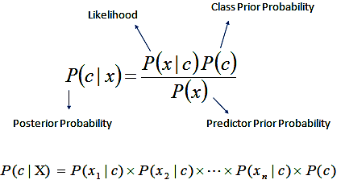
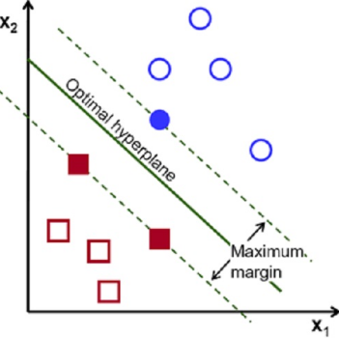
Naive Bayes
Support Vector Machines

Slide 29
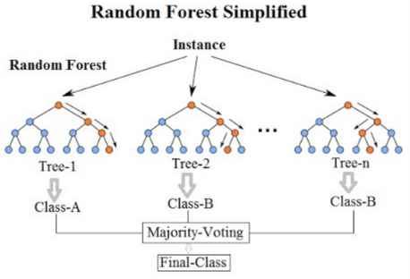
Random Forest Classification: It also deals with ensembling, feature selection.
Ensembling techniques-Predictions by learning from all models predictions
Averaging, weighted averaging, max voting
Advanced-Bagging, Boosting etc .Bagging used in random forest.

Slide 30
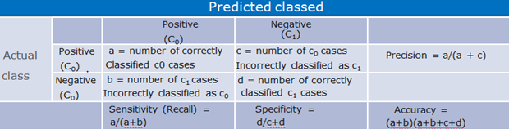
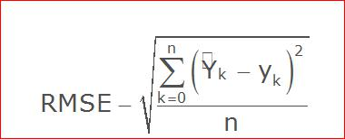
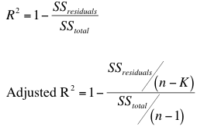
Model evaluation:
Classification : Confusion Matrix
Regression evaluation
RMSE R-square(coeff of determination)

Slide 31
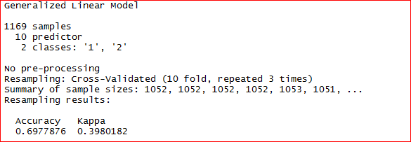
Hyperparameter Tuning
Random Search
Grid Search
Manual Tuning
Our model evaluation
Logistic

Slide 32
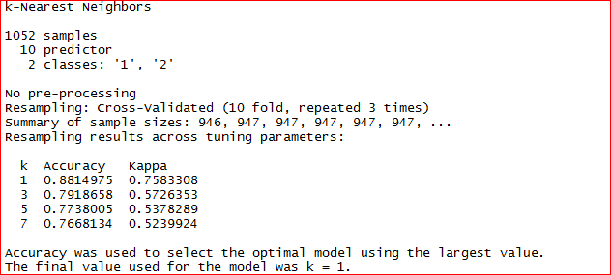
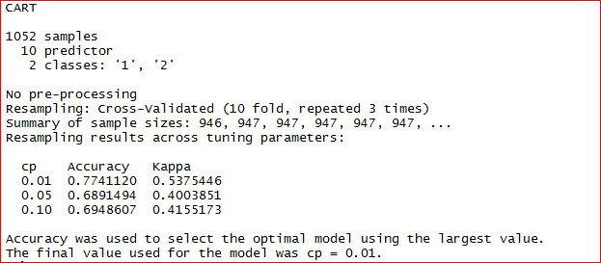
KNN
Decision Tree

Slide 33
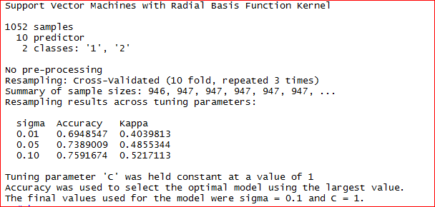
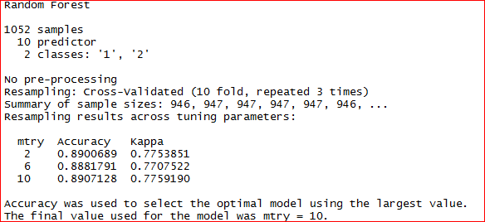
SVM:
Random Forest

Slide 34
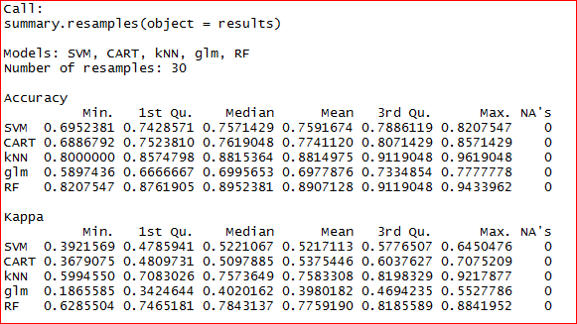
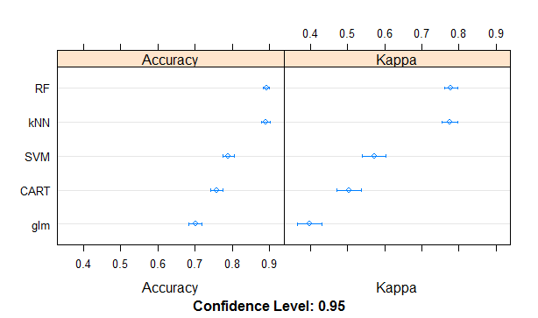
Comparing algorithms:
we got best accuracy for Random Forest

Slide 35
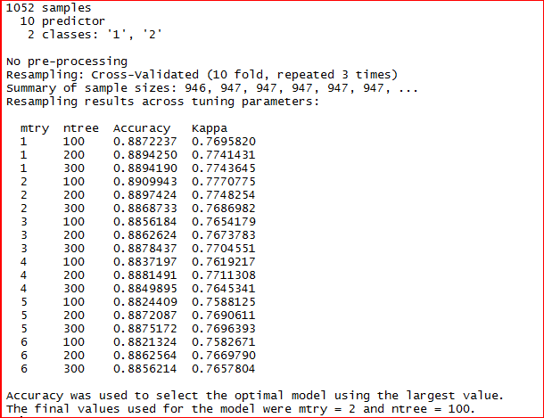
Tuning the parameters in RandomForest:
Hyper parameters in RF are tuned to extract the best parameters for final model.
Number of trees as 100 or 200 or 300.
Number of variables in each tree range-1 to 6
Best accuracy at ntree=100, mtry=2

Slide 36
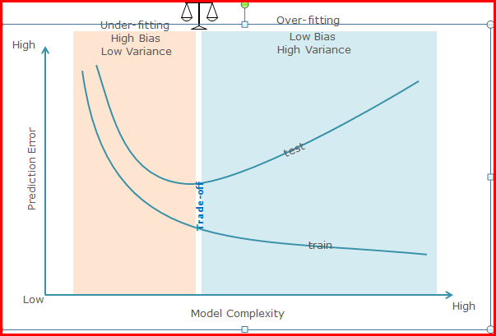
Model Diagnosis with over fitting and under fitting
When the model performs well on training but not on testing it is called as overfitting
When the model doesn’t perform well on training and on testing is called under fitting

Slide 37
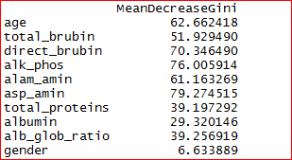
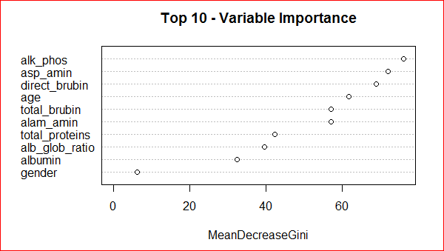
Finding key variables using RandomForest:
Visualization of key variables importance:

Slide 38
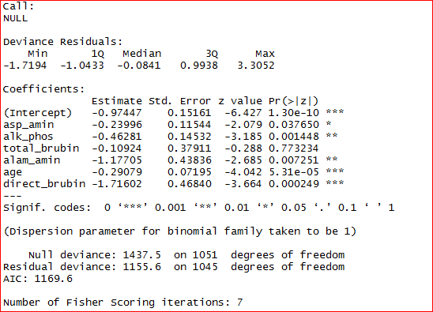
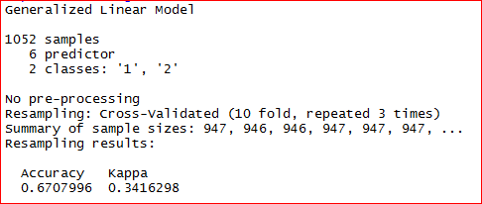
Fitting the final model:
Top 6 variables from RF taken to fit Logistic Regression
Summary
Accuracy

Slide 39
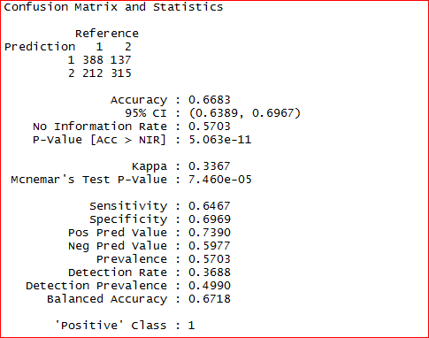
Confusion matrix for Train data:

Slide 40
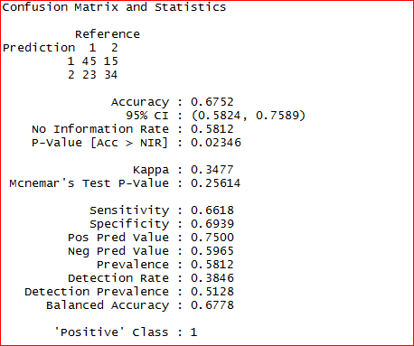
Confusion matrix on Test data:
As the accuracy obtained from train and test data do not differ significantly, the obtained Logistic model is considered as a Generalised model with six important variables – alk_phos, asp_amin, direct_brubin, age, total_brubin, alam_amin.

Slide 41
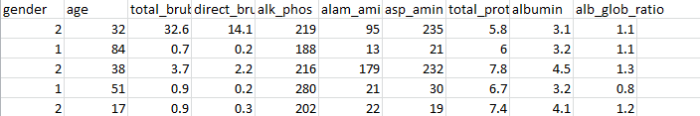

Deployment
Deploy the plan
Output for label for new data is
Monitor the plan and Refine it.

Slide 42

Thank you

