Slide 1

STATISTICAL MODELING FOR EVALUATING THE Business ORGANISATION USING MACHINE LEARNING TECHNIQUES

Slide 2

Scope of the problem
This problem is related to the marketing & operations decision area.
One of the leading brands of coffee shop chains desired to ascertain
What are parameters to evaluate the coffee shop segments
Whether any marketing actions need to be taken, given the customer needs and segment sizes
An algorithm, by which we can classify new respondents into existing groups
What are the attributes that make the respondents visit again
To achieve the above, we have prepared a Questionnaire which consists of different attributes to be rated on a 1 to 4 point scale. Here, 1 represents not at all satisfied, 2 means not satisfied, 3 means satisfied and 4 means extremely satisfied.

Slide 3
Questionnaire
Retail image Ratings
Please rate the different coffee chains from 1 to 4 on the following factors:
1=Not at all satisfied, 2=Unsatisfactory, 3=Satisfactory, 4=Extremely Satisfactory
 | Extremely satisfactory | satisfactory | Un satisfactory | Not at all satisfied
1) The route to the café is:
2) Traffic on the way is:
3) Time taken to get to the café is:
4) Variety of categories of food and beverage products
5) Number of items in each category
6) Availability of what you like
7) Number of outstanding products in Menu
8) Variety and suitability of Merchandise products
9) Price of my regular order in this café is
10) Prices of most menu items are

Slide 4
11) My opinion of Discount Offers and Combos at this café is
12) The quantity and presentation of items is
13) Courtesy and general helpfulness of staff
14) Suggests items only when asked
15) Reliable billing
16) Quick Service
17) I can pay when I want
18) I can pay how I want cash/ credit card/coupons
19) Food and Beverage is served in the best way possible- Coffee is hot, food is warmed etc.
20) Easy to walk about in, layout of the café

Slide 5
21) Interior décor
22) Merchandise and other displays
23) Social class of other customers
24) Music and noise levels in café
25) Comfortable Seating
26) Ambient temperature
27) Lighting is just right

Slide 6
Review of the Chapters
Chapter 2 gives the brief introduction about machine learning techniques like need of ML today, types of ML Algorithms and various models in each algorithm and what technique to use when and how to validate, Tune the ML algorithms and how to measure the performance of the ML model
Chapter 3 describes the various results obtained for the problem. This section contains all the outputs generated through the ML algorithms applied on the data as well as validation and performance matrices.

Slide 7

2. Machine Learning Process
The CRISP-DM (Cross-Industry Standard Process for Data Mining) Process was designed specifically for the data mining. However, it is flexible and thorough enough that it can be applied to any analytical project whether it is predictive analytics, data science, or Machine learning. The Process has the following six phases
Business Understanding
Data Understanding
Data preparation
Modeling
Evaluation
Deployment
Fig. : CRISP-DM Process

Slide 8
Types of Machine Learning
Broadly, the Machine Learning Algorithms are classified into 3 types.
Fig. : Machine Learning Algorithms

Slide 9
Supervised Learning
This algorithm consists of a target / outcome / dependent variable which is to be predicted from a given set of predictors / independent variables. Using these set of variables, we generate a function that maps inputs to desired output. The training process continues until the model achieves a desired level of accuracy on the training data.
The process of Supervised Learning model is illustrated in the below picture:
Fig.: Supervised Learning
Examples of Supervised Learning: Regression, Decision Tree, Random Forest, KNN, Logistic Regression etc.,

Slide 10
Unsupervised Learning
In this algorithm, we will not have any target or outcome variable to predict / estimate. It is used for clustering population into different groups, which is widely used for segmenting customers in different groups for specific intervention. (More of Exploratory Analysis)
Examples of Unsupervised Learning: Data reduction techniques, Cluster Analysis, Market Basket Analysis etc.,

Slide 11
Reinforcement Learning
Using this algorithm, the machine is trained to make specific decisions.
It works in this way: the machine is exposed to an environment where it trains itself continually using trial and error. This machine learns from past experience and tries to capture the best possible knowledge to make accurate business decisions.
The process of reinforcement learning is illustrated in the below picture:
Examples of Reinforcement Learning: Markov Decision Process, Self-driving cars etc.,
Fig.: Reinforcement Learning

Slide 12
Choosing the algorithm
Choosing the right algorithm will depend on the type of the problem we are solving and also depends on the scale of the dependent variable. In case of continuous target variable, we will use regression algorithms and in case of categorical target variable, we will use classification algorithms and for the model which doesn’t have target variable, we will use either cluster analysis / data reduction techniques.
Below picture describes the process of choosing the right algorithm:
Fig.: Machine Learning Types

Slide 13

Unsupervised Learning
Dimensionality Reduction Algorithms:-
There are many dimensionality reduction algorithms in machine learning, which are applied for different dimensionality reduction applications. One of the main dimensionality reduction techniques is Principal Component Analysis (PCA) / Factor Analysis.
Principal Component Analysis:-
Principal Component Analysis is one of the algorithms of Dimensionality reduction. In this technique, it transforms data into a new set of variables from input variables, which are the linear combination of real variables. These Specific new set of variables are known as principal components. As a result of the transformation, the first primary component will have the most significant possible variance, and each following component in has the highest possible variance under the constraint that it is orthogonal to the above components. Keeping only the best m < n components, reduces the data dimensionality while retaining most of the data information.

Slide 14
Factor Analysis:-
Factor Analysis is an exploratory technique applied for data reduction..
The objective of Factor Analysis is to reduce and summarize a large number of
Original variables into smaller number of synthetic variables called Factors.
And the basic idea of Factor Analysis as a data reduction technique is to
Combine two or more correlated variables into one Factor.
The following are the different considerations and steps to be taken
to perform a Factor Analysis
1) Data type and Minimum sample size
2) Factor Extraction
3) Factor Rotation
4) Interpretation
Data Type and Minimum Sample Size
Data should be of Metric (Interval/Ratio Scale) type and the minimum
sample size is 5 for each and every variable

Slide 15
Factor Extraction
In the Factor Extraction process, our objective is to identify the
number of factors to be extracted from the data. The most popular method
used for this is called Principal Components Analysis. There is also a rule-of thumb based on the computation of an Eigen value, to determine how many
factors to extract.
Selection of the suitable Factor solution
In order to select the suitable factor solution, we will check if the
factor variance percentage explained is greater than 5% or if the Eigen value is
greater than or equal to 1(Eigen value is the total variance explained by each
factor).
Factor Rotation
After factor number is finalized, we will use factor rotation in order to
get the meaningful interpretation. We use different rotations like Varimax,
Quartimax—escort of these Varimax is commonly used rotation procedure.

Slide 16
Varimax rotation
Is an orthogonal rotation of the factor axes to maximize the variance
Of the squared loadings of a factor (column) on all the variables (rows) in a
factor matrix, which has the effect of differentiating the original variables by
extracted factor. Each factor will tend to have either large or small loadings of
any particular variable. A varimax solution yields results which makes it as easy
as possible to identify each variable with a single factor. This is the most
common rotation option.
Rotated Factor loadings
Rotated factor loadings are useful in order to profile the factors. In this we will
examine the attribute loadings under each factor based on these we will profile
them accordingly.
Factor Scores
Instead of using the original variables, one may use the factor scores
as a surrogate for factors. Factor scores maybe used for further analysis like
cluster, Discriminant, Regression –etc.,

Slide 17
Assumptions in Factor Analysis
The critical assumption underlying Factor Analysis are more
Conceptual than statistical. Normality is necessary if a statistical test is applied to test the significance of the factors but, these tests are rarely used. In fact, some degree of multi collinearity is desirable because, the objective is to identify inter related sets of variables. If visual inspection of the correlation is less than 0.30 then, the Factor Analysis would probably be inappropriate. Another mode of determining the appropriateness of Factor Analysis is to examine the entire correlation matrix.

Slide 18
Cluster Analysis:-
Cluster Analysis is an exploratory data analysis tool for solving
classification problems. Its objective is to sort cases (people, things, events,
etc.) into groups or clusters, so that the degree of association is strong between
members of the same cluster and weak between the members of different
clusters or simply Cluster Analysis is used for grouping individuals or brands.
Data Type
Interval scale/Nominal variables are ideally suited for Cluster Analysis. If the variables differ in scaling we should standardize them.

Slide 19
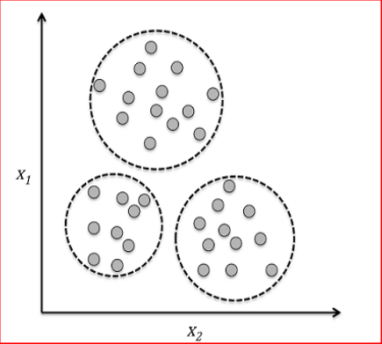
Different Types of Cluster Analysis
The basic methods of clustering have been dividing into the following
3 groups:
1) Hierarchical Clustering
2) Non Hierarchical Clustering
3) Two-Step Clustering
Fig. : Cluster Analysis

Slide 20
K – means Cluster Method :
The Most popular Non Hierarchical approach is K-mean cluster method. This process does not involve the tree like construction process instead, assigns the objects into clusters once the number of clusters to be formed is specified. This procedure follows as specified below.
The first step is to select a cluster seed as an initial solution cluster center and all the objects with the pre specified threshold distance are included in the resulting cluster then, another cluster seed is chosen and assignment continues until all objects are classified. Objects then may be reassigned if they are closer to another cluster than the originally assigned one.

Slide 21
Assumptions in Cluster Analysis
Cluster Analysis does not require any special assumptions like Normality, Linearity etc., Whereas, Multi collinearity might affect the results which can be eliminated by using Factors instead of collinear variables. And cluster analysis technique is Subjective.

Slide 22
3. MACHINE LEARNING - AT WORK
An Approach to the Problem:
In order to carry out the analysis, we have extracted 180 records from the café coffee day using questionnaire and the information of the same is mentioned in Chapter 1.
In this Chapter, we are going to discuss about the results of different Machine Learning methods used in order to obtain the solution for the problem mentioned in Chapter 1.
As mentioned in Chapter 2, the first step of a ML Algorithm is Data cleaning and preparing data for the modeling. As a first step, we have to check whether the data was read properly and all the scale types are as per the data.

Slide 23
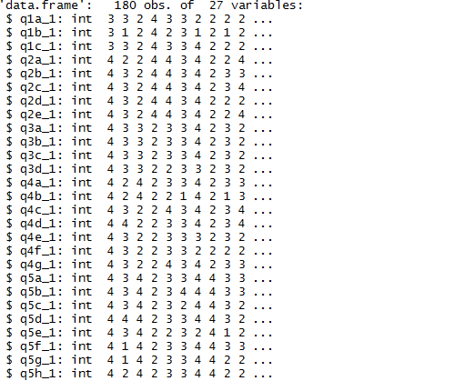
str(data)
Output : Description of Data
We are considering all variables as integer type variables so as to obtain the relations between the variables.

Slide 24
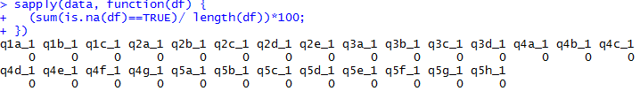
Checking for the missing values:
Output : Checking for missing values
The above output shows that there are no missing values in the data
Checking for correlations:
By using correlations we are finding whether the variables are related to each other or not. The below picture illustrates the correlation between the variables:
library(corrplot)
pre1.cor = cor(data)
corrplot(pre1.cor, method="circle")

Slide 25
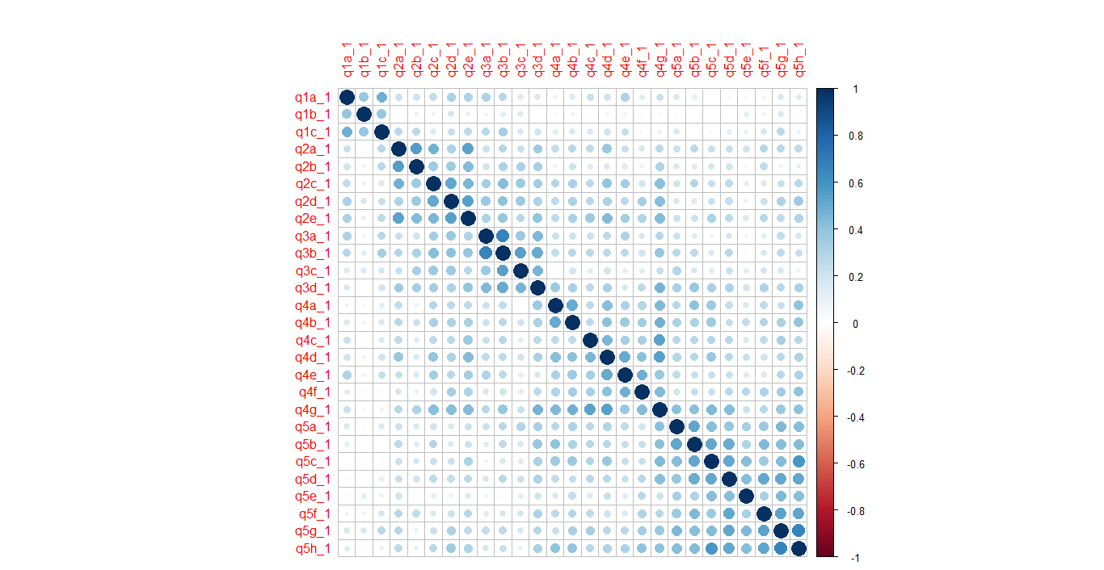
Fig. : Correlation Plot

Slide 26
From the above plot, blue color signifies the positive correlation between the attributes and red color signifies the negative correlation between attributes. And size of circle measures the quantity of relation between variables.
So we can say that correlations are positive and most of variables are correlated.
Number of factors extracted
To extract the number of factors, we have applied the thumb rule
as “Eigen Value greater than or equal 1”.We will get this information from
total variance explained output which is as follows:

Slide 27
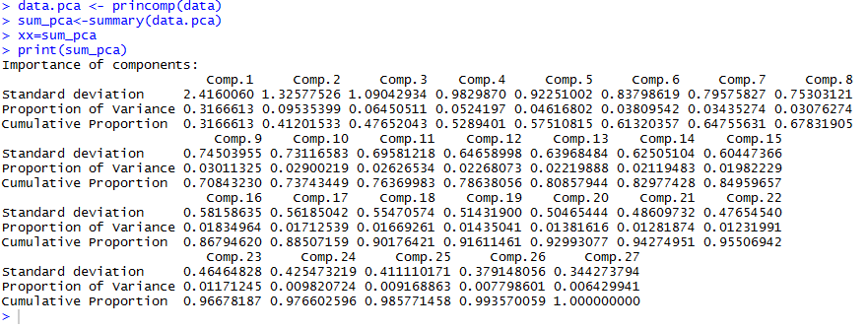
Output : Importance of Components

Slide 28
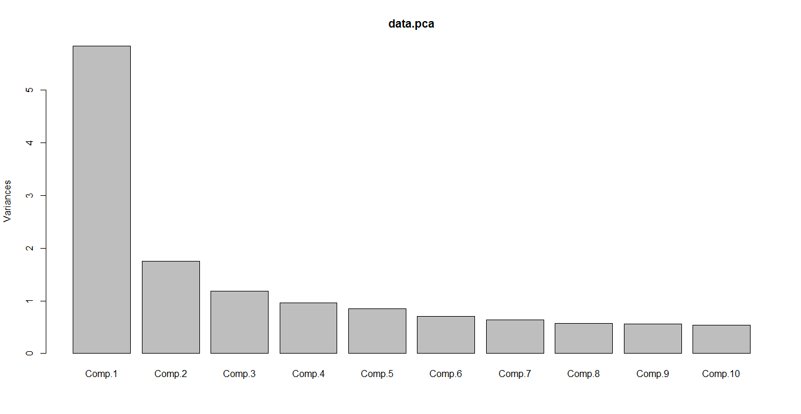
Output : Variance Components Plot
From the above outputs, we can observe that we have got 5factor
solution which is explaining 60% variance of the data. Here, we have
applied Principal Component Analysis.

Slide 29

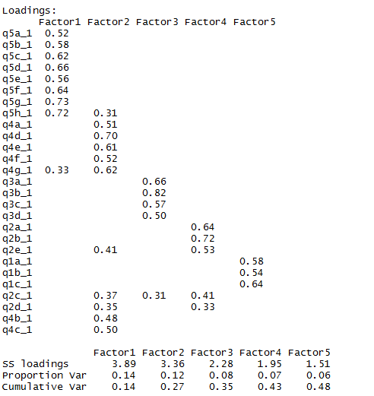
Factor loadings:
In order to get the meaningful interpretation, we have applied the
Varimax Rotation and the resulting rotated factor scores are as follows:
library(psych)
fact<-factanal(data,factors=5,rotation="varimax")
print(fact$loadings, digits=2, cutoff=0.3, sort=TRUE)
Output : Factor Loadings

Slide 30
Factor Rotation:
 | Factor 1 | Factor 2 | Factor 3 | Factor 4 | Factor 5
Q5g_1.Ambient temperature | 0.734651 | 0.191623 | 0.109613 | -0.01199 | 0.299715
Q5h_1.Lighting is just right | 0.724955 | 0.310183 | 0.066379 | 0.028904 | 0.099109
Q5d_1.Social class of other customers | 0.660002 | 0.158959 | 0.170115 | 0.134431 | -0.02696
Q5f_1.Comfortable Seating | 0.643482 | 0.075148 | 0.073099 | 0.188085 | 0.108025
q5c_1.Merchandise and other displays | 0.621252 | 0.2967 | 0.036915 | 0.157093 | -0.12868
Q5b_1.Interior décor | 0.581297 | 0.241015 | 0.177166 | 0.111774 | -0.12217
Q5e_1.Music and noise levels in café | 0.557259 | 0.126746 | -0.05366 | 0.033215 | 0.082097
Q5a_1.Easy to walk about in, layout of the café | 0.517822 | 0.223486 | 0.204063 | 0.081217 | 0.026519
Q4g_1.Food and Beverage is served in the best way possible- Coffee is hot, food is warmed etc. | 0.325097 | 0.61526 | 0.251478 | 0.223351 | -0.09341
q4b_1.Suggests items only when asked | 0.299144 | 0.479796 | 0.137091 | 0.157508 | 0.035307
Q3d_1.The quantity and presentation of items is | 0.287752 | 0.244322 | 0.503297 | 0.283101 | -0.03134
Q4f_1.I can pay how I want- cash/credit card/coupons | 0.280099 | 0.518452 | 0.059779 | 0.020714 | 0.056835
Q4a_1.Courtesy and general helpfulness of staff | 0.277982 | 0.507584 | 0.124807 | 0.068272 | -0.06153
Q4c_1.Reliable billing | 0.220061 | 0.498525 | 0.129073 | 0.11449 | 0.085534
Q2a_1.Variety of categories of Food and Beverage Products | 0.201344 | 0.221378 | 0.109454 | 0.639531 | 0.158465
Q4d_1.Quick Service | 0.167003 | 0.704146 | 0.094793 | 0.199604 | 0.016132
Q2d_1.Number of outstanding products in Menu | 0.15461 | 0.354878 | 0.290042 | 0.331818 | 0.252941
Q2e_1.Variety and suitability of Merchandise products | 0.152939 | 0.408435 | 0.196606 | 0.525892 | 0.193794
Q3c_1.My opinion of Discount Offers and Combos at this café is | 0.131036 | 0.019145 | 0.567048 | 0.274303 | 0.087655
Q4e_1. I can pay when I want | 0.119755 | 0.612348 | 0.090613 | 0.048464 | 0.234128
Q2c_1.Availability of what you like | 0.117462 | 0.374644 | 0.312252 | 0.412699 | 0.093562
Q3b_1.Prices of most menu items are | 0.111787 | 0.207592 | 0.820725 | 0.149932 | 0.192031
Q2b_1.Number of Items in each category | 0.080713 | 0.044826 | 0.201276 | 0.717929 | 0.117425
Q1c_1Time taken to get to the cafe is: | 0.065026 | 0.091263 | 0.175446 | 0.17398 | 0.639002
Q1b_1.Traffic on the way is: | 0.058028 | -0.0797 | 0.045696 | 0.044153 | 0.539144
Q3a_1.Price of my regular order in this café is | 0.04609 | 0.248705 | 0.664321 | 0.034086 | 0.230262
Q1a_1.The route to the café is | -0.01969 | 0.261627 | 0.141985 | 0.142578 | 0.578768

Slide 31

Factor Names
From the above output, we can see different loadings for different
factors. In order to name the factors, we will check the attributes that have
highest loading compare to other factors and assign the respective name.
After checking the above factor loadings, we got the following 5 factors
Ambience
Service
Price-Value
Suitable Menu and Merchandise
Convenient Location

Slide 32
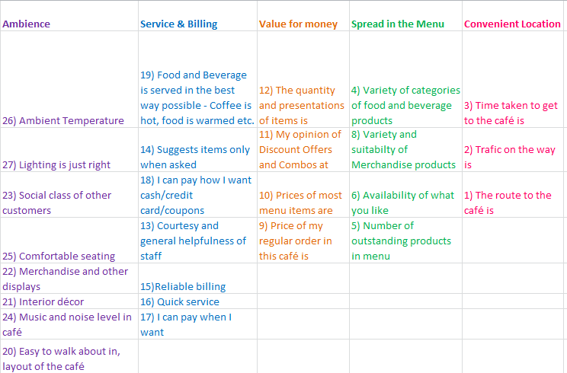
Table : Factor Names

Slide 33
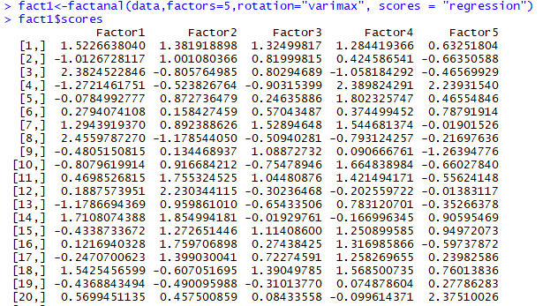
Factor Scores
fact1<-factanal(data,factors=5,rotation="varimax", scores = "regression")
fact1$scores

Slide 34
Cluster Analysis
In order to classify the respondents into groups, we apply the Cluster
Analysis technique. Here, we consider the factor scores obtained from the Factor Analysis as attributes instead of the original variables.
The output is derived by first doing a Hierarchical Cluster Analysis to
find the number of clusters and then running a K-means Cluster Analysis by
giving the number of clusters as the one obtained from Hierarchical clustering.
Non Hierarchical(k means) Cluster Analysis
Now, with these cluster centres we interpret the clusters by looking at the
attributes that have high positive/negative scores on each of these clusters
compared to others. We get the segments as below:
We can also get the information about the number of cases in each
cluster from the following output:

Slide 35
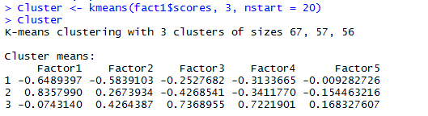
Output : Cluster Means
Final Clusters
Table :Cluster groups
 | Cluster 1 | Cluster 2 | Cluster 3
Ambience | -0.6489397 | 0.8357990 | -0.0743140
Service | -0.5839103 | 0.2673934 | 0.4264387
Price | -0.2527682 | -0.4268541 | 0.7368955
Menu | -0.3133665 | -0.3411770 | 0.7221901
Location | -0.009282726 | -0.154463216 | 0.168327607

Slide 36
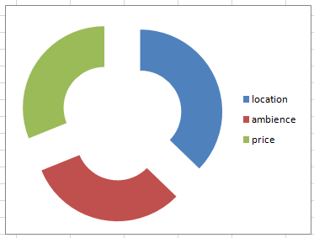
1. Location /Convenience Seekers
2. Ambience/Service Seekers
3. Price seekers
Number of Cases in each Cluster
1 67.000
2 57.000
3 56.000
Valid 180.000
The above figure indicates that there are 67 (out of 180) respondents who prefer convenience amongst all, 57 respondents who prefer Ambience/service and 56 respondents prefer Price.

Slide 37

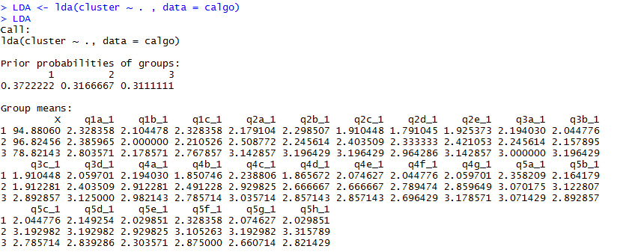
Discriminant Analysis
Discriminant Analysis is a technique by which we can easily classify the new respondent into existing segments. Here, we will take the cluster membership as a dependent variable and all the attributes as independent variables and run the Discriminant Analysis.
Output : Cluster group means

Slide 38
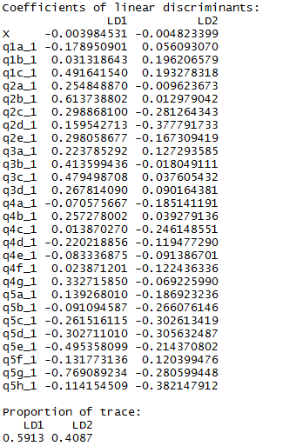
Standardized canonical discriminant functions
In order to find the relative importance of the independent variables over
dependant variable, we use the standardized canonical discriminate co-efficient,
which is as follows:
Output : Coefficients of Linear discriminants

Slide 39

Cross validation
The below is the output for the classification of customers into the three clusters using linear discriminant function which are obtained above for the data.
Output : Cross Validation
From the confusion matrix accuracy of the LDA is (173/180) = 96%.
So, this model can be used for future prediction.

Slide 40
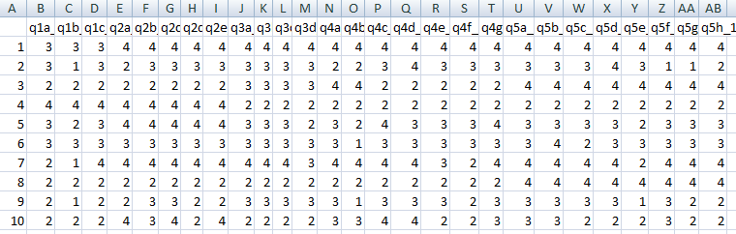
Fig. : Test Data
For the above given test data, using the LDA we classify new customers into the three clusters.

Slide 41


The below is the output for the classification of 10 new customers into the clusters.
Output :Classification of new customers into clusters
Output : Prediction of new customers
From the above table, we can see that 2 customers are classified into cluster 2(ambience seekers) and 8 customers are classified into cluster 3(price seekers)

Slide 42


