Slide 1
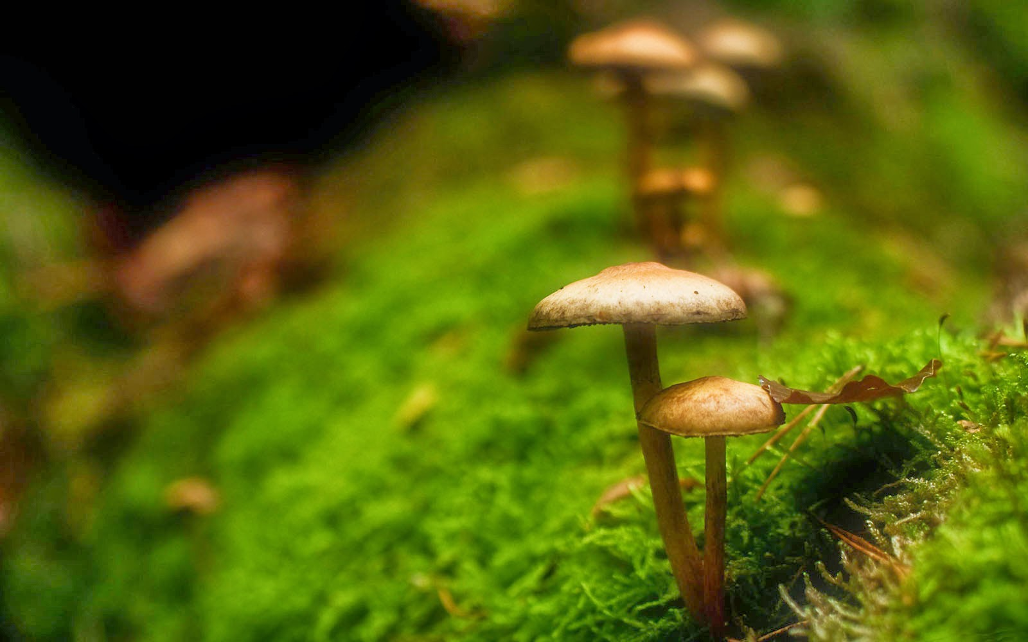

STATISTICAL MODELLING FOR CLASSIFICATION OF MUSHROOM

Slide 2
Introduction and scope of the problem
Scope of the problem :
Problem:
The problem concerns whether the mushroom’s nature is fit for human consumption or not. There are 22 diverse characteristics defined for each mushroom in the dataset. The interest here is to find different combinations of aspects of their features and ecospheres that mostly influence their kind.
Objective:
To assess the class/type of a mushroom entrenched on their varied environmental surroundings and physical appearance.
Goals:
Identifying attributes that strongly affect a mushroom’s type.
Developing an algorithm, by which we can classify the mushrooms based on their physiognomies.
Given a set of characteristics, predicting in which group of class a new mushroom falls.

Slide 3
Data Source:
The dataset has been acquired from a secondary source. It was downloaded from UCI repository. (Source: https://archive.ics.uci.edu/ml/datasets/mushroom).
Data Description:
The original dataset consists of 8124 observations taken over 22 features and the target variable being the type of mushroom. All the variables considered are categorical type.

Slide 4
Machine Learning Process
Data understanding
Data types
Summary measures
Fitting a Model
Choosing appropriate model
Validating the model
Running on test data
Data preparation
Missing values
Outliers
Comparing accuracies
Maintaining the model
Updating
Performing regular checks

Slide 5
Understanding Relationships Between Data:
Contingency Tables
Contingence tables are valuable for revealing how edible/poisonous mushrooms are segmented across their features.
These are generally called as proportion tables.
prop.table(m,1) – value of each cell divided by the sum of the row cells.
prop.table(m,2) – value of each cell divided by the sum of the
column cells.
where ‘m’ represents an object in R, here it is a table.
Relation between dependent and x1

Slide 6
1. Visual representation of relations among features and target variable:
Here, we use scatter plot to have a visual idea of relationships among features and target variable.
2. Variable significance:
At this phase of modelling, we find the significance of variables.
We are using the chi-squared test of significance.
Example :Chi square test between dependent and x2

Slide 7
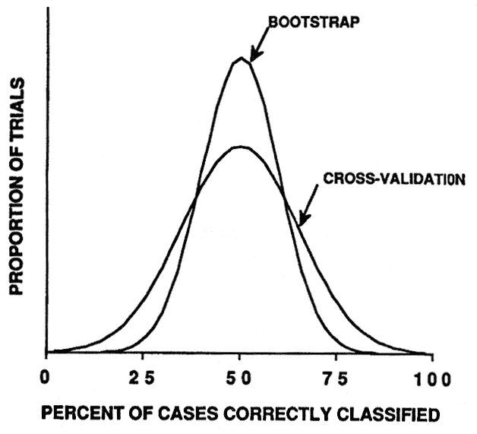
Resampling Methods
Resampling methods: Cross Validation (CV) , Boot Strap
1. CV: Model Assessment, Model Selection
2. Boot Strap: Measure of Accuracy – parameter estimate / statistical learning method
set.seed(): element of randomness

Slide 8
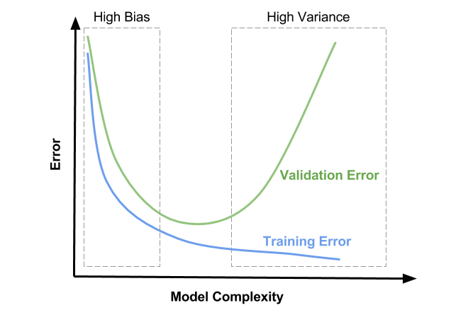
Training error rate v/s Test error rate
Bias refers to the error that is introduced by approximating a real-life problem
Variance refers to the amount by which fitted model would change if it is estimated using a different training data set

Slide 9
Cross Validation
Purpose: To estimate test error associated with fitting a particular statistical learning method on a set of observations.
Validation Set approach
Leave-One-Out CV
k-Fold CV
Stratified k-Fold CV
Dividing data set as training set & validation/hold-out set
Validation set error rate gives estimate of test error rate
MSE – Quantitative data
Confusion Matrix – Qualitative
Fitting model on training set and run on validation set

Slide 10
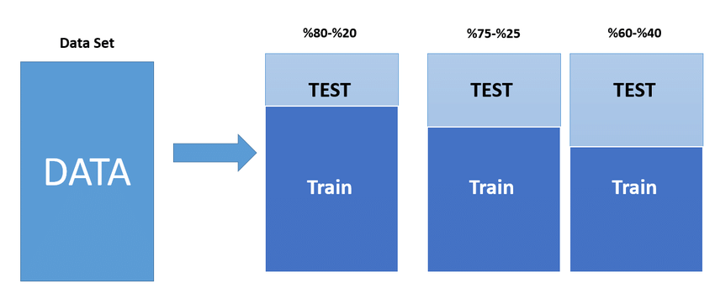
Validation Set Approach
Division of dataset
Split: 70-30 or 80-20
Demerits : highly variable, overestimates test error rate

Slide 11
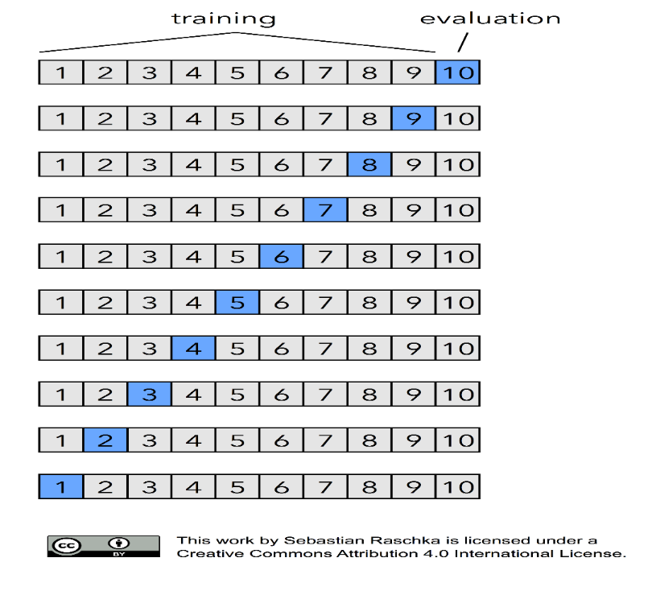
Leave-One-Out CV (LOOCV)
Model is fit on n-1 observations and run on 1 observation held-out
n iterations
Merits: Less biased, yields same result, valid for any kind of predictive modelling
Demerits: Expensive, Time consuming

Slide 12
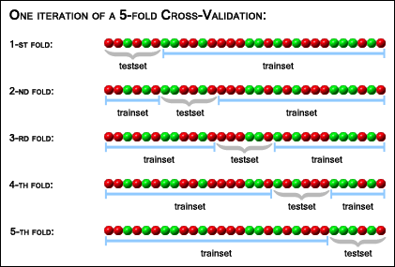
k-Fold & Stratified k-Fold CV
k-Fold CV
LOOCV is a special case
Model fit on k-1 sample sets and run on 1 set left out
k iterations
Stratified k-Fold CV
k-fold is a special case
Heterogeneous to homogenous

Slide 13
k-Fold CV continued ………
A typical example of a 10-fold CV

Slide 14
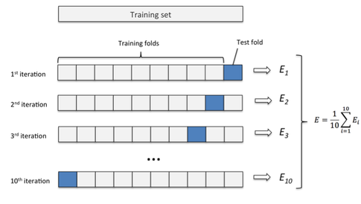
k-Fold’s Test Error Rate
Error is calculated for every iteration and mean of errors is taken
Error measured using MSE

Slide 15
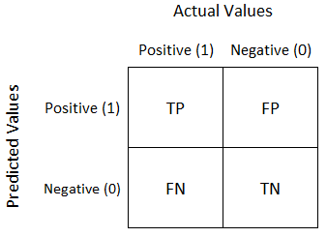
Confusion Matrix/Error Matrix
Diagonal elements indicate correct predictions & off-diagonals represent incorrect predictions
Error rate
Precision
Recall/Sensitivity
Specificity
Accuracy

Slide 16
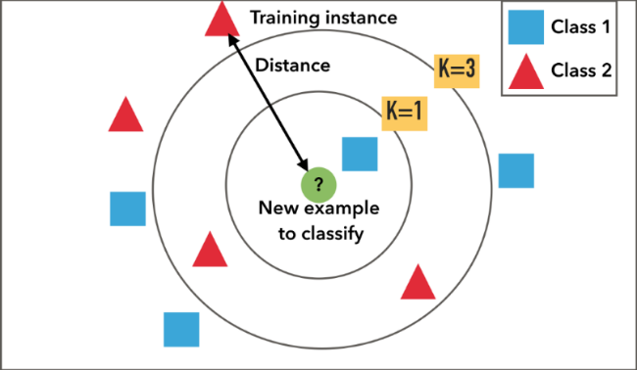
KNN(K-Nearest Neighbourhood):
k-NN algorithm is one of the most straightforward algorithms in classification and also used for regression.
It is one of the most used ML algorithms.

Slide 17
# kNN set.seed(9) grid = expand.grid(.k=c(1,3,5,7)) fit.knn = train(y~., data=Train, method="knn", metric="Accuracy", tuneGrid=grid, trControl=control) print(fit.knn)

Slide 18
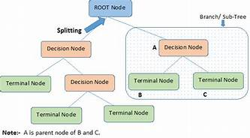
Decision Tree:
Decision tree builds classification models in the form of a tree structure.
Decision trees can handle both categorical and numerical data.
Structure of Decision Tree

Slide 19
# CART set.seed(9) grid = expand.grid(.cp=c(0.01,0.05,0.1)) fit.cart = train(y~., data=Train, method="rpart", metric="Accuracy", tuneGrid=grid, trControl=control) print(fit.cart)

Slide 20
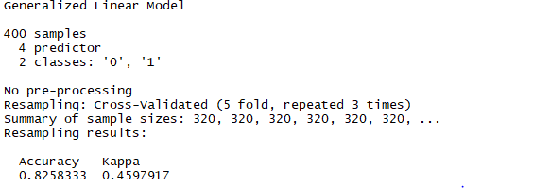
Logistic Regression:
Logistic regression falls under the category of supervised learning.
It measures the relationship between the dependent variable which is categorical with one or more than one independent variables by estimating probabilities using a logistic/sigmoid function.

Slide 21
SVM(Support Vector Machines):
SVM is a linear model for classification and regression problems.
This algorithm creates a line or a hyperplane which seperates the data into classes.

Slide 22
Random Forest:
Random Forest is a versatile supervised learning algorithm capable of performing both classification and regression tasks.
The forest it builds is an ensemble of Decision Trees.
Important hyper parameters:
Ntree
mtry
nodesize

Slide 23
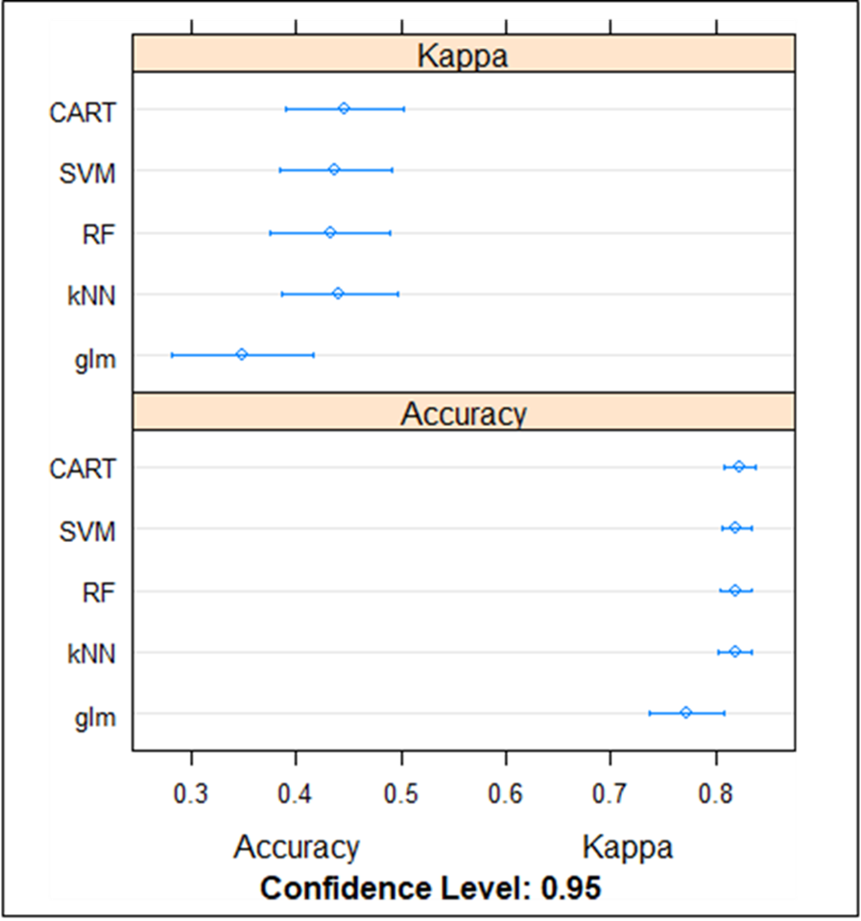
Inspecting Accuracy:
After running these classification algorithms, we compare their accuracies. That is, how well are these models explaining the data.
The visual representation of these accuracies is presented in the dot plot below

Slide 24
Inference made based on accuracy:
As we can notice, Random Forest has the best accuracy of all.
We can do two things at this stage: Parameter Tuning and Variable Importance.
1.Tuning the parameters in RF:
Hyper parameters in Random Forest are tuned to extract the best parameters for final model.
2.Variable Importance:
Here, we identify the key features that establish whether a mushroom is edible or not.

Slide 25
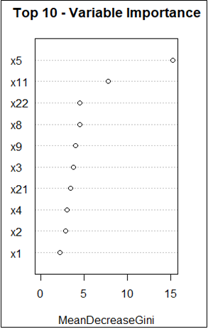
The plot showing variable importance is as follows :
This feature selection plot gives the top 10 variables that prominently define a mushroom into its type.

Slide 26
Final Model:
The final step under this phase of modelling is to fit a model with 4 key features Odour(x5), Habitat(x8), Gill size(x11) and Stalk root(x22).
We fit a Logistic Regression due to its simplicity to the end-user.

Slide 27
Validation and Prediction:
The last phase is the evaluation of the model.
This is a crucial step of the machine learning process.
It determines how well do they perform on unseen data.
Confusion Matrix:
Confusion matrix is one of the most popular ways to evaluate a classification model.

Slide 28
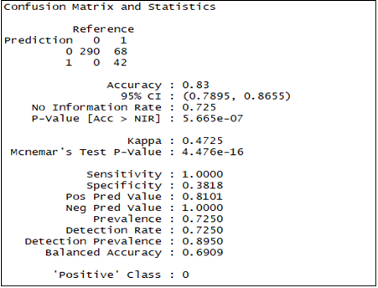
Validating the accuracy of the trained data:

Slide 29
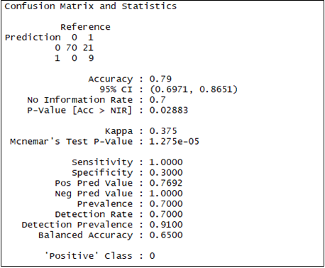
Validating the accuracy of Test data

Slide 30
From the above confusion matrices, we can see that both train and test data show almost near accuracies.
We can therefore conclude that Logistic regression with 4 variables: Odour, Habitat, Gill size, Stalk root classify the mushroom correctly 80% of the time.

Slide 31
SUMMARY:
Classification systems play a major role in decision-making tasks by categorizing the available information based on some principles.
In this project, we focused on prediction accuracy. Our intent was to learn a model that has a good generalization performance on the Mushroom dataset. We recognized the characteristics of the mushroom that are best-suited for its classification. In a way, we compared and evaluated the relative performance of some well-known classification models: k-NN, Decision Trees, SVM, Random Forest, GLM, for the problem at hand.
Over all the algorithms, Random Forest gave a pre-eminent accuracy. We have then tried to tune the parameter of Random Forest Technique to obtain superior performance.
The summary of accuracies of various algorithms are as follows.
Using these, we have fitted logistic regression and obtained the final model.
Conclusion:
A decision to choose Logistic regression model with 4 variables: Odour, Gill Size, Stalk Root, Habitat has been accepted to group the mushroom as edible or poisonous.
k-NN SVM Decision Trees Random Forest GLM
81% 80% 82% 82% 77%

Slide 32
R code:
A: R Code
# Checking and setting the path
getwd()
setwd("C:/Users/mghnp/Desktop/RProject")
getwd()
# Loading required packages
install.packages("mice")
install.packages("randomForest")
install.packages("ggplot2")
install.packages("glmnet")
install.packages(“Hmisc”)
install.packages(“e1071”)
install.packages(“caret”)
library(mice)
library(randomForest)
library(ggplot2)
library(glmnet)
library(Hmisc)
library(e1071)
library(caret)

Slide 33
# Reading the data file into R
# File name: Mushroom
M1=read.csv("Mushroom.csv")
# Looking at basic framework of the dataset – observations, attributes, datatypes
dim(M1)
class(M1)
names(M1)
str(M1)
cols=c("y","x1","x2", "x3","x4","x5", "x6","x7","x8","x9", "x10", "x11", "x12", "x13", "x14", "x15","x16", "x17", "x18", "x19", "x20", "x21", "x22")
M1[cols]=lapply(M1[cols], factor)
str(M1)
summary(M1)
View(M1)
# Removing x16 variable as it has only one level and irrelevant for data analysis
M2=M1[,c(1:16,18:23)]
str(M2)
summary(M2)
#Checking for missing value
print(all(!is.na(M2)))

Slide 34
# Numerical relationships between variables
prop.table(table(M2$x1,M2$y),2)
prop.table(table(M2$x1,M2$y),1)
prop.table(table(M2$x2,M2$y),2)
prop.table(table(M2$x2,M2$y),1)
prop.table(table(M2$x3,M2$y),2)
prop.table(table(M2$x3,M2$y),1)
prop.table(table(M2$x4,M2$y),2)
prop.table(table(M2$x4,M2$y),1)
prop.table(table(M2$x5,M2$y),2)
prop.table(table(M2$x5,M2$y),1)
prop.table(table(M2$x6,M2$y),2)
prop.table(table(M2$x6,M2$y),1)
prop.table(table(M2$x7,M2$y),2)
prop.table(table(M2$x7,M2$y),1)
prop.table(table(M2$x8,M2$y),2)
prop.table(table(M2$x8,M2$y),1)
prop.table(table(M2$x9,M2$y),2)
prop.table(table(M2$x9,M2$y),1)
prop.table(table(M2$x10,M2$y),2)
prop.table(table(M2$x10,M2$y),1)
prop.table(table(M2$x11,M2$y),2)

Slide 35
prop.table(table(M2$x11,M2$y),1)
prop.table(table(M2$x12,M2$y),2)
prop.table(table(M2$x12,M2$y),1)
prop.table(table(M2$x13,M2$y),2)
prop.table(table(M2$x13,M2$y),1)
prop.table(table(M2$x14,M2$y),2)
prop.table(table(M2$x14,M2$y),1)
prop.table(table(M2$x15,M2$y),2)
prop.table(table(M2$x15,M2$y),1)
prop.table(table(M2$x17,M2$y),2)
prop.table(table(M2$x17,M2$y),1)
prop.table(table(M2$x18,M2$y),2)
prop.table(table(M2$x18,M2$y),1)
prop.table(table(M2$x19,M2$y),2)
prop.table(table(M2$x19,M2$y),1)
prop.table(table(M2$x20,M2$y),2)
prop.table(table(M2$x20,M2$y),1)
prop.table(table(M2$x21,M2$y),2)
prop.table(table(M2$x21,M2$y),1)
prop.table(table(M2$x22,M2$y),2)
prop.table(table(M2$x22,M2$y),1)

Slide 36
# Visual relationships between variables
pairs(M2)
#Dividing dataset into smaller dataset for clear picturing
M_a=M2[,c(1,2:6)]
M_b=M2[,c(1,7:11)]
M_c=M2[,c(1,12:16)]
M_d=M2[,c(1,17:22)]
pairs(M_a)
pairs(M_b)
pairs(M_c)
pairs(M_d)
# Finding if variables are significant by performing chi-squared test
chisq.test(M2$y,M2$x1)
chisq.test(M2$y,M2$x2)
chisq.test(M2$y,M2$x3)
chisq.test(M2$y,M2$x4)
chisq.test(M2$y,M2$x5)
chisq.test(M2$y,M2$x6)
chisq.test(M2$y,M2$x7)
chisq.test(M2$y,M2$x8)
chisq.test(M2$y,M2$x9)

Slide 37
chisq.test(M2$y,M2$x10)
chisq.test(M2$y,M2$x11)
chisq.test(M2$y,M2$x12)
chisq.test(M2$y,M2$x13)
chisq.test(M2$y,M2$x14)
chisq.test(M2$y,M2$x15)
chisq.test(M2$y,M2$x17)
chisq.test(M2$y,M2$x18)
chisq.test(M2$y,M2$x19)
chisq.test(M2$y,M2$x20)
chisq.test(M2$y,M2$x21)
chisq.test(M2$y,M2$x22)
# Splitting dataset as Train and Test data
Train_Rows=sample(1:nrow(M2), size=0.8*nrow(M2))
Train_Rows
Train=M2[Train_Rows, ]
Test=M2[-Train_Rows, ]
dim(M2)
dim(Train)
dim(Test)

Slide 38
# Model Pipeline
# Run algorithms using 5-fold cross validation
library(caret)
control = trainControl(method="repeatedcv", number=5, repeats=3)
# GLM
set.seed(9)
fit.glm = train(y~., data=Train, method="glm", metric="Accuracy", trControl=control)
print(fit.glm)
# CART
set.seed(9)
grid = expand.grid(.cp=c(0.01,0.05,0.1))
fit.cart = train(y~., data=Train, method="rpart", metric="Accuracy", tuneGrid=grid, trControl=control)
print(fit.cart)
# SVM
set.seed(9)
grid = expand.grid(.sigma=c(0.01,0.05,0.1), .C=c(1))
fit.svm = train(y~., data=Train, method="svmRadial", metric="Accuracy", tuneGrid=grid, trControl=control)
print(fit.svm)
# kNN
set.seed(9)
grid = expand.grid(.k=c(1,3,5,7))
fit.knn = train(y~., data=Train, method="knn", metric="Accuracy", tuneGrid=grid, trControl=control)
print(fit.knn)
#Random Forest
fit.rf = train(y~., data=Train, method="rf", metric="Accuracy", trControl=control)
print(fit.rf)

Slide 39
# Comparing algorithms
M3=resamples(list(SVM=fit.svm, CART=fit.cart, kNN=fit.knn, glm=fit.glm, RF=fit.rf))
summary(M3)
dotplot(M3)
#Tuning Random Forest
customRF = list(type = "Classification", library = "randomForest", loop = NULL)
customRF$parameters = data.frame(parameter = c("mtry", "ntree"), class = rep("numeric", 2), label = c("mtry", "ntree"))
customRF$grid = function(x, y, len = NULL, search = "grid") {}
customRF$fit = function(x, y, wts, param, lev, last, weights, classProbs, ...) {
randomForest(x, y, mtry = param$mtry, ntree=param$ntree, ...)
}
customRF$predict = function(modelFit, newdata, preProc = NULL, submodels = NULL)
predict(modelFit, newdata)
customRF$prob = function(modelFit, newdata, preProc = NULL, submodels = NULL)
predict(modelFit, newdata, type = "prob")
customRF$sort = function(x) x[order(x[,1]),]
customRF$levels = function(x) x$classes
# Choosing desired parameter values
library(caret)
library(randomForest)
control = trainControl(method="repeatedcv", number=5, repeats=3)
tunegrid = expand.grid(.mtry=c(1:6), .ntree=c(100, 200, 300))
set.seed(9)
M4= train(y~., data=Train,method=customRF, tuneGrid=tunegrid, trControl=control)
print(M4)

Slide 40
# Feature Selection
rf_model3 = randomForest(y ~ ., data =Train, ntree=100, mtry=2)
varImpPlot(rf_model3, sort = T, n.var = 10, main = "Top 10 - Variable Importance")
importance(rf_model3)
#Running final model using Logistic Regression
dim(Train)
trainControl = trainControl(method="repeatedcv", number=5, repeats=3)
final.glm =train (y~ x5 + x11 + x9 + x8 + x21, data=Train, method="glm", trControl=trainControl)
summary(final.glm)
print (final.glm)
# Finding accuracy of Logistic regression on Train data
predslog = predict(final.glm, data=Train, type="raw")
tabtrain = table(Predicted = predslog, Actual = Train$y)
caret::confusionMatrix(predslog,Train$y)
# Running and finding accuracy of the final model on Test data
dim(Test)
names(Test)
M5 = predict(final.glm,newdata=Test,type="raw")
tabTest = table(Predicted = M5, Actual = Test$y)
caret::confusionMatrix(M5,Test$y)

Slide 41
Sampled Mushroom Data
Table 1:
Variable Representations Nature y
Cap_Shape x1
Cap_Surface x2
Cap_Colour x3
Bruises x4
Odour x5
Gill_Attachment x6
Gill_Spacing x7
Gill_Size x8
Gill_Colour x9
Stalk_Shape x10
Stalk_Root x11
Stalk_Surface_Above_Ring x12
Stalk_Surface_Below_Ring x13
Stalk_Colour_Above_Ring x14
Stalk_Colour_Below_Ring x15
Veil_Type x16
Veil_Colour x17
Ring_Number x18
Ring_Type x19
Spore_Print_Colour x20
Population x21
Habitat x22

Slide 42

THANK YOU

