Slide 1







PREDICTING HOUSING PRICES AROUND SINGAPORE
The IT5006 Project

Slide 2
INTRODUCTION
Comprehending housing prices can be tough for residents and internationals, especially in a dynamic environment like Singapore.
Agents rely on real estate knowledge, but predicting prices can be streamlined with basic understanding of how housing works and application of data analytics!

Slide 3
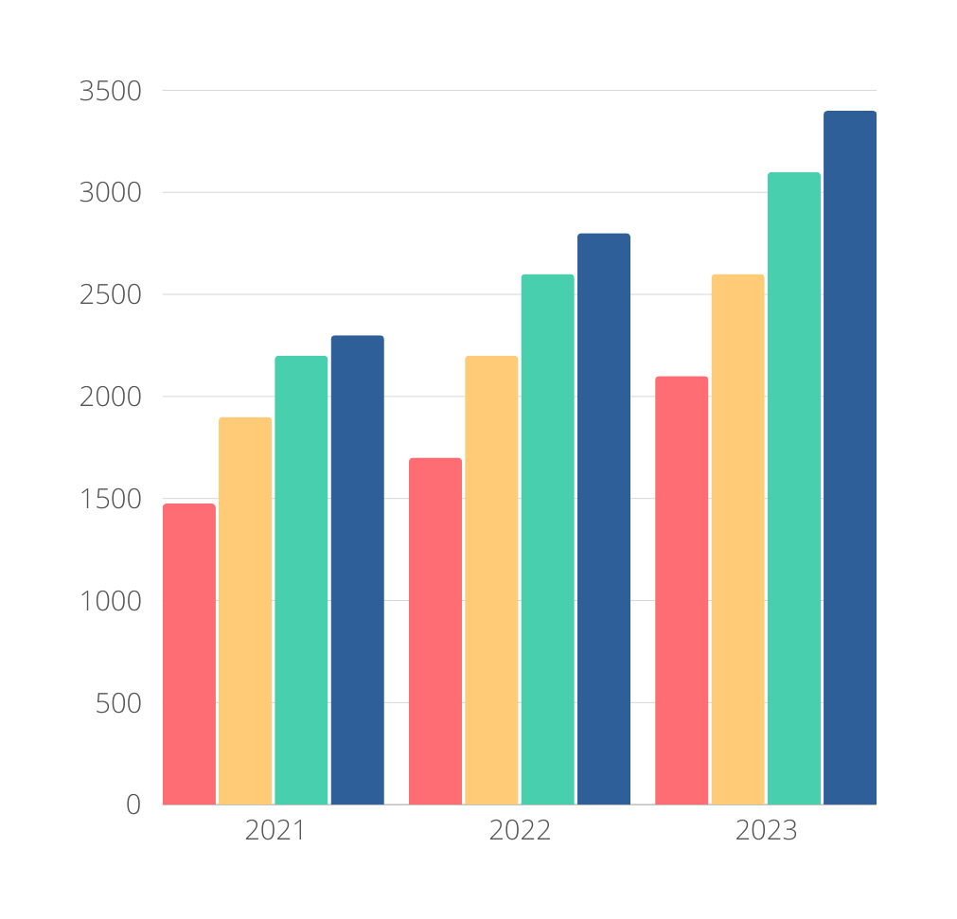
A BRIEF HISTORY OF HOUSING
How the flat types affect the average monthly rental prices of HDB?
01 - 2-ROOM
02 - 3-ROOM
03 - 4-ROOM
04 - 5-ROOM
There is a direct positive correlation -
more the rooms, more the price

Slide 4
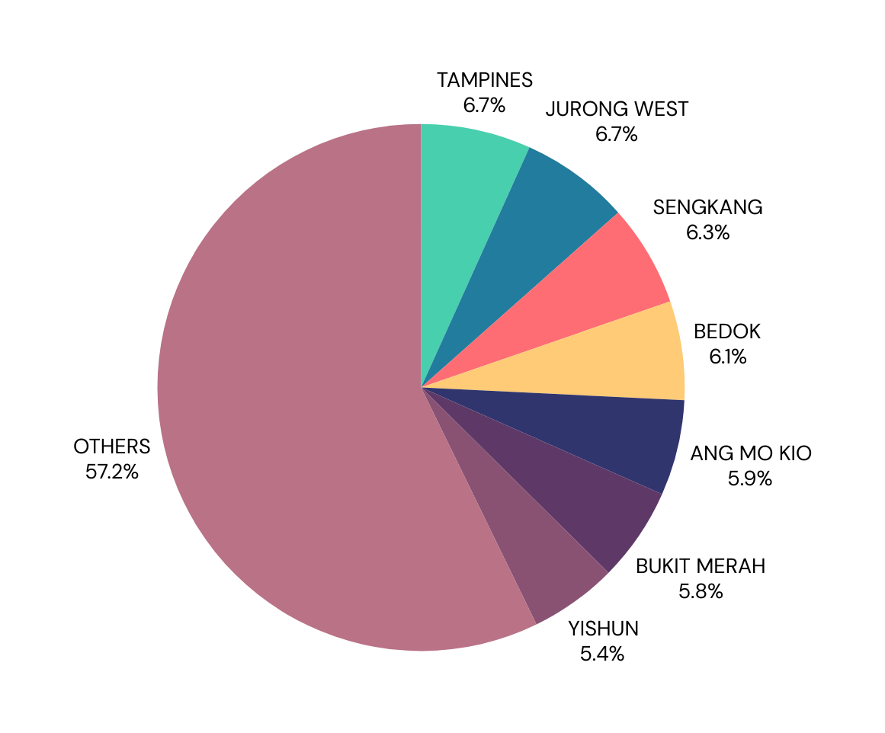
MARKET TRANSACTION SHARE OF HDB RENTALS
TOWNS
Towns like Tampines, Jurong West, Sengkang, Bedok, Ang Mo Kio, Bukit Merah and Yishun cover almost half of all rental transactions!
Regions matter!
EAST - Tampine, Bedok
NORTH EAST - Sengkang, Ang Mo Kio
WEST - Jurong West
CENTRAL - Bukit Merah
NORTH - Yishun

Slide 5
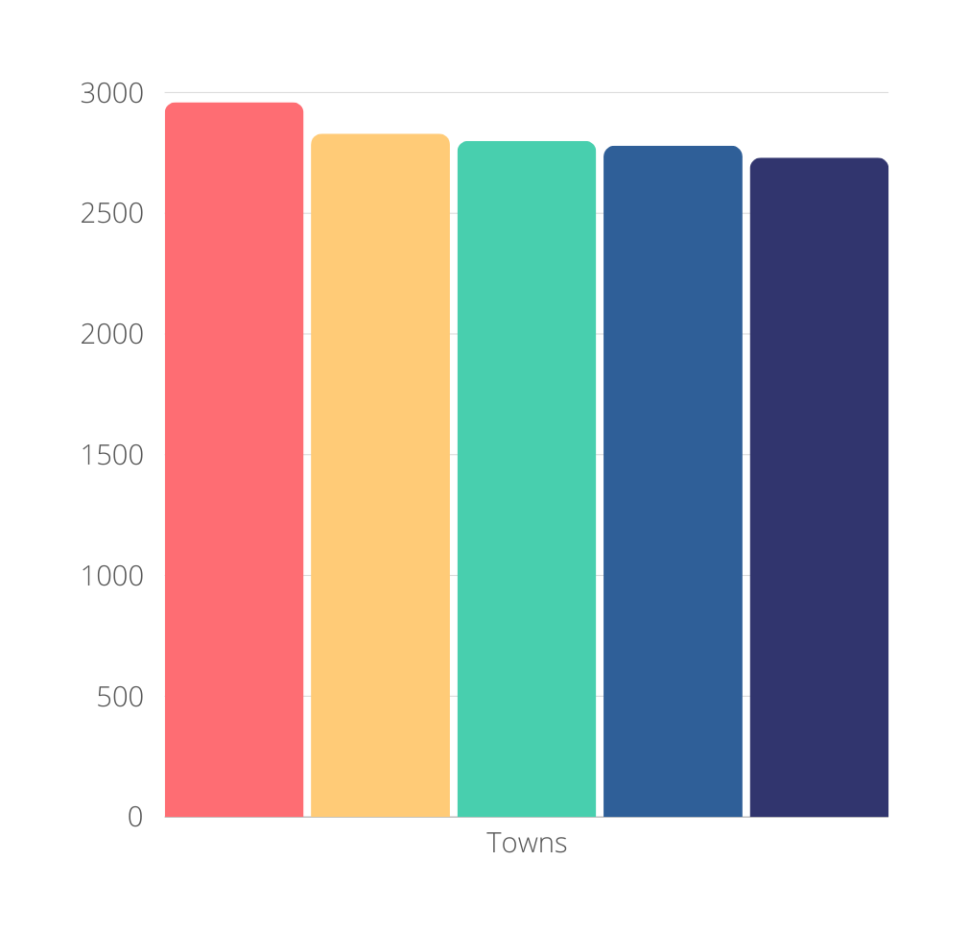
EXPENSIVE TOWNS
Top five towns with the highest average monthly HDB rental prices
CENTRAL
BUKIT MERAH
BISHAN
BUKIT TIMAH
QUEENSTOWN
4 out of these 5 places are located in the Central region!
Region matters! (again)
Almost all of the other towns have rental prices < 2500

Slide 6
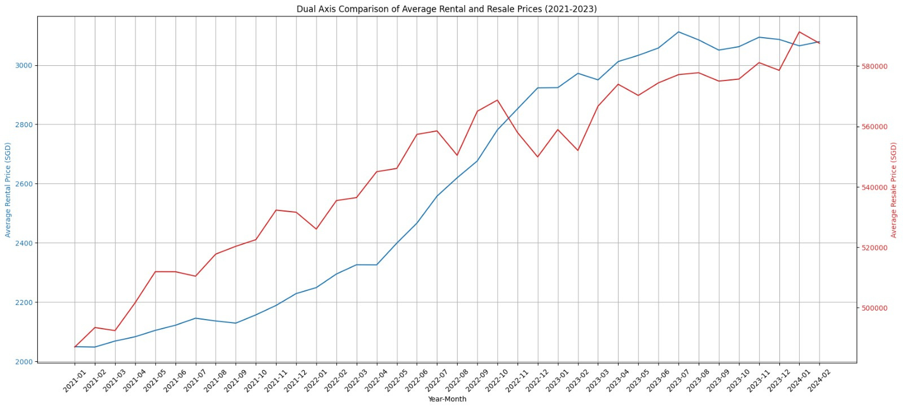
CROSSOVER OF RENTALS AND RESALE PRICES
2022
A generally increasing trend
What happened in Oct 2022?

Slide 7
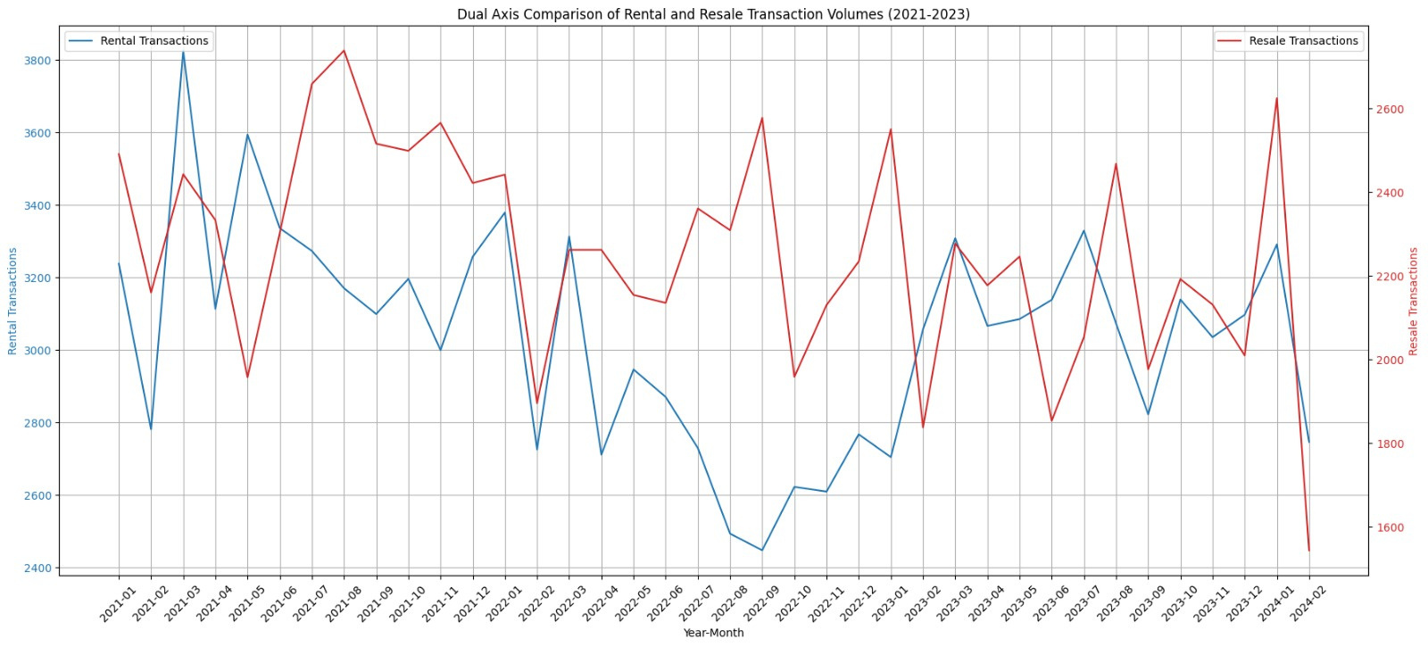
CROSSOVER OF RENTALS AND RESALE TRANSACTIONS
2023
Interestingly dynamic trends
A general tendency of “buy house, leave rental” until 2023

Slide 8
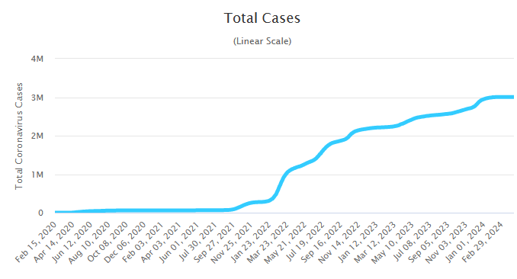
OTHER FACTORS?
The dip in rentals in the year 2022 could be partly explained by the COVID surge
Source: worldometers.info

Slide 9
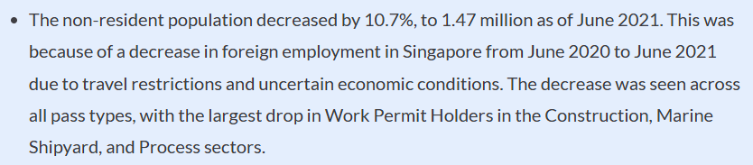
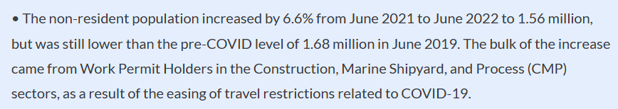
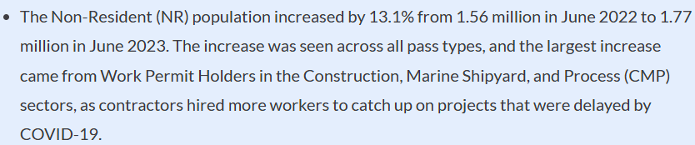
OTHER FACTORS?
The surge in rental transactions after 2022 could be due to increased population of non residents
Source: population.gov

Slide 10
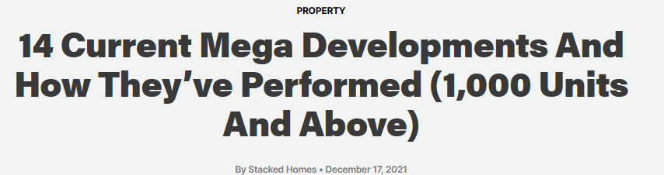
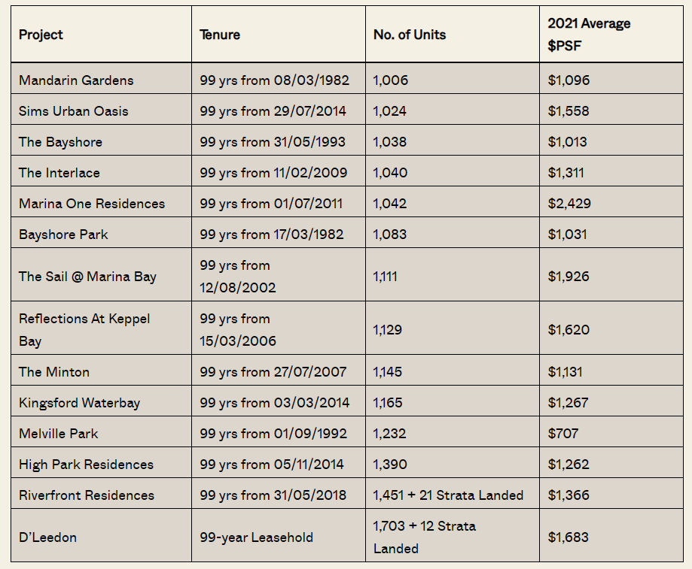
OTHER FACTORS?
2021 saw the soldouts of 1000+ mega developments
Possible reason for decline in resales?
Source: finance.sg

Slide 11
FEATURE ENGINEERING
The number of rooms in the flat affects the rental prices positively. More the rooms, more the real estate, more the rental price
01 - FLAT TYPE
From the visualizations, regions seem to have an impact on the number of transactions as well as the prices
02 - REGION
Amenities around the housing properties can also serve as a crucial factor in rental pricing. Amenities can include MRTs, schools, malls, etc.
03 - OTHER FACTORS

Slide 12
FEATURE ENGINEERING
04 - STOREY RANGE
Premium flats can have many storeys, which implies that they can be pricey
A flat is more prone to be sold at a higher price if there is enough lease period left, as people don’t incline towards buying flats on the verge of lease ending
05 - LEASE LEFT
Economic factors in the country such as inflation can modify the purchasing power of people, and can impact pricing
06 - ECONOMICS

Slide 13
DATA SOURCES
Resale and rental transactions - data.gov.sg
Existing and planned MRTS, Primary schools, malls - data.gov.sg
CPI - SingStat
Coordinates of amenities - OpenStreetMaps API

Slide 14


PREPROCESSING
For how long is the place valid?
Putting the pieces together
Singapore HDBs have a typical lease period of 99 years, so the remaining period of time was calculated for all housings based on its approval period
Removal of nulls and duplicate values in the dataset,
Encoding of ordinal types such as flat type, town, region, model, storey range and cyclical encoding of months
Scaling of continuous features such as floor area, distances to amenities
PROXIMITY TO AMENITIES
CLEANING,
ENCODING,
SCALING
CALCULATE REMAINING LEASE
INTEGRATE WITH
CPI
Raw Data
Processed Data
How happening is the place?
How is the country doing?
Amenities such as existing and planned MRTs, shopping malls, primary schools were explored. Nearest amenities to various flats were calculated using Haversine distance
In order to make it relevant for previous years data, we need to adjust inflation. Consumer Price Index (CPI) was used to integrate with resale prices.

Slide 15
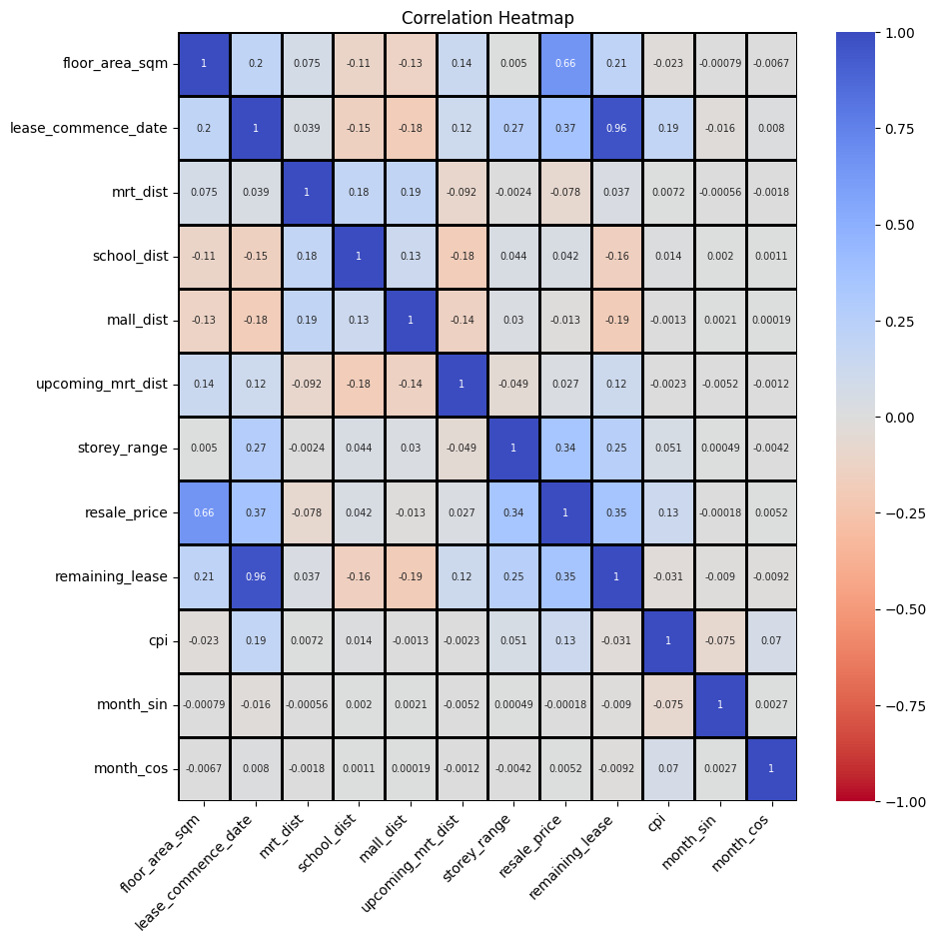
UNDERSTANDING CORRELATIONS - RESALE
BEST INFLUENCERS
Floor area, lease commence date, storey range, remaining lease
MULTICOLLINEARITY
Understandably, lease commence date and remaining lease have a strong correlation

Slide 16
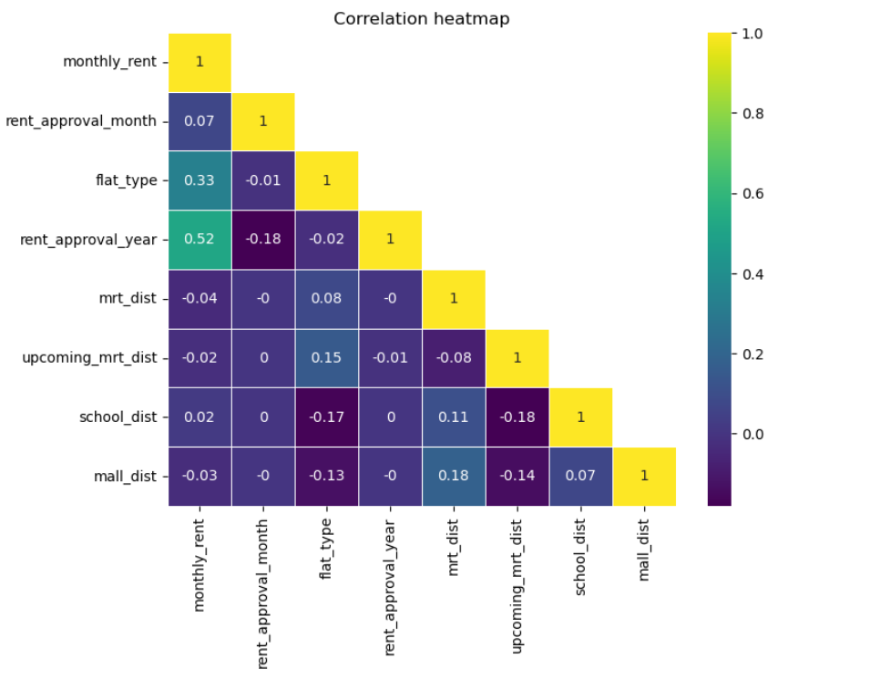
UNDERSTANDING CORRELATIONS - RENTAL
BEST INFLUENCERS
Rent approval year
MULTICOLLINEARITY
No multicollinearity exists

Slide 17





MODELS EVALUATION
HDB Resales
R-squared scores
0.873
0.747
0.97
0.945
LINEAR AND RIDGE
KNN REGRESSOR
RANDOM FOREST
DECISION TREE
Ordinary least squares with logarithmic y
Best parameters using GridSearchCV
n_neighbors = 8
5-fold cross validation
Maximum depth - 50
Minimum samples in leaf nodes - 20
Features finalized: floor area, nearest amenities, flat_type, storey range, remaining lease, cpi, month, region, town

Slide 18




MODELS EVALUATION
HDB Resales
R-squared scores
0.968
0.892
0.969
0.962
ADABOOST
GRADIENT BOOSTING
VOTING REGRESSOR
STACKING REGRESSOR
Base regressor - DecisionTree
Number of estimators - 100
With base regressors as RandomForest and AdaBoost (equally weighted)
With base regressors as Ridge and AdaBoost (equally weighted) and final estimator as RandomForest

Slide 19




MODELS EVALUATION
HDB Rentals
R-squared scores
0.36
0.457
0.5
0.553
KNN REGRESSOR
ADABOOST
LINEAR REGRESSION
GRADIENT BOOSTING
STACKING REGRESSOR
Algorithm - Ball Tree, n_neighbors = 10,
Weights - Distance
Number of estimators = 200,
Learning rate = 0.1
Learning rate = 0.1
Number of estimators = 300,
Max depth = 5,
Learning rate = 0.1

Slide 20


MODELS EVALUATION
HDB Rentals
R-squared scores
0.483
0.445
RF REGRESSOR
MLP REGRESSOR
Number of estimators = 100
activation- relu, hidden_layer_sizes- (100,), 'earning_rate- constant,
solver- adam

Slide 21
INFERENCES
Resales
Region seems to play a very important role in resale prices, with high feature importance shown in linear regression
Towns, floor area, flat models, flat types and amenities come next, with significant coefficients
CPI, remaining lease and month are the next most important features

Slide 22
INFERENCES
Resales
Random Forest Regressor brought out the best predictions with the highest R2 value of 0.97
Linear Regression by itself was great in accounting for the resale price behavior, with a good R2 score of 0.873
Boosted trees and CV showed a good performance but not a good increase in R2, owing to the already well performing base models

Slide 23
INFERENCES
Rentals
Region seems to play a very important role in rental prices, with high feature importance shown in XGBoost Regressor
Features such as nearest amenities had little influence on improving predictive capability of our models
CPI which was expected to play a role in impacting rental prices surprisingly did not affect much

Slide 24
INFERENCES
Rentals
XGBoost Regressor relatively performed the best out of all the models with a R2 score of 0.553
Mostly every other model other than KNN regressor had around the same R2 scores , typically in the range of 0.45 - 0.5
KNN Regressor proved to be the worse model for rental price prediction.

Slide 25
CAN WE DO BETTER?
More amenities can be explored, such as hawker centers, hospitals, local attractions, etc
Making predictions with the behavioral pattern of the specific individual/family searching
Using APIs such as OpenStreetMaps for obtaining accurate driving distances instead of Haversine

Slide 26
CAN WE DO BETTER?
A more intelligent implementation of nearest amenities
Is the nearest MRT for a house same in all years?
Chances that the nearest MRT might not have existed in that year
Upcoming projects in areas in proximity to the housings can be analysed

Slide 27
THANK YOU!
Team 1 -
Nguyen Ngoc Yen Nga, Nivash Sudalaimani, Shamik Banerjee, Sricharan Sriram

