Slide 1

리뷰

Slide 2
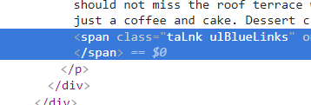
span.taLnk.ulBlueLinks

Slide 3
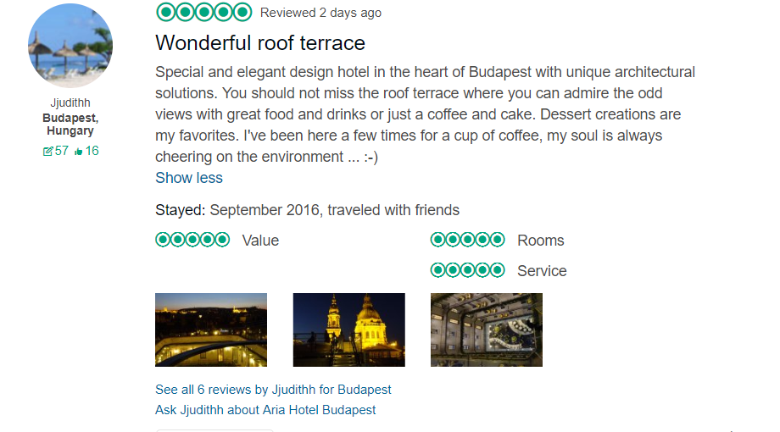

Slide 5
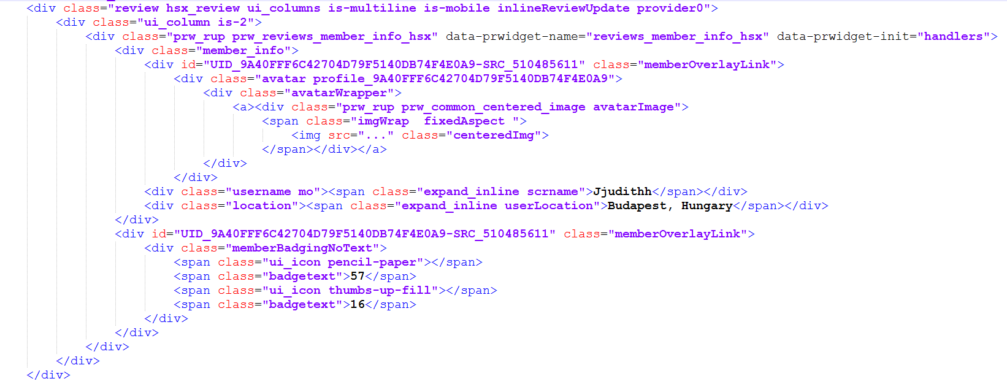
Notes:
div.username
div.location
div.memberBadgingNoText

Slide 6
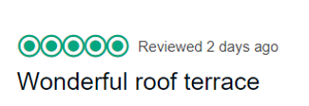


Slide 7
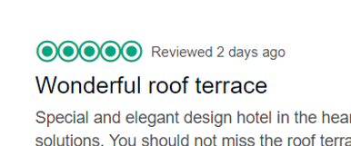


Slide 8



Slide 9

Notes:
.recommend-titleInline

Slide 10
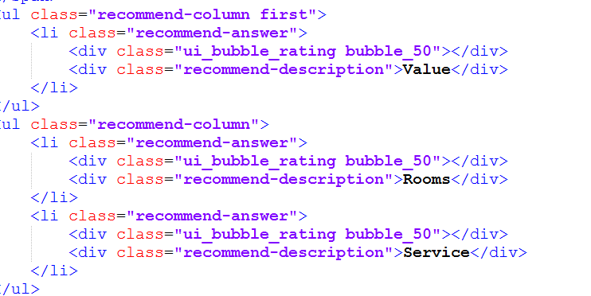

Slide 11


