Slide 1

SPRINT-1 Research Submissions Management (Author Search)
Sindhu Atmakuri
Simhadri Pushpa Latha
Suneetha KK
Hamsa S
Divya Reddy Teluri

Slide 2

1. Introduction
2. Purpose
3. Applications
4. Design
4.1 System Class Diagram
4.2 System Use-cases Diagram
4.3 System Sequence Diagram
5. System feature and Requirements
5.1 Functionality
5.2 Non-Functional Requirement
6. Testcases and Results
7. Conclusion
1. Introduction
2. Purpose
3. Applications
4. Data Flow Diagram
5. System feature and Requirements
5.1 Functionality
5.2 Non-Functional Requirement
6. Testcases and Results
7. Conclusion
INDEX

Slide 3
1.Introduction
Intended Audience: -This document is intended to be read by, Client.
Intended Use:
Development Team
Maintenance Team
Clients
Aim:-
The aim of this document is to gather, analyze and give an in-depth insight into the complete Research Submission Management application by defining the problem statement in detail. The detailed requirements of the Research Submission Management application is provided in this document.

Slide 4
2. Purpose
The purpose of this application is to manage research submission papers submitted by various authors.
This application can be very helpful to find a particular author or number of submissions done by the author.
This application displays all research papers count submitted by the author.
So, with this application it will fetch Numerous research papers as results, which contains the total count of submissions that we have searched.

Slide 5

3. Application
This application can be useful to find out project ids and project titles of a specific author.
The purpose of this program is to help to maintain a record of all types of papers submitted and no. of submissions by author.
This application will take various types of submission papers filenames and it will filter a particular file and show which type of research submission paper it is.
This can be very useful to search for a particular author, file or total number of submissions of the author.

Slide 6
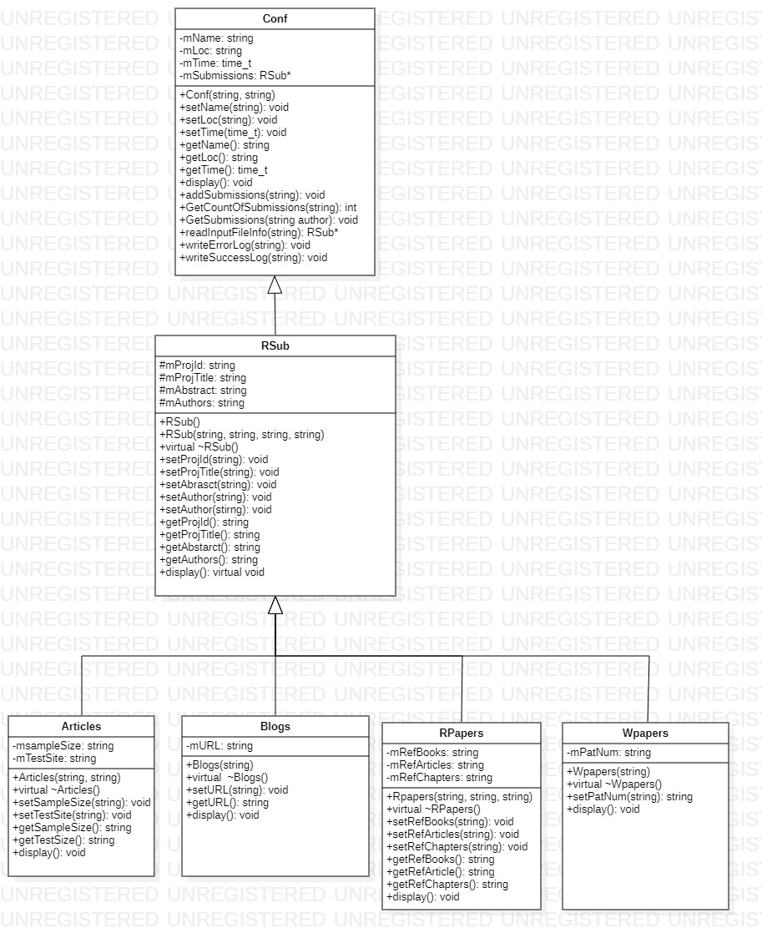
4. Design
4.1 System Class Diagram

Slide 7
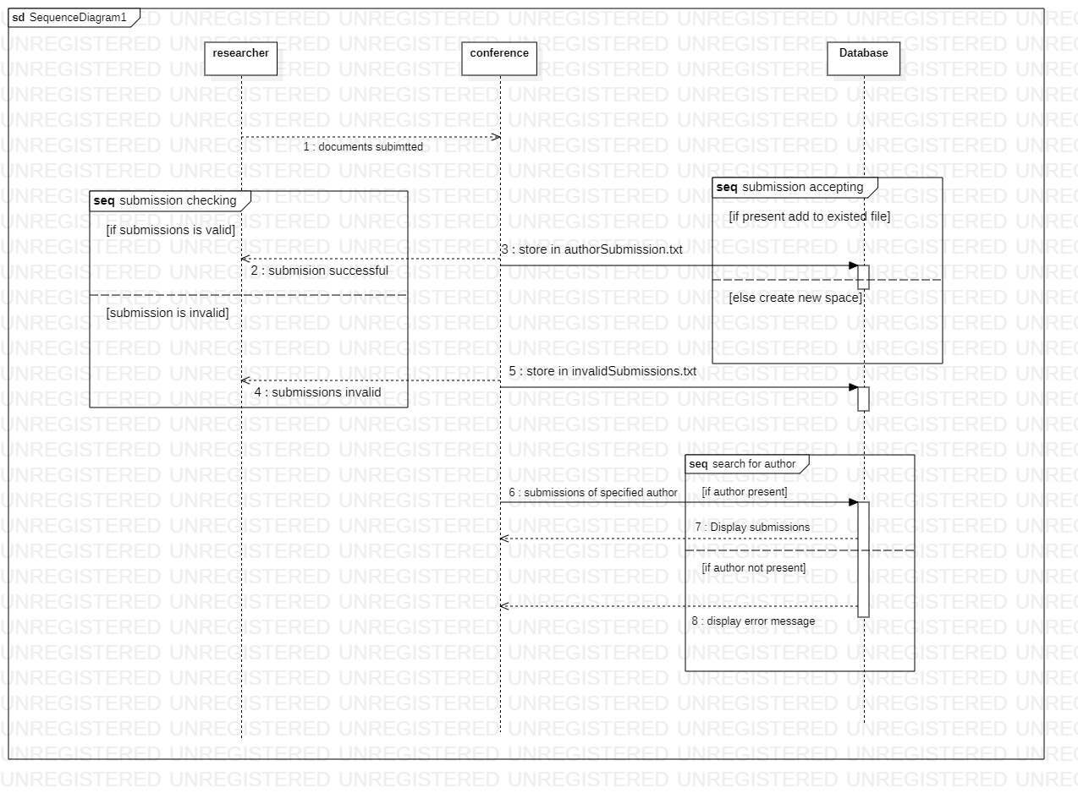
4.3 System Sequence Diagram

Slide 8
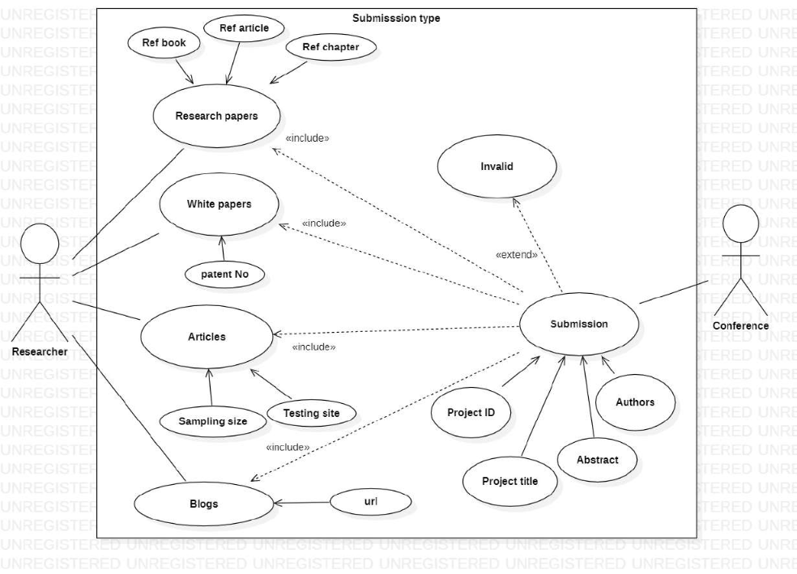
4.2 System Use-case Diagram

Slide 9
Library used :
iostream
vector
fstream
sstream
ctime
iterator
string

Slide 10
5. System feature and requirement
Functionality
File_Parsing
Search Author
Display total count of submisssions
File_Validation
Obtain and store Result
Store Invalid Results

Slide 11
Non-Functional Requirements:
Tools to be used:
Make file : It aids in simplifying building program executables.
CPP Unit : To automate testing to test unit function

Slide 12
Non-Functional Requirements:
Pthread Library :
Basically POSIX threads are used to allow concurrent processes. Here, In this application threads are used to process multiple input files.
Valgrind: to detect memory leak
The Final version of application gives Multi-file multi directory solution with two step compilation process.

Slide 13
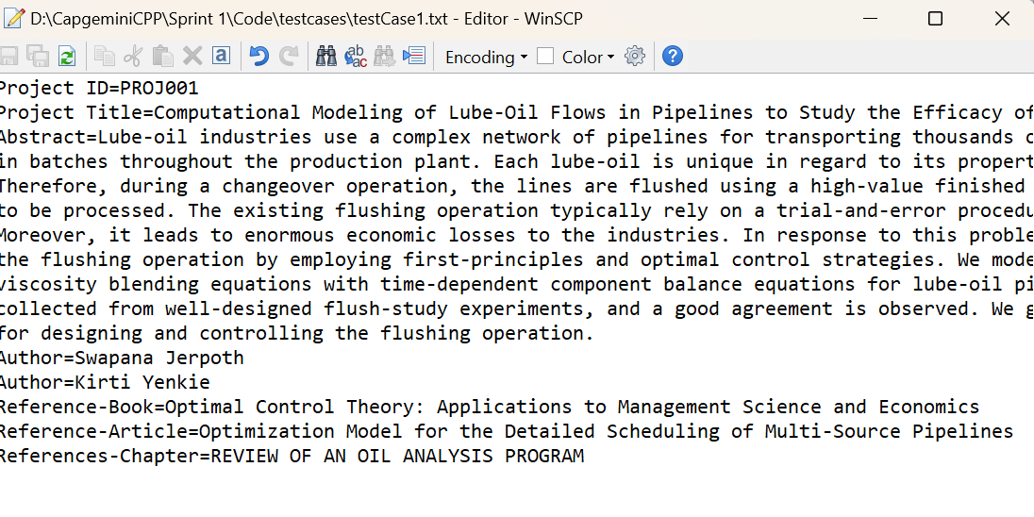
6. Sample Testcase and Result

Slide 14
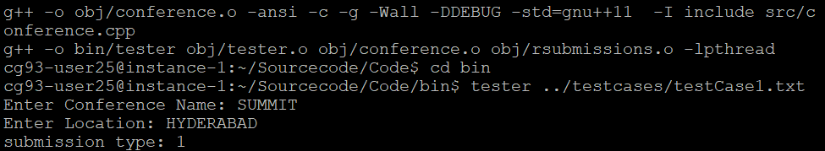
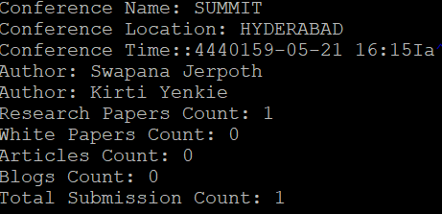
Result for Testcase 1:
Input file in command line arguments
Valid details stored in the file

Slide 15
Conclusion
In this application , conference accepts submissions from researchers which contains articles,blogs,researchpapers, whitepapers.
Valid submissions are stored in one file , invalid submissions are stored in another file.
This makes seggregation of files easier and the user can access the total number of submissions done by the author.

