Slide 1
SPRINT-2
Hotel Reservation/ManagEment SYSTEM
Sindhu Atmakuri
Simhadri Pushpa Latha
Suneetha KK
Hamsa S
Divya Reddy Teluri

Slide 2
INDEX
1. Introduction
2. Purpose
3. Application of project
4. Basic Libraries used
5. DFD Level 0
6. DFD level 1
7. Flow chart
8. System features and requirement
9. Conclusion

Slide 3
1.Introduction
This project titled “HOTEL RESERVATION/MANAGEMENT SOFTWARE” is designed mainly for the purpose of managing all activities like :
1. Hotel Booking 2. Login 3. Room Details
4. Payment

Slide 4
INTENDED USE
Client.
READ BY
Used by
Development Team
Maintenance Team
Clients

Slide 5

2. Purpose
Provide a menu-based interface to select the intended requirement
Ease of use

Slide 6

3. Application of Project
Can be implemented in each and every hotel.
Help with booking procedure, selection of the room type.
Display total amount if reservation is confirmed.

Slide 7
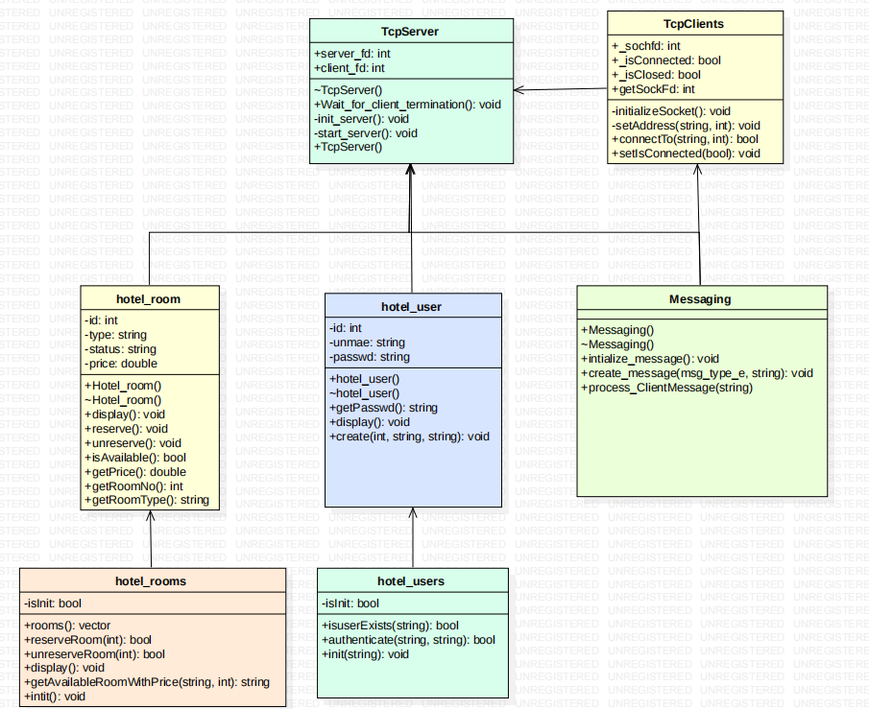
Class Diagram

Slide 8
4. BASIC LibrarIES used
iostream
map
fstream
Iterator
string
vector

Slide 9
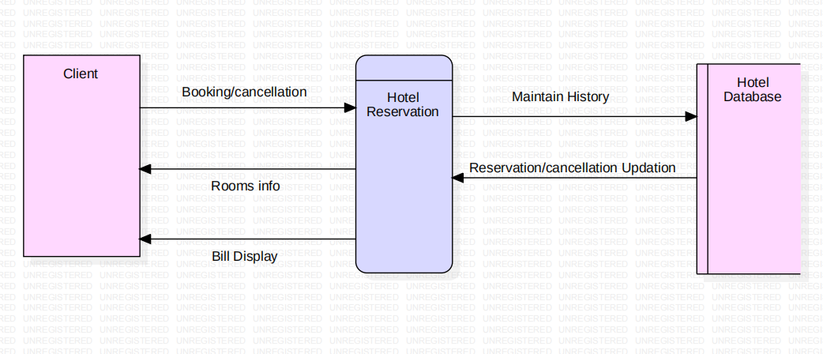
5. DFD LEVEL 0

Slide 10
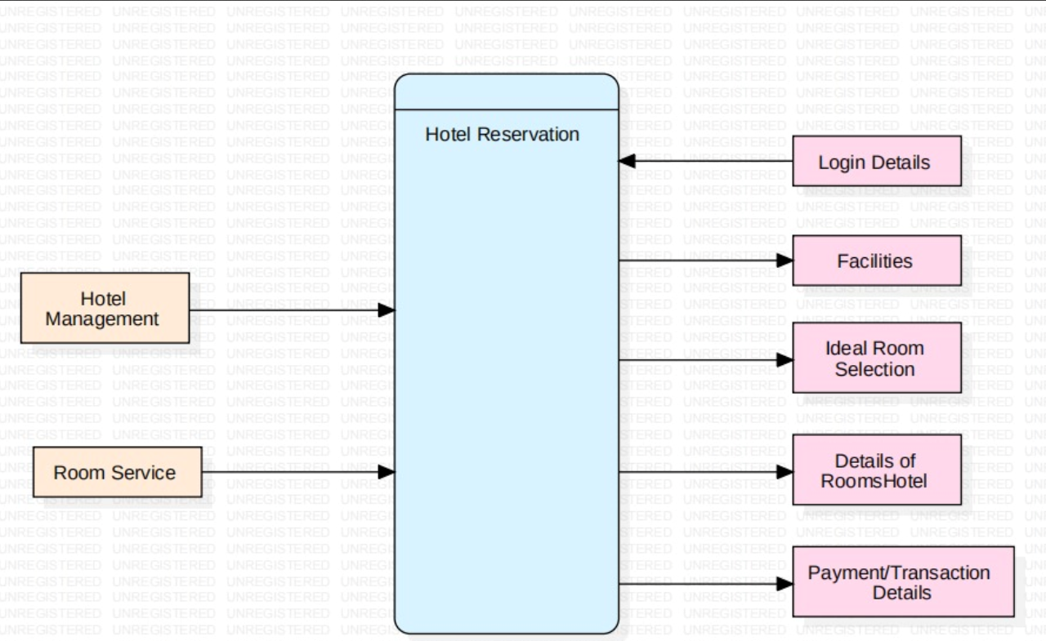
6. DFD LEVEL 1

Slide 11
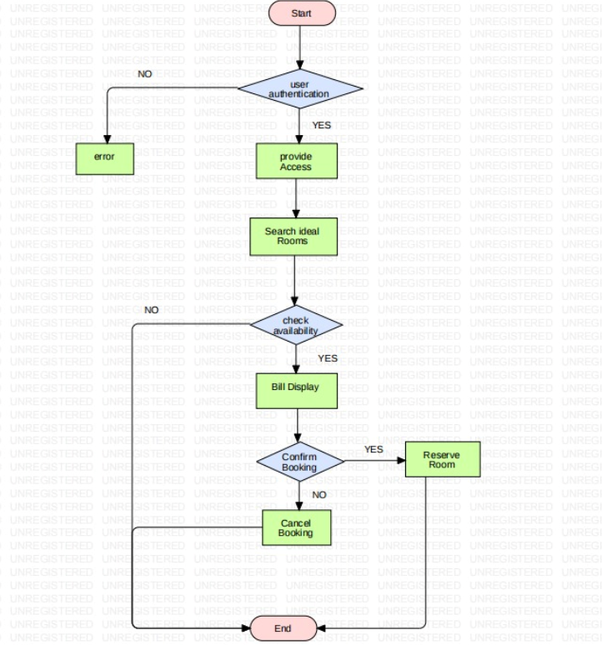
7. FLOW CHART

Slide 12
8. System feature and requirement
Functionality
c++
linux
system programming

Slide 13
Non-Functional Requirements:
Tools to be used:
Make file : It aids in simplifying building program executables.
CPP Unit : To automate testing to test unit function

Slide 14
Valgrind : To detect memory leak
Posix threads: They are used to allow concurrent processes. We use it to manage multiple clients accessing the server

Slide 15
FURTHER IMPLEMENTATIONS/FURTHER SCOPE
Storing atleast one month history of the hotel’s reservations and payments.

Slide 16
9. Conclusion
Implemented using c++ concepts and System programming.
Application of conceptual knowledge wherever necessary.
The output is a user-friendly hotel reservation system.
Menu based interface provided to clients makes it easier and comfortable for them to use.
The final outcome of the project can be considered as real time application of hotel reservation system

Slide 17
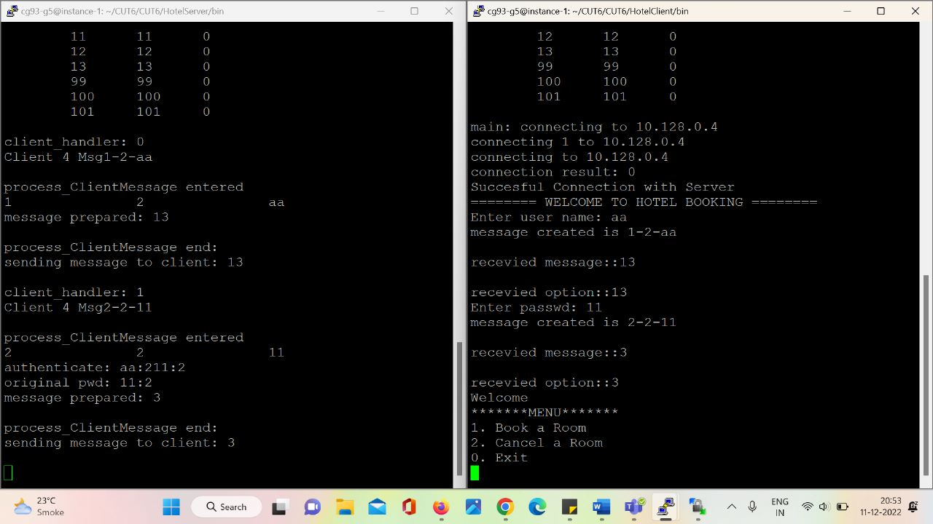
Sample Test Cases And Results

Slide 18
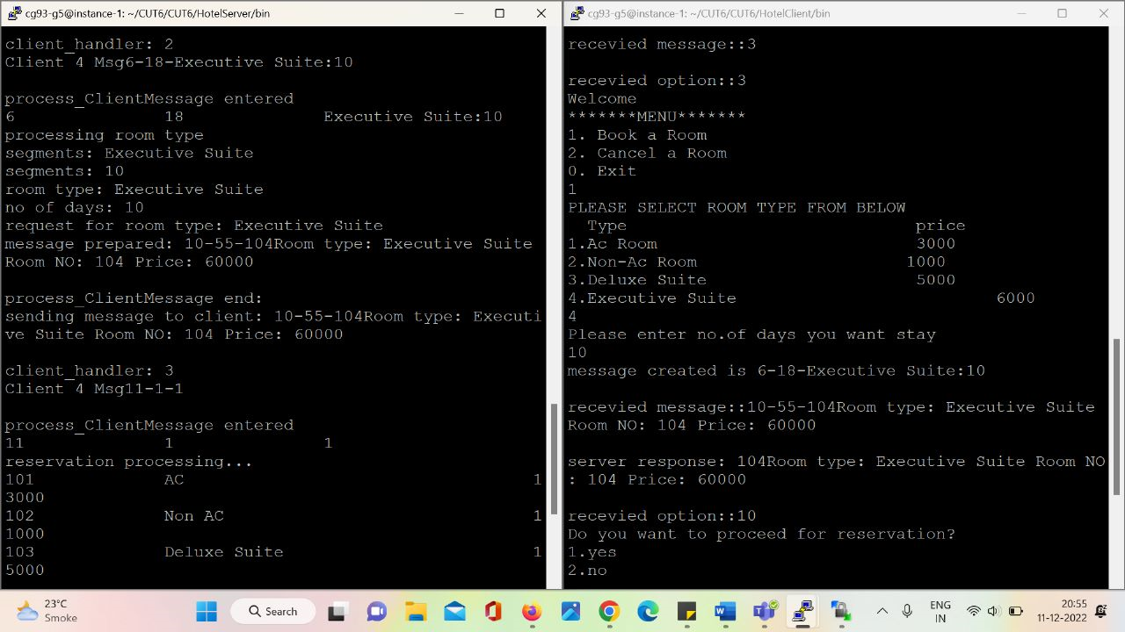

Slide 19
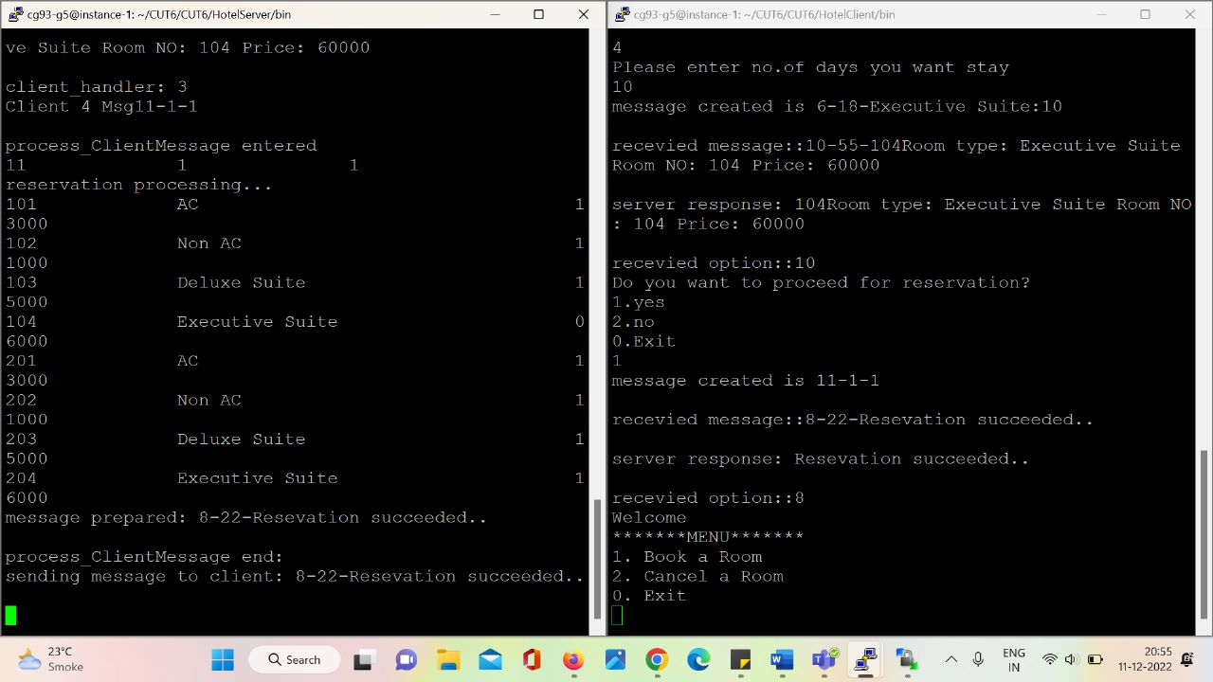

Slide 20


