Slide 1
Bug Classification and Vulnerability Dataset
Dawson Tripp
Christopher Theisen
Dr. Laurie Williams

Slide 2
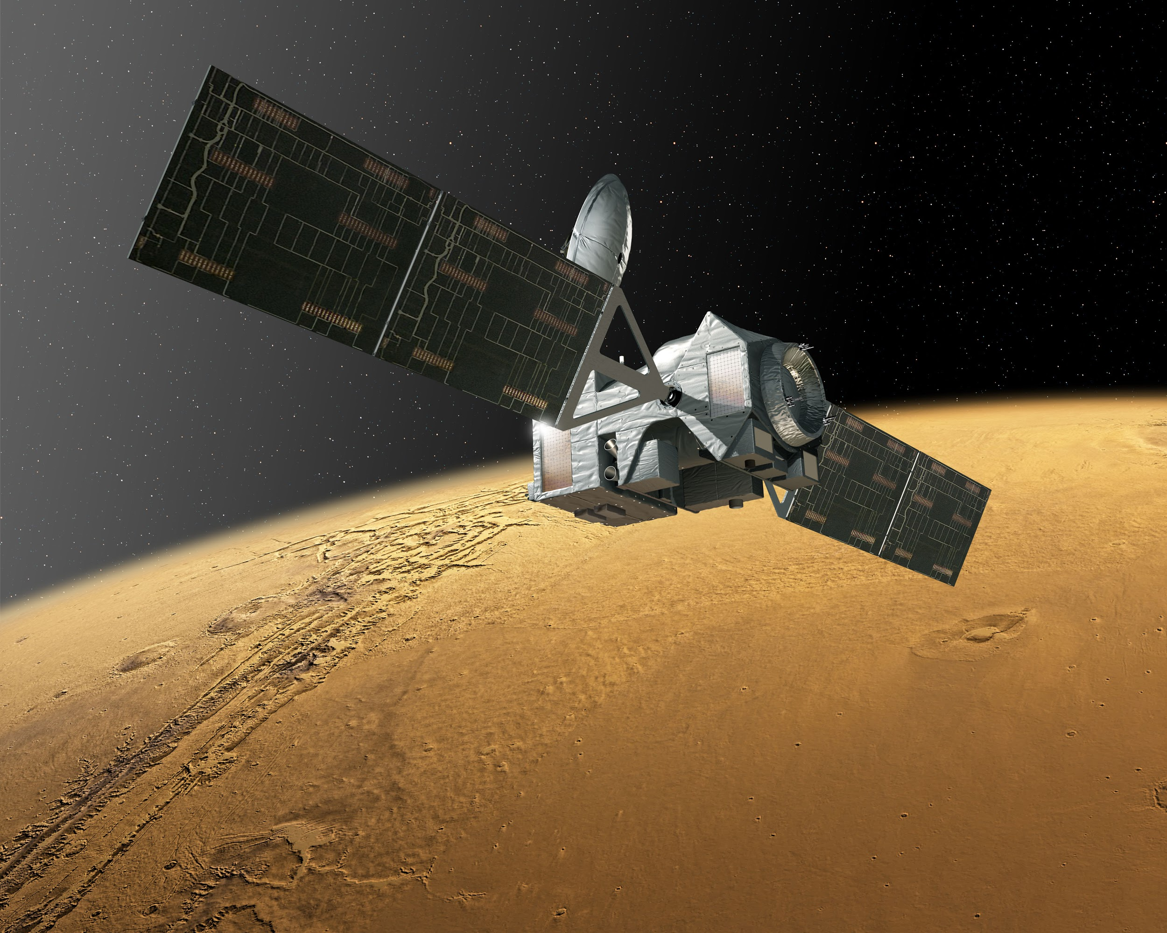

Slide 3

Vulnerability:
A flaw or weakness in system security procedures, design, implementation, or internal controls that could be exercised (accidentally triggered or intentionally exploited) and result in a security breach or a violation of the system's security policy.
NIST SP 800-30 Risk Management Guide for Information
http://csrc.nist.gov/publications/nistpubs/800-30/sp800-30.pdf

Slide 4
Mission
To help security researchers communicate clearly about security vulnerability classifications by providing a categorized bug corpus for research purposes

Slide 5


Background Work
CVE and NVD
Bugs from multiple sources
No groupings
Subjective Danger scores
Poorly organized
Bug Trackers
Broad categories
Discussion over classification in online comments
Can’t track trends of bugs based on official classifications

Slide 6
Goals
Create data set of all bugs
Easily searchable/sortable
Categorized based on vehicle and effect

Slide 7
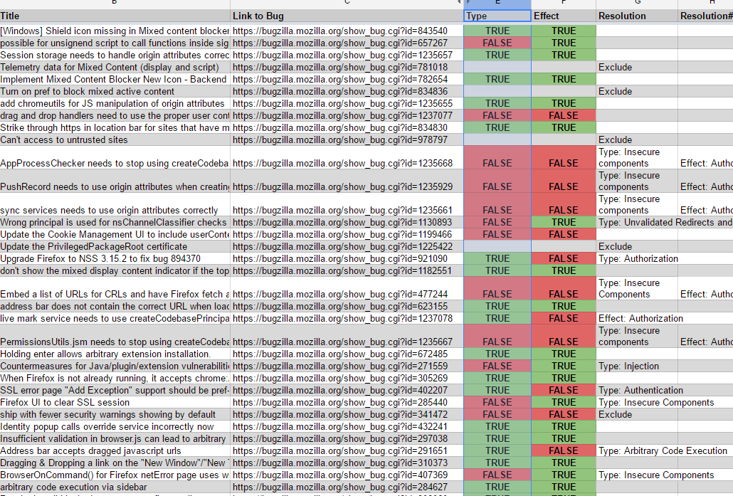
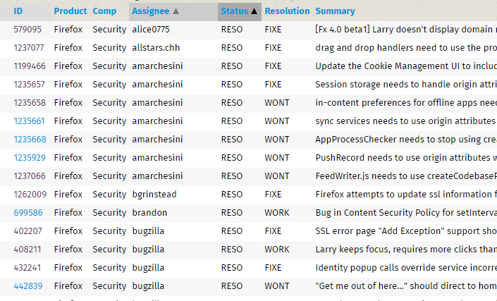

Methodology
Extract bug list from Mozilla Firefox Bug Tracker
→ Python w/ Selenium
Move to CSV, then to spreadsheet
Edit over google docs with collaborators
Tally and organize results

Slide 8

Methodology
Vehicles
Injection
XSS
Flooding Systems
Man-in-the-Middle
Cross-Site Request Forgery
Insecure Components
Unvalidated Redirects and
Forwards
Weak Cryptography
Other
Effects
Data Loss
Authentication
Authorization
Arbitrary Code Execution
Denial of Service
Other

Slide 9
Number of bugs matching search criteria | 496
Number of bugs with code solutions | 108
Number of bugs after exclusions | 91
Results
Vehicles Effects
Injection | 8 | 9.52%
XSS | 3 | 3.57%
Flooding Systems | 0 | 0.00%
Man-in-the-Middle | 4 | 4.76%
Cross-Site Request Forgery | 2 | 2.38%
Insecure Components | 31 | 36.90%
Unvalidated Redirects and Forwards | 4 | 4.76%
Weak Cryptography | 3 | 3.57%
UI Issue | 29 | 34.52%
Data Loss | 8 | 9.52%
Authentication | 19 | 22.62%
Authorization | 6 | 7.14%
Arbitrary Code Execution | 21 | 25.00%
Denial of Service | 1 | 1.19%
UI Hardening | 20 | 23.81%
UI Misrepresentation | 9 | 10.71%

Slide 10
Limitations
Taxonomy based on OWASP Top 10
One bug, many categories
Collaborating with teacher

Slide 11
Future Work
UI as a category
Researchers vs Practitioners
Classifying rest of bugs
Mining additional bugs
Improving scripts, extracting code from comments

Slide 12


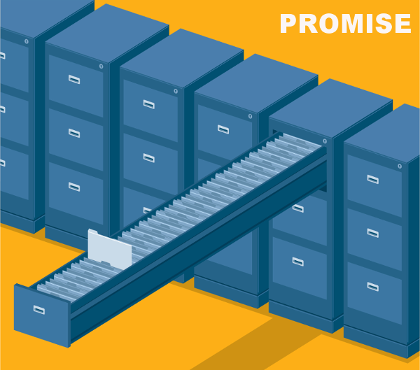
Contact
drtripp@ncsu.edu
www.linkedin.com/in/DawsonTripp

