Slide 1
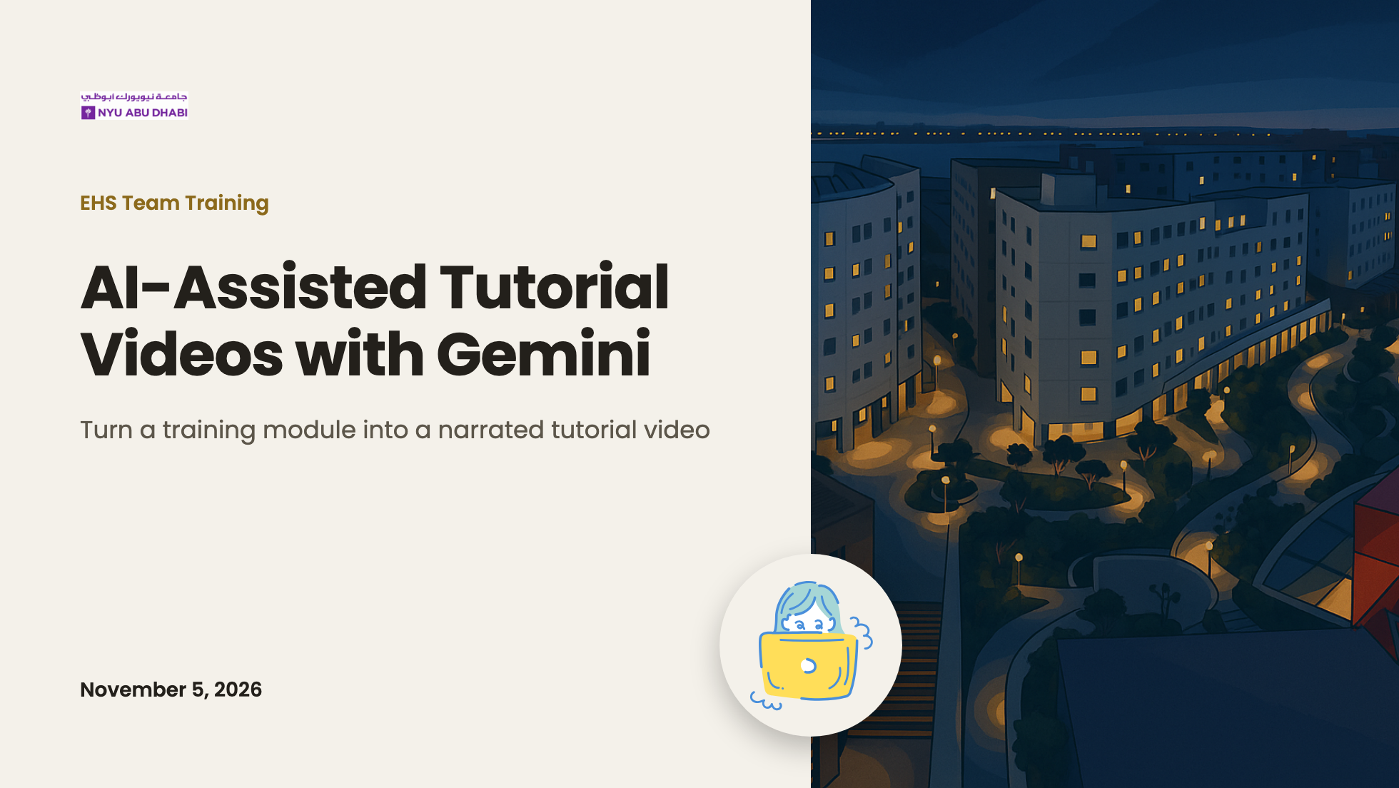
Notes:
[Welcome, about 2 min with the agenda]
Introduce yourselves. One sentence on why we're here: EHS already has good training modules; today we use Gemini to turn one into a video people can watch on their own time.

Slide 2
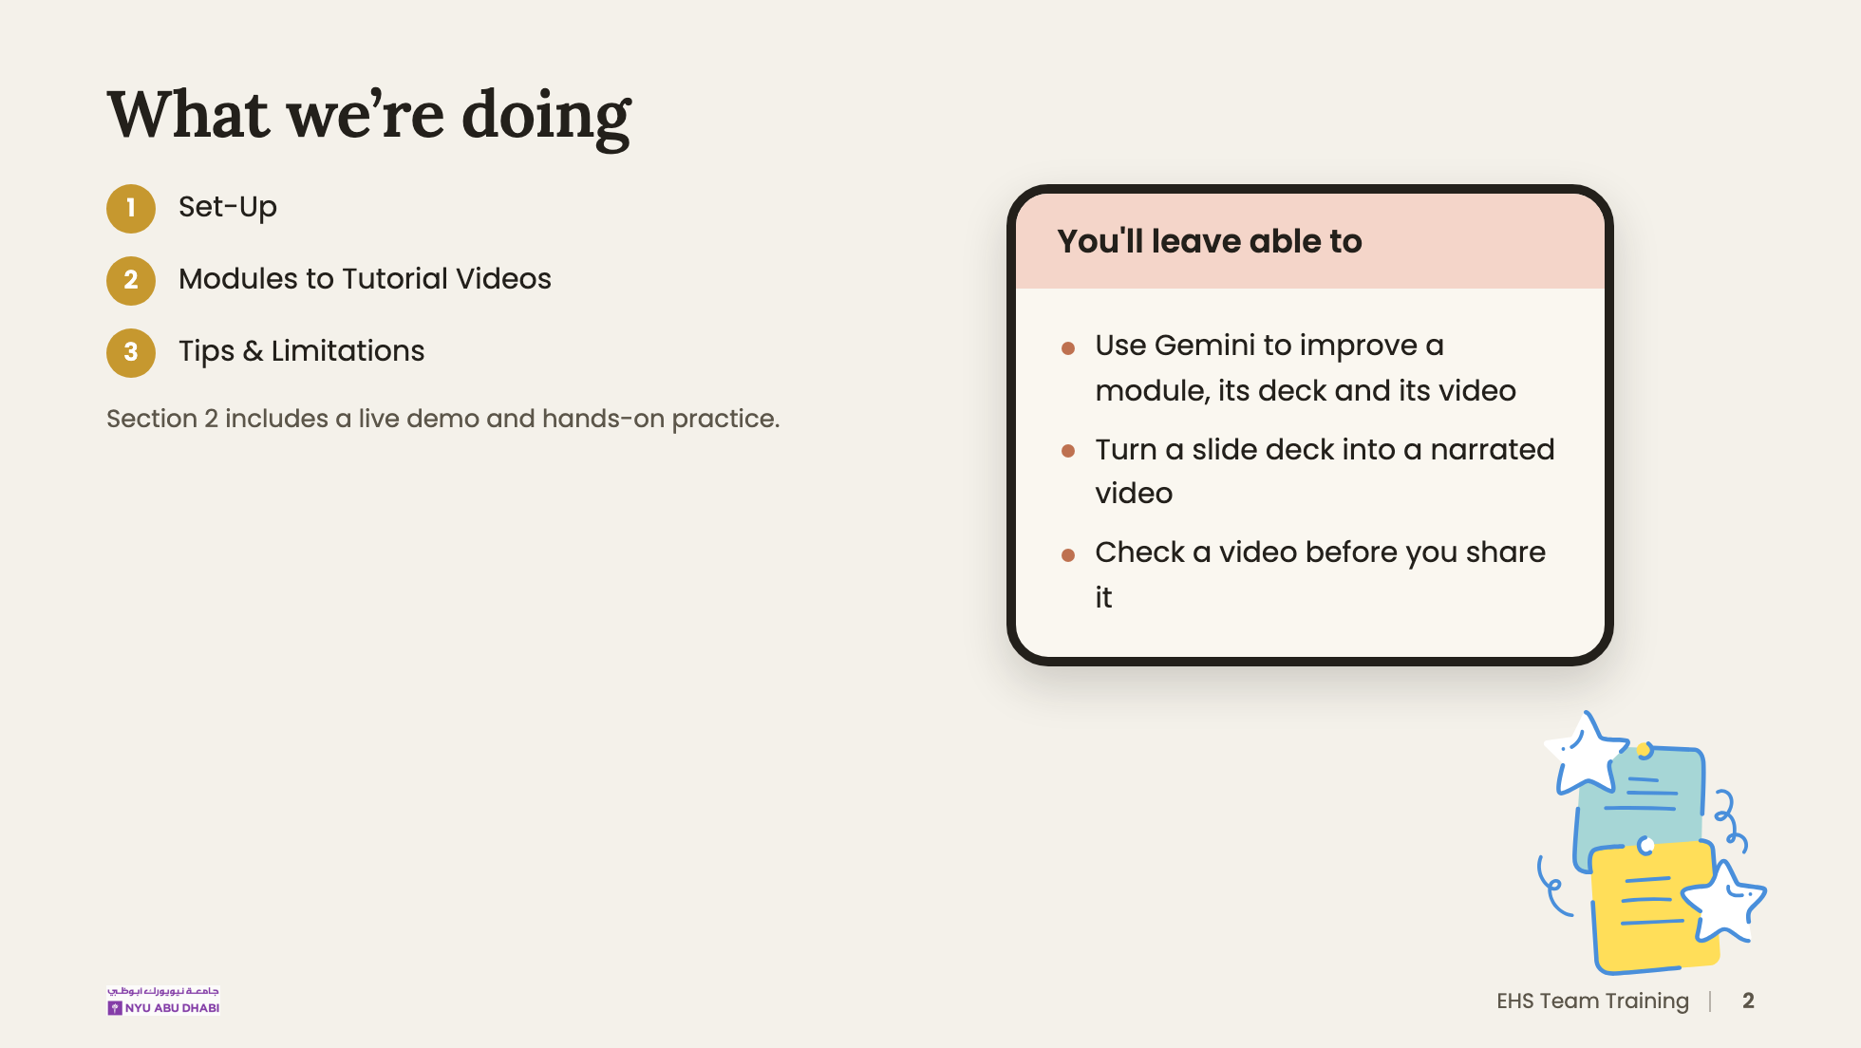
Notes:
Three sections. Have laptops open; people follow along from section 2 onwards.

Slide 3
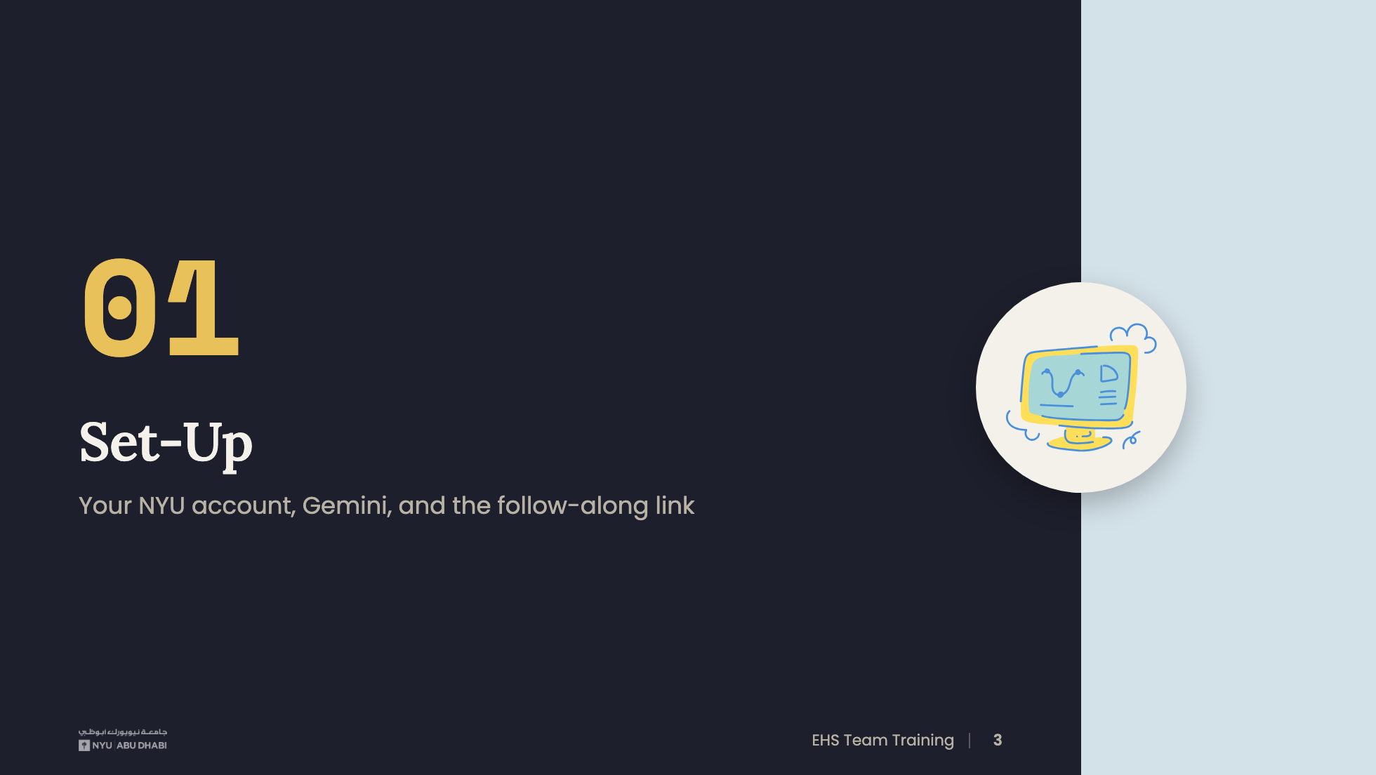
Notes:
[Section 01, about 5 min]
Why Gemini: we use it end to end. It's built into the Google Workspace tools EHS already uses (Docs, Slides and Vids), so the whole workflow happens in one place, on your NYU account, in a university-approved tool. No extra sign-ups, and files stay in NYU Drive.

Slide 4
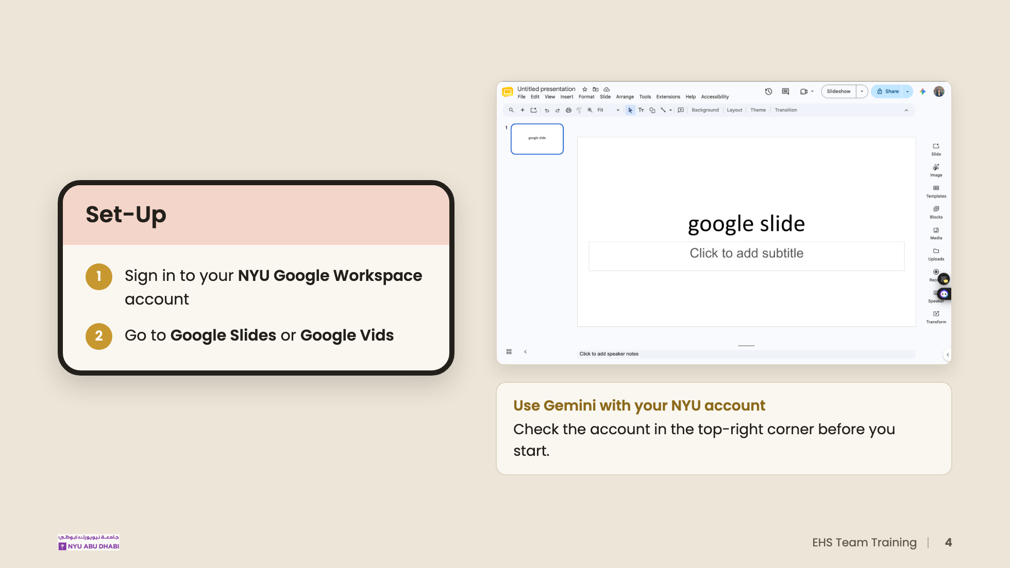
Notes:
Common problem: people are signed in to a personal Gmail in the same browser. The top-right avatar tells you which account is active. Gemini is the only AI tool we use today.
TO CONFIRM: which plan covers the Vids AI features for NYU accounts.

Slide 5
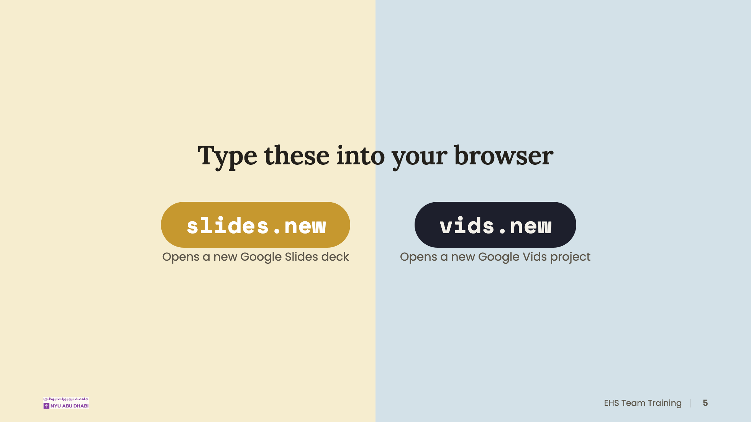
Notes:
These shortcuts create a new deck or a new video in one step. Ask everyone to try vids.new now to confirm their access works.

Slide 6
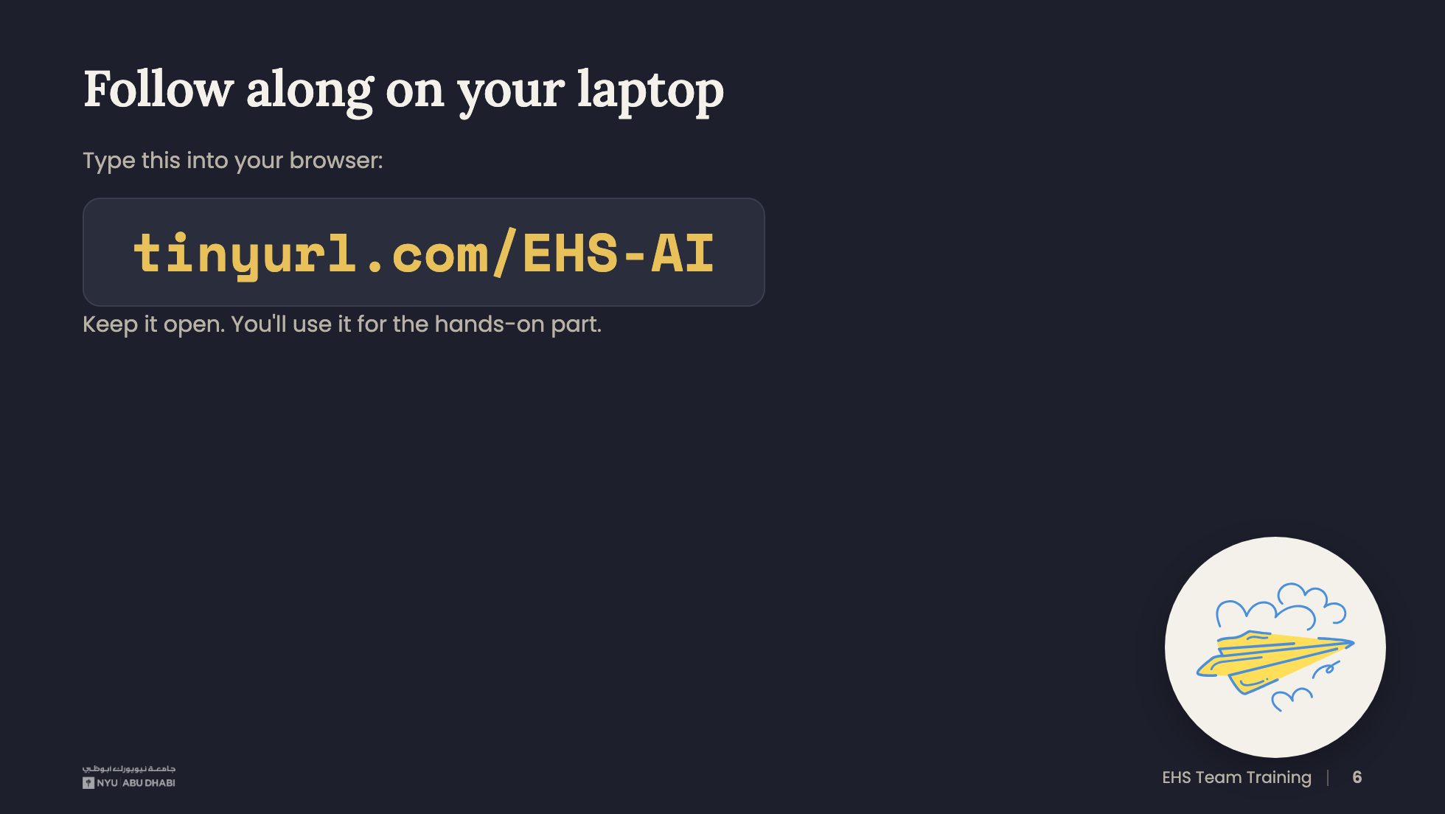
Notes:
Wait until most people have the page open before moving on.
TO CONFIRM: what the tinyurl links to, and that the practice deck is in there.

Slide 7
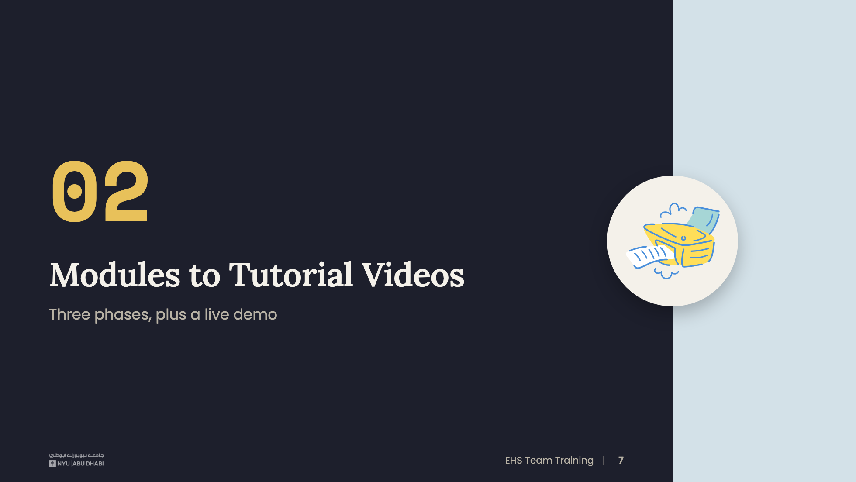
Notes:
[Section 02, about 22 min. This is the core of the session.]

Slide 8
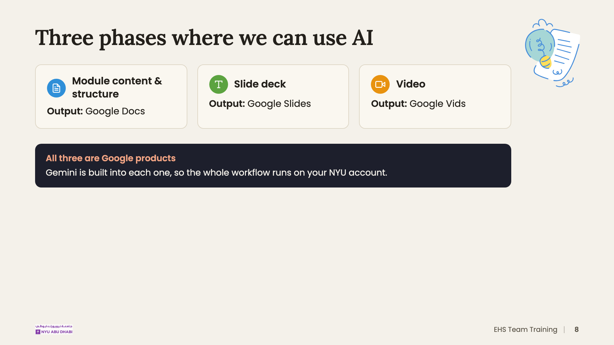
Notes:
The same colors show up in the tracker at the top of the next slides.

Slide 9
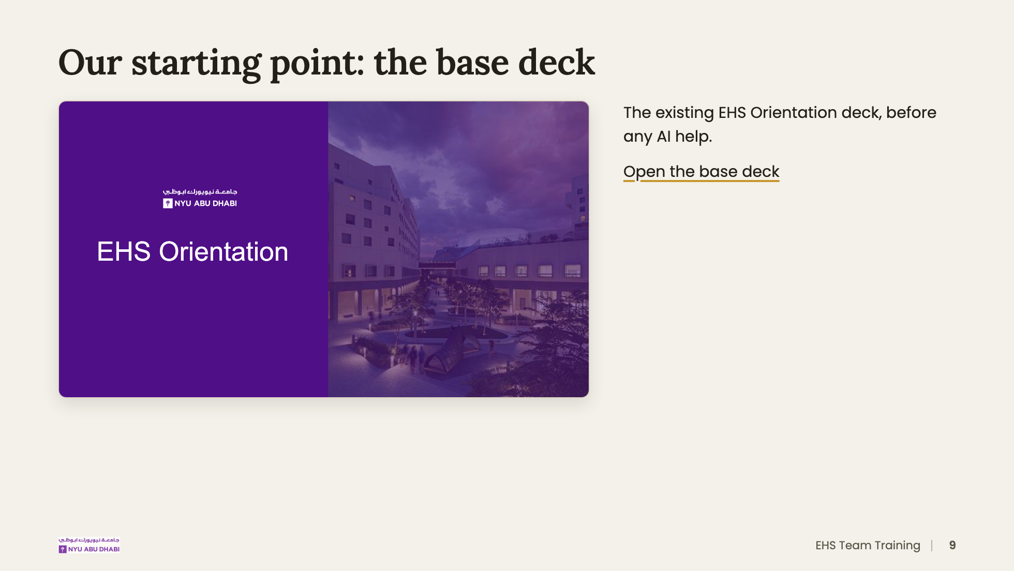
Notes:
Everything that follows starts from this deck. Keep it open in a tab to compare.

Slide 10
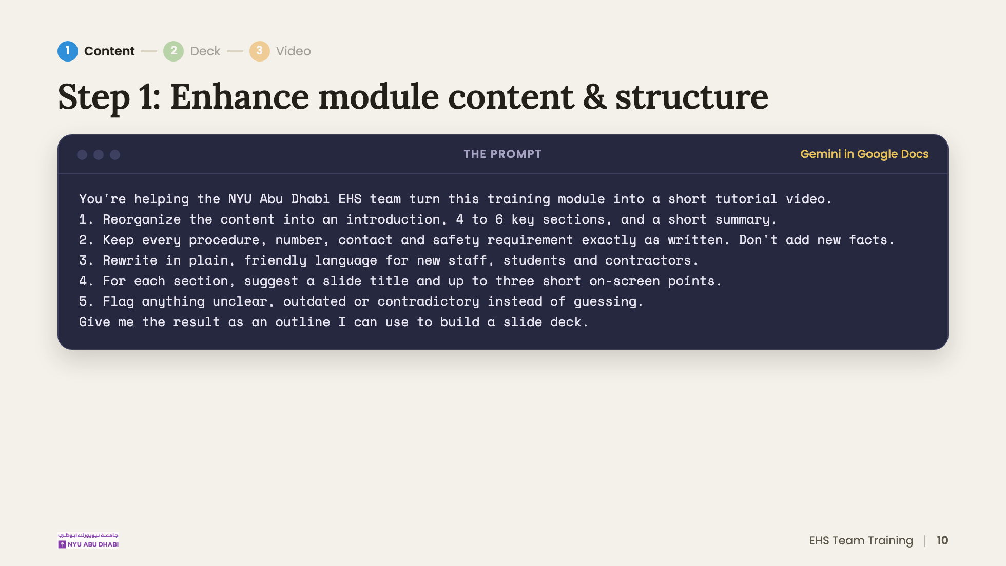
Notes:
[About 3 min]
DRAFT PROMPT: adjust to match what you actually ran. Point out rule 2: Gemini improves structure and tone, but EHS decides the facts.

Slide 11
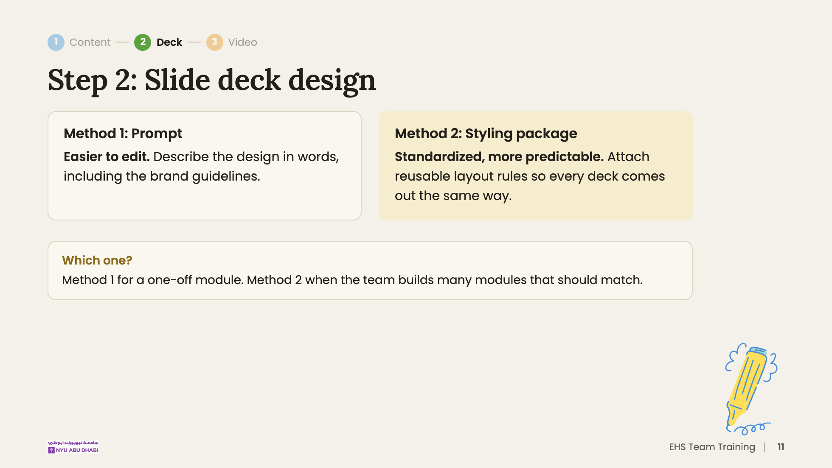
Notes:
[Step 2, about 6 min total]

Slide 12
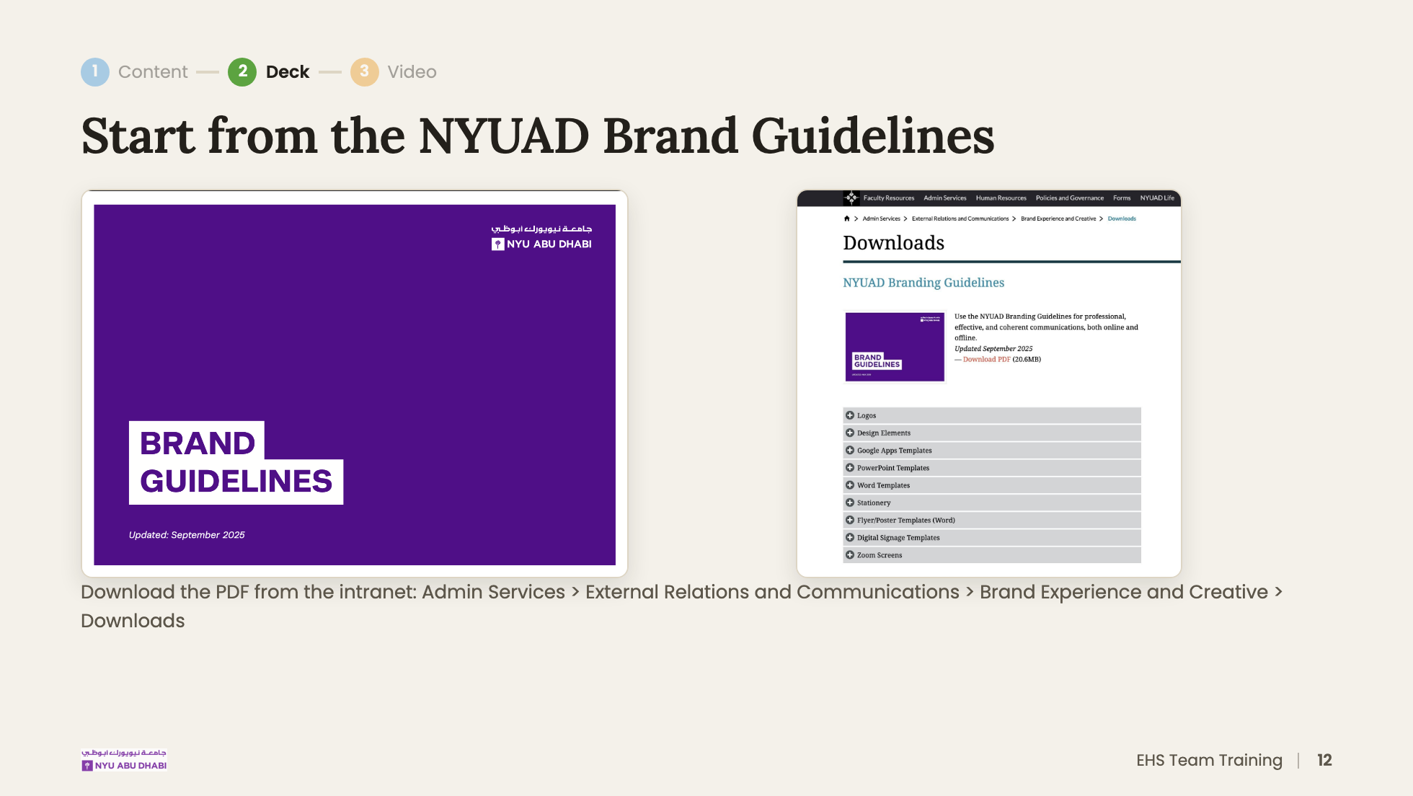
Notes:
Both methods use the guidelines: Method 1 puts them in the prompt, Method 2 builds them into the styling package.
TODO: add the direct link to the downloads page.

Slide 13
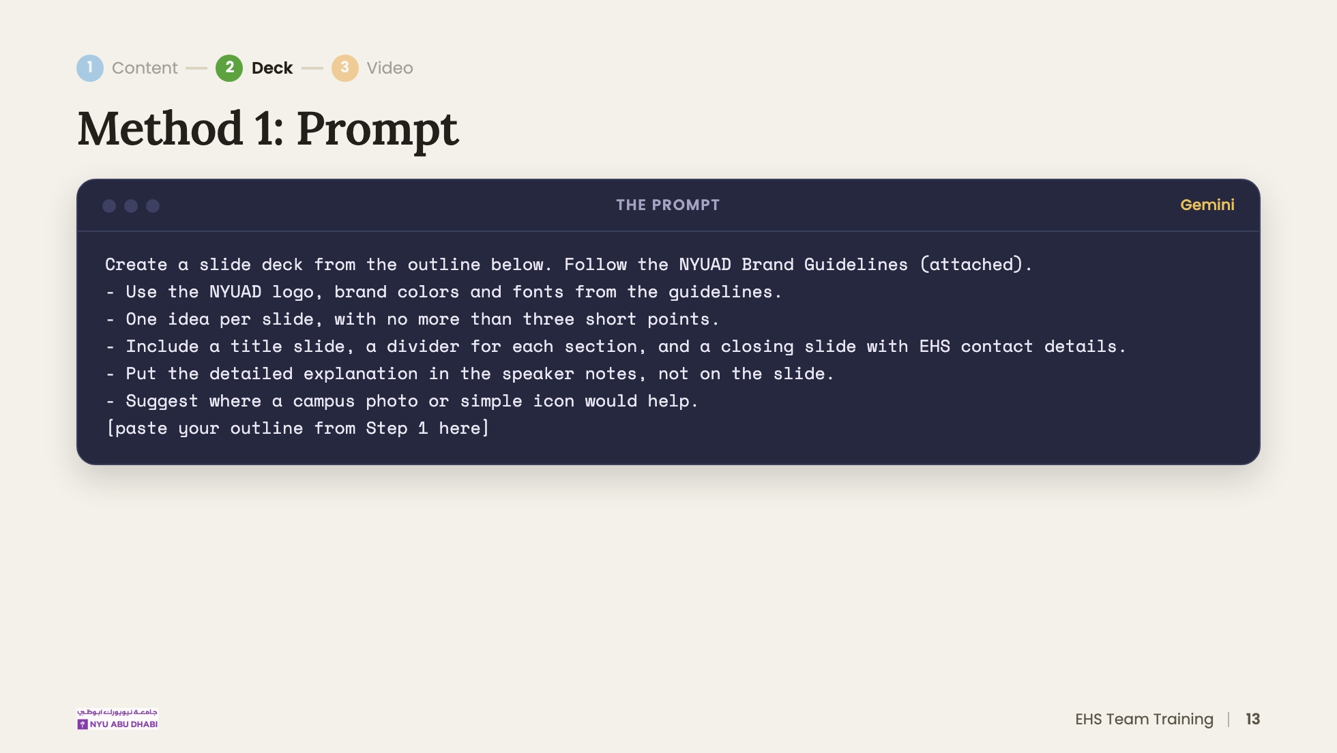
Notes:
DRAFT PROMPT: adjust to match what you actually ran, and say where you ran it (Gemini app or the Gemini panel in Slides).
Speaker notes matter later: in Step 3 you can reuse them as the video script.

Slide 14
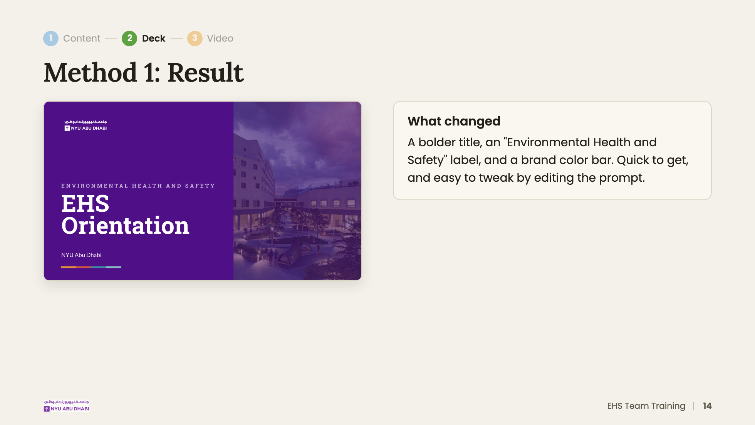
Notes:
Point out what Gemini got right from the brand guidelines, and anything you had to fix by hand. Adjust "What changed" to match your own comparison.

Slide 15
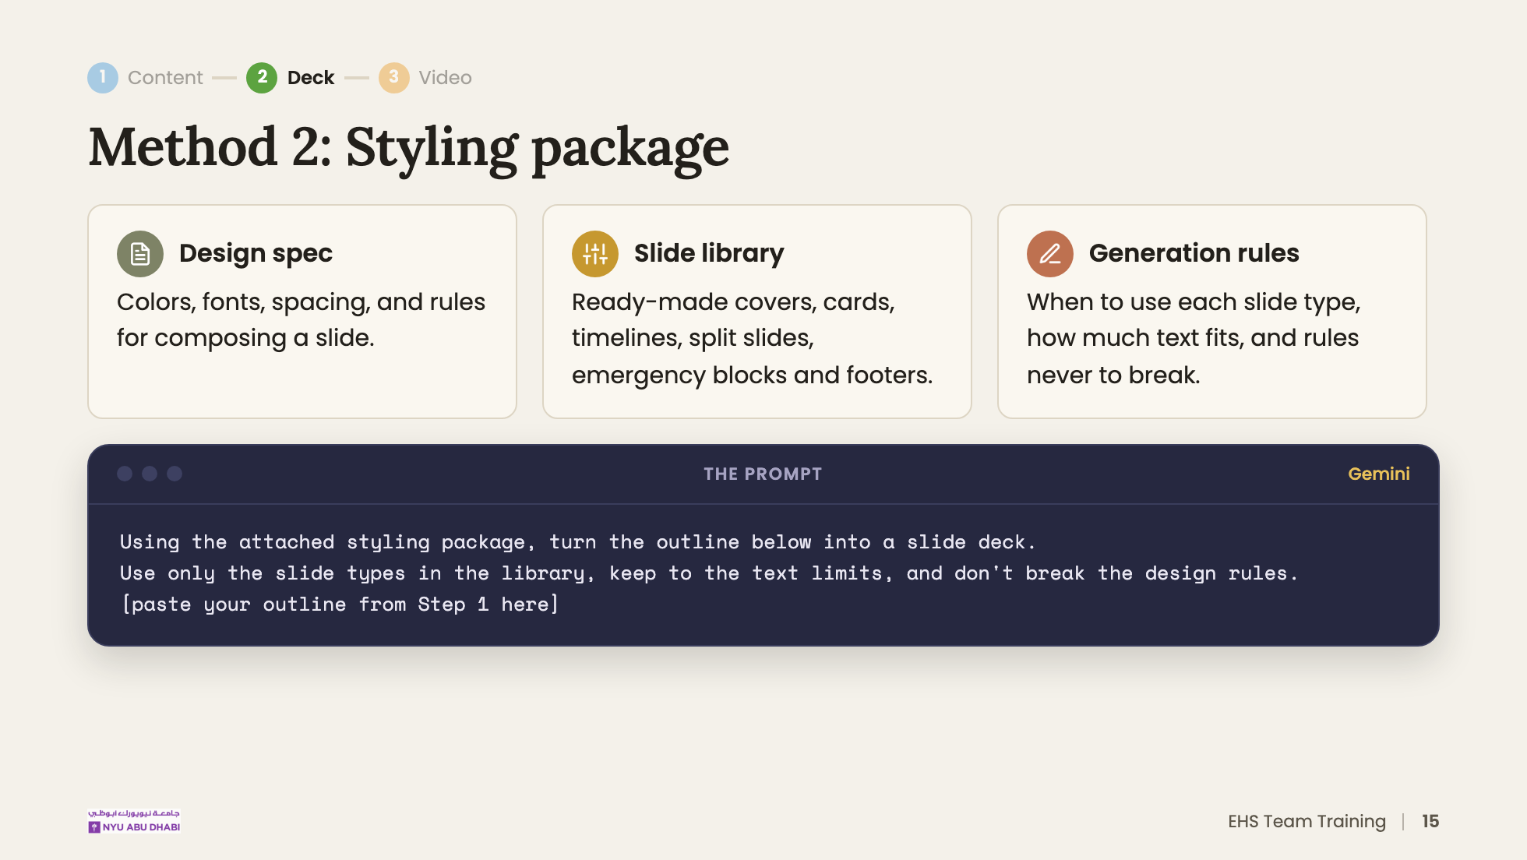
Notes:
The package is made once and reused for every module, which is why results are more predictable.
DRAFT PROMPT: adjust to match what you actually ran.

Slide 16
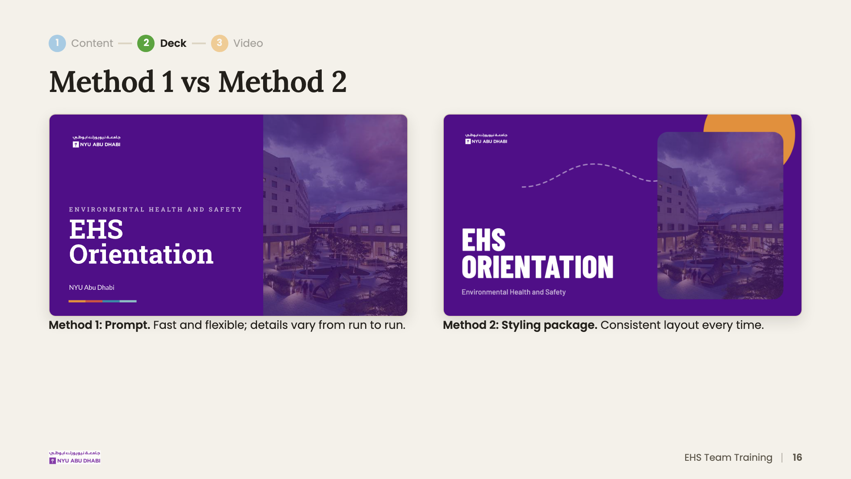
Notes:
Method 2 result deck: https://docs.google.com/presentation/d/1cc1AO4dN-4AP5zGZzokqOMZfVAh8AOdpFV8AapEIbwo/edit
Method 1 result deck: https://docs.google.com/presentation/d/1C3cJe54p1i36ekv1OtZMLMIG-BAybOI2jXQPahjKBzs/edit
(TO CONFIRM these two links match the right methods.)

Slide 17
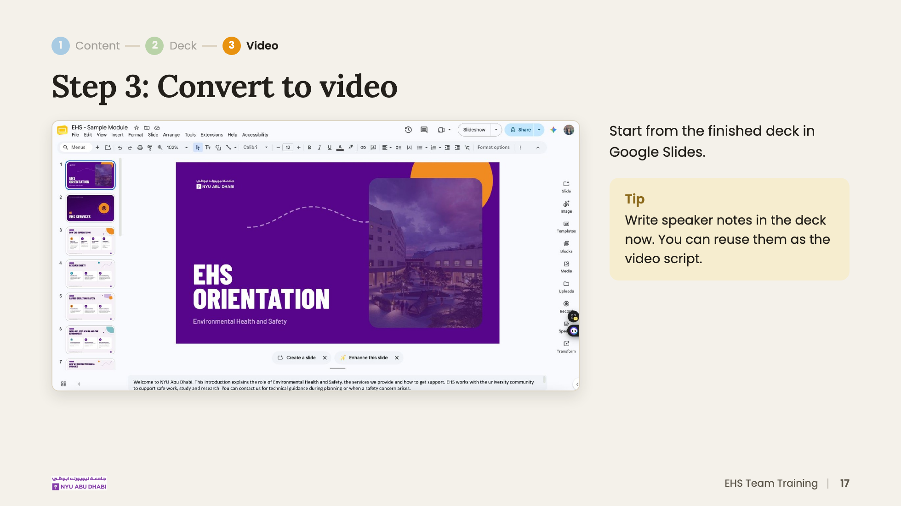
Notes:
[Step 3, about 11 min total]
LIVE DEMO from here, using the EHS Sample Module deck.

Slide 18
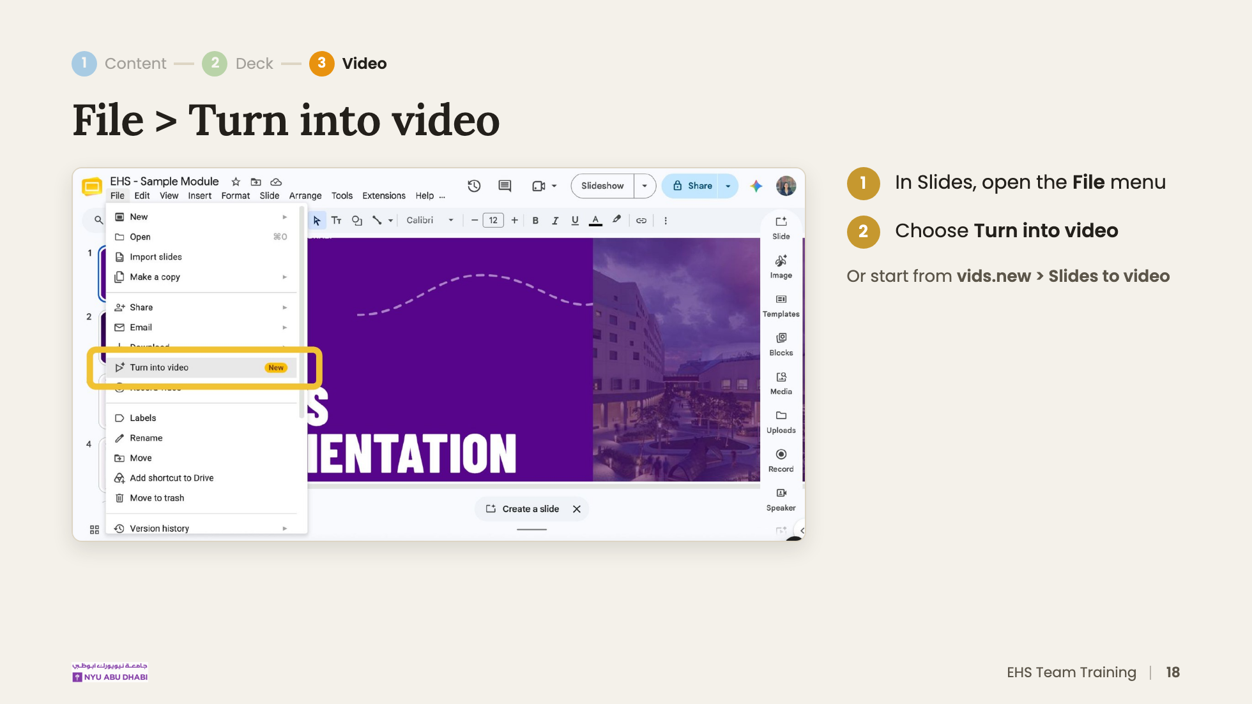

Slide 19
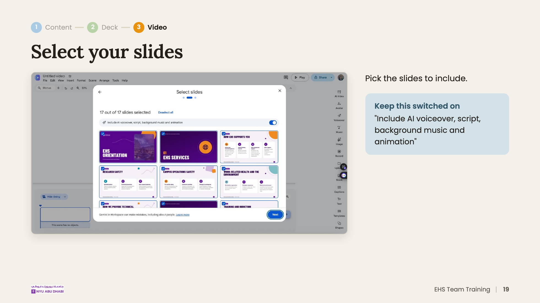
Notes:
If the toggle is off, you get scenes with no script or voiceover.

Slide 20
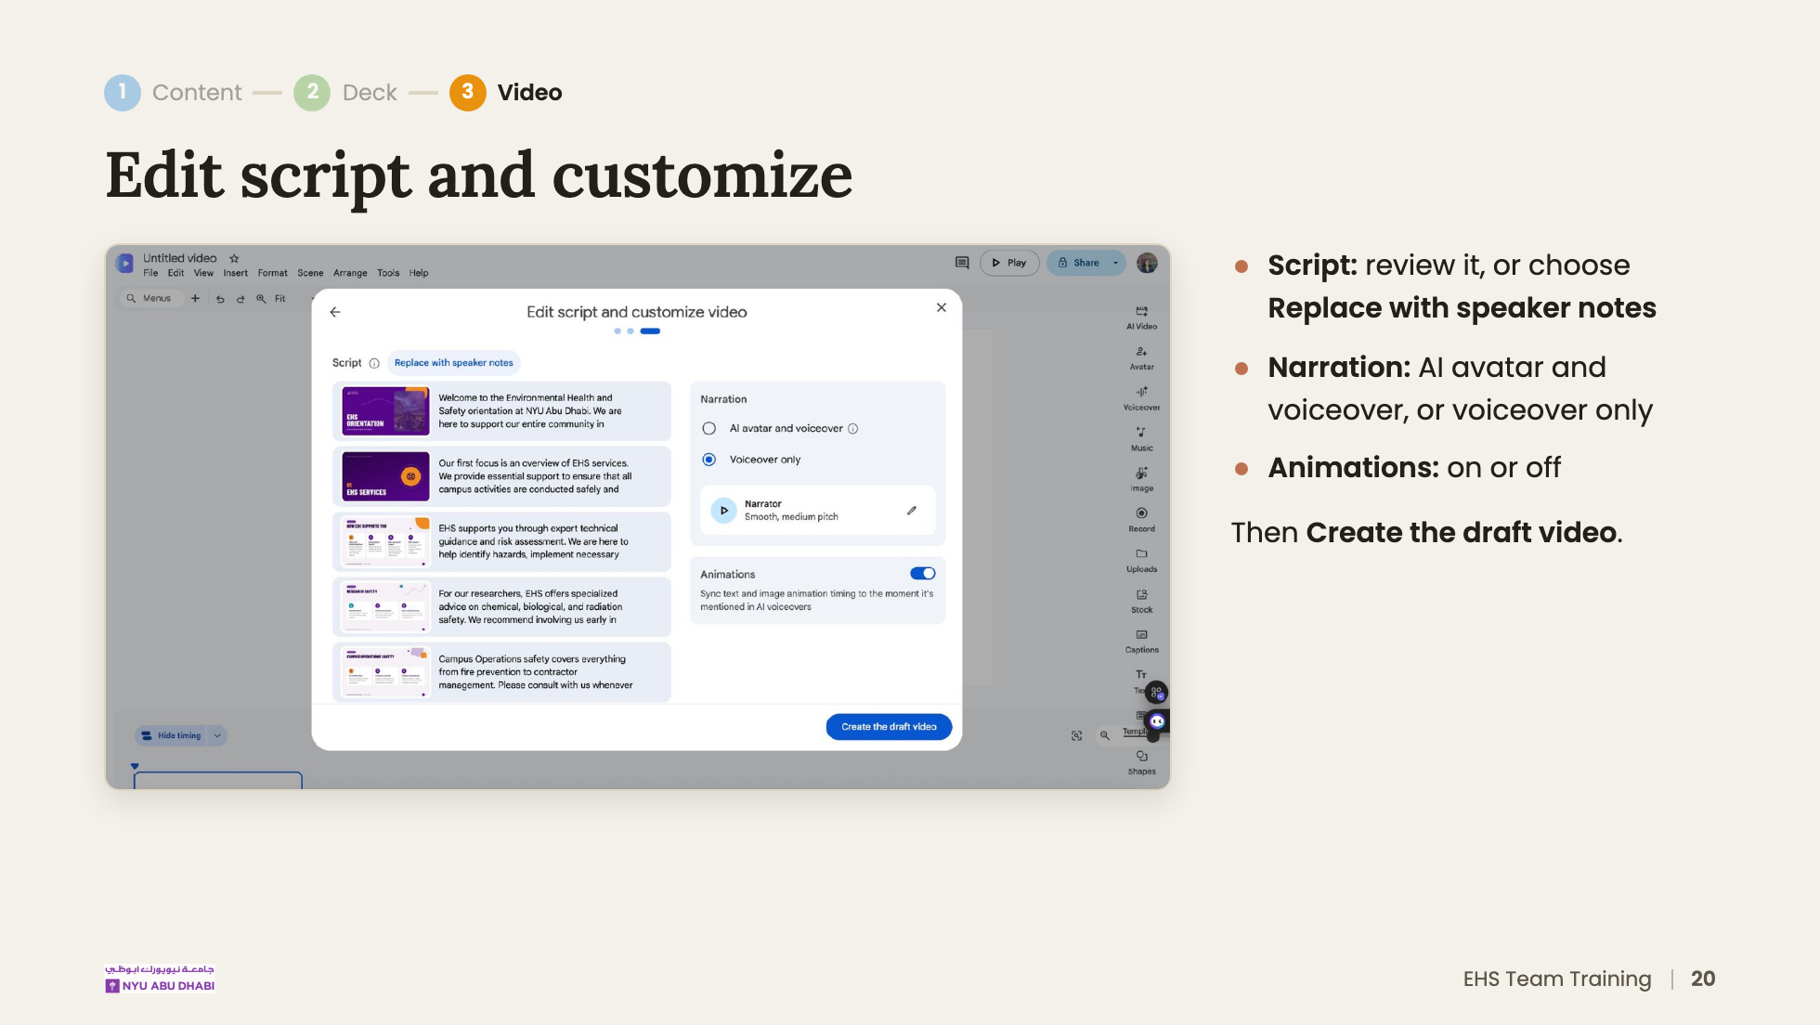

Slide 21
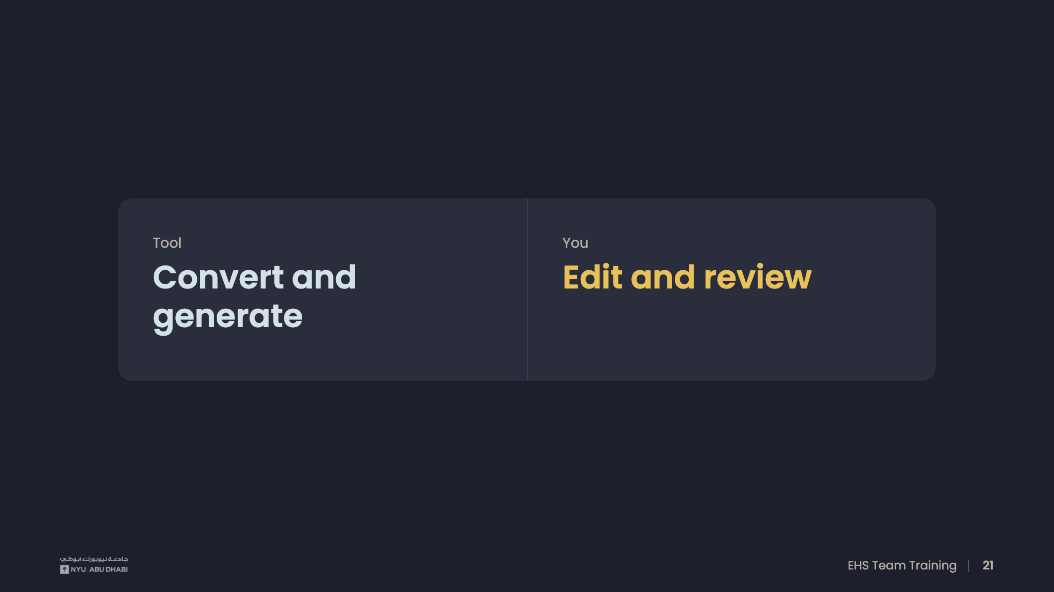
Notes:
The draft takes one click. Most of your time goes into editing, and that's where your EHS expertise matters.

Slide 22
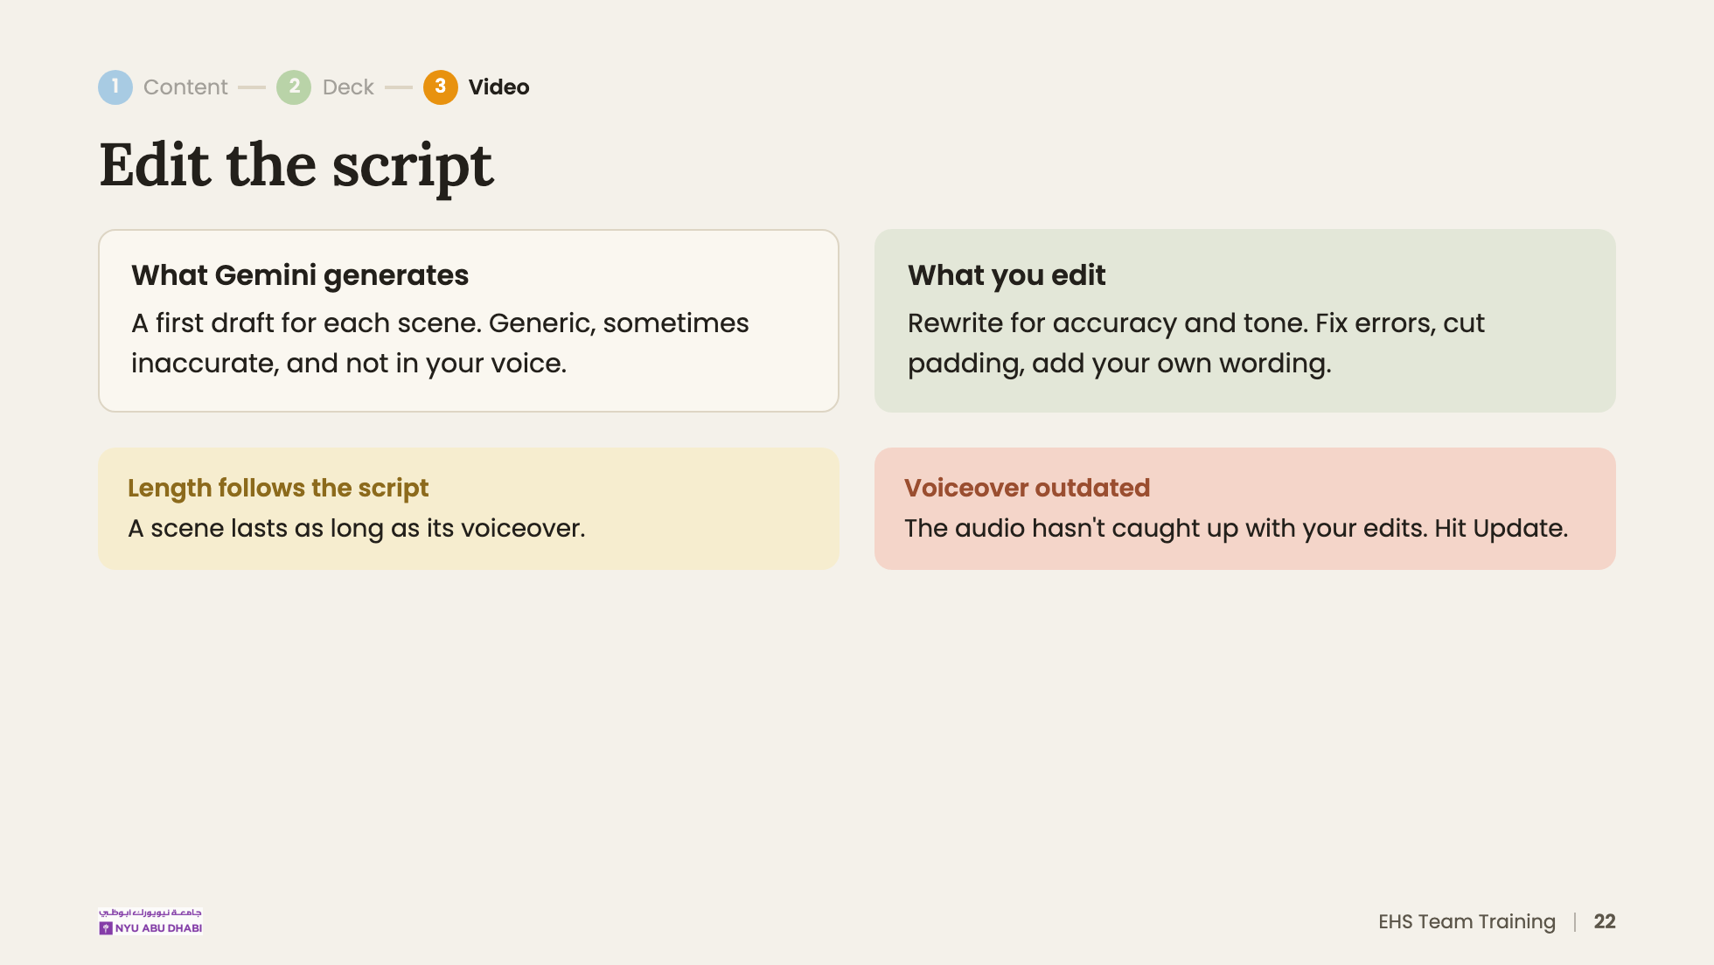
Notes:
LIVE DEMO: edit one scene, show the "Voiceover outdated" label appear, then click Update and replay.

Slide 23
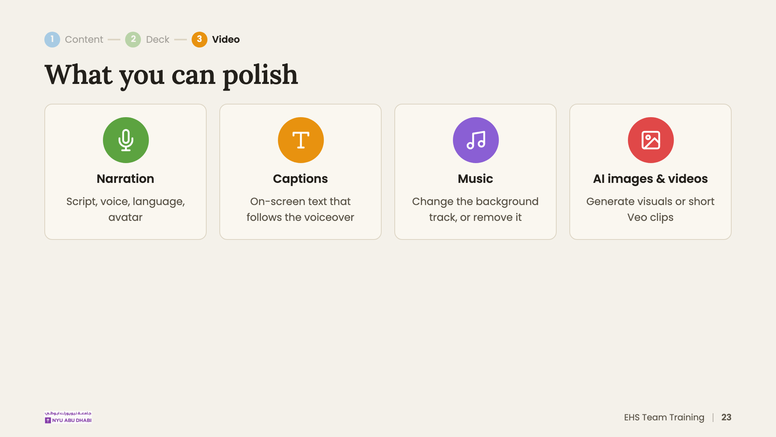
Notes:
Narration makes the biggest difference, so the next slide goes deeper on it. Captions help viewers watching without sound.

Slide 24
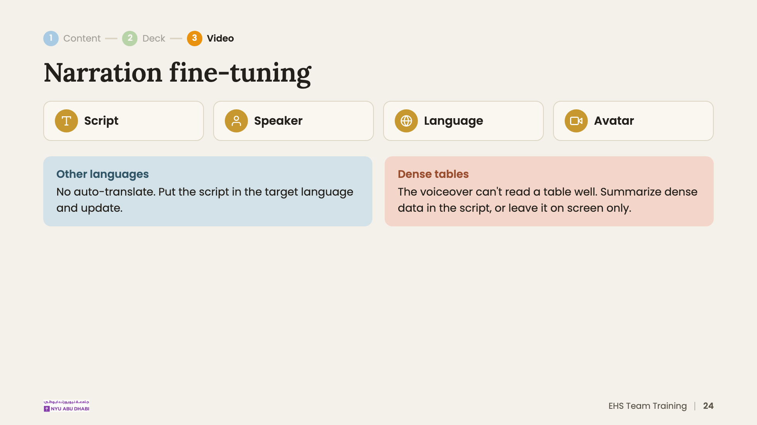
Notes:
The voiceover reads whatever script it's given, in whatever language that script is written in.

Slide 25
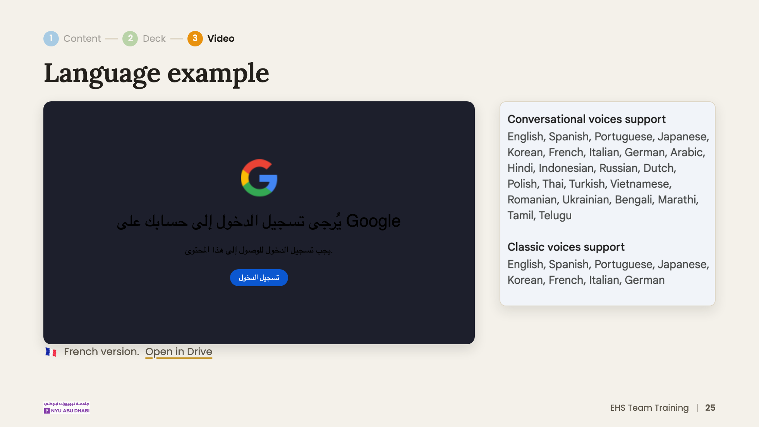
Notes:
Optional slide. Skip if running behind on time.

Slide 26
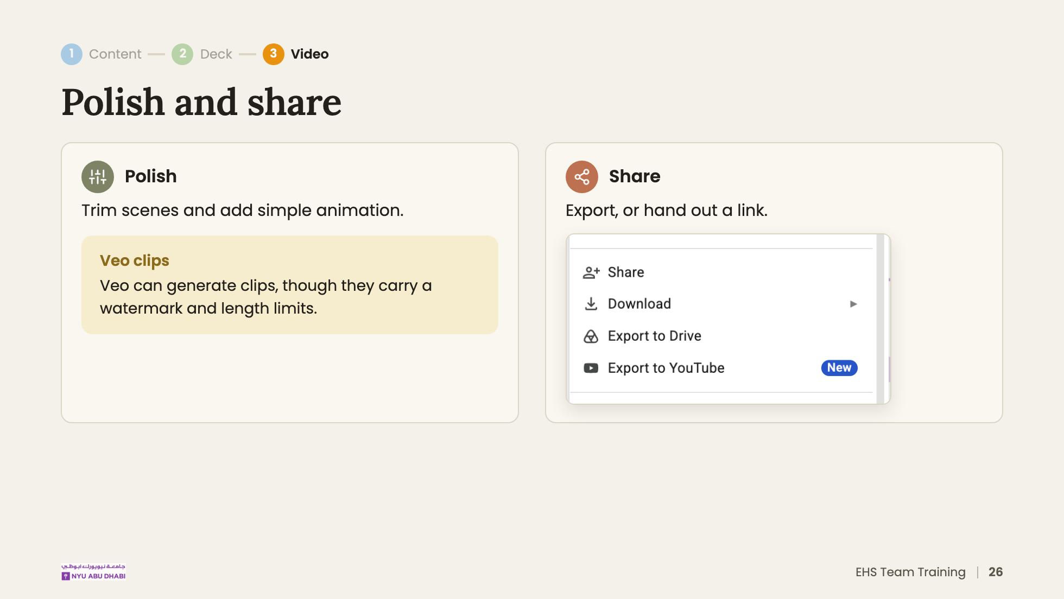
Notes:
For EHS training, a Drive link with NYU-only access is usually the safest default.

Slide 27
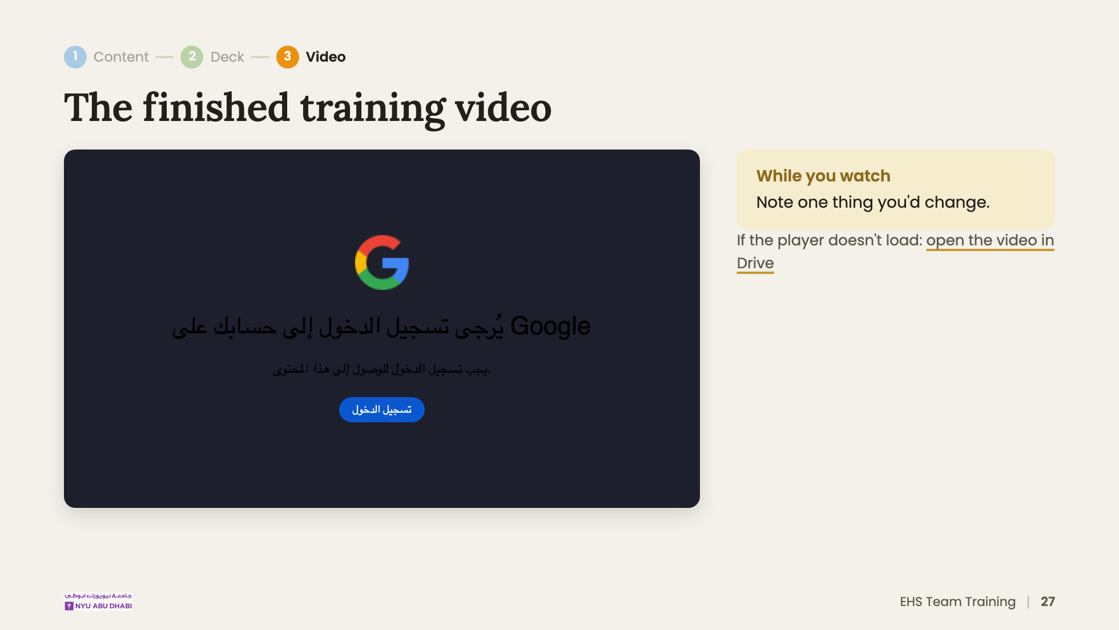
Notes:
Play a short clip, not the whole thing. Ask 2 or 3 people what they'd change.
The embed only plays if you're signed in with an account that can view the Drive file.

Slide 28
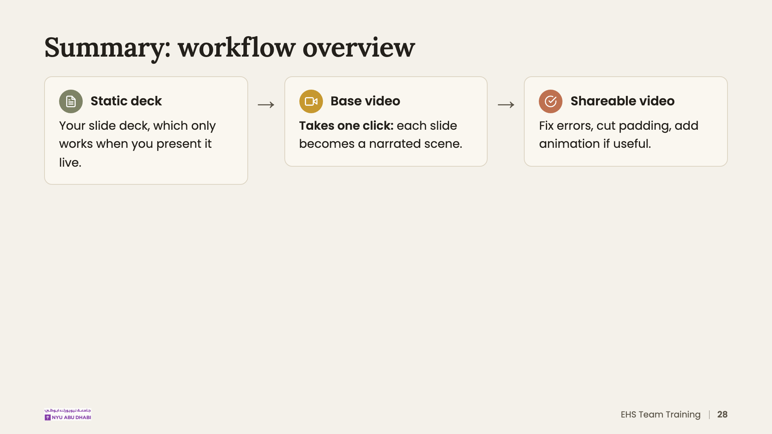
Notes:
Recap of Step 3 before people try it themselves.

Slide 29
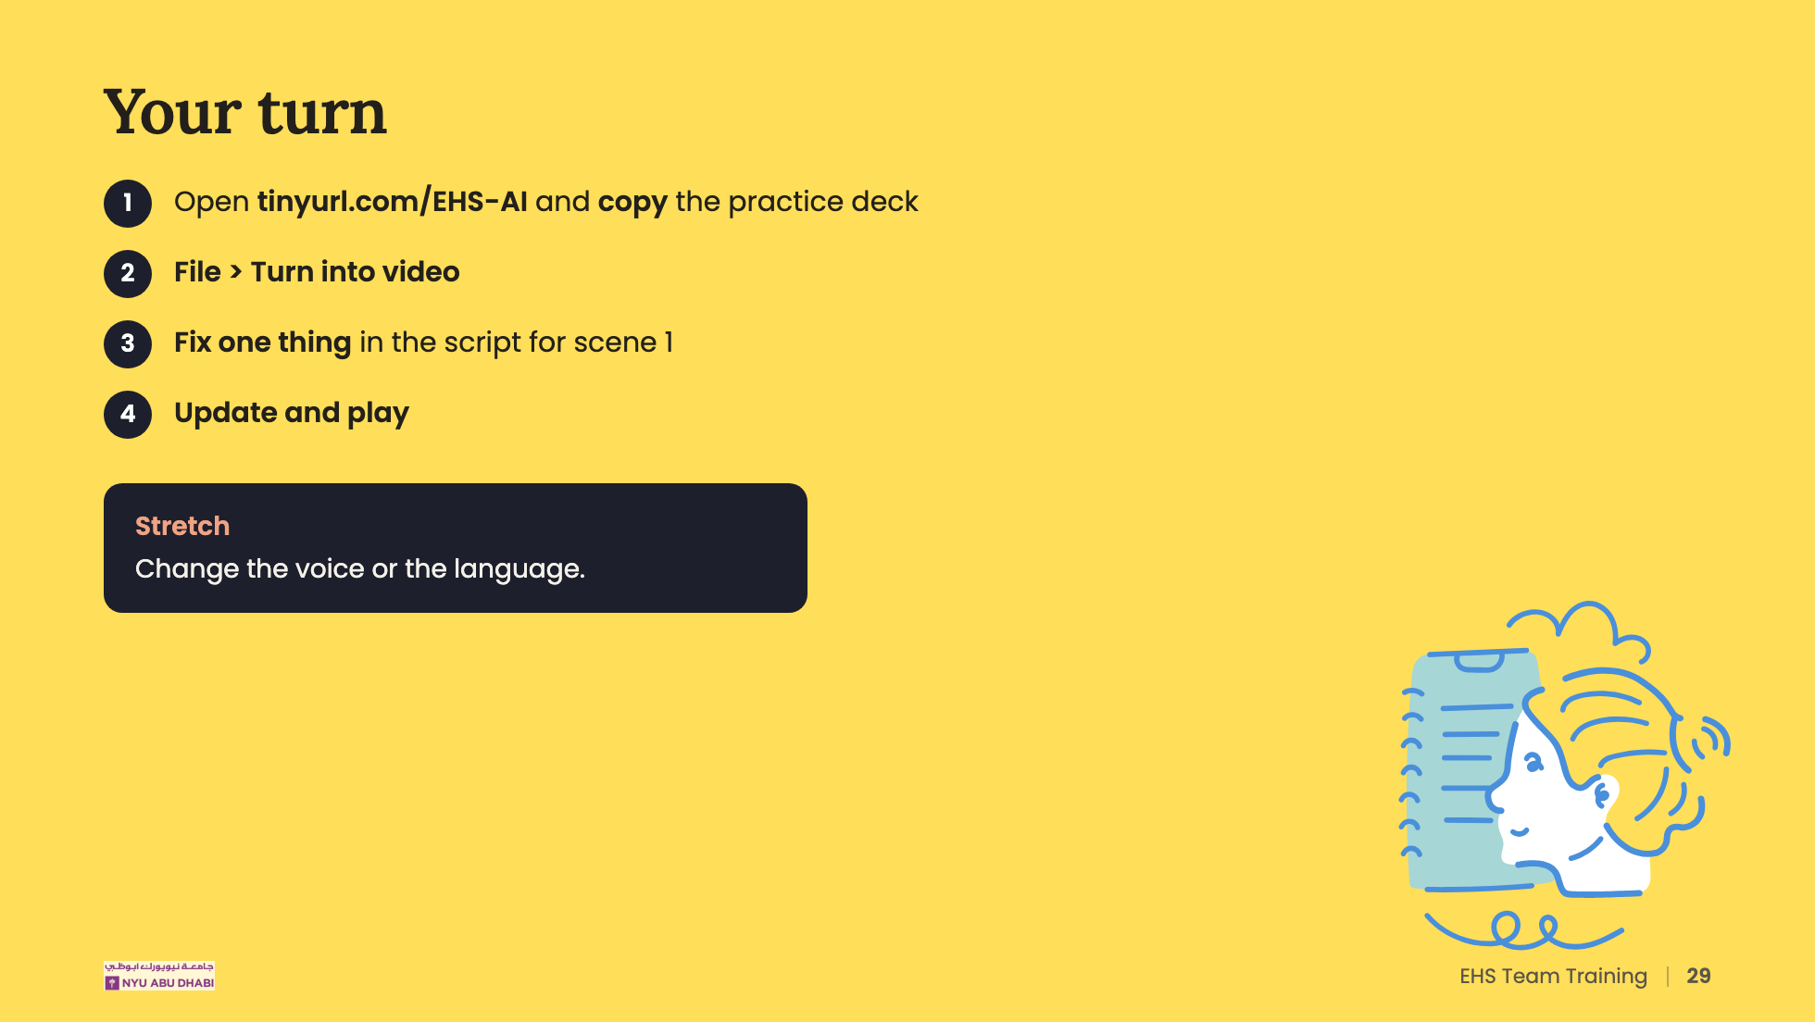
Notes:
[About 8 min]
Walk the room. The usual blockers are the wrong signed-in account and the AI toggle being off.
TO CONFIRM: the practice deck is in the tinyurl folder (File > Make a copy).

Slide 30
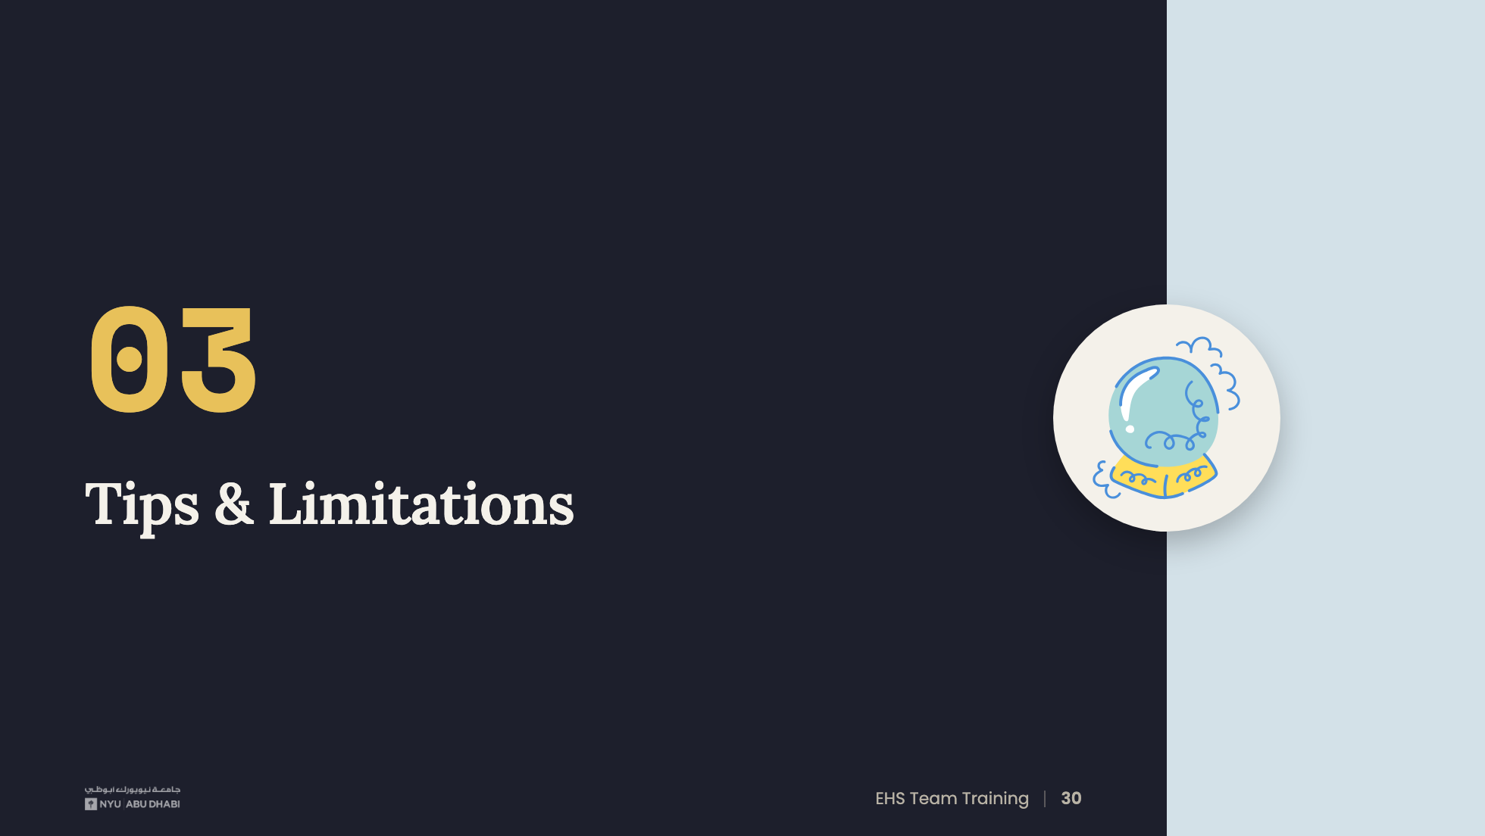
Notes:
[Section 03, about 5 min]

Slide 31
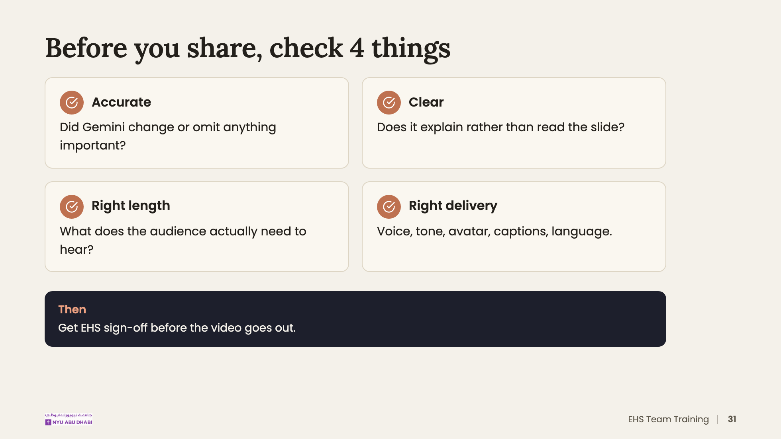
Notes:
Accuracy matters most for safety content. If a procedure step or number is wrong, the video shouldn't be shared, however polished it looks.

Slide 32
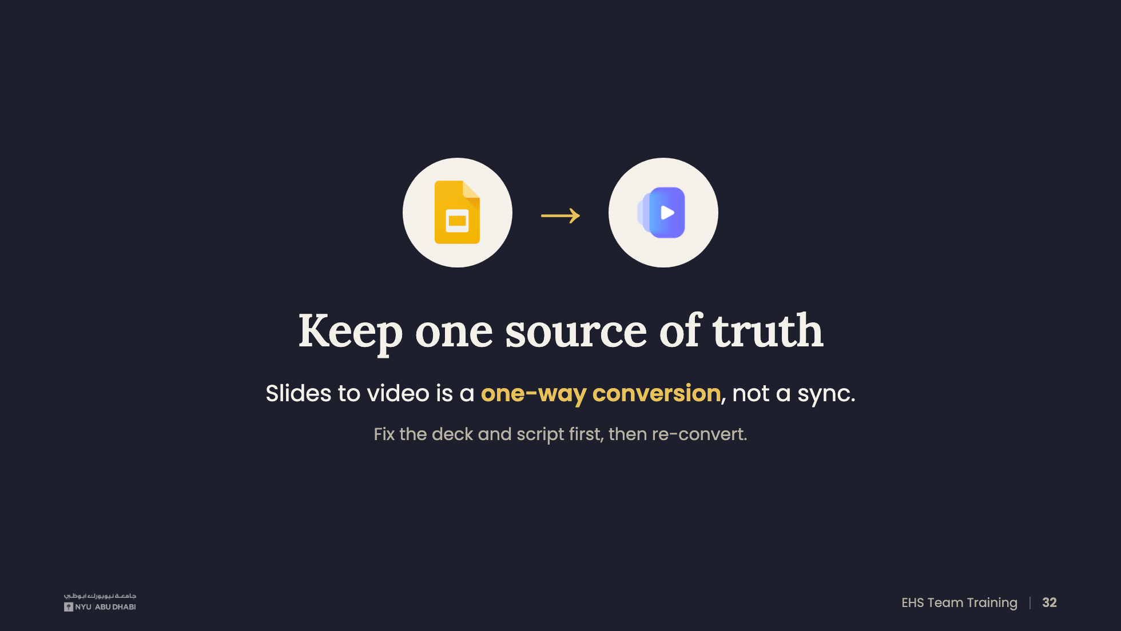
Notes:
Edits made in Vids don't flow back to the deck, and later edits to the deck don't update the video. Keep the deck as the master copy.

Slide 33
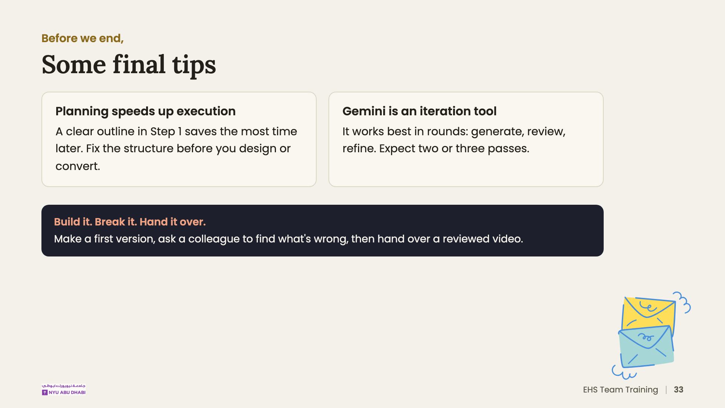
Notes:
DRAFT WORDING for the two tips and the tagline: adjust to match what you mean.

Slide 34
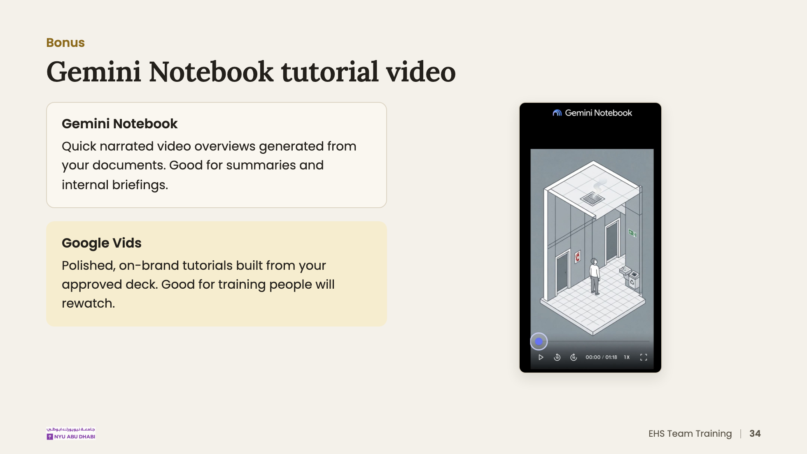
Notes:
TODO: add the link to the Gemini Notebook example video if you want to play it.

Slide 35
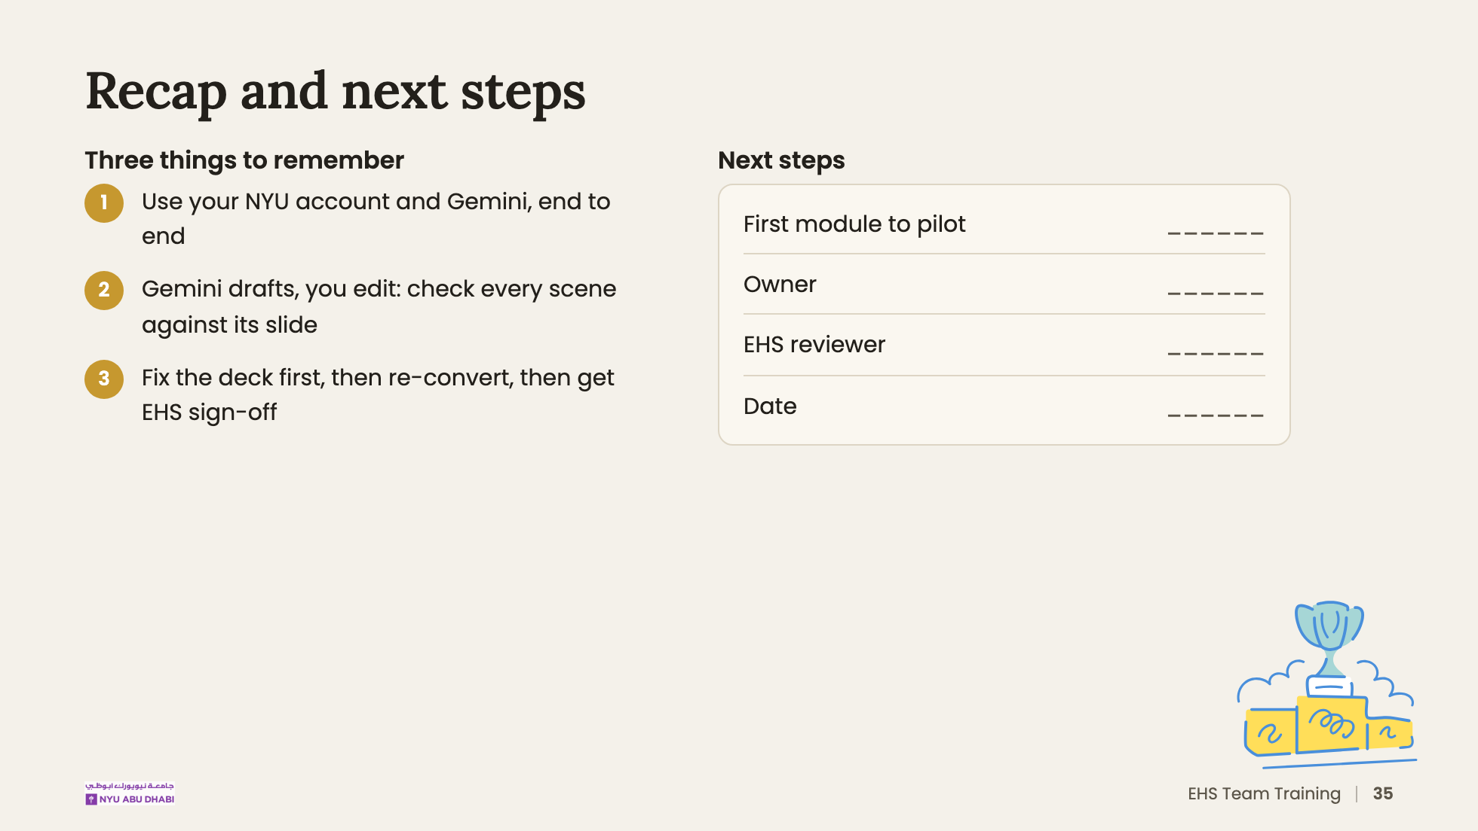
Notes:
[Wrap-up, about 3 min]
Fill in the table live with the team before people leave.

Slide 36
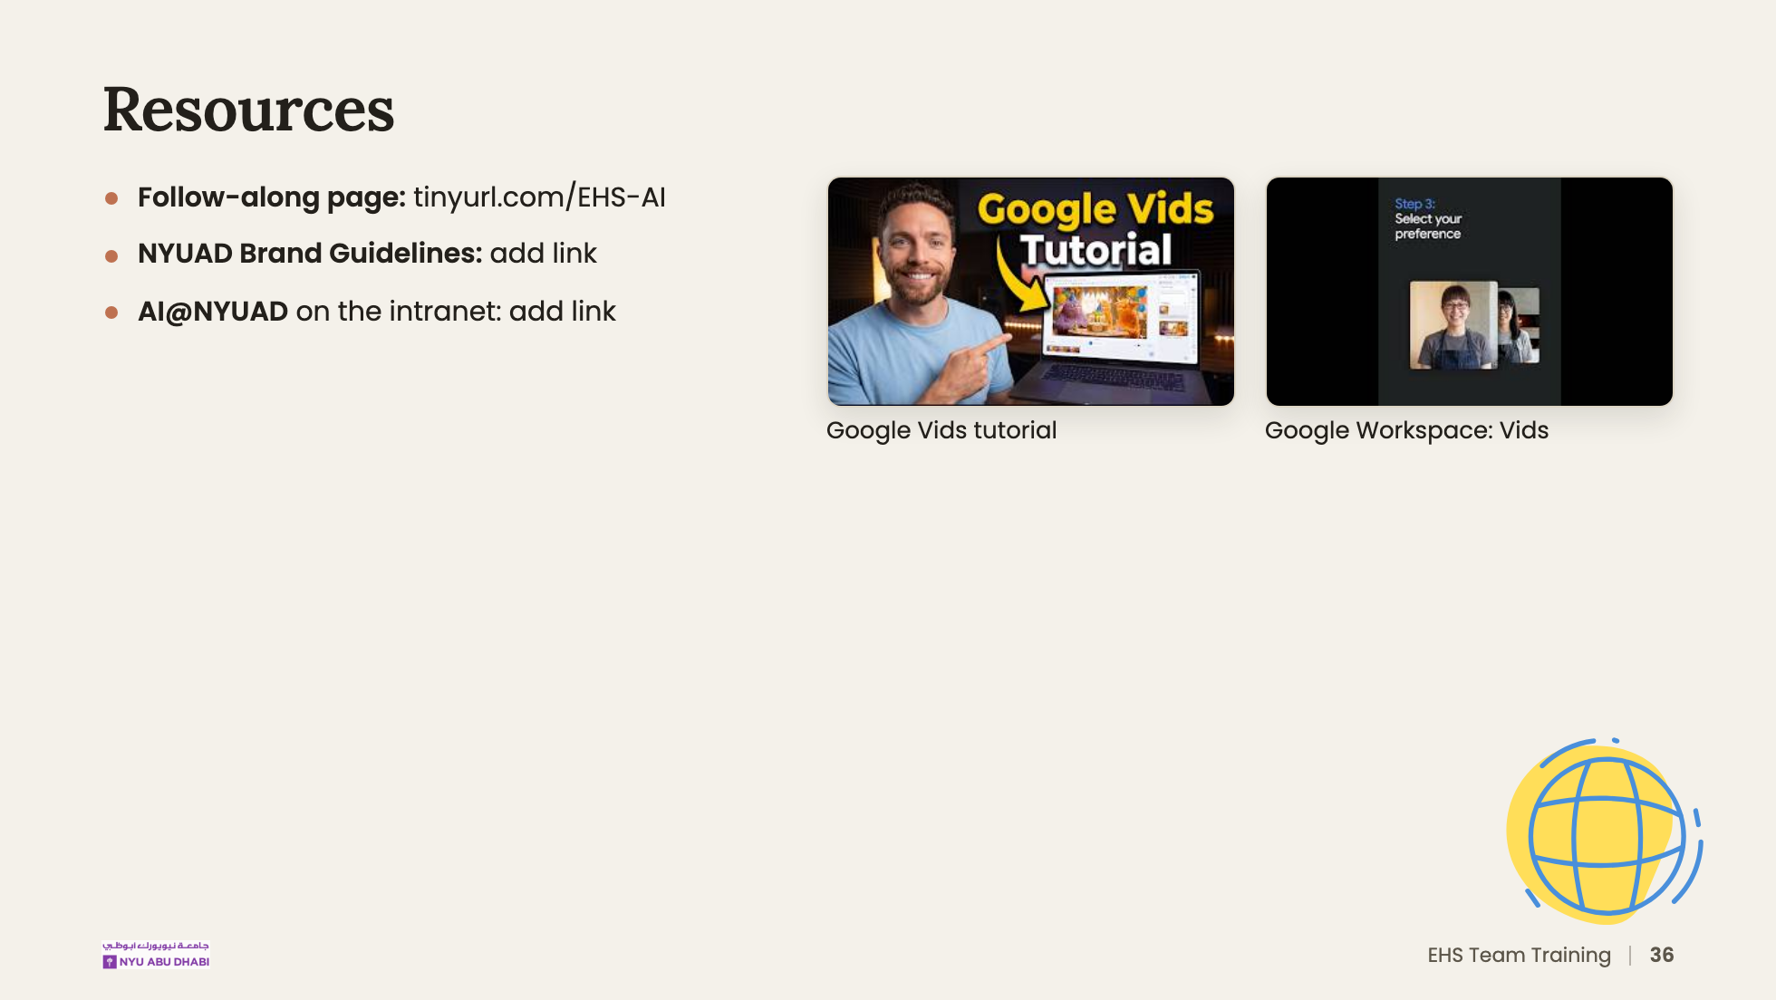
Notes:
The Google Vids tutorial link starts at 7:00, as in your original deck.
TODO: add the brand guidelines and AI@NYUAD links.

Slide 37
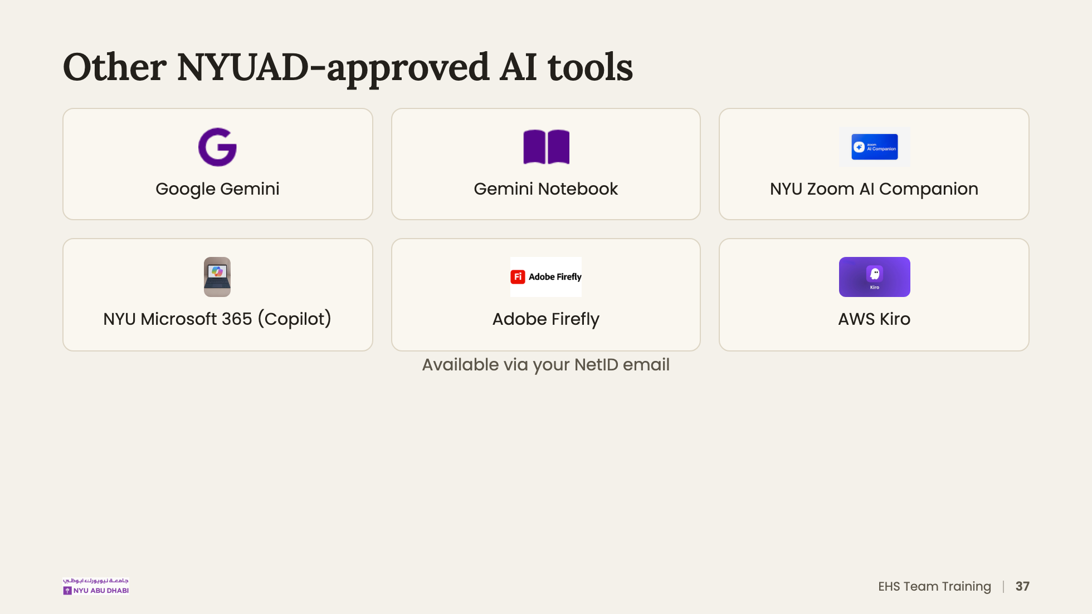
Notes:
For reference only. Today's workflow uses Gemini.

Slide 38


