Slide 1

US Natural Gas Prices - Future Performances
by
Angus Ogubuike

Slide 2
Introduction
Natural gas consists primarily of methane
It is created using one of two mechanisms: biogenic and thermogenic.
It is a major source of power generation, especially for heating and cooling systems in the U.S.
In 2015, Natural gas was the nation's second-largest source of energy in the United States, after petroleum.
The natural gas industry includes exploration for, production, processing, transportation, storage, and marketing of natural gas and natural gas liquids. The exploration for and production of natural gas and petroleum form a single industry, and many wells produce both oil and gas.
The most commonly quoted producer price for natural gas is the Louisiana-based Henry Hub price, which is futures-traded on NYMEX.

Slide 3
Problem Statement
“Determine the major factors that influence Natural Gas Prices. Use these factors to predict natural gas prices future performance”

Slide 4
Data for the study
Data Set:
Natural Gas Data Set from the United States Energy information Administration:
https://www.eia.gov/dnav/ng/ng_pri_fut_s1_d.htm
INDEPENDENT VARIABLES DERIVED VARIABLES DEPENDENT VARIABLE
- Average Coal Price - Weather Status - Gas Price
- Oil Price - Gas Price Status
- Gross Gas Production
- Total Gas Consumption

Slide 5
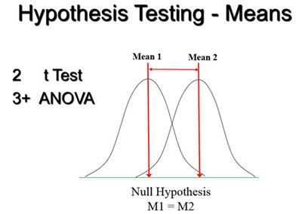
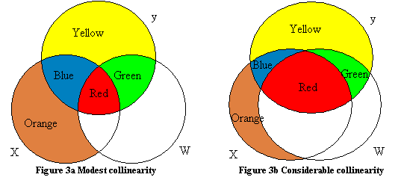





Approach to solving the problem
Hypothesis Testing
Data Wrangling
Anomaly detection
Quantifying Multicollinearity
Accuracy Boosting/
Machine Learning
Data Exploration
Data Analysis

Slide 6
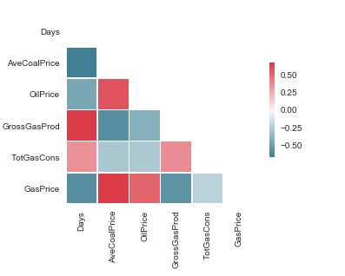
Correlation Matrix

Slide 7
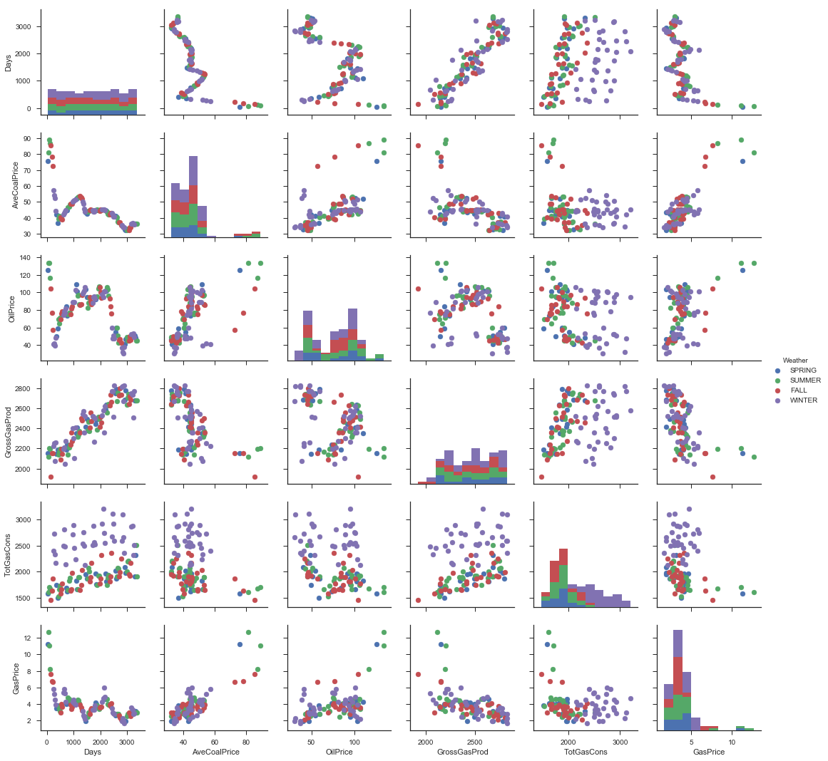
Scatter Matrix of All Variables Included in the Study Data-Set

Slide 8
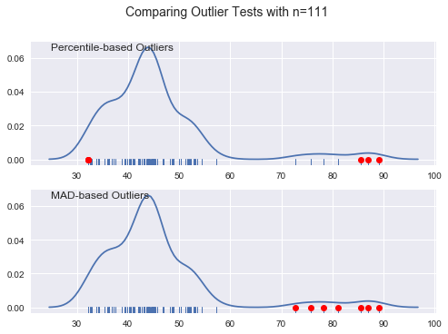
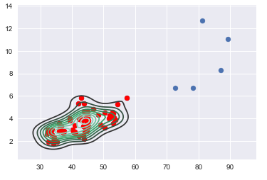
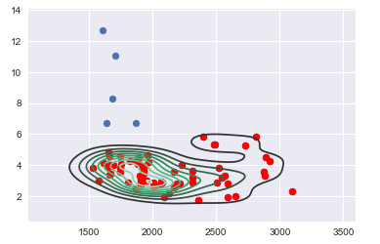
Anomaly Detection
Median-absolute-deviation (MAD) based outlier detection
Percentile based outlier detection
kde Plot of Average Coal Price vs Gas Price
Anomalies were removed from subsequent analysis
Outliers
kde Plot of Total Gas Consumption vs Gas Price

Slide 9
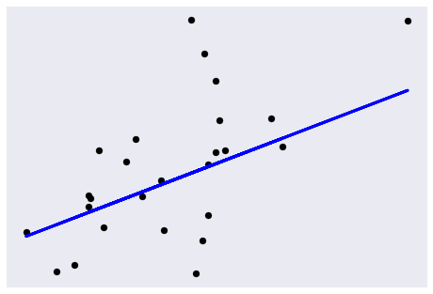
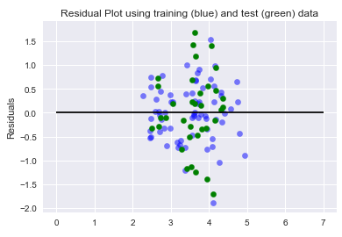
Linear Regression
PROCEDURE
Regress Gas Price vs Each Independent Variable
Regress Gas Price vs All Independent Variables
Gas Price vs Average Coal Price
Residual Plot for all variables regression
Gas Price vs Score MSE Cross Val Score
Average Coal Price 0.33 0.75 0.60
Oil Price 0.10 0.62
Gas Production 0.19 0.75
Gas Consumption -0.04 0.58
All Variables 0.47 0.44

Slide 10
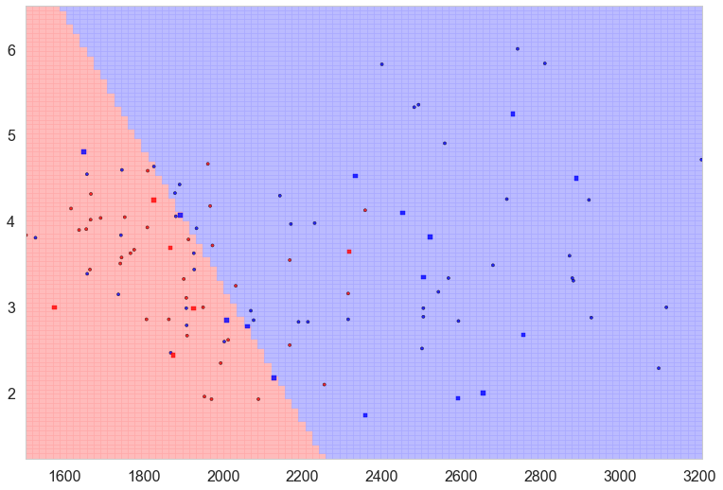
Logistic Regression
PROCEDURE
Use Gas Price Status as dependent variable
HIGH Gas Price: >$3.00
LOW Gas Price: <$3.00
Classification of Gas Price wrt average Coal Price
Gas Price vs Accuracy Score (Training) Accuracy Score (Test)
Average Coal Price 0.87 0.81
Oil Price 0.88 0.81
Gas Production 0.82 0.76
Gas Consumption 0.84 0.86
Days 0.88 0.81

Slide 11
Model Tuning
Accuracy score = 77%
This suggests that the risk that a portion of the sample is misclassified is 23%
PROCEDURE
Cs = [0.001, 0.1, 1, 10, 100]
max_score = 0.76
best_C = 0.001
Gas Price vs Logistic Regression Grid CV Search
All variables 0.77 0.77 (CV=5)

Slide 12
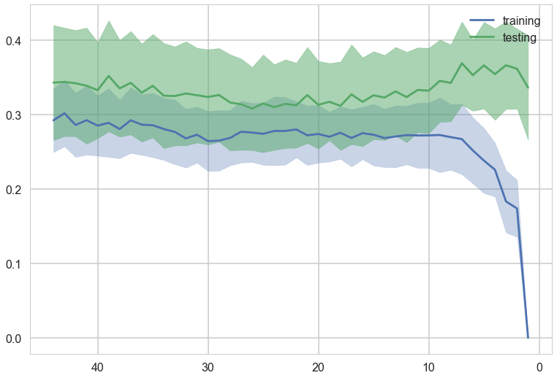
Principal Components Analysis
Sum of explained variance ratio of PCA = 0.999925003031
pc1 = 80.9% of variance
pc2 = 18.8% of variance
pc3 =0.2% of varance
Only two components are enough to explain the variation in the model.
Error against complexity (k), and cross-validation

Slide 13
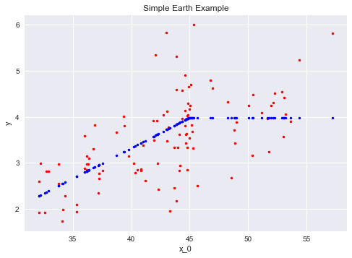
Prediction
Using Ridge Regression: Coef of Ridge =
['AveCoalPrice', 'OilPrice', 'GrossGasProd', 'TotGasCons']:
array([ 0.05515652, 0.00292577, -0.00167807, 0.00039166])
Multivariate Adaptive Spline
GasPrice vs AveCoalPrice

Slide 14
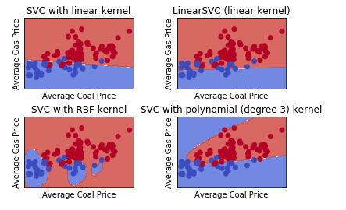
Supervised Vector Machine / Classification

Slide 15
Boosting accurracy of the machine learning model
Accuracy Score
Linear Decision Extremely Random Extra
Regression Tree Randomnized Tree Forest Tree
0.47 0.68 0.69 0.78 0.73
Accuracy Score (Ada Boost = 0.70)
GradientBoostingClassifier (Score) - 92%
GradientBoostingRegression - MSE: 0.12

Slide 16
Summary and Recommendation
Coal price remains the key indicator of increase in gas price. Therefore, it is a variable that investors should watch out for.
Whereas Oil price was seen as the major determinant of natural gas prices, our study shows that its impact in the past decade is marginal.
Gas demand is a key factor that determines US gas price. Gas demand is primarily driven by seasonal variation or occurence of natural disaster.

Slide 17
Recommendation
Seasonal weather, including tropical storms and hurricanes, can have a great influence on natural gas production.
The seasonal effect of weather on gas price cannot be effectively analyse using logistic regressison and classification.
Time series Analysis is therefore recommended in order to explore the effect of seasonality.
There are other factors that ontribute to gas price variation that have not been captured in this project.
Such variables as economic growth, natural gas storage and availability of gas pipelines have effect on gas prices.
It is recommended that future studies include these variables.

Slide 18
End

