Slide 1
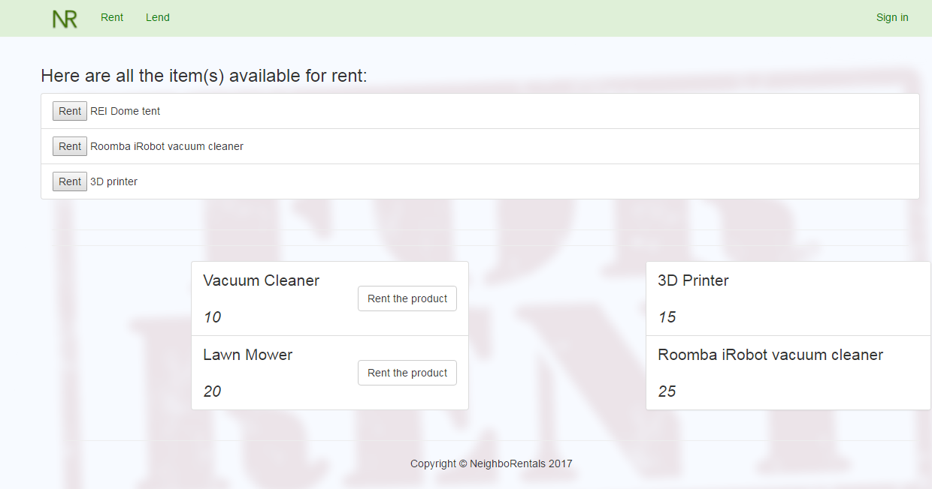

Slide 2
Technologies
Boostrap Twitter Modal Snippets
Firebase Authentication
Sequelize
Handlebars
Deployed Sequelized - mySQL to Heroku

