Slide 1
PREDICTING CUSTOMER BEHAVIOR ON RETAIL SALES
OPTIMIZING RETURNS BASED ON MARKDOWN SUCCESS
By
Angus Ogubuike

Slide 2
OBJECTIVE & DATA - CODEBASE 1.0

Slide 3
FOCUS OF PROJECT
Impact of
Holiday on sales
major events that happen once a year (called markdown) on sales
Predict future performance based on these factors
Optimize sales in different departments based on the features
Answer Environmental Questions

Slide 4
ENVIRONMENTAL QUESTIONS
What impact does the following have on customer behavior and sales return?
Weather (Temperature)
Customer's income potential (CPI)
Unemployment
Type of store
Size of Store
If the impact is significant, how could future sales performance be optimized based on these factors?

Slide 5
DATASET - General
Historical sales data for 45 stores located in different regions in the United States
Features include
Departments
Promotional Markdowns: They precede prominent holidays. The five largest of which are the Super Bowl, Easter, Mother's Day, Thanksgiving, and Christmas
MarkDown 1 - Super Bowl
MarkDown 2 - Easter
MarkDown 3 - Mother's Day
MarkDown 4 - Thanksgiving
MarkDown 5 - Christmas
Environmental Variables: These are additional data related to the store, department, and regional activity for the given dates

Slide 6
DATASET - Specific
Three tranches of excel spreadsheets:
TRANCHE 1 - 8191 x 12 features data set
COLUMNS
Store - The store number
Date - The date for the day of the week
Temperature - The average temperature in the region
Fuel_Price - The cost of fuel in the region
MarkDown1-5 - These are anonymized data related to promotional markdowns.
CPI - The consumer price index
Unemployment - The unemployment rate
IsHoliday - This is a boolean variable that determines whether the week is a special holiday week
TRANCHE 2 - 46 x 3 store dataset
COLUMNS - Size & Type of retail stores
TRANCHE 3 - 421571 x 5 Sales data set (Columns: Sales Data per Department)

Slide 7
PROCEDURE
Data Wrangling
Loading Datasets
Data Manipulation - Merging the three dataset tranches
Handling missing values
Data Exploration

Slide 8
DATA WRANGLING
Three Datasets were merged into one master dataset
The missing values in the first few rows were filled using the backfill method while the remainder will be filled using the interpolate method.
Duplicate Columns were deleted
Master Dataset was saved

Slide 9
DATA EXPLORATION - CODEBASE 2.0

Slide 10
STATISTICAL OVERVIEW
The dataset has 8190 sales record and 95 features
7% of the total period of sales are holidays
Mean promotional sales are as follows:
Markdown 1 = 8887.617797
Markdown 2 = 6107.224317
Markdown 3 = 928.785220
Markdown 4 = 3130.176556
Markdown 5 = 4544.031686
Promotions are generally more successful (more sales are recorded) during holidays than during non-holidays

Slide 11
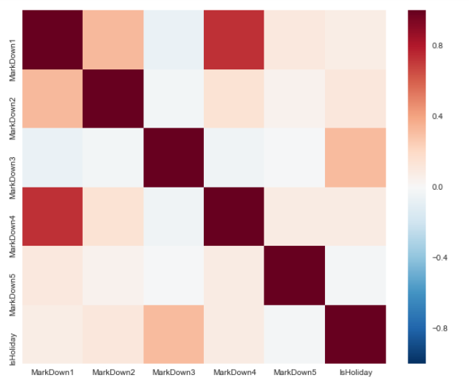
CORRELATION RESULT : HOLIDAY & PROMO SALES
MarkDown 3 (promo events during Mother's Day) has slight positive correlation with Holiday (32%),
Sales at other promotional events seem not to have any significant correlation with holidays

Slide 12
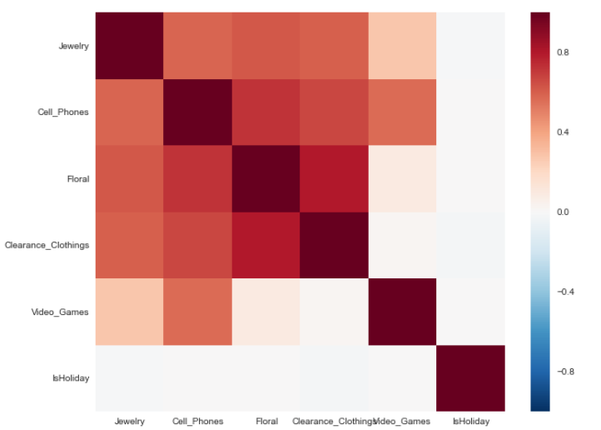
CORRELATION RESULT: HOLIDAY vs SELECTED GIFT ITEMS
Positive correlations among sales of gift items (suggesting collinearity)
Correlation between these items and holidays is not significant

Slide 13
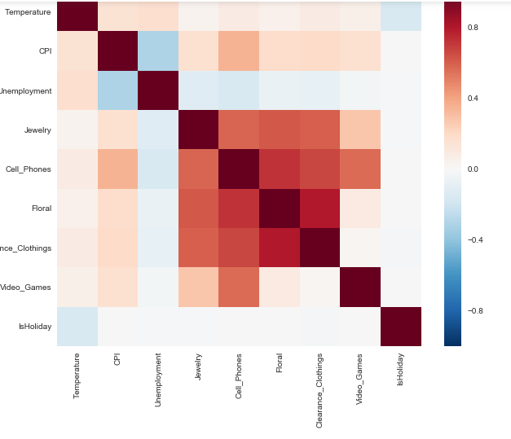
CORRELATION RESULT: ENVIRONMENTAL VARIABLES & SELECTED GIFT ITEMS
Very weak correlation between temperature and sales of gift items
Moderate positive correlation between Cell Phone purchase and CPI
Negative correlation between unemployment and purchase of gifts items (This is the expectation)

Slide 14
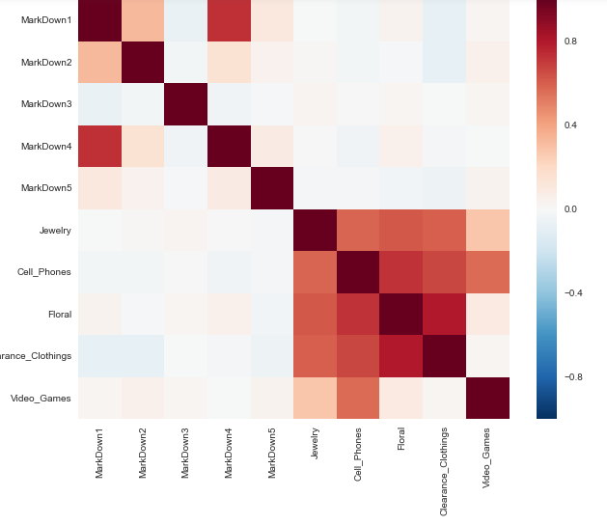
CORRELATION RESULT: PROMO & SELECTED GIFT ITEMS
1. Possible spill over of customer behavior from Thanksgiving to superbowl.
2. Moderate positive correlation between MarkDown 1 and MarkDown 2 - Occurs within the same month range
3. Correlation with departmental gift items is insignificant except an observed weak negative correlation between MarkDown1, MarkDown 2 and MarkDown 3 and the purchase of clearance clothing.

Slide 15
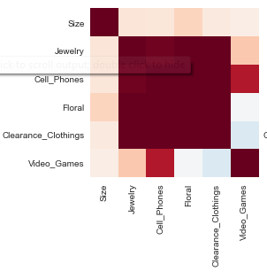
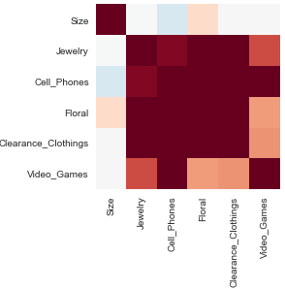
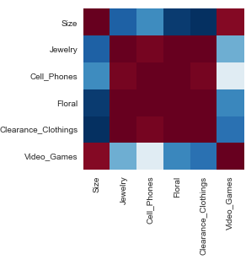
CORRELATION RESULTS - SIZE, TYPE & DEPARTMENTAL SALES
STORE TYPE A
Store Size is moderately correlated to floral sales
Store Size has relative weak positive correlation to sales of other gift items.
Indicates store type is a wholesale store.
STORE TYPE B
Store Size has a moderate negative correlation with cell phone sales,
Store Size has a moderate positive correlation with floral sales and
Very weak or no correlation with sales of other items.
Indicates that this store type is likely a neighborhood store
STORE TYPE C
Strong negative correlation between size and sales.
High activity indicates that this is a superstore type
Negative correlation with size indicates that customers are likely to purchase things in more compact superstores than in the bigger superstores.
The behavior described above also gives us early indication of clustering with respect to type which will be useful in prediction and classification.
A
D
C

Slide 16
HYPOTHESIS TESTING - CODEBASE 3.0

Slide 17
Statistical Test for Correlation
9 hypotheses tested
Store size has impact on Markdown Success
Missing values significantly affect result of tests
The difference between sales recorded on holidays and those recorded on non-holiday weeks is statitically significant
The difference between markdown sales on holidays and those recorded on non-holiday weeks is statistically significant
The difference in Markdowns for each Store Type is statistically significant
The difference in Sales of gift items for each store Type is statistically significant
The difference in Store Size for each Store Type is statistically significant
Store size has impact on Sales of Gift Items
Store size has impact on MarkDowns

Slide 18
MARKDOWN SUCCESS
The t-distribution left quartile range is: -1.96402740931
The t-distribution right quartile range is: 1.96402740931
Create composite function for Markdown success
High markdown success is denoted: "1" (>= Mean of the Markdown sum)
"0" for low Markdown success: (<Mean of the Markdown sum)
Markdown Mean = 4719.567115
Hypothesis Testing: Is there significant difference in the means of size of the stores who had high Markdown success and those who had low markdown success?
Null Hypothesis: (H0: pSS = pMS) The null hypothesis would be that there is no difference in store size between stores which had high Markdown success and those with low markdown success.
Alternate Hypothesis: (HA: pSS != pMS) The alternative hypothesis would be that there is a difference in store size between stores who had high Markdown success and those who had low markdown success.
t- statistic (95%) = 45.54, pvalue (5%) =0.0
Reject Null hypothesis!

Slide 19
MISSING VALUES
The t-distribution left quartile range is: -1.96402740931
The t-distribution right quartile range is: 1.96402740931
Hypothesis Testing: Is there significant difference in the means of the filled missing values and those of the general population?
Null Hypothesis: (H0: pSS = pMS) There is no difference in the result by filling the missing values with numbers using the back fill/ interpolation methods.
Alternate Hypothesis: (HA: pSS != pMS) there is a difference in the result by filling the missing values with numbers using the back fill / Interpolation methods
t- statistic (95%) = -0.22, pvalue (5%) =0.82
Accept Null Hypothesis!

Slide 20
HOLIDAY vs Non-HOLIDAY SALES
The t-distribution left quartile range is: -1.96402740931
The t-distribution right quartile range is: 1.96402740931
For Five Selected Gift Items
Hypothesis Testing: Is there significant difference in the means of the Gift Item sales during holidays and those of the general population??
Null Hypothesis: (H0: pSS = pMS) There is no difference in the mean.
Alternate Hypothesis: (HA: pSS != pMS) There is difference
Department | T- Statistic | P - Value | Decison on Null Hypothesis
Jewelry | 3.55 | 0.0004 | Reject
Cell Phones | -0.47 | 0.64 | Accept
Floral | -0.52 | 0.60 | Accept
Clearance Clothing | 5.24 | 1.62e-07 | Reject
Video Games | -1.66 | 0.097 | Accept

Slide 21
PROMO (HOLIDAY vs Non-HOLIDAY)
The t-distribution left quartile range is: -1.96402740931
The t-distribution right quartile range is: 1.96402740931
For Five MarkDowns
Hypothesis Testing: Is there significant difference in the means of the promos during holidays and those of the general population?
Null Hypothesis: (H0: pSS = pMS) There is no difference in the mean.
Alternate Hypothesis: (HA: pSS != pMS) There is difference
Department | T- Statistic | P - Value | Decison on Null Hypothesis
MarkDown1 | -24.16 | 0.0 | Reject
MarlkDown2 | -37.24 | 0.0 | Reject
MarkDown3 | -103.98 | 0.0 | Reject
MarkDown4 | -26.69 | 0.0 | Reject
MarkDown5 | 5.92 | 0.0 | Reject

Slide 22
MARKDOWNS FOR EACH STORE TYPE
The t-distribution left quartile range is: -1.96402740931
The t-distribution right quartile range is: 1.96402740931
Hypothesis Testing: Is there significant difference in the Markdowns in each Store and those of the general population?
Null Hypothesis: (H0: pSS = pMS) There is no difference in the mean.
Alternate Hypothesis: (HA: pSS != pMS) There is difference
Department | T- Statistic |  |  | P - Value
 | Store A | Store B | Store C | Store A | Store B | Store C
MarkDown1 | -5.74 | -16.87 | 28.09 | 0.00 | 0.00 | 0.00
MarkDown2 | 7.53 | -64.21 | 43.89 | 0.00 | 0.00 | 0.00
MarkDown3 | 0.02 | -5.14 | 3.39 | 0.98 | 0.00 | 0.00
MarkDown4 | 1.87 | -25.27 | 43.07 | 0.06 | 0.00 | 0.00
MarkDown5 | -8.95 | -7.70 | 32.40 | 0.00 | 0.00 | 0.00
Reject Null Hypothesis
Accept Null Hypothesis

Slide 23
STORE SIZE FOR EACH STORE TYPE
The t-distribution left quartile range is: -1.96402740931
The t-distribution right quartile range is: 1.96402740931
Hypothesis Testing: Is there significant difference in the Selected Gift Items in each Store and those of the general population?
Null Hypothesis: (H0: pSS = pMS) There is no difference in the mean.
Alternate Hypothesis: (HA: pSS != pMS) There is difference
Department | T- Statistic |  |  | P - Value
 | Store A | Store B | Store C | Store A | Store B | Store C
Size | -30.15 | -103.26 | -133.198 | 0.00 | 0.00 | 0.00
Reject Null Hypothesis
Accept Null Hypothesis

Slide 24
SALES OF SELECTED GIFT ITEMS FOR EACH STORE TYPE
The t-distribution left quartile range is: -1.96402740931
The t-distribution right quartile range is: 1.96402740931
Hypothesis Testing: Is there significant difference in the Selected Gift Items in each Store and those of the general population?
Null Hypothesis: (H0: pSS = pMS) There is no difference in the mean.
Alternate Hypothesis: (HA: pSS != pMS) There is difference
Department | T- Statistic |  |  | P - Value
 | Store A | Store B | Store C | Store A | Store B | Store C
Jewelry | -38.998 | -12.153 | -55.878 | 0.00 | 0.00 | 0.00
Cell Phone | -102.805 | -30.475 | -105.423 | 0.00 | 0.00 | 0.00
Floral | 3.314 | 16.011 | -12.262 | 0.0009 | 0.00 | 0.00
Clearance Clothing | 2.193 | 21.362 | -94.814 | 0.028 | 0.00 | 0.00
Video Games | -143.506 | -58.888 | -66.557 | 0.00 | 0.00 | 0.00
Reject Null Hypothesis
Accept Null Hypothesis

