Slide 1
NEPR208 - Optimality and adaptation
Stephen Baccus
Department of Neurobiology
baccus@stanford.edu

Slide 2
What?
What are the important biological functions ?

Slide 3
How?
What are the mechanisms of a function?

Slide 4
Why?
What are the functional benefits …
of a particular neural code?
of specific mechanisms?

Slide 5
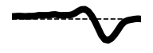
Why this neural code?
Linear-Nonlinear (LN) Model
Spatiotemporal
Filter
Nonlinearity
Time
Functional advantages of response properties and changes in those properties
Why do cells have a particular nonlinear response function?
Why does the nonlinearity change?
Why do cells have a certain duration filter?
Why do they have a certain shape filter?
Why does the filter change?

Slide 6
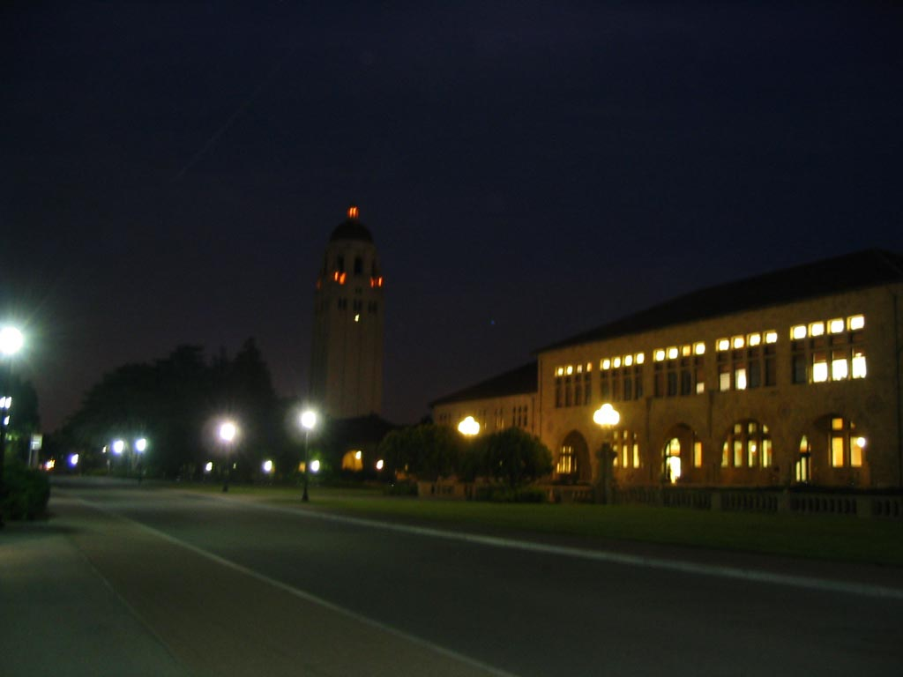
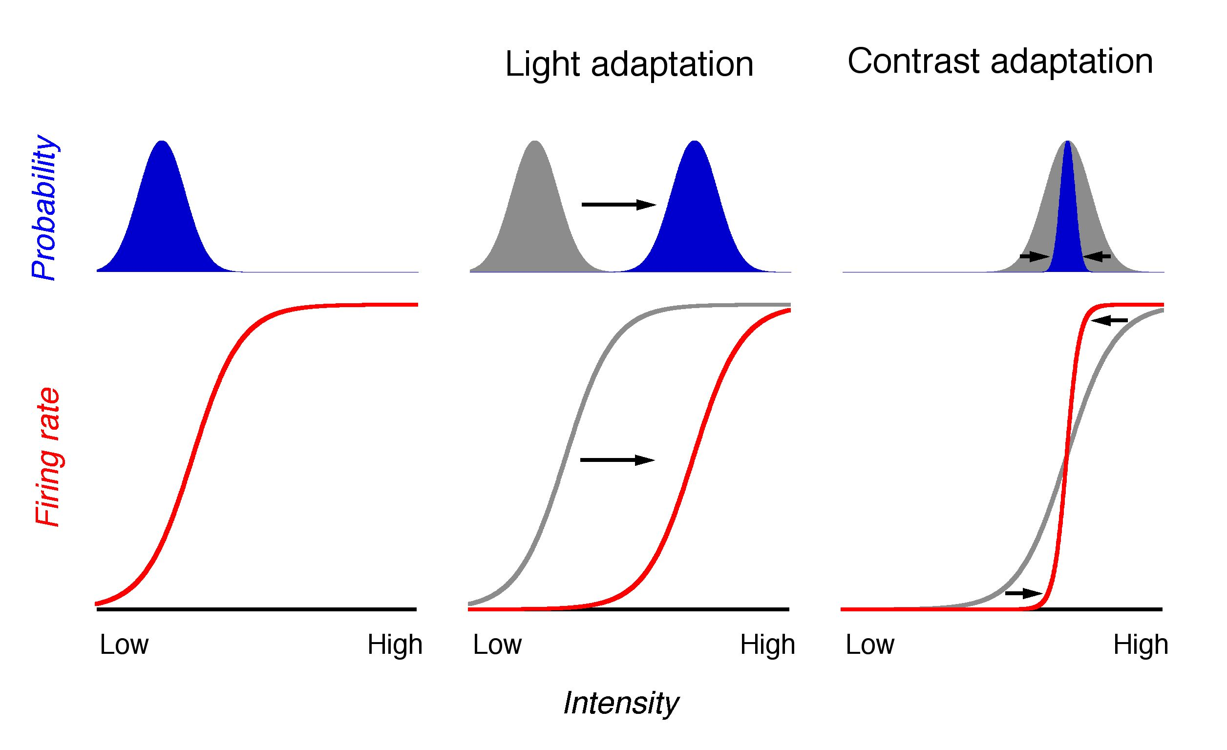
Adaptation to the average input
Intensity

Slide 7
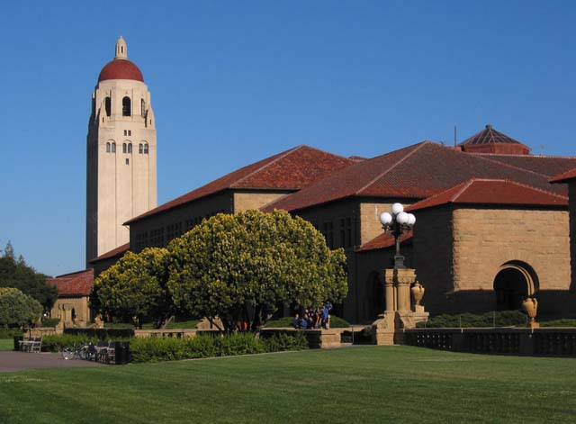
Adaptation to the average input
Intensity

Slide 8
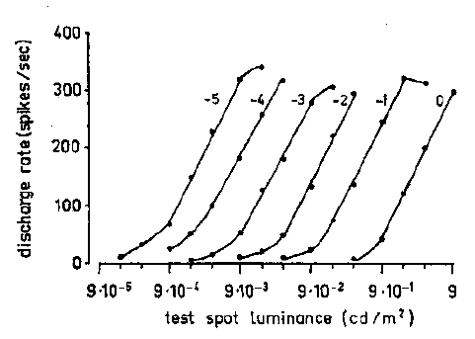
Ganglion cell response curves shift to the mean light intensity
Sakmann and Creuzfeldt, Scotopic and mesopic light adaptation in the cat’s retina (1969)
Notes:
Each of these curves show the response of a ganglion cell to a flashing test spot. Each curve is measured at a different background adapting intensity.

Slide 9
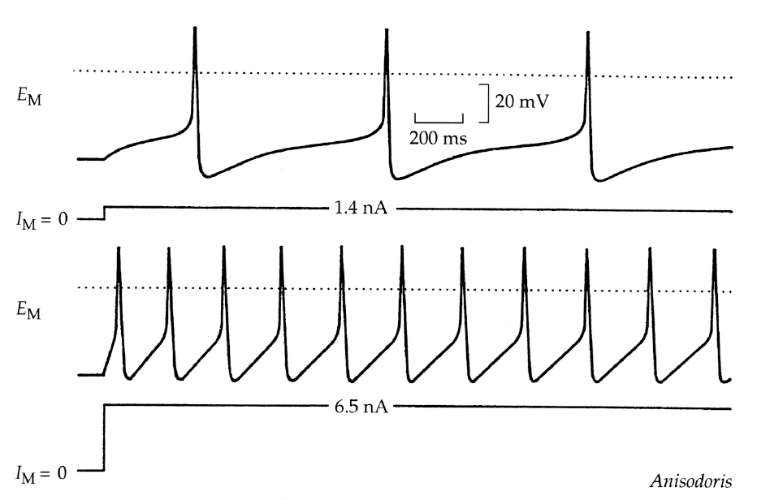
Neurons have a limited dynamic range
set by maximum and minimum output levels, and by noise

Slide 10
S
R
Joint distribution
Joint distribution
P[R,S]
Marginal
distributions
Marginal
distributions
Notes:
Although the joint distribution holds all information about the combined behavior of two signals (here R and S, for response and stimulus), the joint distribution is only experimentally accessible if the number of responses and stimuli are relatively small.
But in reality, there is a huge possibility of stimuli. If the light intensity on each photoreceptor could only take on two values, and there are 5 million cone photoreceptors in each human eye, then the number of possible stimuli is 2 raised to the power of 5 million. The number of responses can also be large if one considers the possible different patterns over time: 10 bins of time, 2 values yields 2^10 possible responses.
So the full joint distribution is only measurable in simple cases.

Slide 11
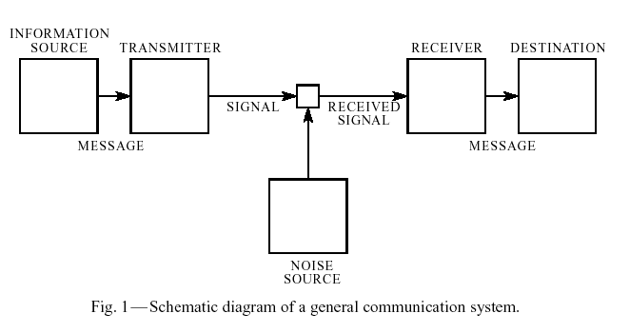
A Mathematical Theory of Communication
Claude Shannon (1948)
Bell System Technical Journal 27, 379-423
Notes:
Modern information theory was established in a single paper by Claude Shannon

Slide 12
A Mathematical Theory of Communication
Claude Shannon (1948)
Spike trains
World
Sense
organs
Higher
brain
Memory,
Behavior
Biophysical
mechanisms
Bell System Technical Journal 27, 379-423
Notes:
Modern information theory was established in a single paper by Claude Shannon

Slide 13
A Mathematical Theory of Communication
Claude Shannon (1948)
Neurotransmitter
Presyn.
V_{m}
Postsyn.
receptor
Postsyn.
V_{m}
Synapse
Biophysical
mechanisms
Bell System Technical Journal 27, 379-423
Notes:
Modern information theory was established in a single paper by Claude Shannon

Slide 14
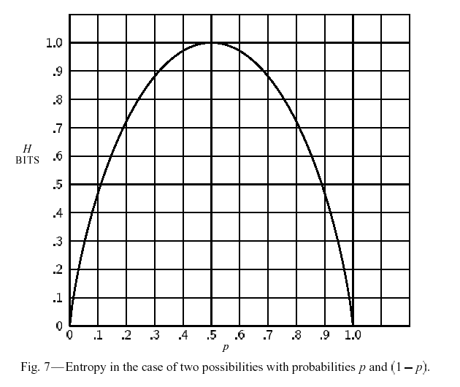
A Mathematical Theory of Communication
Claude Shannon (1948)
What is information?
Entropy*
A measure of uncertainty of a random variable in bits. The maximum possible amount of information there is to be learned from a variable.
Entropy of a fair coin =
- 1/2 log(1/2) - 1/2 log(1/2) = 1 bit
of an unfair coin =
- 3/4 log(3/4) - 1/4 log(1/4) = ~0.8 bits
0 log(0)=0
*By analogy to entropy in statistical mechanics,
k: Boltzmann constant W: Number of possible microscopic states
Notes:
Entropy is also sometimes abbreviated as S() in information theory (like the 97 deRuyter paper).
The specific definition of entropy comes as an answer to a question posed by Shannon. What is a measure of uncertainty of a probability distribution (a set of outcomes) that is;
Additive – If you split a the number of possible outcomes of a variable X into two parts, X1 and X2, then H(X)=H(X1)+H(X2). But if number of possible outcomes (states) of X1 is x1, and the number of possible outcomes of X2 is x2, then the number of possible outcomes of X is x1 times x2 (not x1 + x2). Because of this, the additivity condition gives rise to the log, because log(a+b)=log(a)*log(b).
Symmetric – If you switch around the states of the system, the entropy should be unchanged.
Continuous - if you make a small change in the probabilities of X, you make a small change in the entropy.
Maximum – The measure reaches a maximum when all outcomes are equally likely (like when a coin is fair).
Shannon showed that there is a unique measure, which is – Sum p(x)log(p(x)).

Slide 15
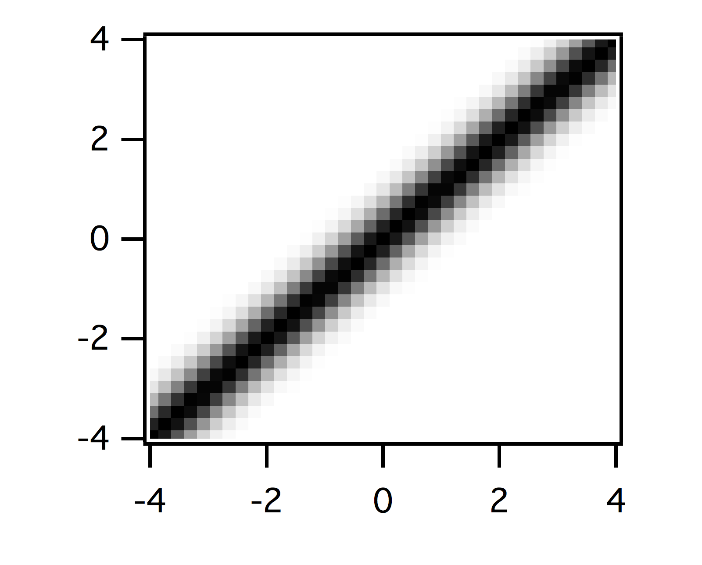
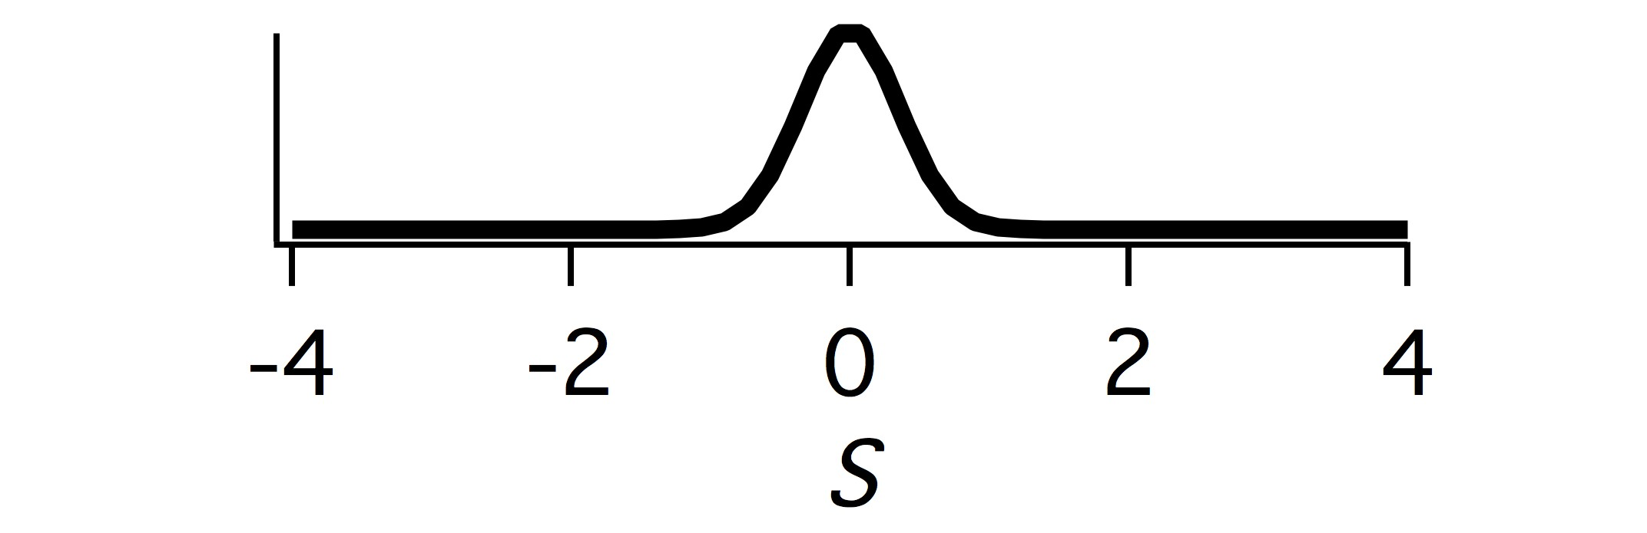

Information is a reduction in entropy
Conditional distribution
R=0
Conditional entropy
Mutual information
A measure, in bits, of how much information is conveyed by one random variable about another random variable. It is equal to the total entropy minus the conditional entropy.
Notes:
So how can the entropy be used? Since entropy indicates uncertainty, a reduction in uncertainty represents information. This can be seen through the conditional distribution P[S|R], read ‘P of S given R’, which is equal to the probability of S once you know what R is. This is the joint distribution P[R,S] normalized by the marginal P[R]. Thus all the rows in the graph at top right sum to one. You can see that once you know what R is, the level of uncertainty decreases.
The measure called the conditional entropy tells about the uncertainty once you know the value of R. It has the log term again like entropy, but it is the log of the conditional distribution. Note also that it is not Sum (P[S|R]logP[S|R]), it is weighted by the original joint distribution.
We can then define a measure of information as the reduction in uncertainty that measured as the difference between the entropy of a variable S, and the conditional entropy once you know another variable R.
Mutual information is symmetric, so the information in S about R is the same S the information in R about S. This means that there is no causal element considered in this relationship. Whether X caused Y or Y caused X or Z caused both of X and Y, I(X;Y) is the same.

Slide 16
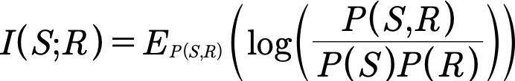
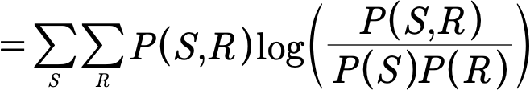
Mutual information as the ‘distance’ between two probability distributions
Product distribution – what things would
Look like with zero information
P[R]P[S]
Notes:
There’s another way to think about and calculate mutual information as the ‘difference’ or ‘distance’ between the actual joint distribution and the distribution of the two variables had no information about each other.
The essence of this equation is a weighted ratio between the two distributions shown at the top.
The left joint distribution is what actually happened P[X,Y] (stated P of X and Y). The right distribution is what would have happened had P[X] and P[Y] been the same, but the two signals were completely independent - in other words carried zero information about each other. This is sometimes called the Product Distribution. The two equations for mutual information give the same result.

Slide 17

Does the early visual system maximize information transmission?
‘Efficient Coding’ - Horace Barlow
Conditional
(“noise”)
entropy
Mutual information
Total
entropy
References in notes section
Chalk, Matthew, Olivier Marre, and Gašper Tkačik. "Toward a unified theory of efficient, predictive, and sparse coding." Proceedings of the National Academy of Sciences 115.1 (2018): 186-191.
Notes:
[1] F. Attneave (1954), Some informational aspects of visual perception. Psychol. Rev. 61(3):183–93.
[2] R. Linsker (1988), Deriving receptive fields using an optimal encoding criterion. IEEE Computer, 21, 105–17.
[3] R. Linsker, (1989). An application of the principle of maximum information preservation to linear systems. In “Advances in neural information processing systems” 186-194.
[4] J. H. van Hateren, (1992). A theory of maximizing sensory information. Biological cybernetics, 68(1):23–29.
[5] H. B. Barlow (1961), Possible principles underlying the transformation of sensory messages. In Sensory Communication, ed. WA Rosenblith, pp. 217–34, Cambridge, MA: MIT Press.
[6] E. P. Simoncelli, B. A. Olshausen (2001), Natural image statistics and neural representation. Annu. Rev. Neurosci. 24:1193–216
[7] H. Barlow (2001) Redundancy reduction revisited. Network: computation in neural systems 12(3): 241–253.
[8] D. J. Field (1987), Relations between the statistics of natural images and the response properties of cortical cells. J Opt Soc Am A 4: 2379–2394.
[9] D. Kersten (1987), Predictability and redundancy of natural images. J Opt Soc Am A 4: 2395–2400.
[10] M. V. Srinivasan, S. B. Laughlin, & A. Dubs (1982). Predictive coding: a fresh view of inhibition in the retina. Proc of the Royal Society of London B: Biological Sciences, 216(1205):427–459.
[11] Y. Dan, J. J. Atick, & R. C. Reid, R. C. (1996). Efficient coding of natural scenes in the lateral geniculate nucleus: experimental test of a computational theory. J Neurosci, 16(10):3351-3362.
[12] B. A. Olshausen & D. J. Field (2004), Sparse coding of sensory inputs. Curr. Op. in Neurobio. 14(4):481–487.
[13] A. Hyv ̈arinen, J. Hurri & P. O. Hoyer (2009) Natural Image Statistics; a probabilistic approach to early computational vision. Springer-Verlag.
[14] A. J. Bell, & T. J. Sejnowski, (1995). An information-maximization approach to blind separation and blind deconvolution. Neural computation, 7(6):1129–1159.
[15] A. J. Bell, & T. J. Sejnowski, (1997). The independent components of natural scenes are edge filters. Vision research, 37(23):3327–3338.
[16] B. A. Olshausen & D. J. Field (1996), Emergence of simple-cell receptive field properties by learning a sparse code for natural images. Nature, 381(6583):607–609.
[17] J. H. van Hateren, A. van der Schaaf (1998), Independent component analysis of natural image sequences yields spatio-temporal filters similar to simple cells in primary visual cortex. Proc. R. Soc. London Ser. B, 265:359–66.
[18] E. C. Smith & M. S. Lewicki (2006), Efficient auditory coding. Nature, 439(7079):978–982.
[19] F. E. Theunissen (2003), From synchrony to sparseness. Trends Neurosi, 26:61–64
[20] R. P. Rao, & D. H. Ballard (1999), Predictive coding in the visual cortex: a functional interpre- tation of some extra-classical receptive-field effects. Nature neuroscience, 2(1):79–87.
[21] M. Boerlin, & S. Deneve (2011), Predictive coding of dynamical variables in balanced spiking networks. PLoS Comput Biol, 7(2), e1001080.
[22] S. Druckmann, T. Hu & D. B. Chklovskii (2017), A mechanistic model of early sensory processing based on subtracting sparse representations. in Advances in Neural Information Processing Systems 25:1979–1987.
[23] J. J. Atick & A. N. Redlich (1992), What does the retina know about natural scenes? Neural Computation, 4(2):196–210.
[24] E. Doi, & M. S. Lewicki (2005), Sparse Coding of Natural Images Using an Overcomplete Set of Limited Capacity Units. Advances in Neural Information Processing Systems 17.
[25] E. Doi, M. S. Lewicki (2014), A simple model of optimal population coding for sensory systems. PLOS Comp. Bio., 10(8):e1003761
[26] Y. Karklin & E. P. Simoncelli (2011), Efficient coding of natural images with a population of noisy Linear-Nonlinear neurons. Advances in Neural Information Processing Systems 24, pp. 999–1007.
[27] B. A. Brinkman., A. I. Weber, F. Rieke, & E. Shea-Brown (2016), How Do Efficient Coding Strategies Depend on Origins of Noise in Neural Circuits? PLoS Comp Bio, 12(10):e1005150.
[28] G. Tkaˇcik, J. S. Prentice, V. Balasubramanian,& E. Schneidman (2010), Optimal population coding by noisy spiking neurons. Proc. of the National Academy of Sciences, 107(32):14419-24.
[29] N. Brenner, W. Bialek, & R. de R. van Steveninck (2000) Adaptive rescaling maximizes information transmission. Neuron, 26(3):695–702
[30] A. L. Fairhall, G. D. Lewen, W. Bialek, W., & R. de R. van Steveninck (2001). Efficiency and ambiguity in an adaptive neural code. Nature, 412(6849):787–792
[31] C.. K.. Machens, T. Gollisch, O. Kolesnikova, & A. V. M. Herz (2005), Testing the efficiency of sensory coding with optimal stimulus ensembles. Neuron, 47(3):447–456.
[33] W. Bialek, R. De Ruyter Van Steveninck, & N. Tishby (2006), Efficient representation as a design principle for neural coding and computation. IEEE International Symposium on Information Theory, pp. 659–663.
[34] J. Salisbury & S. Palmer (2016), Optimal prediction in the retina and natural motion statistics. Journal of Statistical Physics, 162(5):1309–1323.
[35] S. E. Palmer, O. Marre, M. J. Berry II, & W. Bialek (2015), Predictive information in a sensory population. Proc Natl Acad Sci USA, 112(22):6908–6913.
[36] L. Buesing & W. Maass (2010), A spiking neuron as information bottleneck. Neural Comp., 22(8):1961–1992..
[37] F. Creutzig & H. Sprekeler (2008), Predictive coding and the slowness principle: An information- theoretic approach. Neural Comp, 20:1026–1041.
[38] P. Berkes & L. Wiskott (2005), Slow feature analysis yields a rich repertoire of complex cell properties. J. Vis. 5(6).
[39] J. P. Lies, R. M. Hafner, & M. Bethge, (2014), Slowness and sparseness have diverging effects on complex cell learning. PLoS Comp Bio, 10(3):e1003468.
[40] N. Tishby, F. C. Pereira, & W. Bialek (1999), The information bottleneck method. Proc. of the 37th Annual Allerton Conference on Communication, Control and Computing, pp. 368–377.
[41] M. Chalk, O. Marre, & G. Tkaˇcik (2016), Relevant sparse codes with variational information bottleneck. Advances in Neural Information Processing Systems, 1957–1965

Slide 18
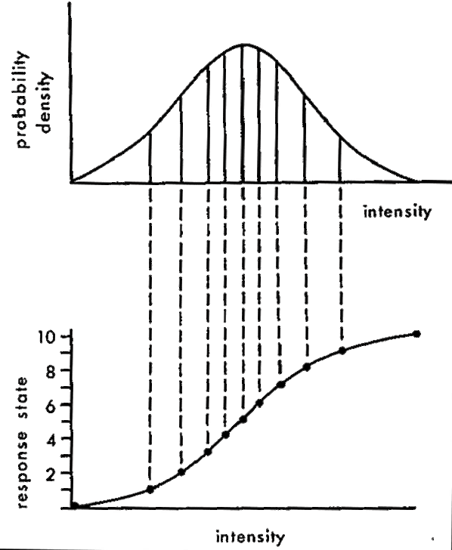
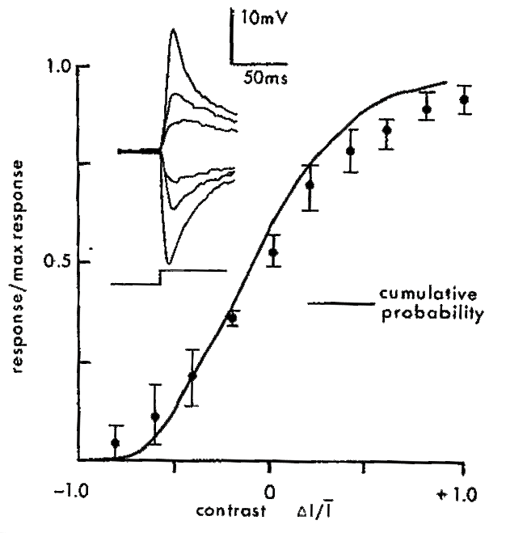
Maximizing information by a nonlinearity that maximizes total entropy
Simon Laughlin, A simple coding procedure enhances a neuron’s information capacity Z. Naturforsch, 36c: 910-912 (1981)
Notes:
Simon Laughlin proposed a simple theory of how a cell should match its response curve to a distribution of intensities. The upper left graph shows a hypothetical probability distribution of light intensities. The response curve that transmits the most information about particular sampled intensities is shown below. It looks like the integral of the intensity distribution.
At right shows the actual response curve for a fly neuron responding to changes in intensity. The x-axis indicates the change in intensity divided by the mean intensity (delta I / I) or the contrast. The dots show a measured response curve of an adapted fly neuron, and the smooth curve is the integral of the intensity distribution used to adapt the photoreceptor.

Slide 19
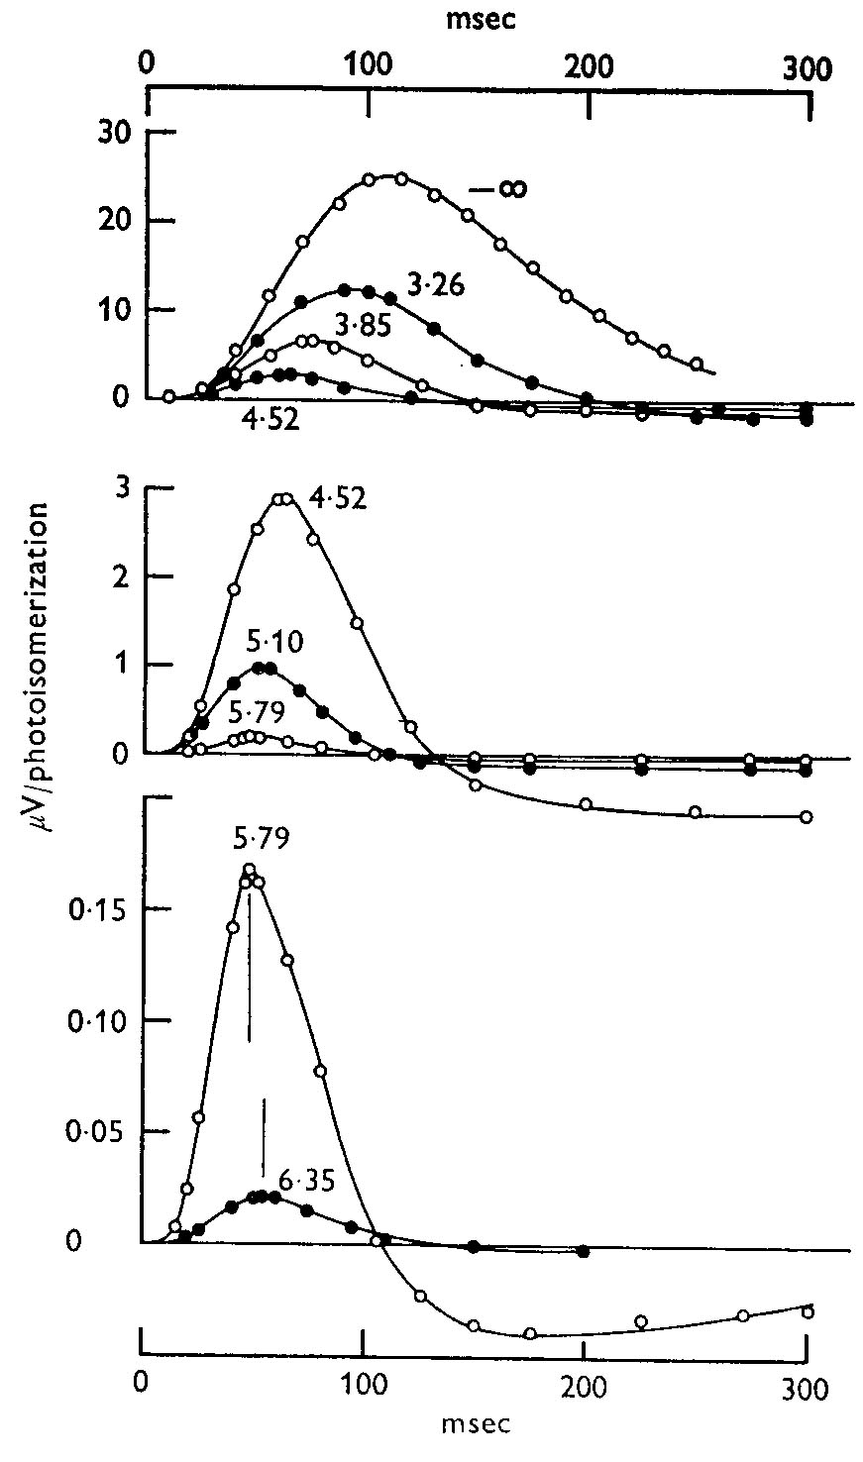
Turtle Cones: Sensitivity and Kinetics change with mean luminance
Baylor & Hodgkin 1974
Notes:
These curves show flash responses at different background luminances. The responses are normalized to show the response per photon absorbed. The three graphs have a different y-scale. The numbers next to the curves show the log of the background intensity. So the brightest background is 6.35, which has the smallest response *per photon*. In other words, sensitivity is less at brighter backgrounds.
But also notice that at brighter backgrounds, the response is faster and more biphasic.

Slide 20
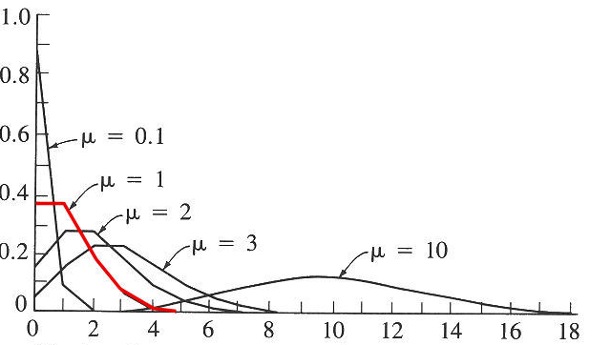
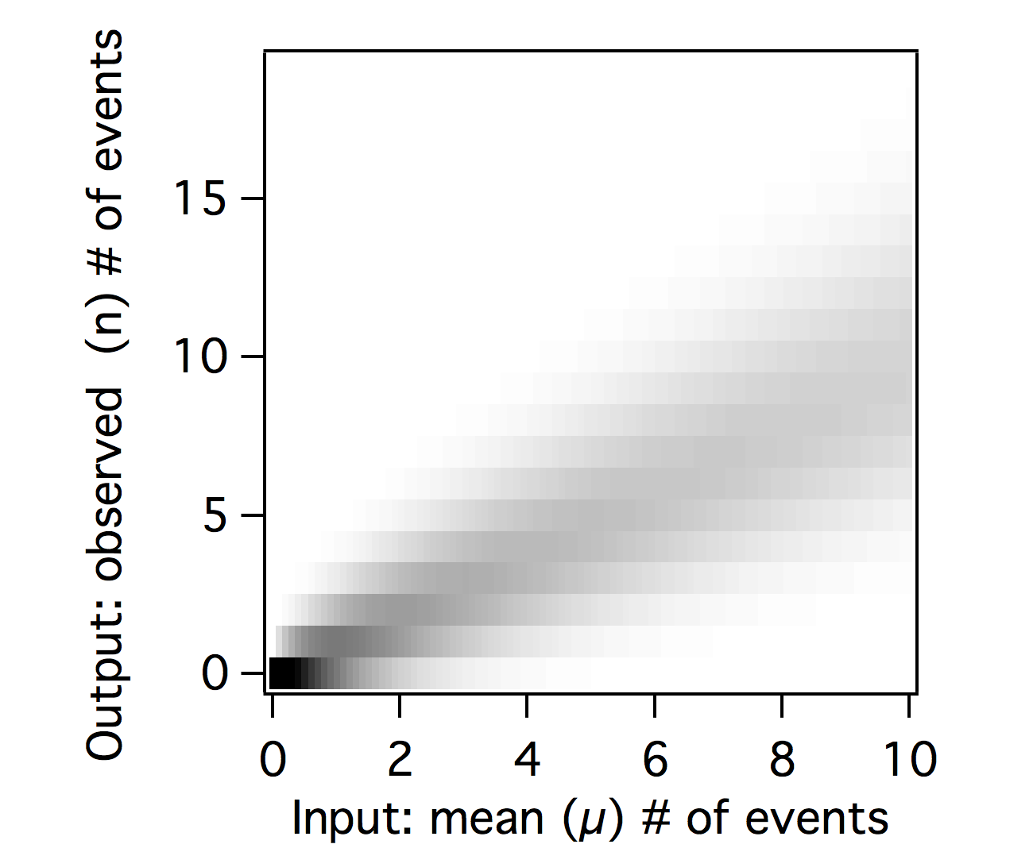
Events with Poisson statistics P[n,µ]
µ = mean # of events in a time interval
n = events in a time interval
Joint probability distribution P[n,µ]
Expected frequency
# of events
variance=mean=µ
Notes:
How to think quantitatively about the noise? A common model of variability is the Poisson distribution, which occurs when events occur at an average rate, and with an independent probability during each time interval. i.e. one event doesn’t influence the occurrence of another. Photon arrival is described by a Poisson distribution.
In a Poisson distribution, if there are n events occurring on average, the variance is also n, and the standard deviation is the square root of n.
For example, if a cell whose spiking following a Poisson distribution fires on average at four spikes per second, then the standard deviation is 2 spikes per second. But a cell that fires at 400 Hz has a standard deviation of only 20 spikes per second. So there are significant gains when a signal is carried by many independent elements such as channels or vesicles. But there is diminishing returns, because the variability only decreases by the square root of n.
Not all variability is Poisson. Some are more Gaussian, some are more complicated because events are not independent. For example, because of the refractory period, if a cell fires a spike, its spiking probability changes for some short interval, in contrast to the Poisson distribution. A cell may have Poisson-like spiking at intervals longer than the refractory period.

Slide 21
Signal with poisson distribution
Rate
Filtered
0.1
1
10
100
1000
Notes:
Examples of photons (or another signal) arriving with a Poisson distribution. The signal is a flashing square wave. At the dimmest light intensities, it is very hard to see the step changes because the noise is so great.
Although it is not shown here explicitly, you can see that you can get more temporal information at a higher intensity - I.e. you can see the exact position of the step at a rate of 1000 per time bin (bottom row), but at a rate of 1, it is very hard to tell where the step starts and stops.
Thus the statistics of photons naturally limit the temporal bandwidth at different light levels.

Slide 22
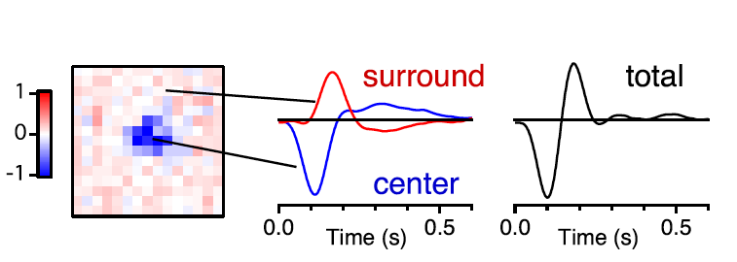
What receptive field maximizes information transmission?
Retinal bipolar cell receptive field
Baccus, Olveczky, Manu & Meister, 2008

Slide 23
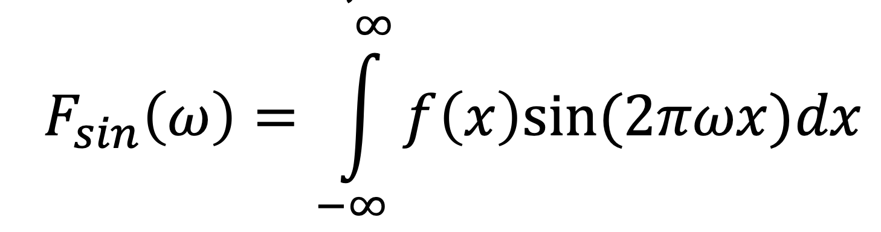
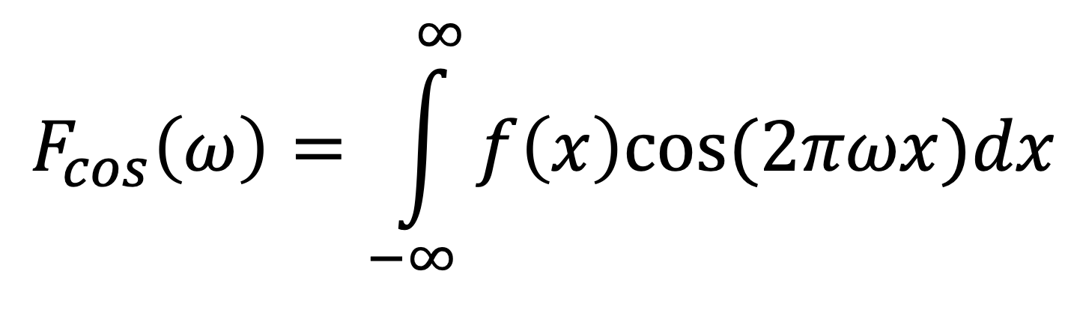
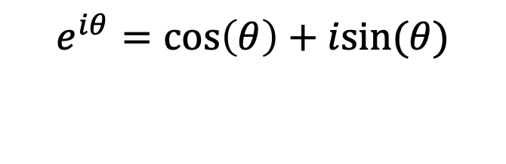
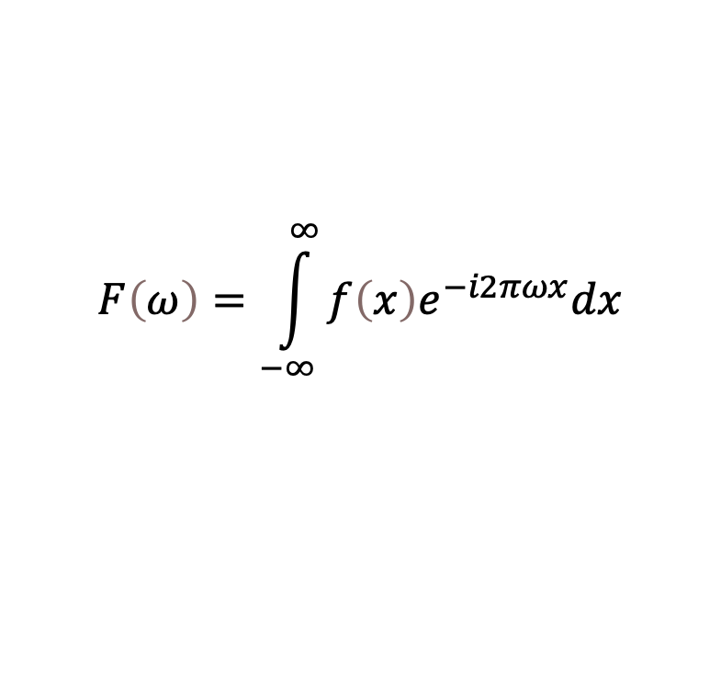
Fourier transform
Represents a function as a weighted sum of sinusoids
Projects the function onto an orthogonal basis - sinusoids
Fourier sine transform, cosine transform
Euler’s equation
Complex Fourier transform
$$e^{iθ}=\cos\left(θ\right)+isin(θ)$$
$$F\left(ω\right)=\int_{−∞}^{∞}{f\left(x\right)e^{−i2πωx}dx}$$

Slide 24
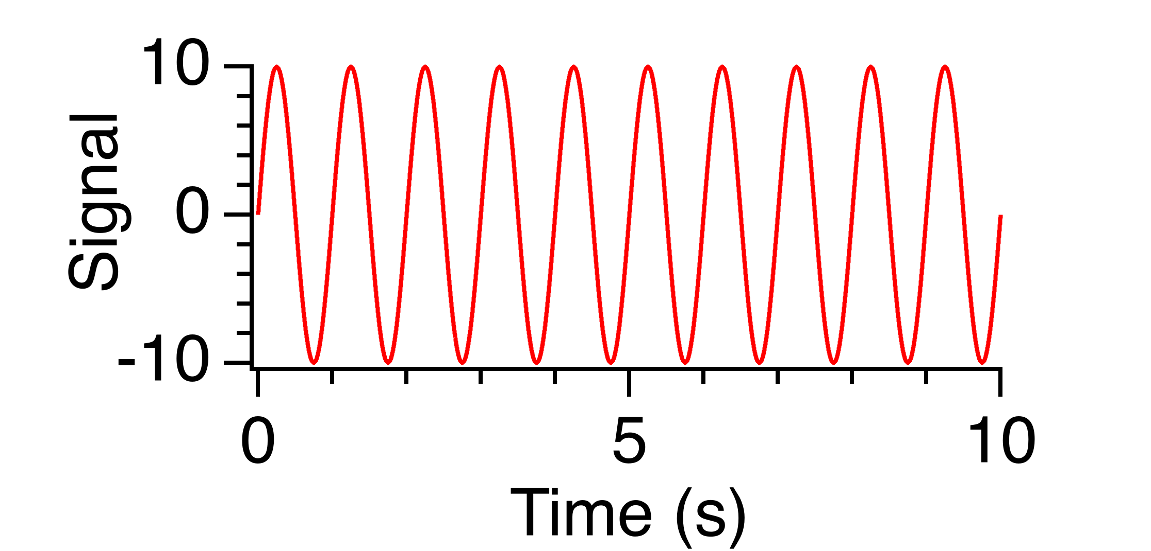
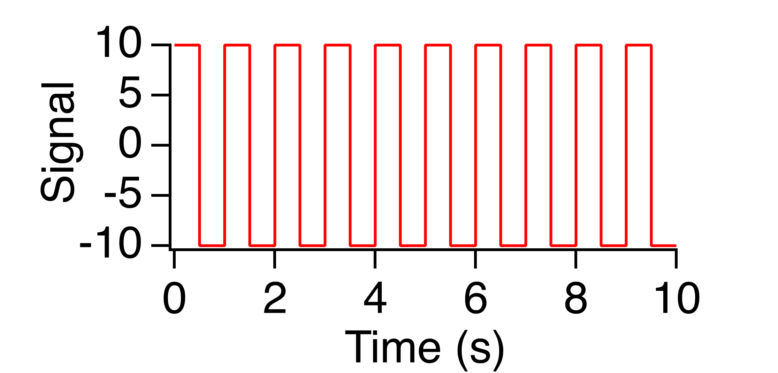
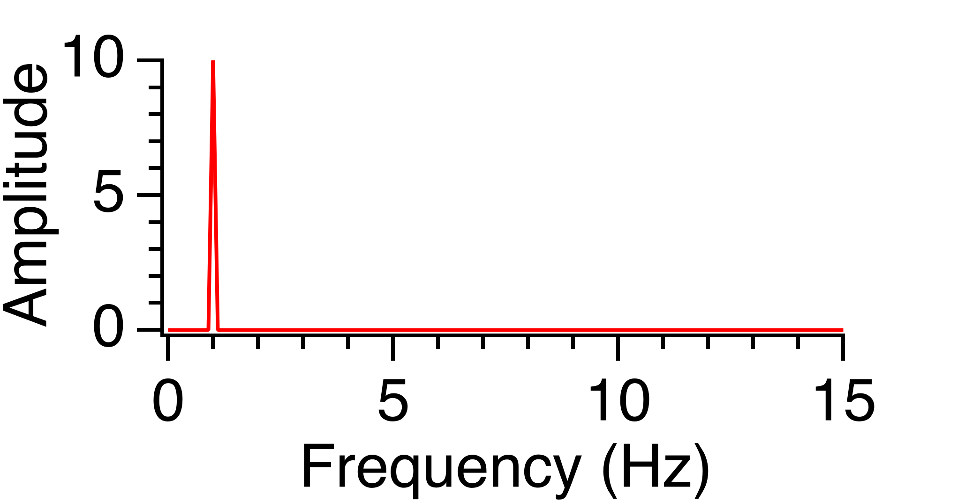
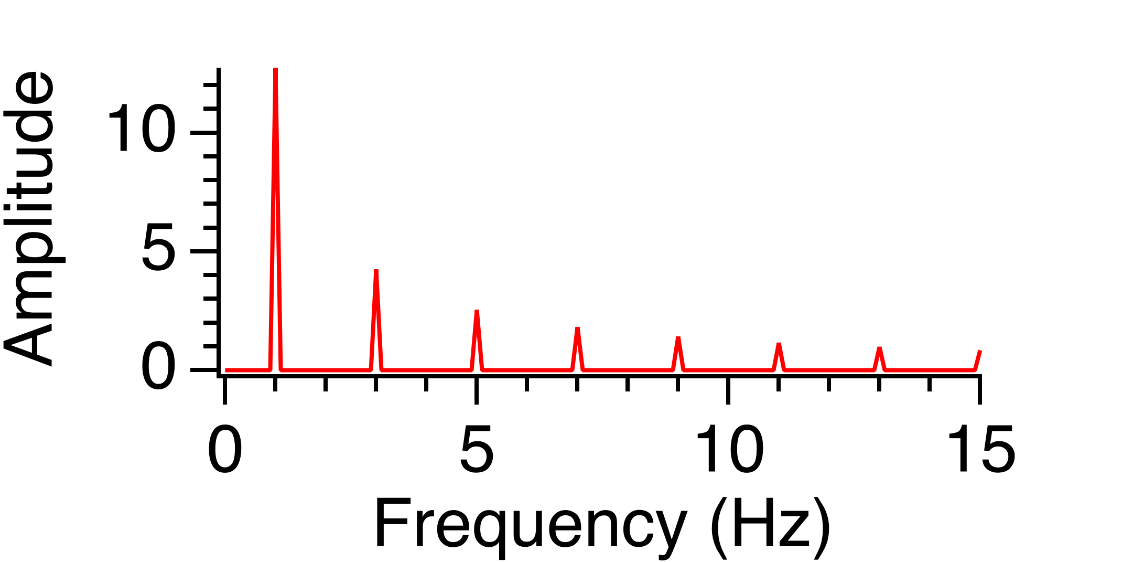
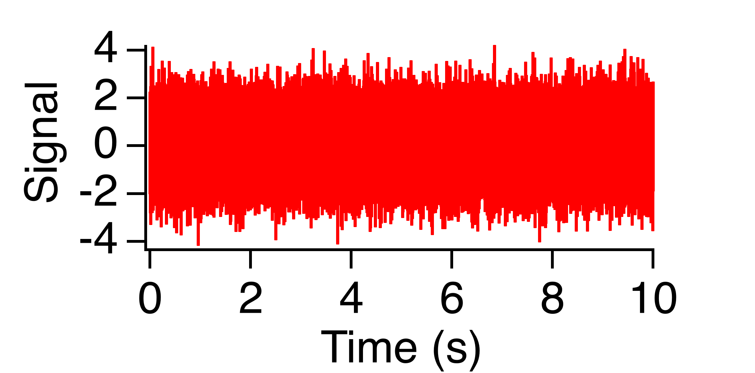
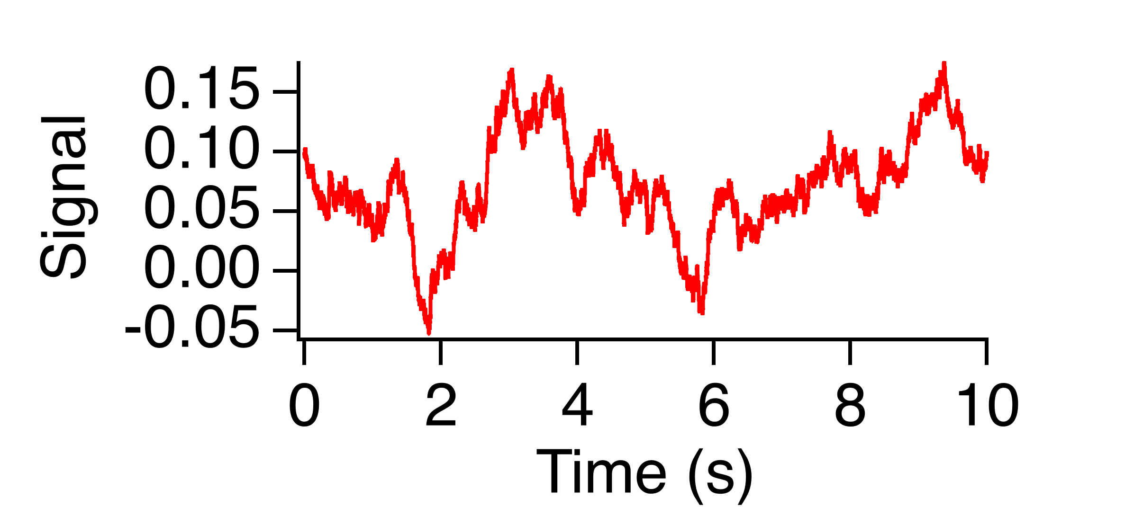
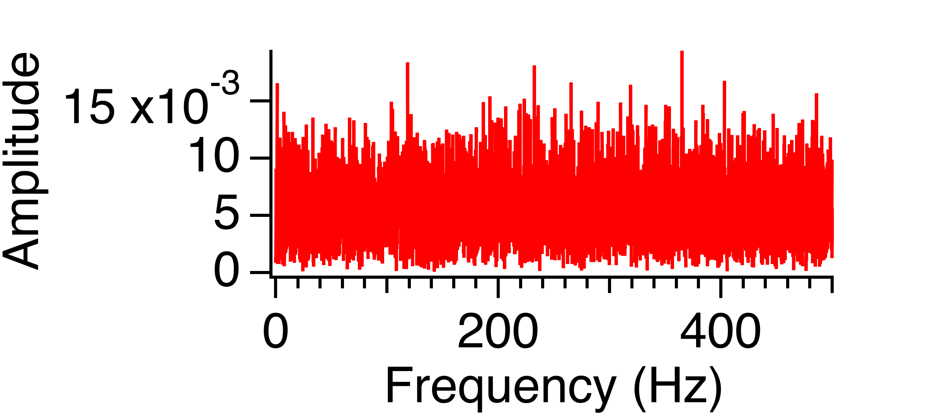
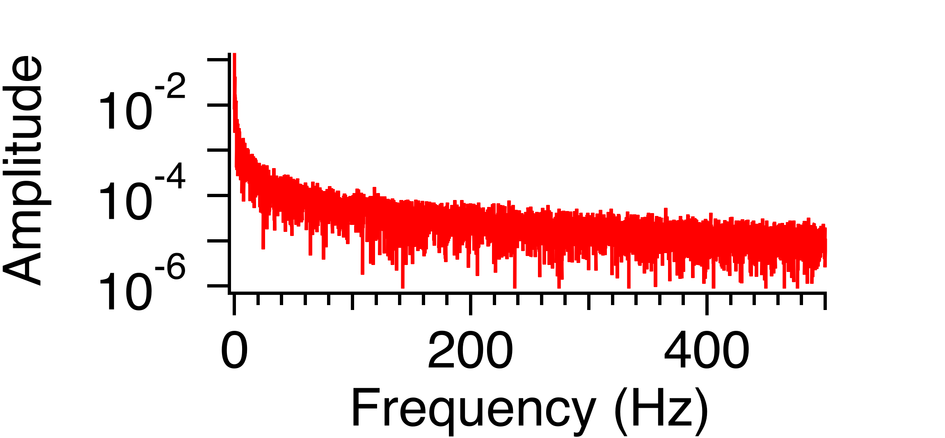
Fourier amplitude spectrum examples
Sine wave
Square wave
White noise
Pink noise
A ∝ 1/f

Slide 25
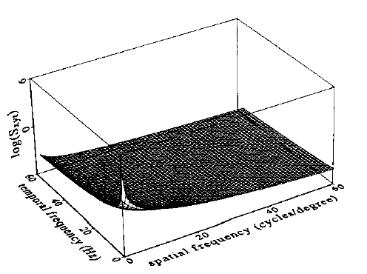
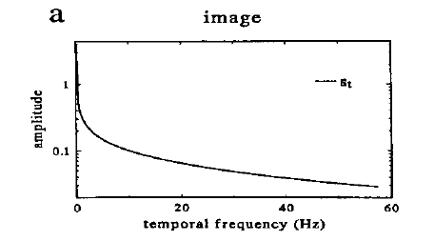
Theory of maximizing information in a noisy neural system
Natural visual scenes are dominated by low spatial and temporal frequencies
J.H. van Hateren. Real and optimal neural images in early vision. Nature 360:68-70 (1992)
J.H. van Hateren, Spatiotemporal contrast sensitivity of early vision. Vision Res., 33:257-67 (1993)
Notes:
Very interesting work by Hans van Hateren has attempted to derive a number of response properties of the early visual system directly from the statistics of natural scenes.
In the model at left, a system receives an image that has noise it in, mainly due to photons (1st added noise). Then, a “neural filter” transforms the input. What this neural filter really means is a temporal and spatial receptive field. Then afterwards a source of intrinsic noise is added (2nd “channel noise”), which might be variability is spiking or in vesicle release, or many other mechanisms.
The effect of this 2nd added noise is that no matter what happens, there is a maximum signal to noise ratio (SNR) that the channel (cell) can have, and it can’t do any better than this. So if the light intensity is very bright (high SNR), and the first noise has a small effect, the 2nd noise will be limiting. But if the light intensity is dim (low SNR) the first noise will be limiting.
The graph at right shows the switch between these two regimes, and gives a equation to describe this change in regimes. The square root of I (light intensity) in the denominator is the photon Poisson noise.

Slide 26
Linear filter and frequency response
Stimulus
Filter
Response
Convolution theorem
a convolution in the time domain
is a simple product in the frequency domain
Notes:
The ~ (there are also other notations) indicates Fourier transform, which transforms a signal that has a different amplitude at each time point into a sum of sinusoids that has different amplitude and phase for each frequency sinusoid. To find the amplitude at each frequency in the response, take the amplitude of that frequency in the stimulus, and multiply it by that frequency in the filter. The convolution theorem implies that to compute a convolution of two functions like f() and g(), you can first take the Fourier transforms of f() and g(), multiply the result for each ω of f(ω) and g(ω), then take the inverse Fourier transform of the result. For these purposes, you don’t need to know how to compute a Fourier transform, just what it means, and that there is an inverse.

Slide 27
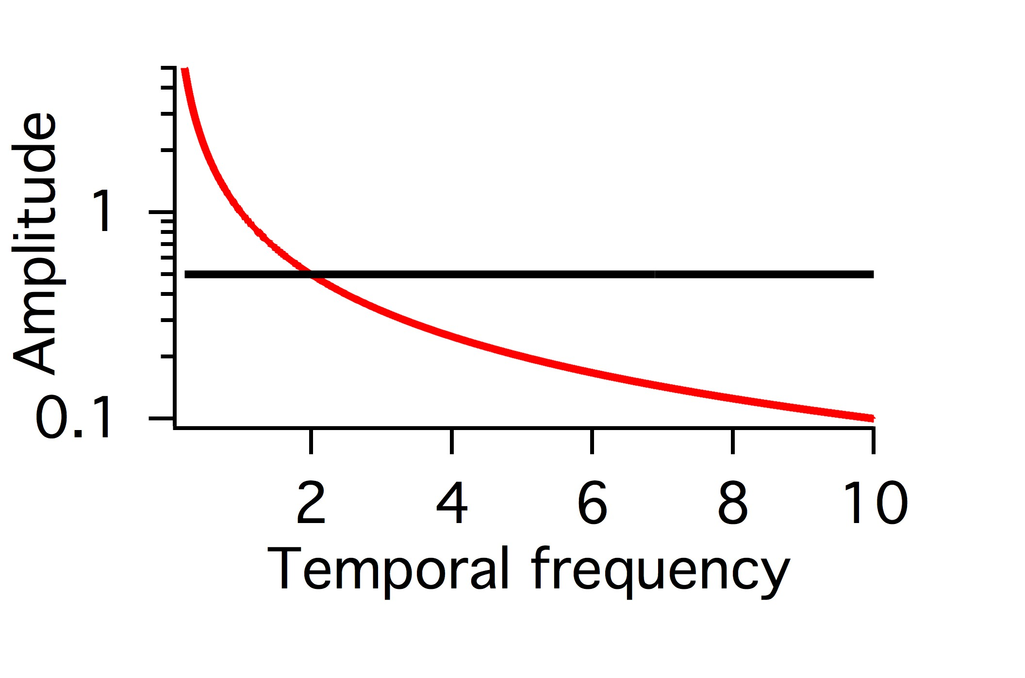
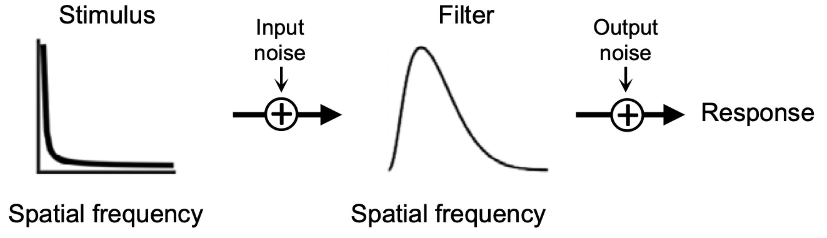
What filter maximizes information?
Stimulus
Noise
∝
1/f
?
Conditional
(“noise”)
entropy
Mutual information
Total
entropy
I(R;S) = H(R) – H(R|S)
I(S;R) = H(F(S+N_{i} )+N_{e} ) – H(F(S+N_{i} )+N_{e} |S)
Notes:
These diagrams show the concepts of optimal filtering discussed in the Van Hateren paper. An efficient system will use all
Symbols with equal frequency. Remember the entropy diagram of the coin that had a peak in the middle. Entropy had a peak
When heads and tails at equal probability. This meant that the amount of information that such a signal could convey had a peak when the two
Symbols had equal probability.
Thinking in terms of temporal frequencies as different inputs and outputs, if a stimulus has more low frequency, it is efficient to ‘whiten’ the output,
Making the response use different frequencies equally. Whitening is accomplished by having a filter that is inverse of the stimulus.
Because a convolution is a produce in the frequency domain, if the Stimulus frequency spectrum is proportional to 1/f, then the optimal filter should be proportional to f.
This discussion however, does not consider the noise. In this case, the noise is equal at all frequencies. Therefore, when passed through a filter that is proportional to f, emphasizing high frequencies, at some point noise becomes greater that the signal represented in the response. Thus it is also the best solution to simply cut out these higher frequencies, because the noise is too great. Thus the optimal filter will have a bandpass appearance, both reducing low and high frequencies.
This situation depends on how great the noise is. When the amount of signal that is above the noise is very small, then it no longer is efficient to reduce the only signal that is available. In this case, a low pass filter that reduces only high frequencies is more efficient (not shown here).

Slide 28
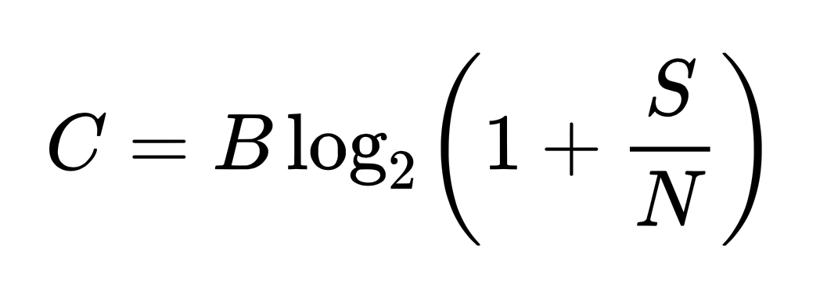
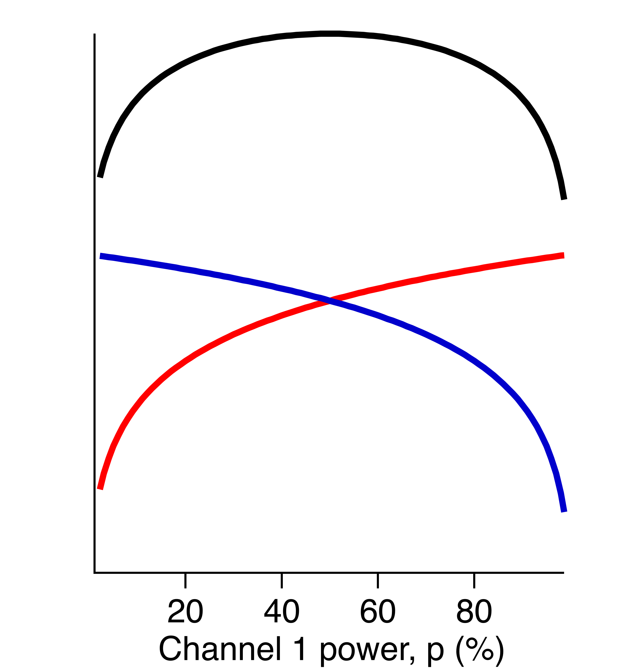
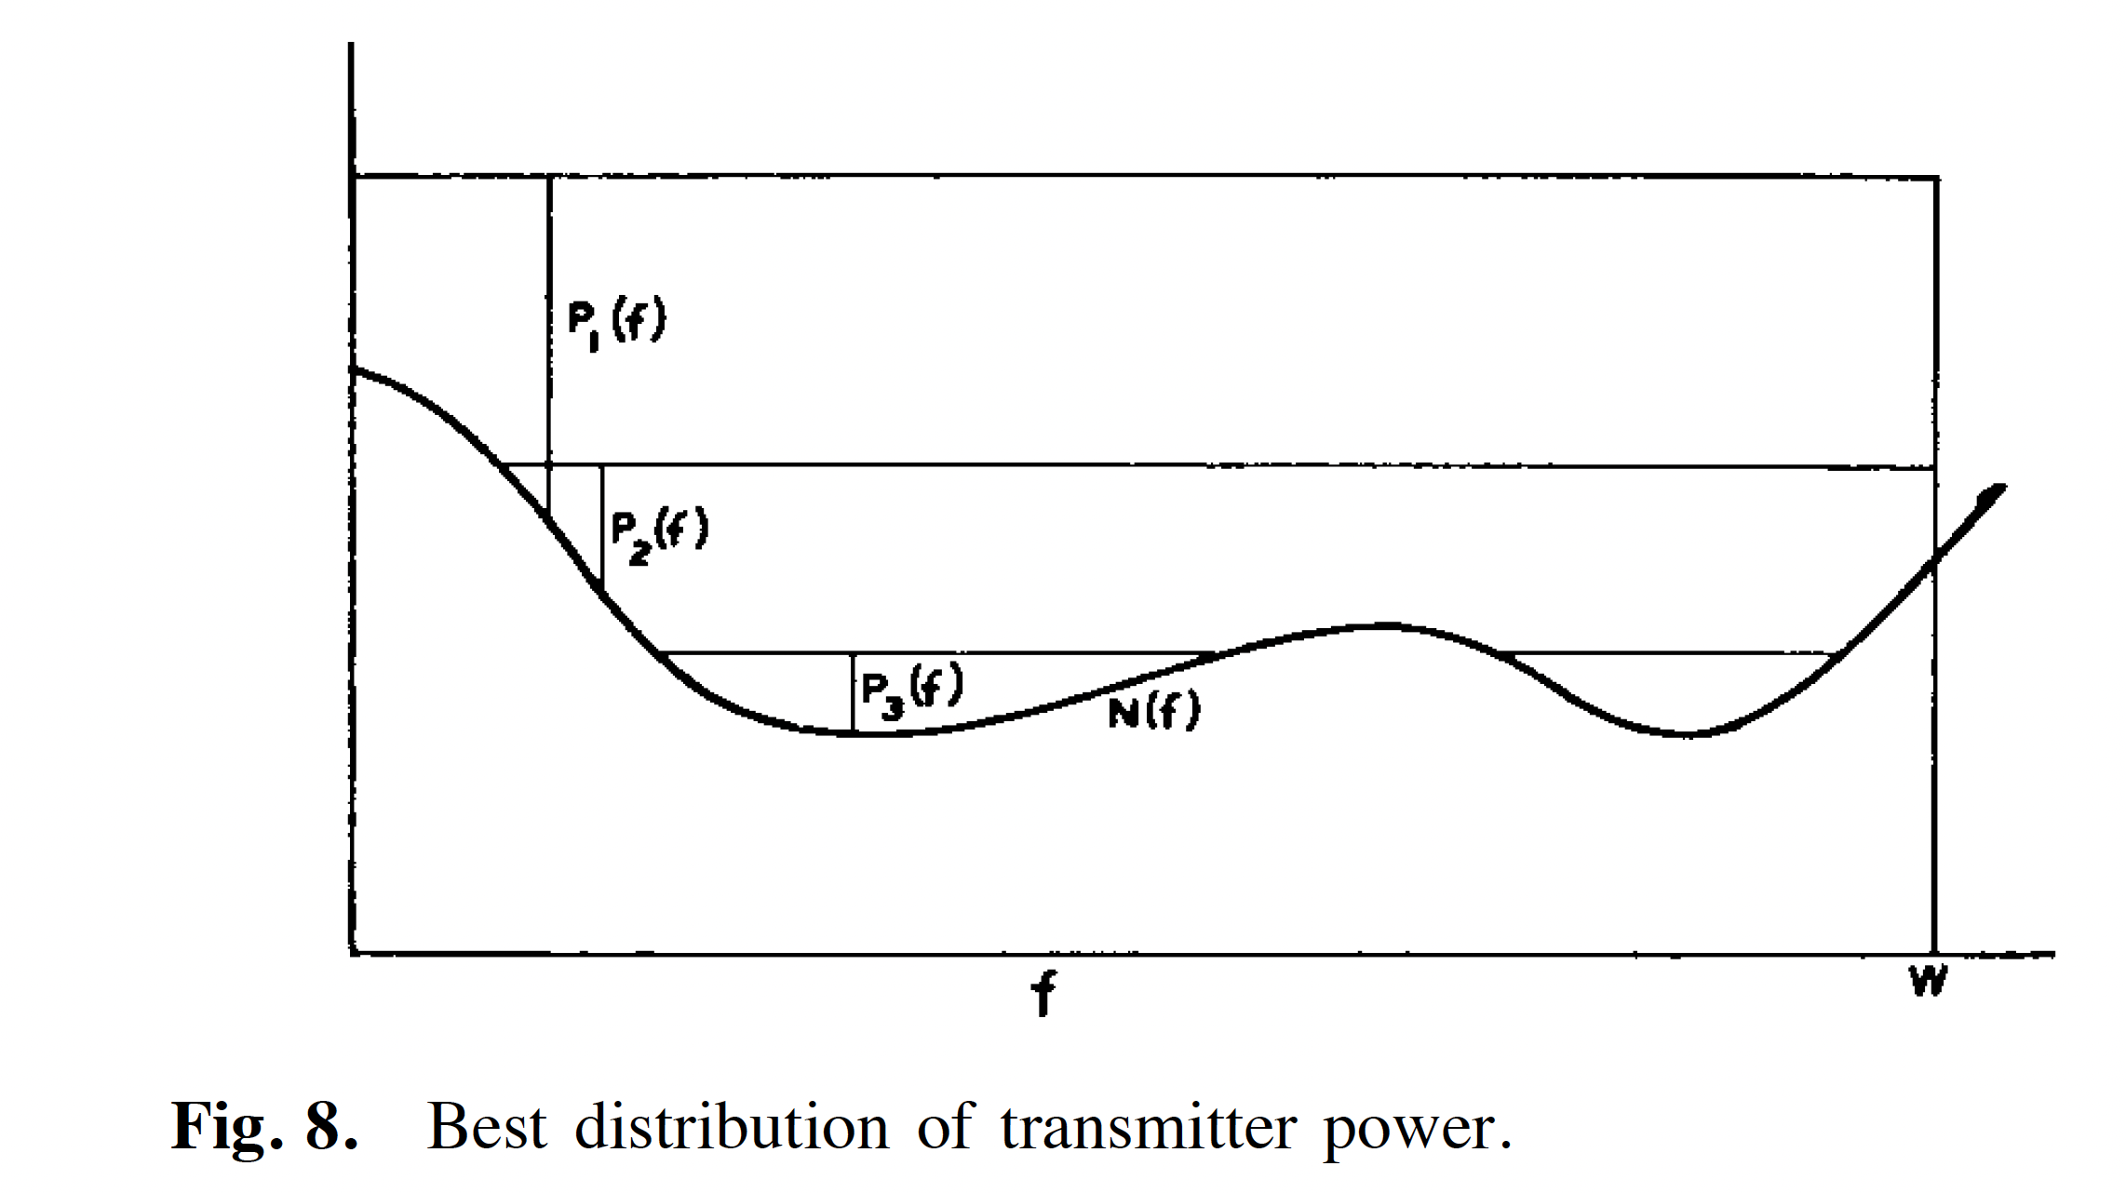



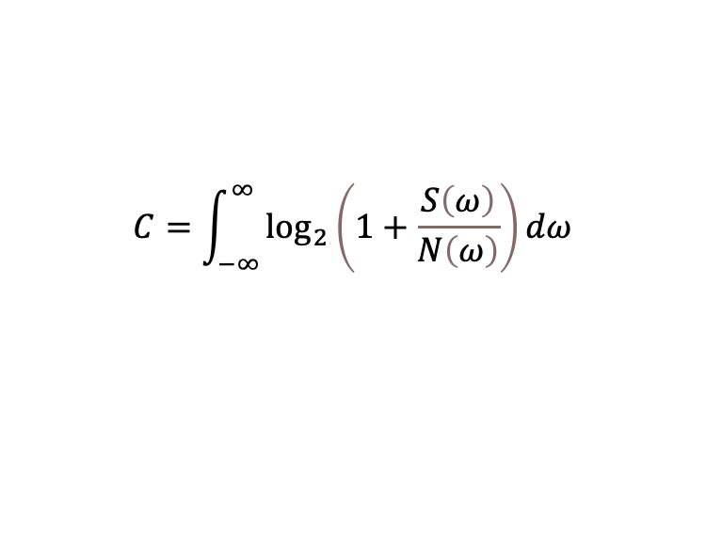

Distributing signal power for optimal transmission
Shannon-Hartley theorem
For multiple frequencies, $ω$
$$C=\int_{−∞}^{∞}{\log_{2}\left(1+\frac{S\left(ω\right)}{N\left(ω\right)}\right)}dω$$
Capacity
Bandwidth
Signal power
Noise power, additive Gaussian
With a constraint on signal power,
$S\left(ω\right)+N\left(ω\right)$ should be constant
“Water-filling” procedure
total
$ω$₂
$ω$₁
log(1+p)
log(1+(1-p))
Shannon, 1949

Slide 29
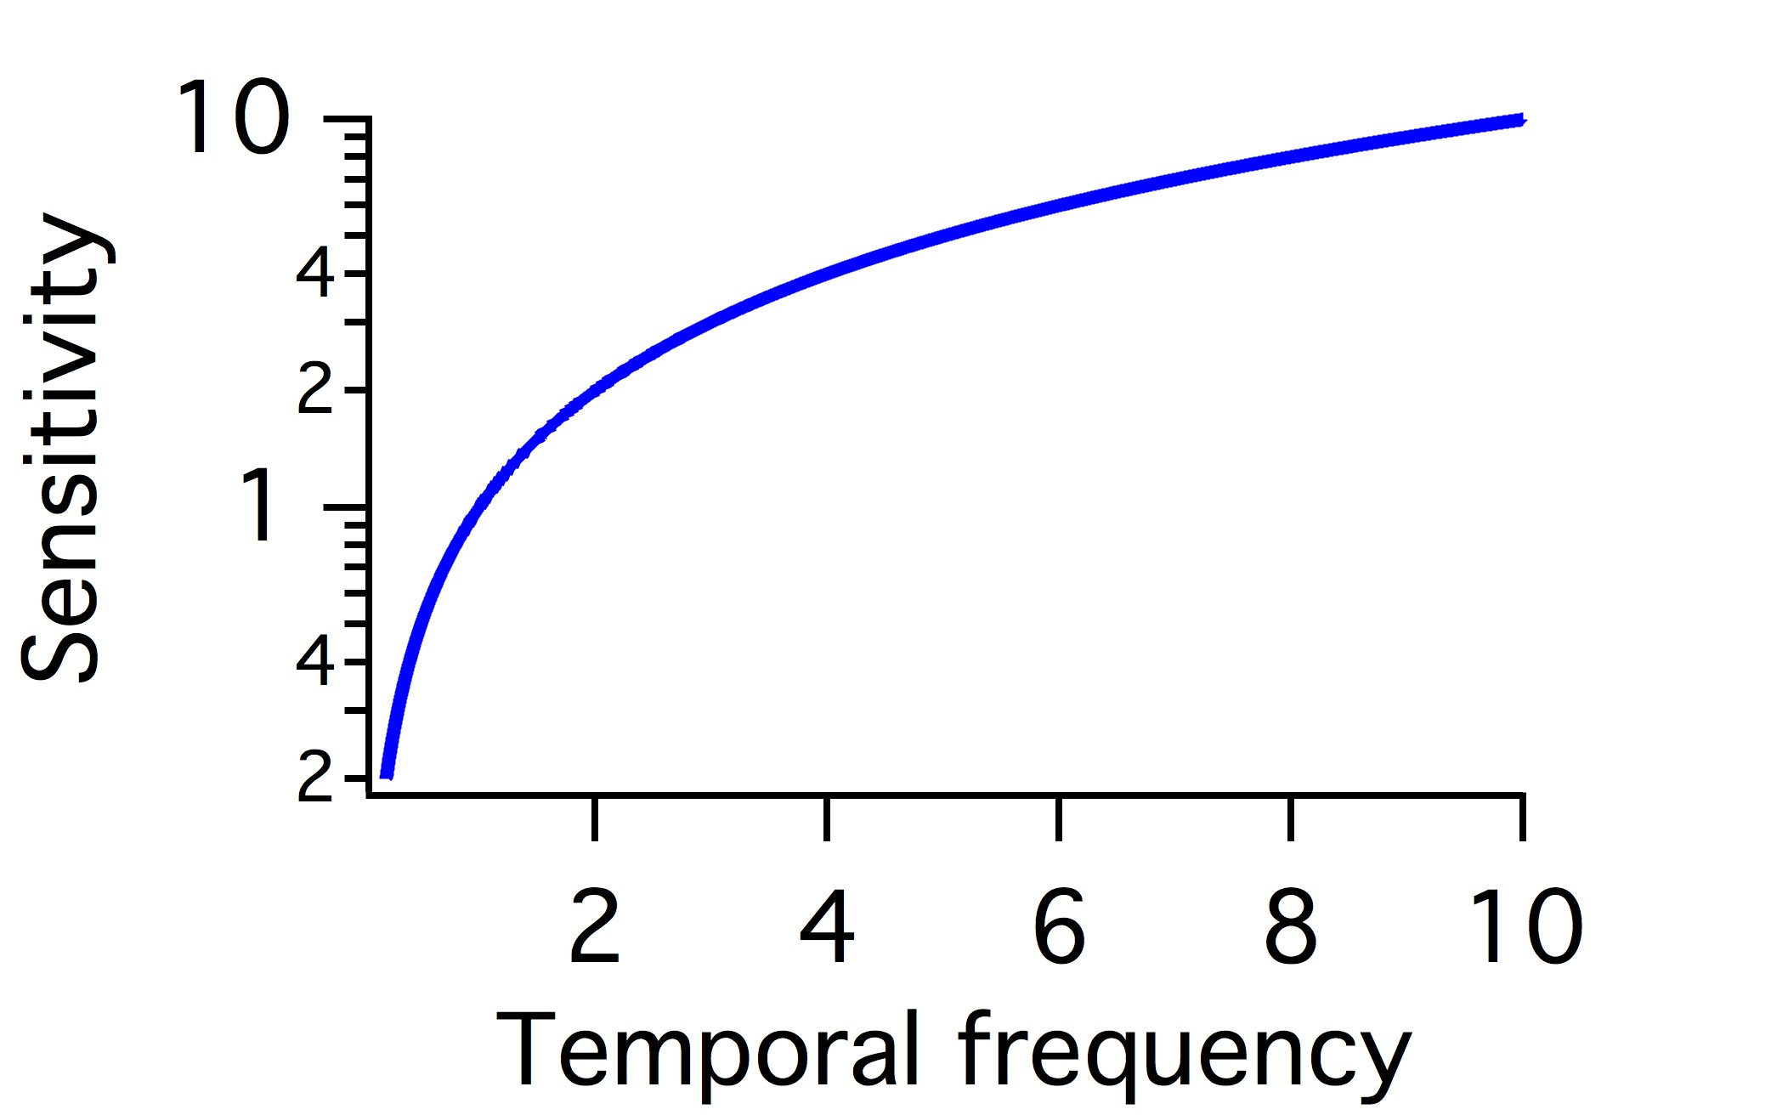
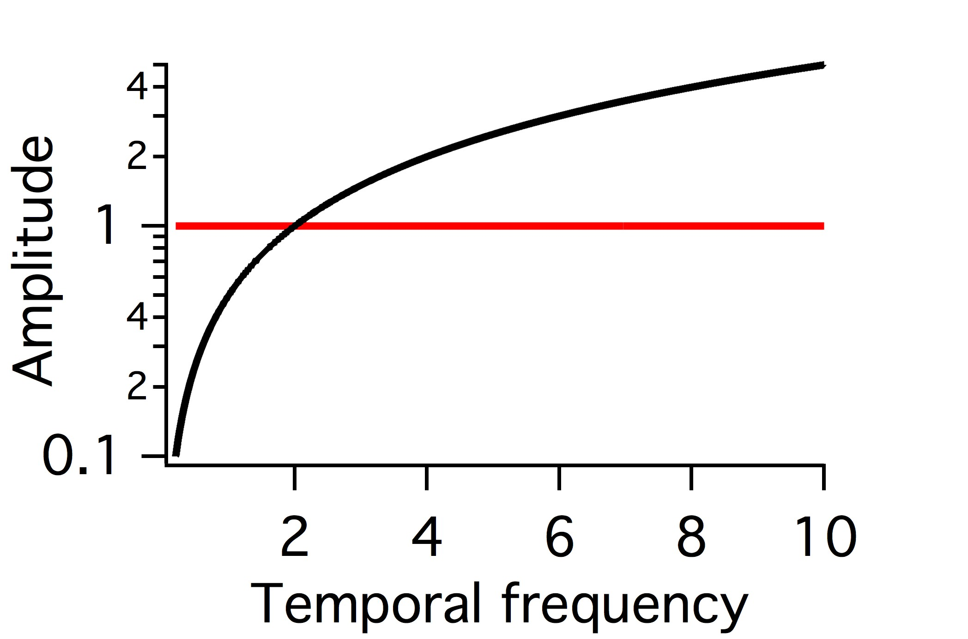
What filter maximizes information?
increases total entropy but limits noise entropy - whitens but also cuts out noise
I(S;R) = H(F(S+N_{i} )+N_{e} ) – H(F(S+N_{i} )+N_{e} |S)
Stimulus
Noise
∝
1/f
‘Whitening’ filter
Filter
Response
Noise
Van Hateren (1993)
Atick & Redlich (1990)
Linkser, (1988)
Notes:
These diagrams show the concepts of optimal filtering discussed in the Van Hateren paper. An efficient system will use all
Symbols with equal frequency. Remember the entropy diagram of the coin that had a peak in the middle. Entropy had a peak
When heads and tails at equal probability. This meant that the amount of information that such a signal could convey had a peak when the two
Symbols had equal probability.
Thinking in terms of temporal frequencies as different inputs and outputs, if a stimulus has more low frequency, it is efficient to ‘whiten’ the output,
Making the response use different frequencies equally. Whitening is accomplished by having a filter that is inverse of the stimulus.
Because a convolution is a produce in the frequency domain, if the Stimulus frequency spectrum is proportional to 1/f, then the optimal filter should be proportional to f.
This discussion however, does not consider the noise. In this case, the noise is equal at all frequencies. Therefore, when passed through a filter that is proportional to f, emphasizing high frequencies, at some point noise becomes greater that the signal represented in the response. Thus it is also the best solution to simply cut out these higher frequencies, because the noise is too great. Thus the optimal filter will have a bandpass appearance, both reducing low and high frequencies.
This situation depends on how great the noise is. When the amount of signal that is above the noise is very small, then it no longer is efficient to reduce the only signal that is available. In this case, a low pass filter that reduces only high frequencies is more efficient (not shown here).

Slide 30
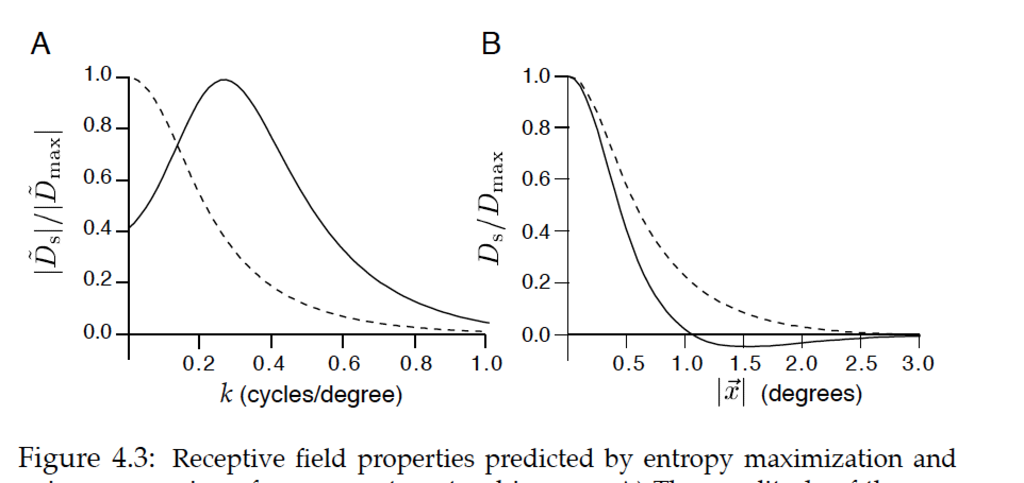
Adapting to different levels of noise
High SNR – increase total entropy
Low SNR – reduce noise entropy
Filter to whiten in the presence of noise
Low pass filter reduces noise
High SNR
Low SNR

Slide 31
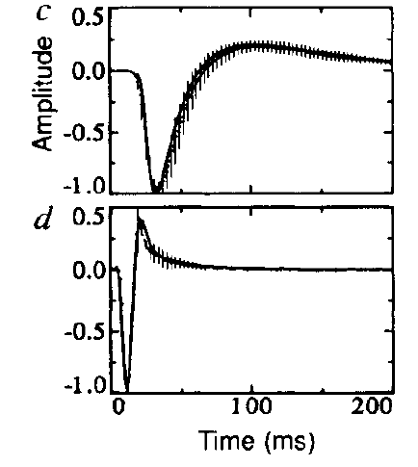
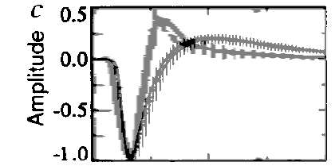
Theory of maximizing information in a noisy neural system
Filter of fly Large Monopolar Cells, 2nd order visual neuron
Low background intensity
Integrates over time
(real and theoretical optimum)
High background intensity
Emphasizes change, is more differentiating
(real and theoretical optimum)
Both, scaled in time to the first peak
J.H. van Hateren. Real and optimal neural images in early vision. Nature 360:68-70 (1992)
Notes:
Using the theory and statistics of natural scenes outlined on the previous slides, the optimal temporal filter can be derived, and it looks very close to the actual filter of a fly 2nd stage neuron. The smooth curve is the derive temporal filter, the vertical lines indicate error bars on the measured filter. At low light intensities, the filter is slower and more monophasic. At high light intensities, the filter is faster and more biphasic. The bottom graph shows the two stretch in time and superimposed to show that the faster filter is more biphasic.

Slide 32
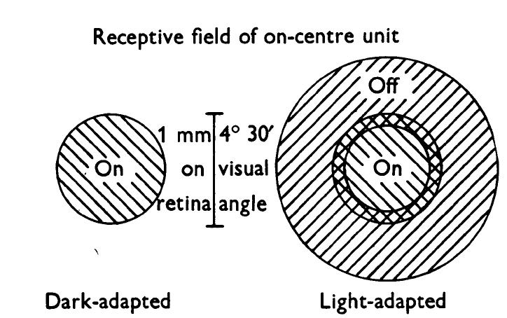
Spatial adaptation in retinal ganglion cells
Barlow, Fitzhugh & Kuffler (1957)

Slide 33
Theories of efficient coding:
To maximize information transmission, at high SNR when noise entropy is lower, an ideal encoder should increase total entropy and use all output values with equal probability
Low frequencies dominate in natural scenes
The highest frequencies should be rejected to reduce noise entropy as they carry little information
An efficient encoder at high SNR should amplify higher frequencies more than low frequencies with a bandpass filter
But at low SNR when noise entropy is high, most higher frequencies should be rejected and low frequencies should be used, shifting to a lowpass filter

