Slide 1
Neural oscillations: Insights from computational modeling
John Huguenard

Slide 2
Neuronal oscillations: functions
Sleep
Generate activity that is independent of sensory input
May play roles in memory consolidation or reprioritization.
Spindles, delta, sharp-wave ripple complexes
Awake behavior
Exploration – theta
Sensory binding & attention – gamma
Sensory discrimination – olfaction
Pathology
Epilepsy
Parkinson’s disease

Slide 3
Non-linearities and oscillations

Slide 4
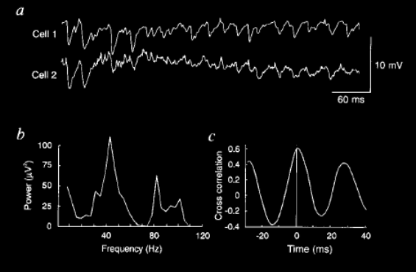
Gamma oscillations develop in cortical networks in absence of excitatory connectivity
Glutamate application, synaptic excitation blocked
Whittington et al, 1995
Notes:
Glutamate application, in presence of ionotropic iGluR blockers. Two CA1 neurons depolarized to make IPSPs larger. Other experiments show this to be mGluR dependent.

Slide 5
Ring inhibitory networks
Wang and Buzsaki, J Neurosci. 16:6402-13.1996
Notes:
Xiao-Jing Wang and Gyuri Buszaki

Slide 6
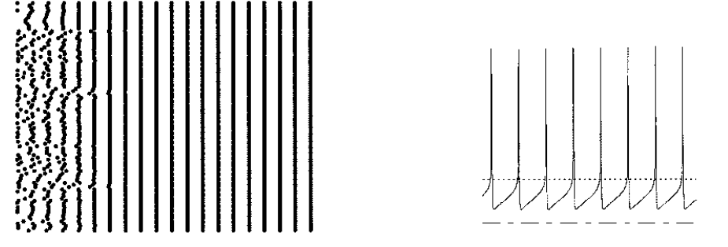
Uniform network of FS cells, random initial conditions: perfect synchrony
Wang and Buzsaki, 1996

Slide 7
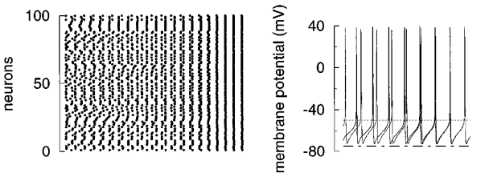
Uniform network, modify AP properties to change AHP, retards synchrony
Wang and Buzsaki, 1996

Slide 8
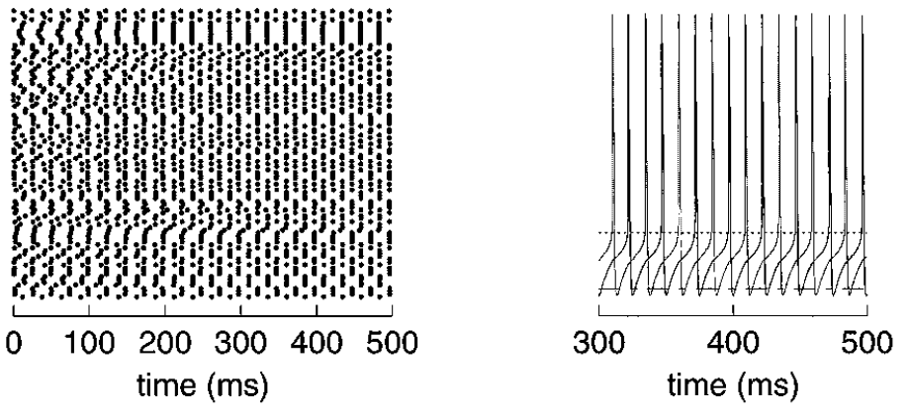
Uniform network, random initial conditions, deep AHP: hemi-synchrony
Wang and Buzsaki, 1996

Slide 9
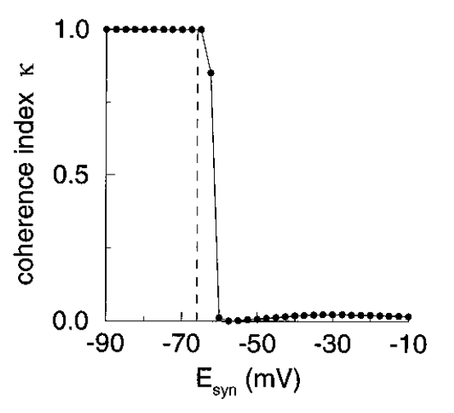
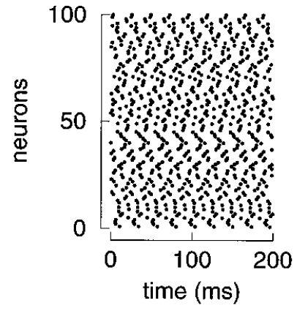
Synchrony as a function of E-syn
E-syn = 0 : ≈ excitatory
Wang and Buzsaki, 1996

Slide 10
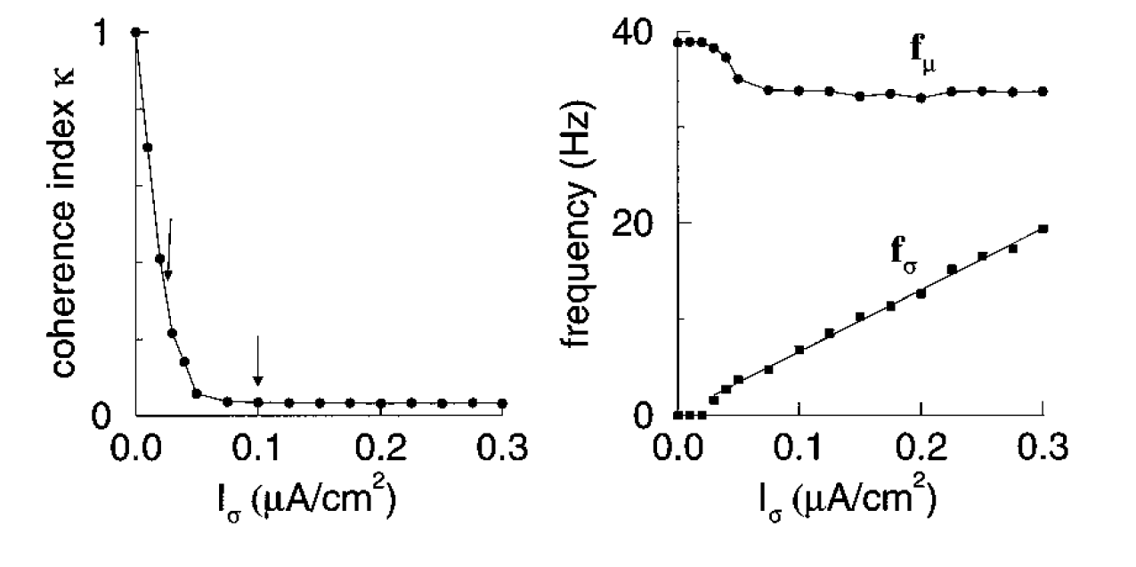
Heterogeneous network: Gamma is common output, while coherence is not
Wang and Buzsaki, 1996

Slide 11
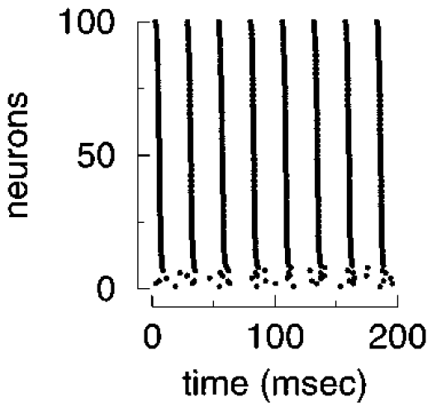
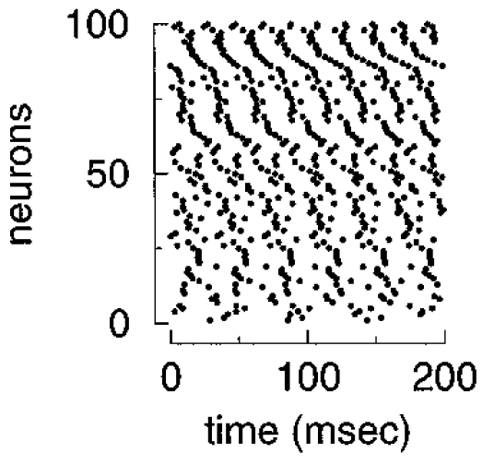
Heterogeneous network: Gamma is common output, while coherence is not
Wang and Buzsaki, 1996

Slide 12
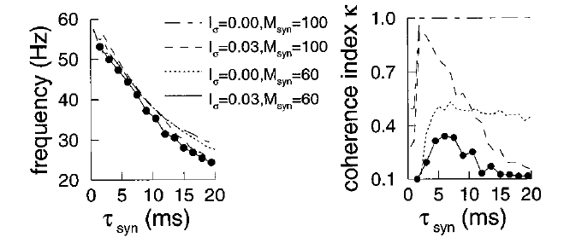
Dependence on synaptic properties: Time constant of decay governs network frequency, and indirectly, coherence
Wang and Buzsaki, 1996

Slide 13
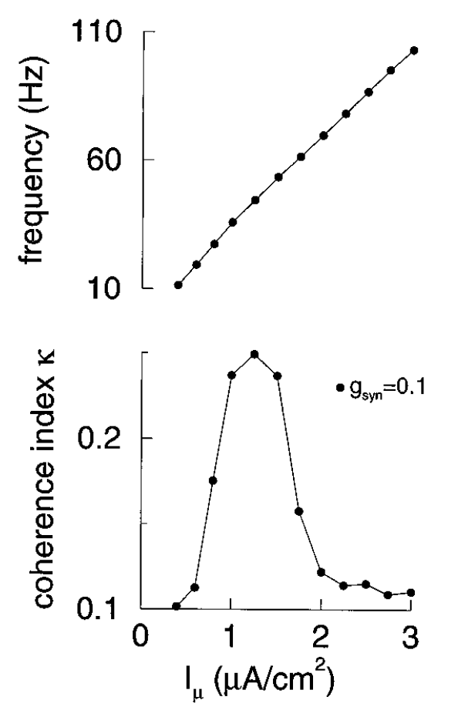
Coherence only in gamma frequencies
Wang and Buzsaki, 1996

Slide 14
Wang and Buszaki conclusions
E-syn more negative than AP-AHP promotes synchrony
Synaptic decay should be compatible with network frequency
Limited heterogeneity will not break synchrony
Connectivity must not be too sparse
Dynamic Clamp extends this approach
Alex Reyes, Vikaas Sohal

Slide 15
Neurons as active computational devices

Slide 16
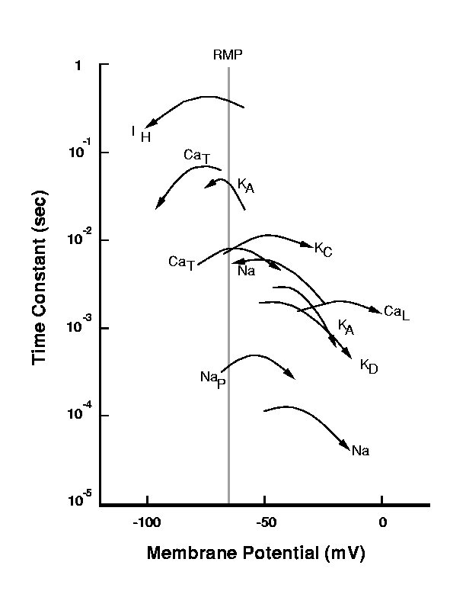
Dynamics of peri-threshold voltage gated ion channels
Courtesy W Lytton

Slide 17
Bistable membranes

Slide 18
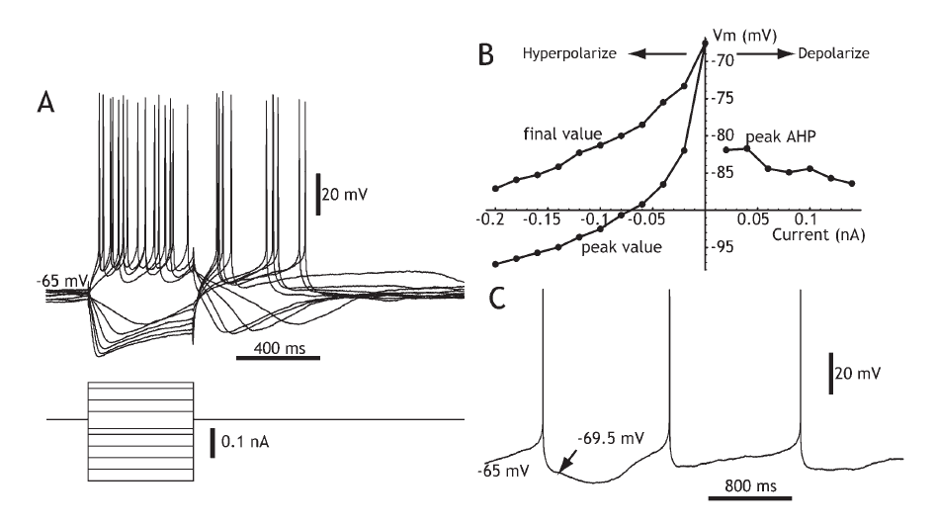
Membrane bistability from non-linearity of ion channel gating
striatal cholingeric neurons pause during relevant sensory stimuli
Wilson CJ. (2005) Neuron 45:575-85.

Slide 19
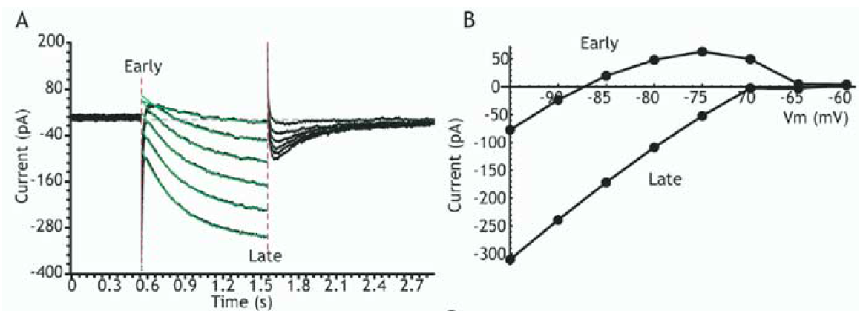
Membrane bistability from non-linearity of ion channel gating
Wilson, 2005

Slide 20
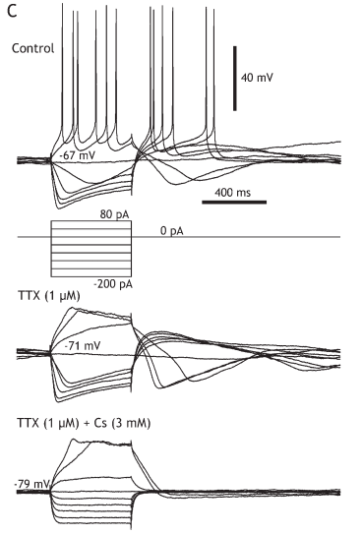
Regenerative depolarization ionic mechanism: Cs-sensitive KIR

Slide 21
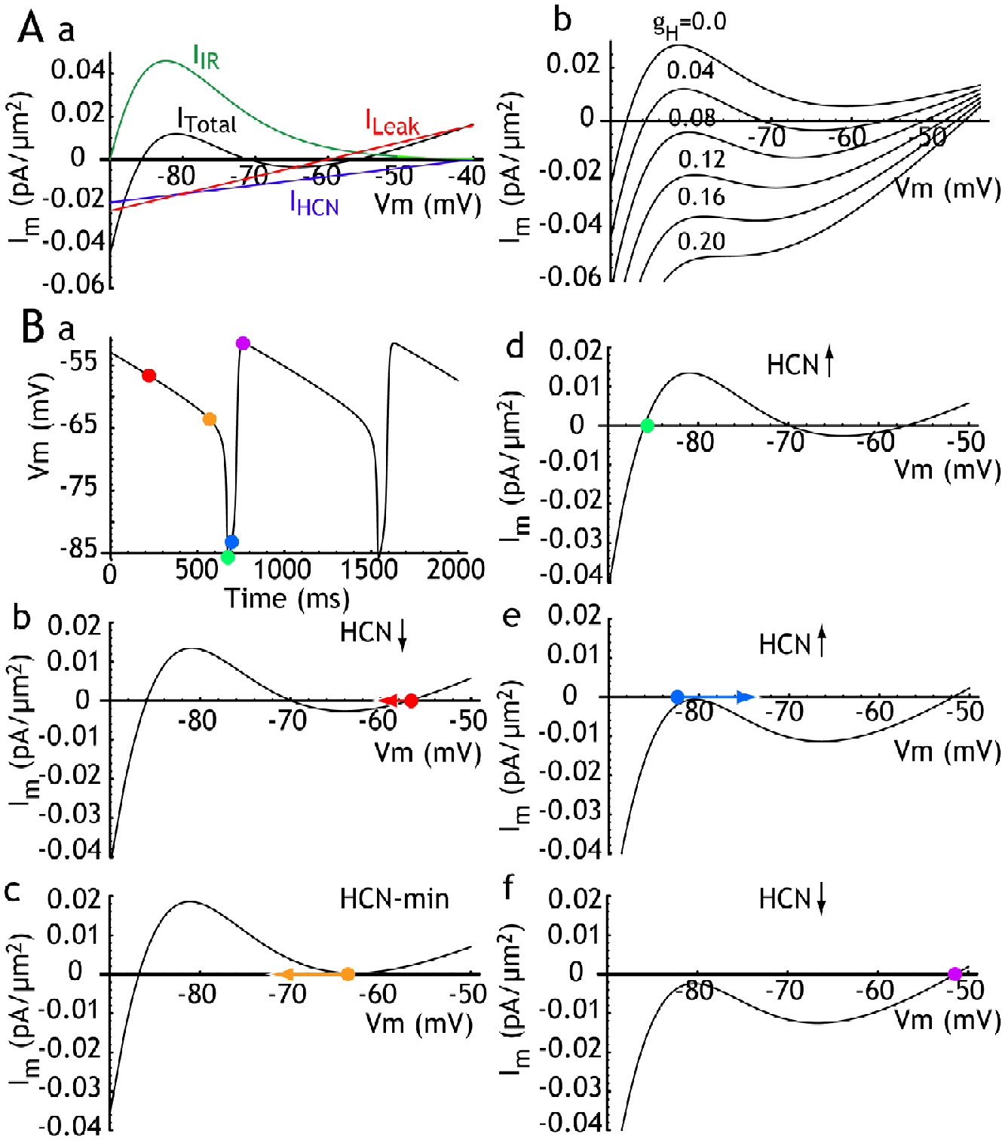
Membrane bistability from non-linearity of ion channel gating
Wilson, 2005

Slide 22
Thalamic oscillators, cells and circuits

Slide 23
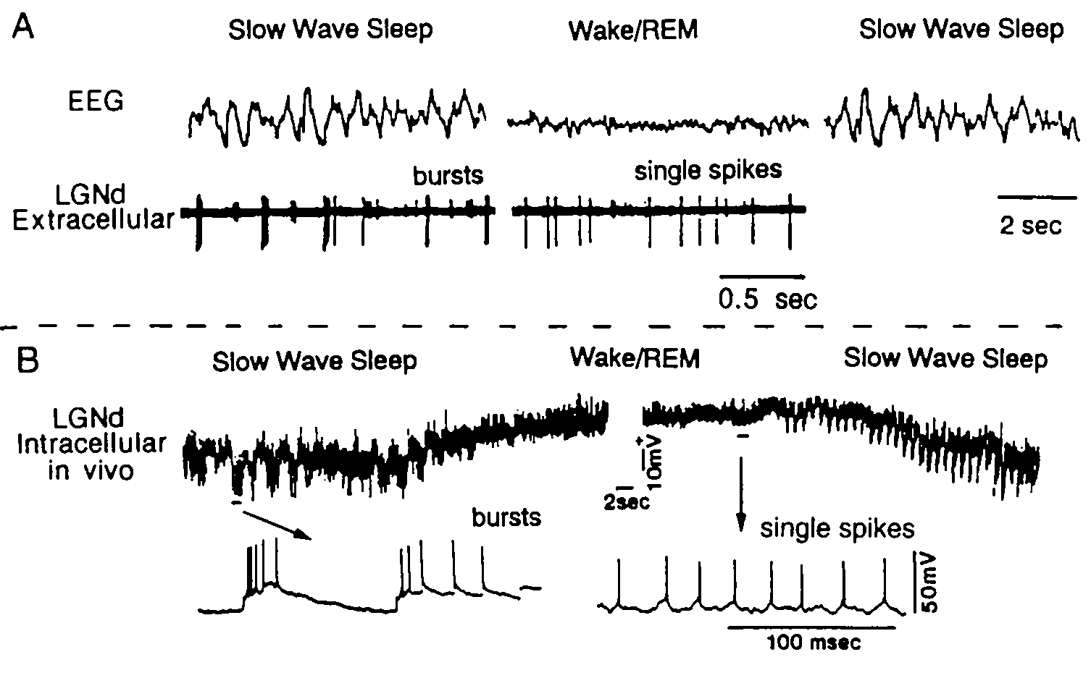
Relay neuron have state dependent firing modes
McCarley, Benoit & Barrionuevo, J. Neurophysiol, 50:798, 1983. Hirsch, Fourment & Marc, Brain Res. 259:308, 1983

Slide 24
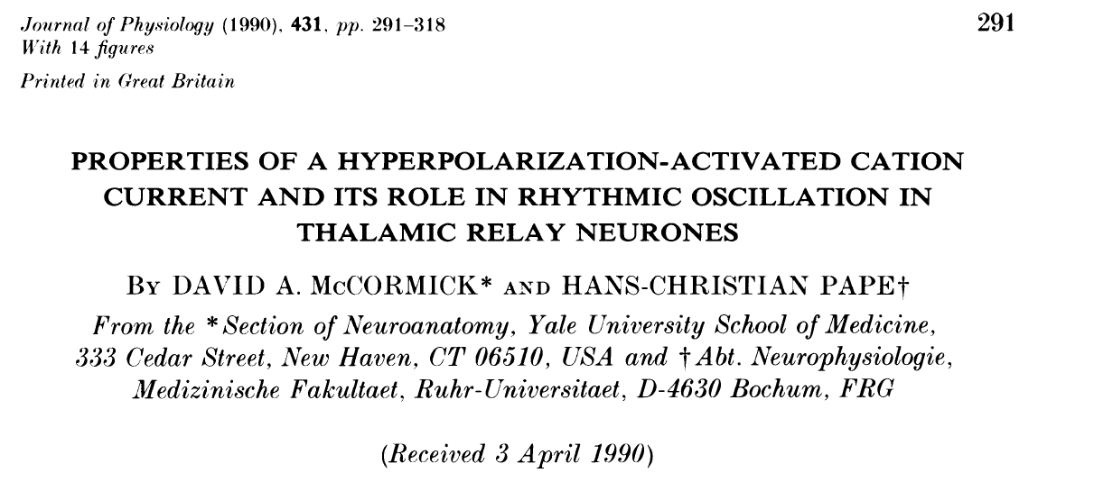
I-h, and its rhythogenic properties

Slide 25
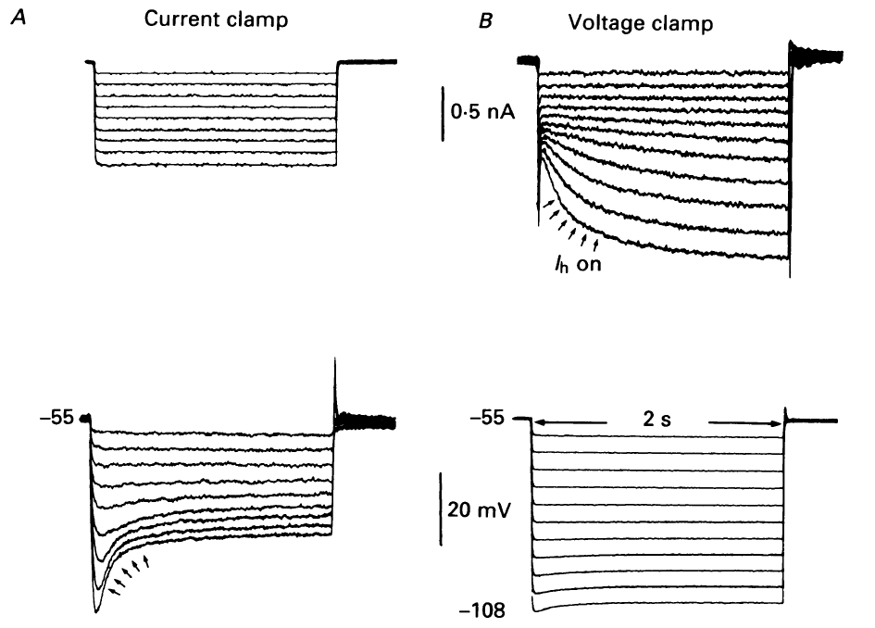
I-h, a hyperpolarization activated current with interesting dynamics
McCormick and Pape, 1990a

Slide 26
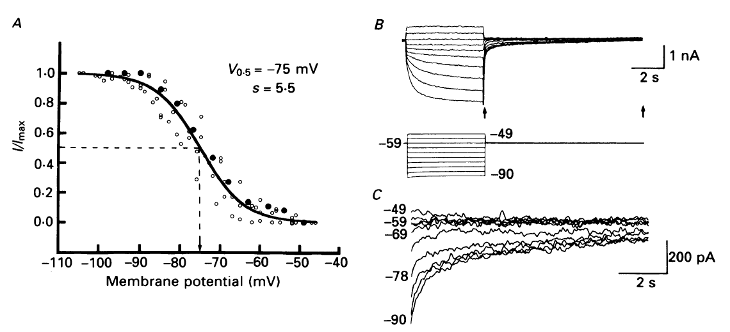
Properties of I-h, steady state activation
McCormick and Pape, 1990a

Slide 27
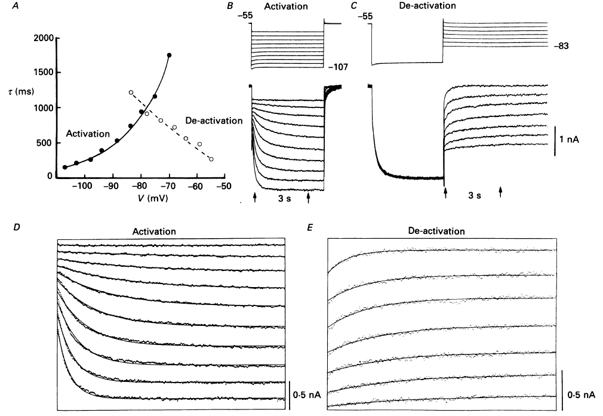
Properties of I-h, activation/deactivation rates
McCormick and Pape, 1990a

Slide 28
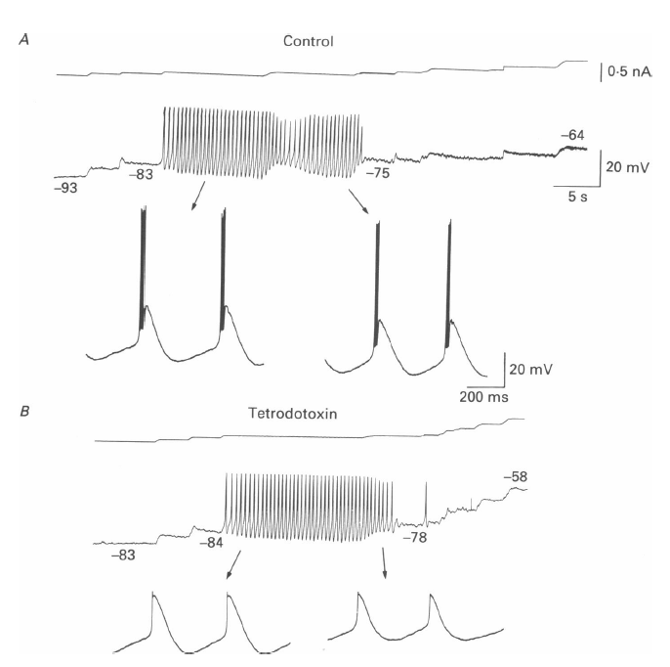
Thalamic relay neurons are intrinsic oscillators: dependence on sub-threshold conductances
McCormick and Pape, 1990a

Slide 29
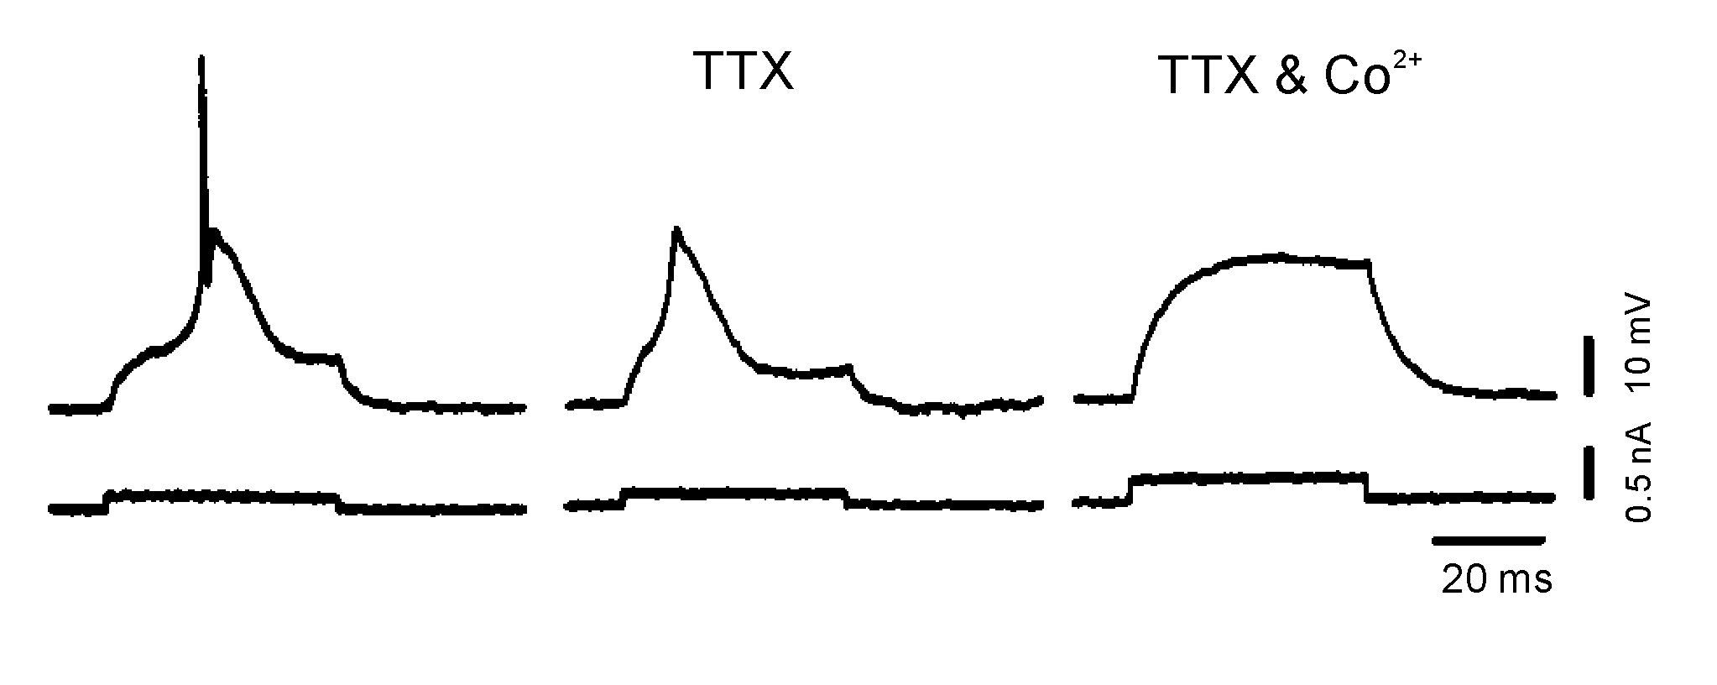
Basis of the burst: the low threshold spike (LTS)
Llinás and Jahnsen, Nature 297:406, 1982

Slide 30
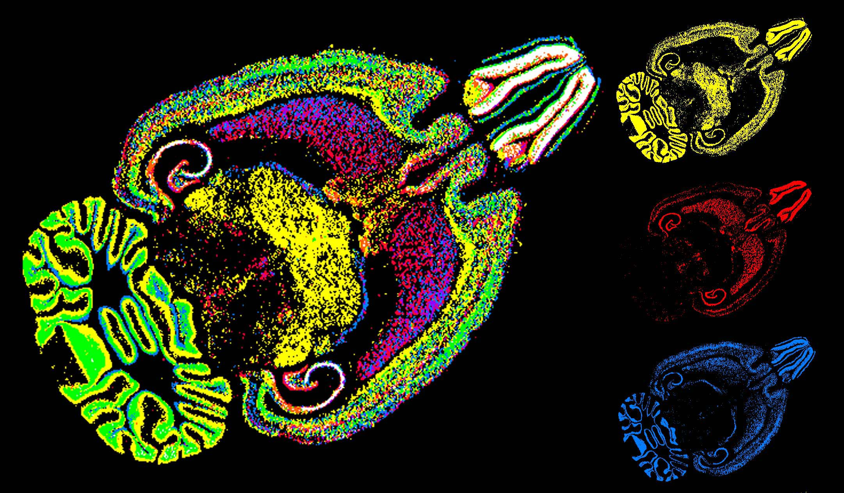
T type calcium channel genes in thalamus
Notes:
A1g in dt, ai,h in nrt , leads to differences in bursts
A1g yellow, a1h red, a1i blue

Slide 31
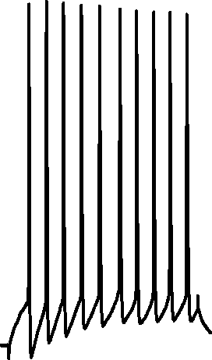
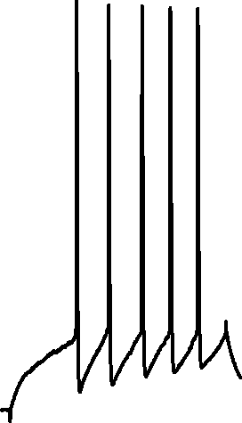
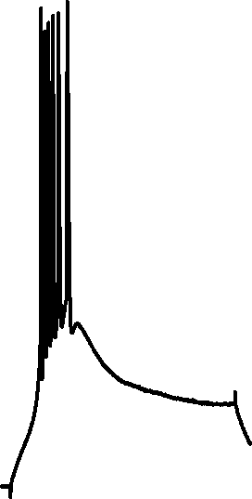

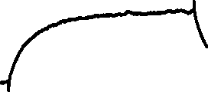
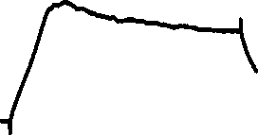
Paradoxical excitability in thalamic relay neurons
Huguenard and Prince, J Neurosci 1992
Notes:
-55 through –75 mV

Slide 32
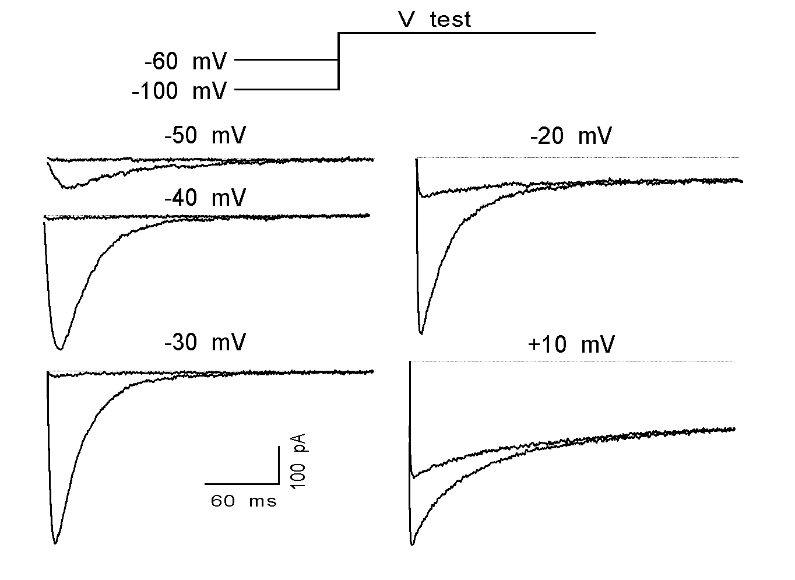
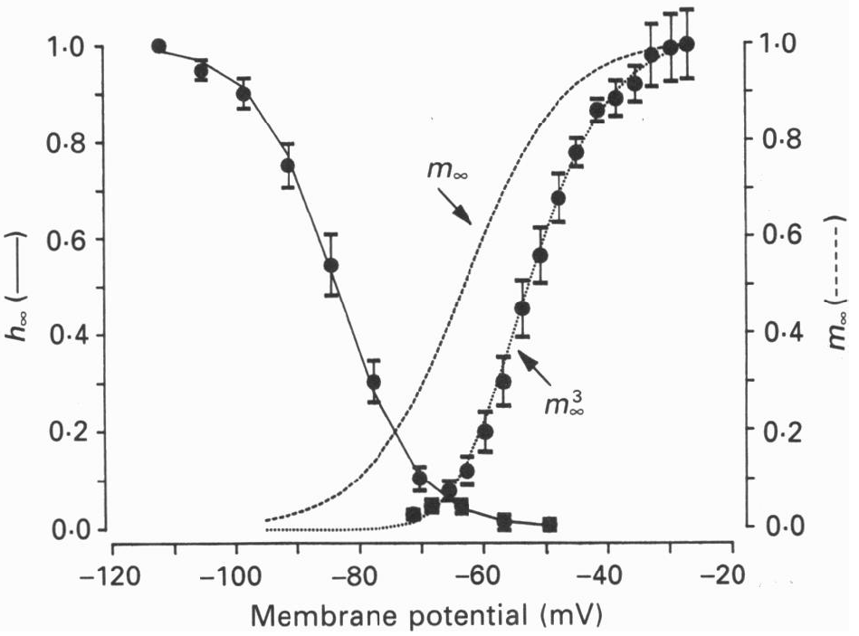
Isolation of I_{T} based on voltage clamp protocols: Hodgkin-Huxley-esque approach
Huguenard and Prince, J Neurosci 1992,
Coulter, *Huguenard and Prince, J. Physiol 1989

Slide 33
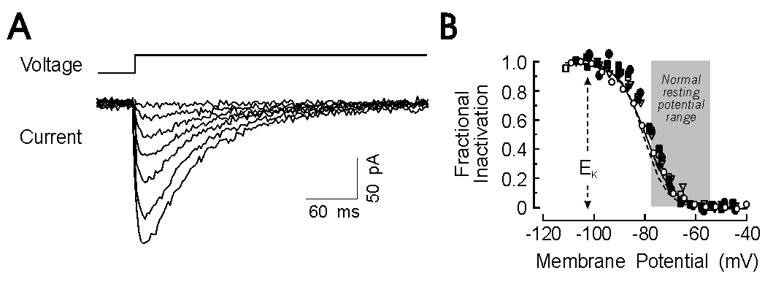
I-t is significantly inactivated at rest

Slide 34
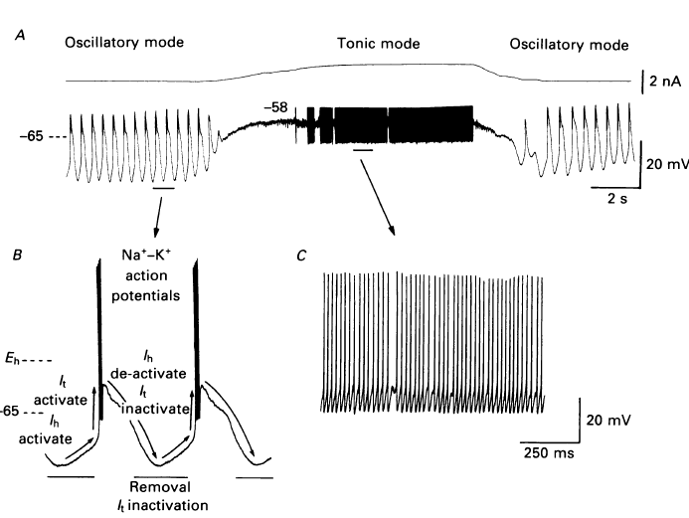
I-h is partner with I-t in intrinsic oscillations
McCormick and Pape, 1990a

Slide 35
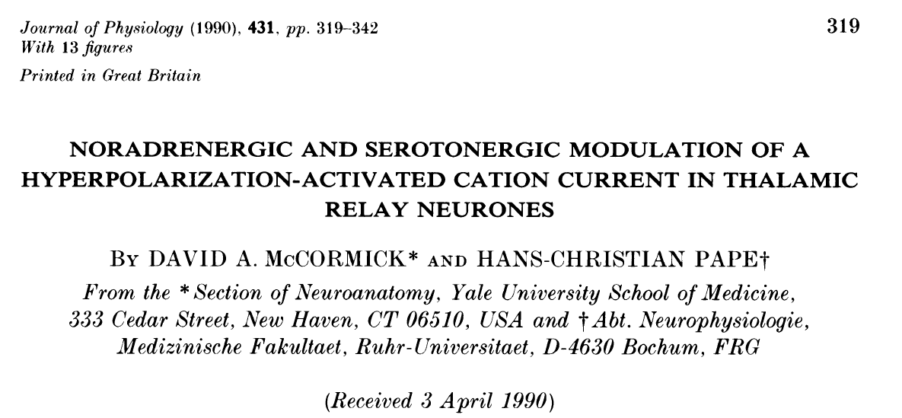
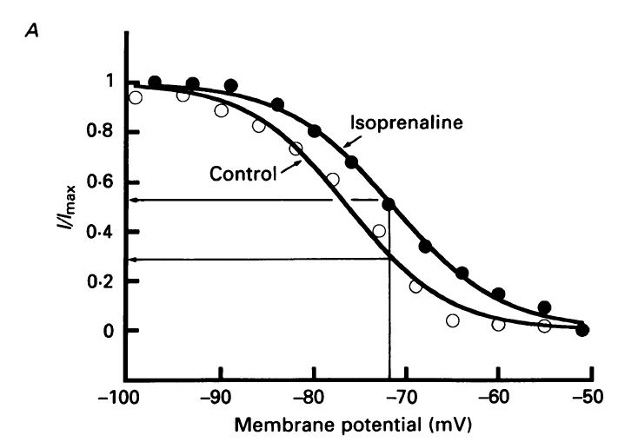
I-h is modulable

Slide 36
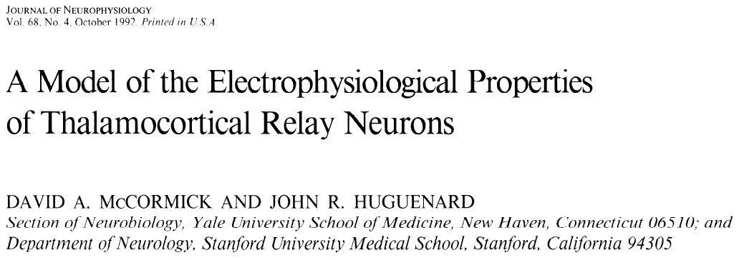
There are models available for cells with complex properties

Slide 37
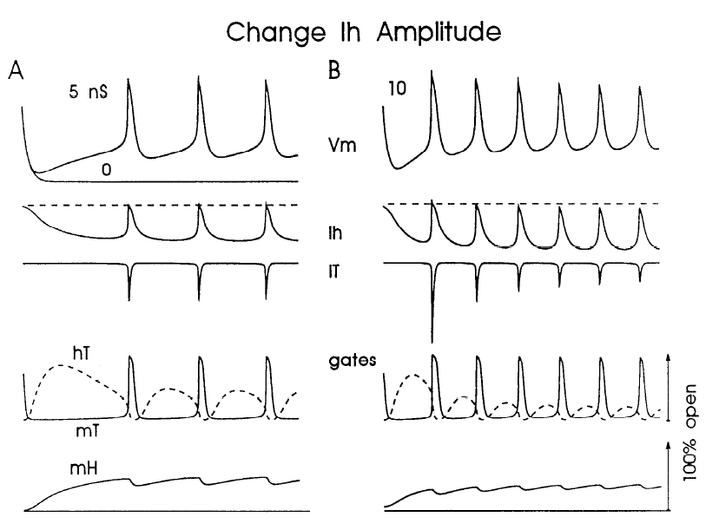
Can systematically vary different parameters to determine, e.g. sensitivity and necessity
McCormick and Huguenard, 1992

Slide 38
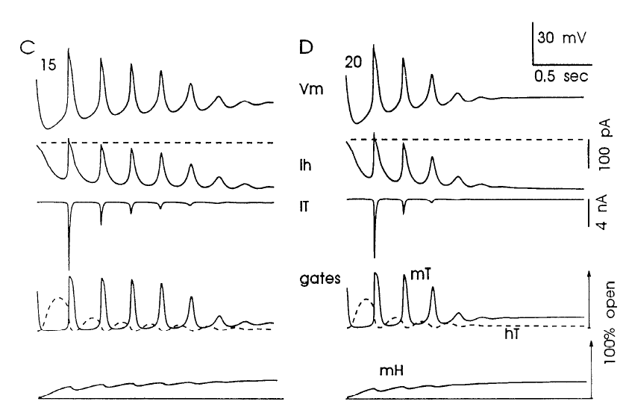
Too much of a good thing?
McCormick and Huguenard, 1992

Slide 39
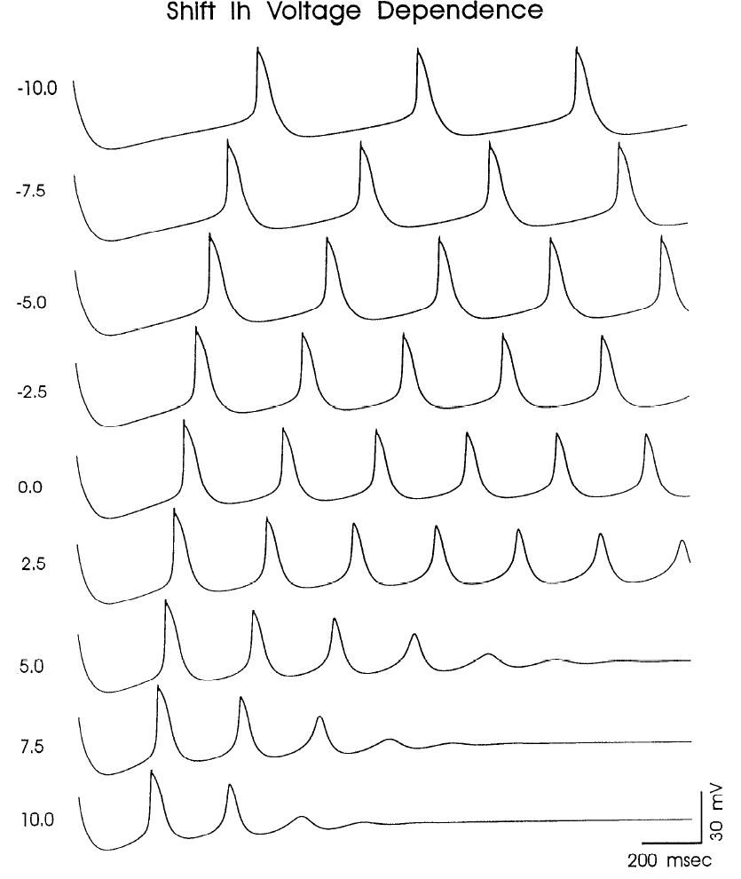
Modulation of I-h modifies network strength and structure
McCormick and Huguenard, 1992

Slide 40
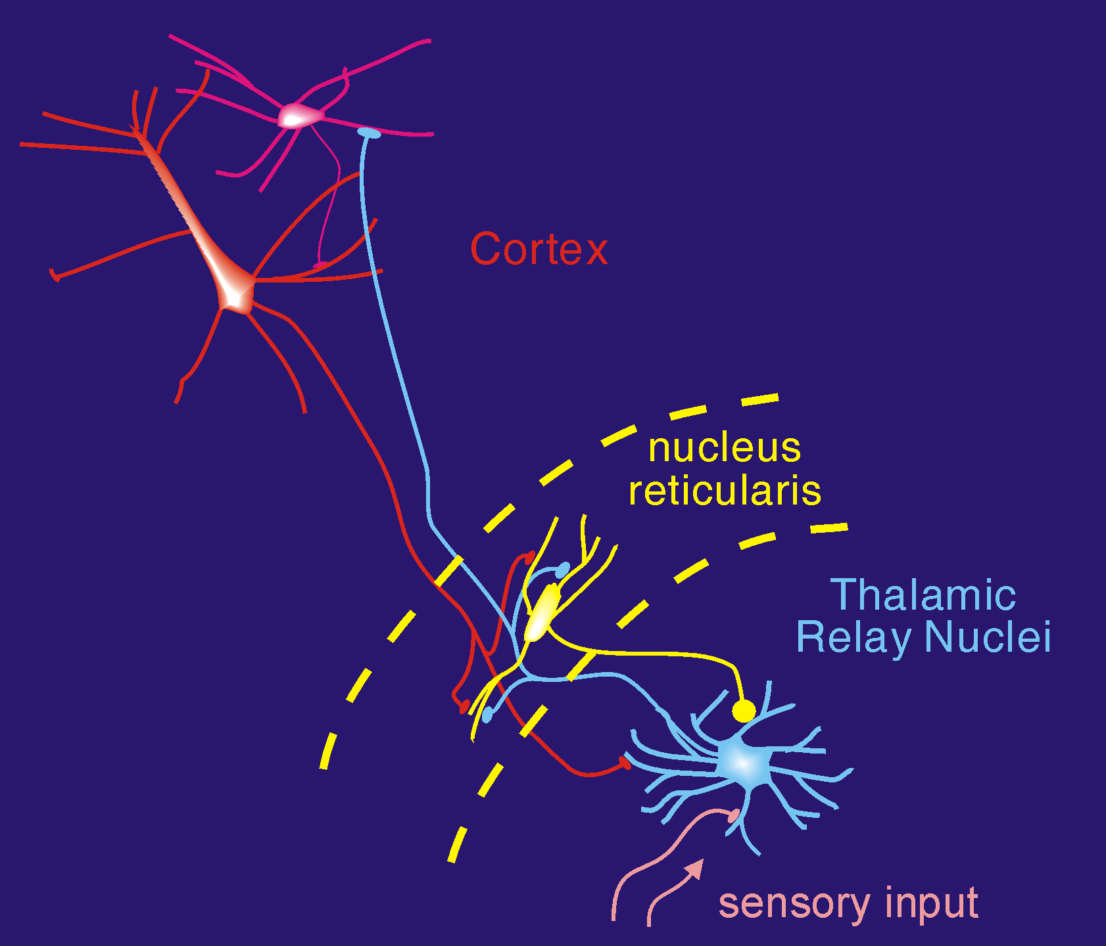
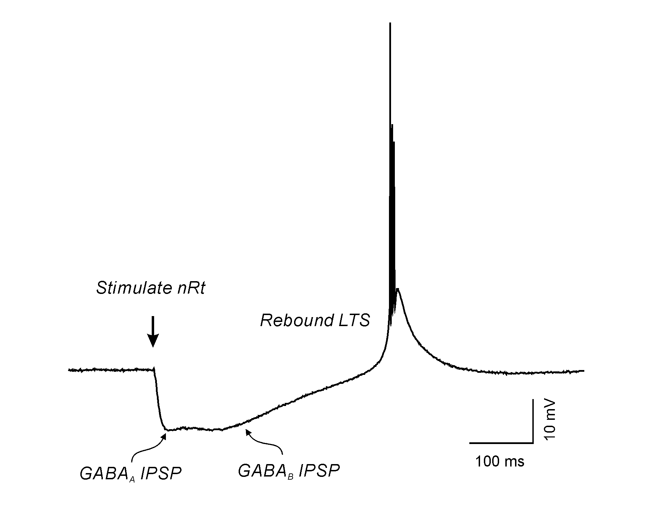
Post inhibitory rebound in thalamus and sleep rhythms
When active, thalamocortical cells receive recurrent (feedback) inhibition from neurons of the thalamic reticular nucleus (TRN). The inhibitory feedback in turn, leads to post-inhibitory rebound low threshold spike, re-excitation of TRN, and recurrent network oscillations, such as those occurring during spindle-stage sleep.

Slide 41
Summary, oscillations
Oscillations can be generated in neural networks
through synaptic interactions, usually inhibitory
Through the intrinsic voltage dependent properties of neural elements

Slide 42
Summary, oscillations
Recurrency promoted by membrane bistability
Between depolarized and hyperpolarized states
The latter is associated with activity
the former is generally associated with quiescence
Bistability is a result of non-linearities in the V/I relationship of neurons

Slide 43
Summary, oscillations
Non-linearities in neural membranes
N-shaped I/V curves
Different from passive cells with largely linear I/V curves
N-shaped I/V curves with more than one positive crossing of current axis will have more than one stable point
Interactions with synapses (e.g. inhibition) or voltage gated ion channels (H-channels) result in reentrant transitions between stable states, and ultimately, oscillations

Slide 44
References
Wang XJ, Buzsáki G. (1996) Gamma oscillation by synaptic inhibition in a hippocampal interneuronal network model. J Neurosci. 16:6402-13.
Wilson CJ. (2005) The mechanism of intrinsic amplification of hyperpolarizations and spontaneous bursting in striatal cholinergic interneurons. Neuron 45:575-85.
McCormick DA, Pape HC (1990) Properties of a hyperpolarization-activated cation current and its role in rhythmic oscillation in thalamic relay neurones. J Physiol. 431:291-318.

