Slide 1

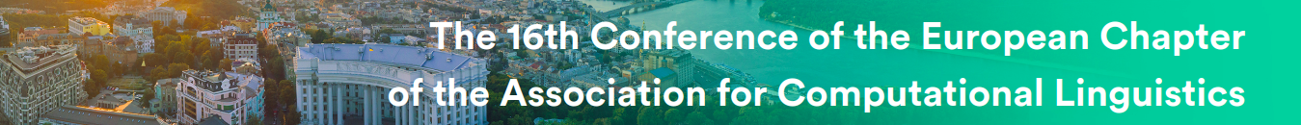
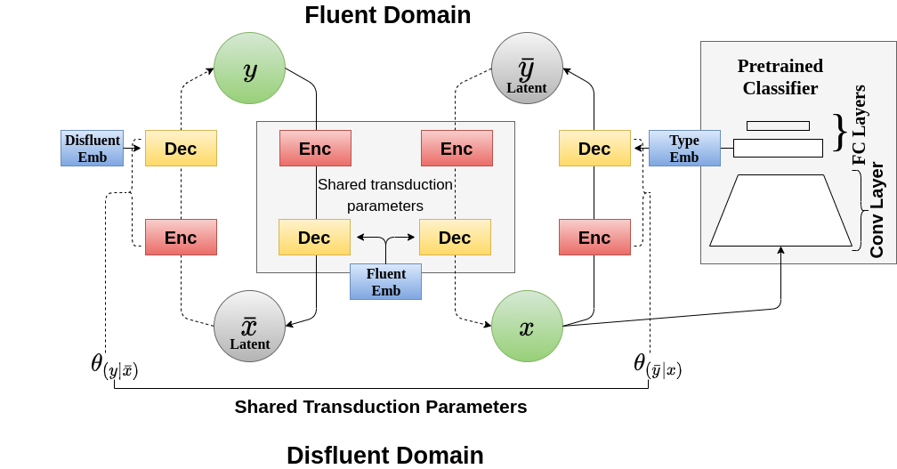
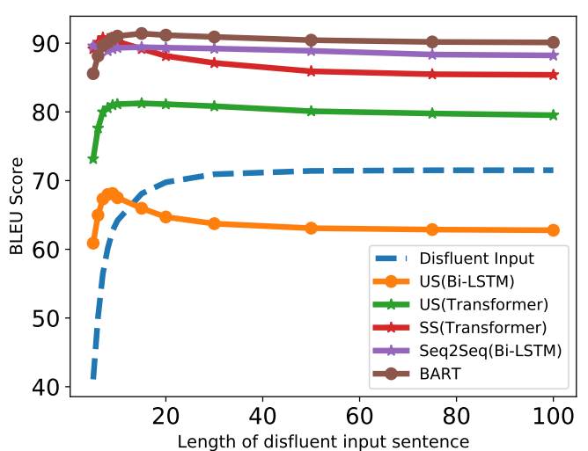



Disfluency Correction using Unsupervised and Semi-supervised Learning
Nikhil Saini, Drumil Trivedi, Shreya Khare, Tejas Dhamecha,
Preethi Jyothi, Samarth Bharadwaj and Pushpak Bhattacharyya

Slide 2
Outline
Motivation
Problem Statement
What is Disfluency ?
Dataset & Need of Unsupervised Setting
Unsupervised Style Transfer
Model Architecture
Results (Quantitative Analysis)
Output (Qualitative Analysis)
Conclusion
Future Work
References
Introduction
Main Approach

Slide 3
Motivation
415
Living Languages in India
121
Languages with more than 10K speakers
60
Languages with more than 100K speakers
29
Languages with more than 1M speakers
*Numbers on this slide aren’t exact, but can be agreed upon for discussion.
300M
Number of individuals who can speak but can’t read/write their Language

Slide 4
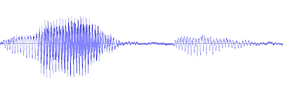
Motivation
Speech : Rehearsed or Conversational(Disfluent) Text : Well formed and formatted
Automatic Speech Recognition
Disfluent Input (en)
Disfluent ASR (en)
well i i was eating umm uh bread uhh no , grapes
Problem
Paucity of parallel Disfluent to Fluent Data
Text-To-Text Disfluency Correction
Disfluent Input (en)
well i i was eating umm uh bread uhh no , grapes
en : English ASR : Automatic Speech Recognition
Fluent Output (en)
i was eating grapes

Slide 5
Problem Statement
The problem statement is "to correct disfluencies present
in spontaneous speech utterances" without affecting the intended semantic meaning of the utterance.
‹#›
‹#›

Slide 6
What is Disfluency ? (1/3)
Example:
Disfluent: well we’re actually uh we’re getting ready
Fluent: we’re getting ready
Surface Structure of Disfluency:
Interruption Point
Reparandum
Interregnum
Repair
Disfluent: I want two tickets, I’m sorry, three flight tickets to Boston.
Fluent: I want three flight tickets to Boston.

Slide 7
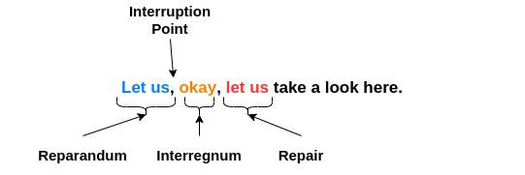
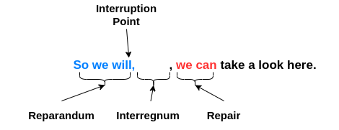
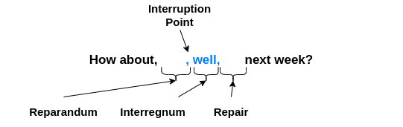
What is Disfluency ? (2/3)
Surface Structure of Disfluency:
Notes:
Its not necessary for all 3 to be present in the text as in the examples shown.

Slide 8
What is Disfluency ? (3/3)
Type | Description | Constituents | Example
Filled Pause | Non lexicalized sounds without semantic content. | uh, um | We’re uh getting ready
Conjunctions | Conjunctions that are incorrectly to used to begin end or even mid of a sentence. | But, and, etc | I dropped my phone again, but.
Discourse | Linking words and do no contribute to the semantic content. | well, you know | This is, you know, a pretty good report.
Restart | Exact repetition or correction of words previously uttered or restarted with a new train of thought. | - | This is is a bad bad situation. We’ll never find a day what about next month ?
Aside | A brief comment that a speaks to the audience | - | I guess it was a male, he ran off twice..
Edit | Phrases refer to the words which just previously have been said, indicating they’re not intended to belong to the utterance. | - | I mean, it's just the amount you’re overspending.

Slide 9
Dataset & Need of Unsupervised Setting
Dataset Name | Parallel Disfluent to Fluent | Language
Switchboard Corpus | 79260 | English
Switchboard Corpus:
Telephone speech and text corpus
2,400 two-sided telephone conversations among 543 speakers.
Domain coverage: over 70 topics
#Numbers on the slide represent: Sentence count
‹#›
---------------------------------------------- es : Spanish en : English DFLT : Disfluent FLT: Fluent

Slide 10
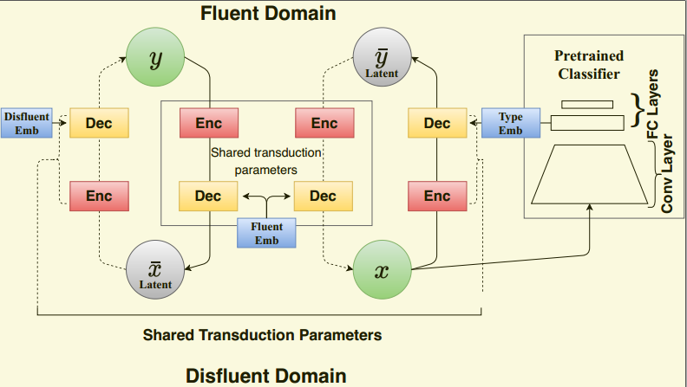
Unsupervised Style Transfer Approach (1/3)
-----------------------------------------------------
X = x₁, x₂, … x_{m} : Data from domain 1 Y = y₁, y₂, … y_{n} : Data from domain 2 X_bar and Y_bar : represents latent parallel sentences in Domain1 & Domain2 Shaded: Observed Variables Unshaded: Latent Variables
C_{D1} & C_{D2} : Domain Embeddings Dotted Lines - Inference Network Solid Lines - Transduction Network
He, Junxian et al. “A Probabilistic Formulation of Unsupervised Text Style Transfer.” ICML, 2020
‹#›
---------------------------------------------- es : Spanish en : English DFLT : Disfluent FLT: Fluent

Slide 11
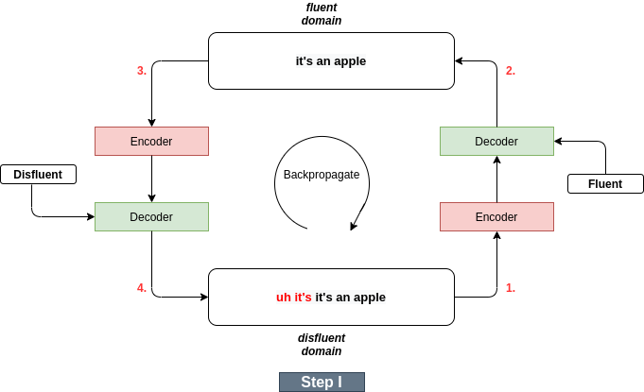
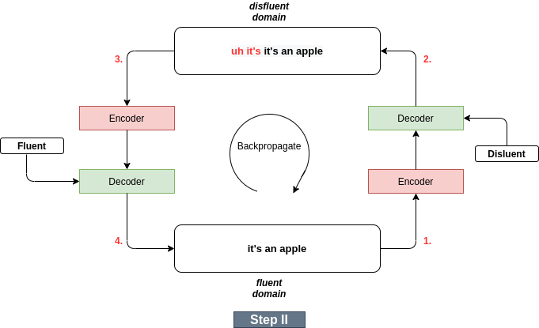
Unsupervised Style Transfer Approach (Training) (2/3)
He, Junxian et al. “A Probabilistic Formulation of Unsupervised Text Style Transfer.” ICML, 2020
‹#›
---------------------------------------------- es : Spanish en : English DFLT : Disfluent FLT: Fluent

Slide 12
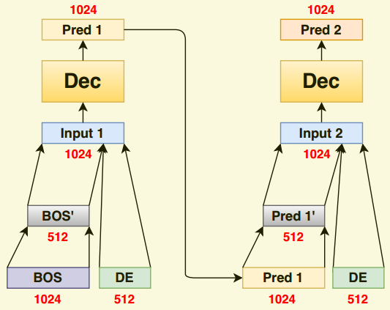
Unsupervised Style Transfer Approach (Setting) (3/3)
Domain Embeddings:
BOS: Start Token Pred: Prediction DE: Domain Embedding
‹#›
---------------------------------------------- es : Spanish en : English DFLT : Disfluent FLT: Fluent

Slide 13
Model Architecture
Attribute | Value | Value
Cell | LSTM | Transformer
Encoder Layers | 1 | 3
Decoder Layers | 1 | 3
Word Embedding Dimension | 512 | 1024
Doman Embedding Dimension | 512 | 512
Word {Shuffle, Blank, Dropout} | 0, 0, 0.3 | 3, 0.1, 0.2
Optimizer, Learning Rate | Adam, 1e-3 | Adam, 1e-5
‹#›
---------------------------------------------- es : Spanish en : English DFLT : Disfluent FLT: Fluent

Slide 14
Results #1.1
1. Classifier vs Binary Embedding in Encoder & Decoder:
 | Binary Embeddings |  | Classifier Embeddings
Model | Validation | Test | Validation | Test
LSTM | 60.61 | 61.81 | 61.26 | 62.64
Transformer | 77.34 | 77.97 | 78.72 | 79.39

Slide 15
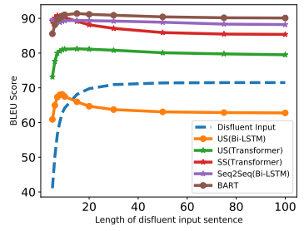
Results #1.2
Model: Unsupervised Style Transfer (Transformer) 4. Effect of Length of Input Sentence:

Slide 16
Results #1.3
Model: Unsupervised Style Transfer (Transformer) 5. Semi-Supervised Experiments:
Fine Tuning: A. Pretrained Model: Unsupervised Style Transfer B. Supervised Fine Tuning on Parallel Data.
Selection of Parallel Data: A. Random x% of shuffled parallel sentences from train set.
Fine Tune Data(Number of Parallel Sentences) | Fine Tune Data (%: Percentage) | Test | Validation
55482 | 100 | 88.22 | 87.16
27741 | 50 | 87.9 | 86.1
13870 | 25 | 87.04 | 85.88
5548 | 10 | 86.12 | 84.98
2774 | 5 | 86.03 | 84.67
554 | 1 | 85.28 | 83.85
‹#›
#Numbers on the slide represent: BLEU Score
---------------------------------------------- es : Spanish en : English DFLT : Disfluent FLT: Fluent

Slide 17
6. Consolidated Results:
Results #1.4
 | Model | Validation | Test
Supervised | Sequence to Sequence (Bi-LSTM) | 87.23 | 88.08
 | BART | 89.27 | 90.08
Unsupervised | Style Transfer (Bi-LSTM) | 61.26 | 62.77
 | Style Transfer (Transformer) | 78.72 | 79.39
Semi-Supervised | Style Transfer (Transformer) | 84.1 | 85.28
SKYLINE
OURS
Semi-Supervised: Amount of parallel data = 554 sentences (1% of train set)
#Numbers on the slide represent: BLEU Score
‹#›
---------------------------------------------- es : Spanish en : English DFLT : Disfluent FLT: Fluent

Slide 18
Results #1.5
Disfluency Type BLEU Scores:
Models | Set | all | conj | filler | restart | disc | edit | aside
US BiLSTM | Dev | 61.26 | 62.68 | 56.96 | 53.76 | 53.84 | 49.06 | 37.07
 | Test | 62.64 | 63.60 | 58.45 | 54.92 | 55.39 | 52.51 | 37.25
US Transformer | Dev | 78.72 | 80.17 | 76.86 | 72.39 | 71.91 | 63.20 | 48.56
 | Test | 79.39 | 80.18 | 77.47 | 73.06 | 73.19 | 64.35 | 45.71
SS Transformer | Dev | 84.10 | 84.65 | 81.01 | 78.13 | 81.05 | 78.28 | 41.25
 | Test | 85.28 | 86.24 | 82.16 | 79.52 | 82.30 | 80.60 | 51.65
Seq2Seq | Dev | 87.23 | 87.63 | 85.01 | 82.24 | 84.64 | 82.86 | 53.98
 | Test | 88.08 | 89.13 | 85.92 | 82.84 | 85.93 | 85.82 | 56.37
BART | Dev | 89.27 | 88.98 | 87.41 | 84.99 | 87.52 | 85.45 | 53.88
 | Test | 90.08 | 89.79 | 88.59 | 85.60 | 88.57 | 87.13 | 55.68
‹#›
#Numbers on the slide represent: BLEU Score
---------------------------------------------- es : Spanish en : English DFLT : Disfluent FLT: Fluent

Slide 19
Output Analysis
Type | Disfluent | BART | Seq-to-Seq | US(Bi-LSTM) | US( Transformer) | SS (Transformer) | Fluent
discourse, filler | so uh been a different turn | been a different turn | been a different turn | been a different turn | been a different turn | been a different turn | been a different turn
conjunction, repetition | but i i i find this whole | i find this whole | i find this whole | anyway i find it all | i find this whole | i find this whole | i find this whole
restart | it’s you’re you’re taking words and developing a picture in your mind | you’re taking words and developing a picture in your mind | you’re taking words and developing a picture in your mind | it’s you’re taking chicken and tobacco words in a mind | it’s taking words and developing and a picture in your mind | it’s taking words and developing and a picture in your mind | you’re taking words and developing a picture in your mind
US: Unsupervised, SS: Semi-supervised
---------------------------------------------- es : Spanish en : English DFLT : Disfluent FLT: Fluent

Slide 20
Relook: Switchboard Dataset
Switchboard Corpus:
Only one disfluency is present in the sentence.
The disfluency type is present along with other disfluencies.
Disfluency Type | # Sentences with single disfluency present | # Sentences with multiple disfluencies present
Filler | 8347 | 27516
Conjunction | 18362 | 40662
Restart | 8608 | 31545
Discourse | 8019 | 23504
Edit | 1075 | 3307
Aside | 19 | 370
The disfluency types are as present in the annotated Switchboard corpus.

Slide 21
References
He, Junxian et al. “A Probabilistic Formulation of Unsupervised Text Style Transfer.” ArXiv abs/2002.03912 (2020): n. Pag. Link To Paper
Vaswani, Ashish, Noam Shazeer, Niki Parmar, Jakob Uszkoreit, Llion Jones, Aidan N. Gomez, Lukasz Kaiser and Illia Polosukhin. “Attention is All you Need.” ArXiv abs/1706.03762 (2017): n. Pag.
Jamshid Lou Paria et.al, "Improving Disfluency Detection by Self-Training a Self-Attentive Model", Proceedings of the 58th Annual Meeting of the Association for Computational Linguistics, Jul 2020, ACL. Link To Paper
Nikita Kitaev and Dan Klein, “Constituency Parsing with a Self-Attentive Encoder”, 2018, ACL
Ansari, E., Axelrod, A., Bach, N., Bojar, O., Cattoni, R., Dalvi, F., Durrani, N., Federico, M., Federmann, C., Gu, J., Huang, F., Knight, K., Ma, X., Nagesh, A., Negri, M., Niehues, J., Pino, J., Salesky, E., Shi, X., St¨uker, S., Turchi, M., Waibel, A., and Wang, C. (2020). FINDINGS OF THE IWSLT 2020 EVALUATION CAMPAIGN. In Proceedings of the 17th International Conference on Spoken Language Translation, pages 1{34, Online. Association for Computational Linguistics.
Bahdanau, D., Cho, K., and Bengio, Y. (2015a). Neural machine translation by jointly learning to align and translate. CoRR, abs/1409.0473.
Bahdanau, D., Cho, K., and Bengio, Y. (2015b). Neural machine translation by jointly learning to align and translate. In International Conference on Learning Representations.

Slide 22
References
Bhattacharyya, P. (2015). Machine translation. CRC Press
Cho, E., Ha, T.-L., and Waibel, A. H. (2013). Crf-based disfluency detection using semantic features for german to english spoken language translation.
Gal, Y. and Ghahramani, Z. (2016). A theoretically grounded application of dropout in recurrent neural networks. In Proceedings of the 30th International Conference on Neural Information Processing Systems, NIPS, pages 1027{1035, Red Hook, NY, USA. Curran Associates Inc.
Gal, Y. and Ghahramani, Z. (2016). A theoretically grounded application of dropout in recurrent neural networks. In Proceedings of the 30th International Conference on Neural Information Processing Systems, NIPS, pages 1027{1035, Red Hook, NY, USA. Curran Associates Inc.
Hassan, H., Schwartz, L., Hakkani-T¨ur, D. Z., and T¨ur, G. (2014). Segmentation and disfluency removal for conversational speech translation. In INTERSPEECH.
He, J., Wang, X., Neubig, G., and Berg-Kirkpatrick, T. (2020). A probabilistic formulation of unsupervised text style transfer. In International Conference on Learning Representations.
Honal, M. and Schultz, T. (2005). Automatic disfluency removal on recognized spontaneous speech-rapid adaptation to speaker-dependent disfluencies. In Proceedings.(ICASSP’05). IEEE International Conference on Acoustics, Speech, and Signal Processing, 2005., volume 1, pages I{969. IEEE.

Slide 23
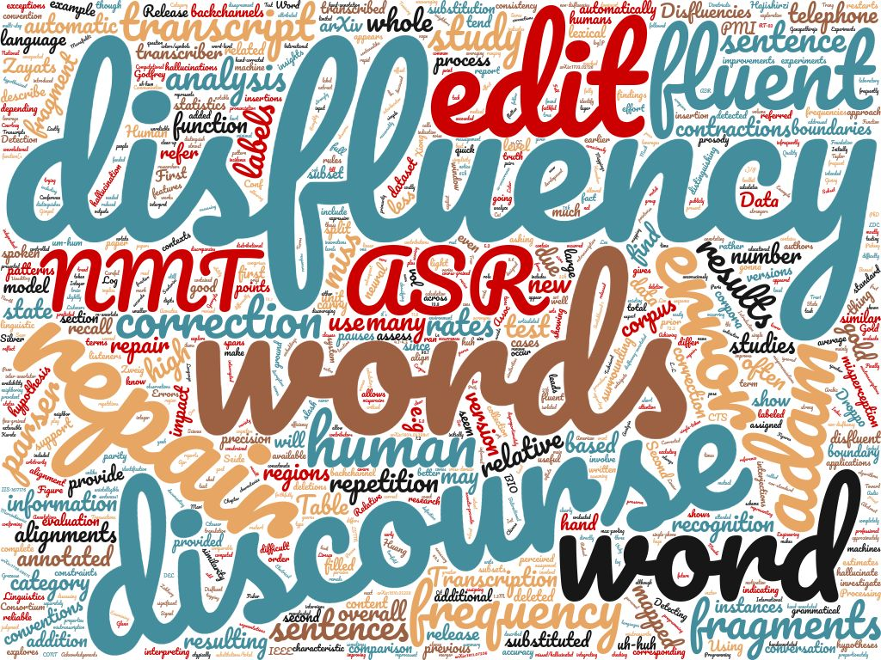
Thank You
Thank You

Slide 24
Training Process (DAE)
Output Batch
Decoder
Encoder
Noise
Input Batch

Slide 25
Results #1.3
Model: Unsupervised Style Transfer (Transformer) 3. Effect of Noise:
 | Classifier Embeddings
Noise [shuffle weight, , blank probability dropout probability] | Validation | Test
0, 0.2, 0.1 | 80.07 | 80.67
2, 0.2, 0.1 | 78.46 | 79.16
3, 0.2, 0.1 | 78.72 | 79.39
4, 0.2, 0.1 | 75.87 | 75.94

Slide 26
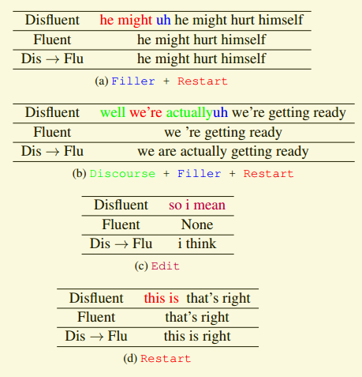
Disfluency Types

Slide 27
Results #1.1
Model: Unsupervised Style Transfer (Transformer) 1. Word Embedding & Domain Embedding Size
Word Emb Dim | Classifier Emb Dim | Validation | Test
640 | 256 | 75.41 | 76.72
1024 | 128 | 75.52 | 76.24
1024 | 256 | 75.93 | 76.33
1024 | 512 | 76.41 | 76.9
2048 | 128 | 72.91 | 73.85
2048 | 256 | 72.25 | 73.06
2048 | 512 | 74.44 | 75.17
2048 | 768 | 75.65 | 75.87
2048 | 1024 | 75.24 | 76.31
‹#›
#Numbers on the slide represent: BLEU Score
---------------------------------------------- es : Spanish en : English DFLT : Disfluent FLT: Fluent

Slide 28
Regex Experiments
 | Validation | Test
sed (Old) | 84.52 | 85.45
sed (Revised) | 86.76 | 87.87
sed (Revised)+ pretrained_49 | 81.53 | 82.89

Slide 29
Analysis (Test Set) 3.1
Disfluent | Transformer | LSTM | Reference
it's it's excellent | it's excellent | it's excellent | it's excellent
or are you a teacher | are you a teacher | are you a teacher | are you a teacher
we're we think books are important around here | we think books are important around here | we're i think books are important around here | we think books are important around here
well you have a good day | you have a good day | hopefully you have a good day | you have a good day
but it would of taken longer | it would taken of longer | if it would take taken longer | it would taken of longer
but i hope to uh set an example for ours that you know that reading is can it can be your best friend | i hope to set an example for ours that you know that reading is it can be your best friend | if i hope to set an example for ours that you know that is reading it can be your best friend | i hope to set an example for ours that reading it can be your best friend

Slide 30
Analysis (Test Set) 3.2
Disfluent | Transformer | LSTM | Reference
i was i was very against our involvement so quickly | i was very against our involvement so quickly | i was very fortunate with our economy so quickly (remarks: intent & content change) | i was very against our involvement so quickly
but i'm not for sure we know exactly what what all happened in that situation | i'm not for sure we know exactly what all happened in that situation | although i'm not for sure we know exactly what all what happened in that situation | i'm not for sure we know exactly what all happened in that situation
uh and then i saw a nightline program last night about all the funding of hussein's uh back as early as nineteen eighty-six | then i saw a pilot program last night about all the last funding of the early forties as nineteen eighty-six (remarks: missing some content) | when i did a court saw plano news about all the funding of the month of getting back as early as nineteen eighty-six (remarks: random) | i saw a nightline program last night about all the funding of hussein's back as early as nineteen eighty-six

Slide 31
Analysis (Test Set) 3.3
Disfluent | Transformer | LSTM | Reference
i just think i think if we had been very i mean if we had that good of a correlation through the united nations then they could have uh they could have made sanctions work i'm pretty sure | i just think if we had been very i mean if we had that good type of stuff through the united nations that they could have made pretty much of thing (remarks: content missing, dtype: restart) | i just think i think if we had been very i mean if we had that good of a branch through the united states could then they could have made work pretty convenient i'm pretty much (remarks: content miss) | if we had that good of a correlation through the united nations then they could have made sanctions work i'm pretty sure
give them the awareness of the different cultures and uh you know have all sorts of um at least you know let them know what that that other people do things differently than than than maybe in their own neighborhood | give them the media fan of different cultures and uh you know all sorts of um at least let them know what other people do that are in their own things than | give them the gamut of the different cultures and the country you have all sorts of basically at least you know let them know that what that other people do things differently than than than in their own neighborhood | give them the awareness of the different cultures and at least let them know that other people do things differently than maybe in their own neighborhood
Notes:
Gen_test_ae: give them the awareness of the different cultures and uh you know have all sorts of um at least you know let them know what that that other people do things differently than than than maybe in their own neighborhood

Slide 32
Analysis (Test Set) 3.4
Disfluent | Transformer | LSTM | Reference
well that's the same thing | that's the same thing | that's the same thing | that's the same thing
but uh it's just such a volatile area | it's just such a low area | since it's just such a wooded area | it's just such a volatile area
so uh i just don't see us i don't think there's anybody of of major stature on the scene of like the great statesman of the past | so i just don't see us i don't think there's anybody of the major watcher on the scene of the great wheel of the past (scene of like) | so far i just don't see us i don't think there's anybody of major on the scene of like the great satan of the past (major … ?, scene of like) | i don't think there's anybody of major stature on the scene like the great statesman of the past

