Slide 1
ECE501-DIGITAL IMAGE PROCESSING
GROUP - 2

Slide 2
Image Tampering Detection (Forgery Localization)

Slide 3
INTRODUCTION
Digital images are crucial in media, surveillance, and legal evidence, making their authenticity essential.
Advanced editing tools and AI models make splicing and other manipulations extremely easy and realistic.
Spliced images can mislead viewers, spread misinformation, and compromise forensic investigations.
This work focuses on splicing forgery detection, identifying and localizing manipulated regions using ELA-based analysis.

Slide 4
Work Done (Before Mid term)
Finalized full pipeline for copy-move forgery detection.
Implemented segmentation based on lighting, texture, and sharpness.
Selected and validated the CASIA1 dataset with ground-truth masks.
Performed Feature Matching and Region Localization to identify forged areas.
With ELA-based methods splicing detection provided more clear results and artifacts.

Slide 5
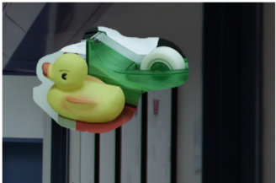
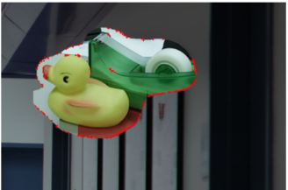
UPDATED METHODOLOGY
Generate ELA: An Error Level Analysis (ELA) heatmap is created by re-saving the image at a specific JPEG quality (80%).
Calculate Difference: The script then calculates the pixel-by-pixel difference between the original and the re-compressed image.
Threshold: This ELA heatmap is converted to a simple black-and-white "predicted mask" by applying a binary threshold (value 25).
Refine Mask: Morphological "opening" is used to remove small, noisy white spots (false positives) from the mask.
Fill Gaps: Morphological "closing" is then applied to fill in small black holes within the detected white regions.
Identify Splicing: The resulting red boundaries on the image highlight the spliced areas.
Tampered Input
Detection Output
| ‹#›

Slide 6
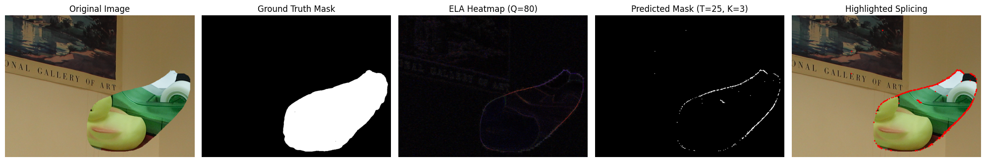
From the dataset
Predicted Forgery
| ‹#›

Slide 7
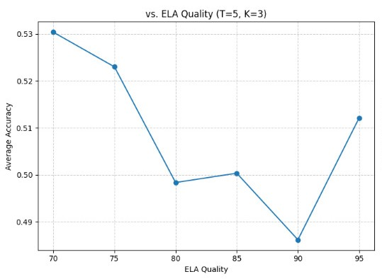
RESULTS
Best accuracy around quality level 70.
Higher JPEG qualities reduce visible ELA artifacts and lower detection accuracy.
Accuracy dips around 90 and rises slightly at 95.
Lower quality levels enhance tampering traces more clearly.

Slide 8
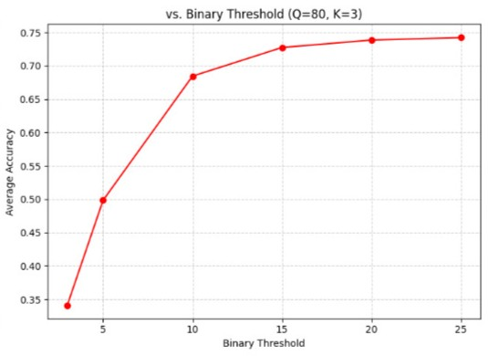
RESULTS
Low thresholds → high noise → poor accuracy (~34%).
Accuracy rises sharply when threshold increases from 5 to 10.
Performance stabilizes around 73–75% for thresholds between 15–25.
Optimal thresholds fall in the 10–25 range.

Slide 9
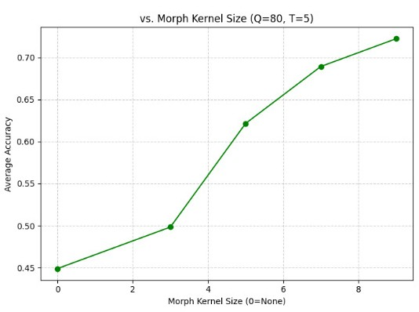
RESULTS
Best accuracy around quality level 70.
Higher JPEG qualities reduce visible ELA artifacts and lower detection accuracy.
Accuracy dips around 90 and rises slightly at 95.
Lower quality levels enhance tampering traces more clearly.

Slide 10
RESULTS
Best combinations:
  Morph Kernel Size: 9
  Binary Threshold: 15–25
  ELA Quality: 70
Error Analysis
  Misclassifications often occur when:
    the tampered region is very small,
    the image is heavily compressed,
    or the manipulation is too subtle.
Morphology improves quality of detection.
Correct thresholding is essential.
ELA works best with lower JPEG quality values.
Combined, these lead to significant improvement in accuracy.

Slide 11
CONCLUSION
This project successfully detects the tampered regions using ELA* based approach.
Binary Thresholding helped produce a clean tampering mask.
Final outlined regions clearly highlights the possible splicing.
Performance was measured by plotting ELA* quality, Binary threshold and morph kernel size.
Overall the system demonstrates that ELA* is a effective method for forgery localization.
It provides a strong base for future enhancements using advanced techniques.
*ELA - Error Level Analysis

Slide 12
REFERENCES
H. Zhang, V. M. Patel and A. K. Roy-Chowdhury, “Image Splicing Localization Using a Multi-task Fully Convolutional Network,” Proc. IEEE Conf. Computer Vision and Pattern Recognition Workshops (CVPRW), 2017, pp. 1881–1889.
A. Singh and S. Kaur, “Passive Image Forgery Detection Using Hybrid Features,” Engineering, Technology & Applied Science Research, vol. 13, no. 1, pp. 9593–9600, 2023.
N. Krawetz, “A Picture’s Worth… Digital Forensics and Image Analysis,” BlackHat Conference, Washington DC, 2008, pp. 1–24. [Online]. Available: https://blackhat.com/presentations/bh-dc-08/Krawetz/Whitepaper/bh-dc-08-krawetz-WP.pdf

Slide 13
THANK YOU
Name | AU ID
Vidhan Nahar | AU2340199
Prasham Mehta | AU2340135
Dhairya Rupani | AU2340195
Drumil Bhati | AU2340211

