Slide 1
ECE501-DIGITAL IMAGE PROCESSING
GROUP - 2

Slide 2
Image Tampering Detection (Forgery Localization)

Slide 3
INTRODUCTION
Digital images are widely used as evidence and in media.
Advanced editing tools make image manipulation easy and undetectable.
Image tampering detection ensures authenticity and integrity.
Focus: Detecting copy-move or duplicated regions within a single image.
Output: Heatmap / highlighted regions showing possible forgeries.

Slide 4
LITERATURE REVIEW
Block Based matching:
Dividing image into overlapping/non-overlapping blocks.
For each block we compute its statistical feature and search for similar blocks.
Feature-based matching:
Instead of choosing blocks, we take interest points(key points) which can be found if the image is scaled or rotated.
SIFT* or SURF* algorithms can be used to detect these key points and describe the local pattern.
*SIFT = Scale Invariant Feature Transform. *SURF = Speeded Up Robust Features

Slide 5
DATASET
Dataset Name: CASIA 1.0 Groundtruth
Contents: Ground truth masks, splicing, copy-move tampered images, authentic images.
Size and Categories: 8 categories (100 pictures each) of authentic pictures.
Strong Points:
Gives pixel-level masks which allows localization.
Both splicing and copy-move.
Diverse image categories

Slide 6
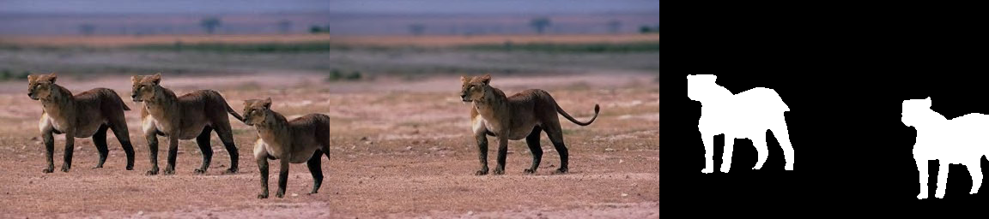
DATASET
Tampered Image
Authentic Image
Ground Truth Mask

Slide 7
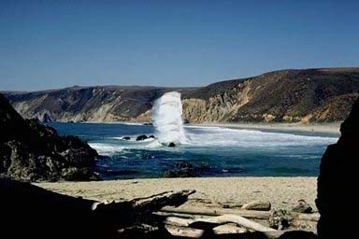
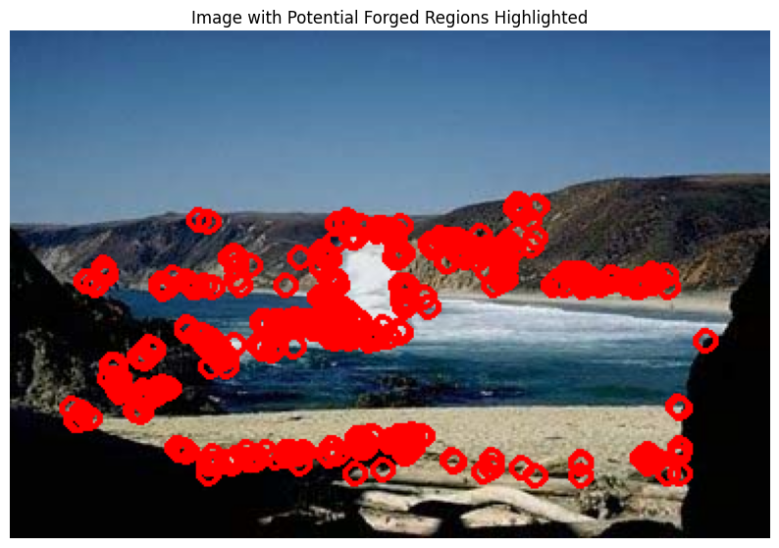
METHODOLOGY
Adaptive Segmentation: The image is divided into solid image-based dynamic parameters such as texture or lighting.
Feature Extraction: Select good and valid points in every section with SIFT* and SURF*.
Feature Matching: Check the points among different segments to identify similarities.
Region Localization: Join up to the similar parts to highlight the entire forged area.
Refine and Output: Clean up the output and indicate the parts that were edited.
*SIFT = Scale Invariant Feature Transform. *SURF = Speeded Up Robust Features

Slide 8
PLAN AHEAD
Implement the complete Image Tampering Detection pipeline using Python (OpenCV, scikit-image). Utilize the CASIA 1.0 Ground Truth Dataset for training and testing — focusing on splicing and copy-move forgeries.
Apply Adaptive Segmentation to divide the image into meaningful regions for analysis. Extract features using SIFT and SURF for robust keypoint detection and matching.
Perform Feature Matching and Region Localization to identify forged areas.
Generate Heatmap Outputs to visualize the detected tampered regions.
Evaluate performance using Precision, Recall, and F1-Score metrics.

Slide 9
REFERENCES
Tralic D., Zupancic I., Grgic S., Grgic M., "CoMoFoD - New Database for Copy-Move Forgery Detection", in Proc. 55th International Symposium ELMAR-2013, pp. 49-54, September 2013
Namtpham, “GitHub - namtpham/casia1groundtruth: Groundtruth images of tampering dataset CASIA 1.0,” GitHub. https://github.com/namtpham/casia1groundtruth
N. K. Gill, R. Garg, and Er. A. Doegar, “A review paper on Digital Image Forgery Detection Techniques,” 2022 13th International Conference on Computing Communication and Networking Technologies (ICCCNT), pp. 1–7, Jul. 2017, doi: 10.1109/icccnt.2017.8203904.
H. R. Arpita, S. B. Shwetha, and S. V. Sathyanarayana, “Image Forgery Detection Using Adaptive Oversegmentation and Feature Point Matching,” JNNCE Journal of Engineering & Management (JJEM), vol. 3, no. 1, pp. 74–83, Jan.–Jun. 2019.

Slide 10
THANK YOU
Name | AU ID
Vidhan Nahar | AU2340199
Prasham Mehta | AU2340135
Dhairya Rupani | AU2340195
Drumil Bhati | AU2340211

