Slide 1
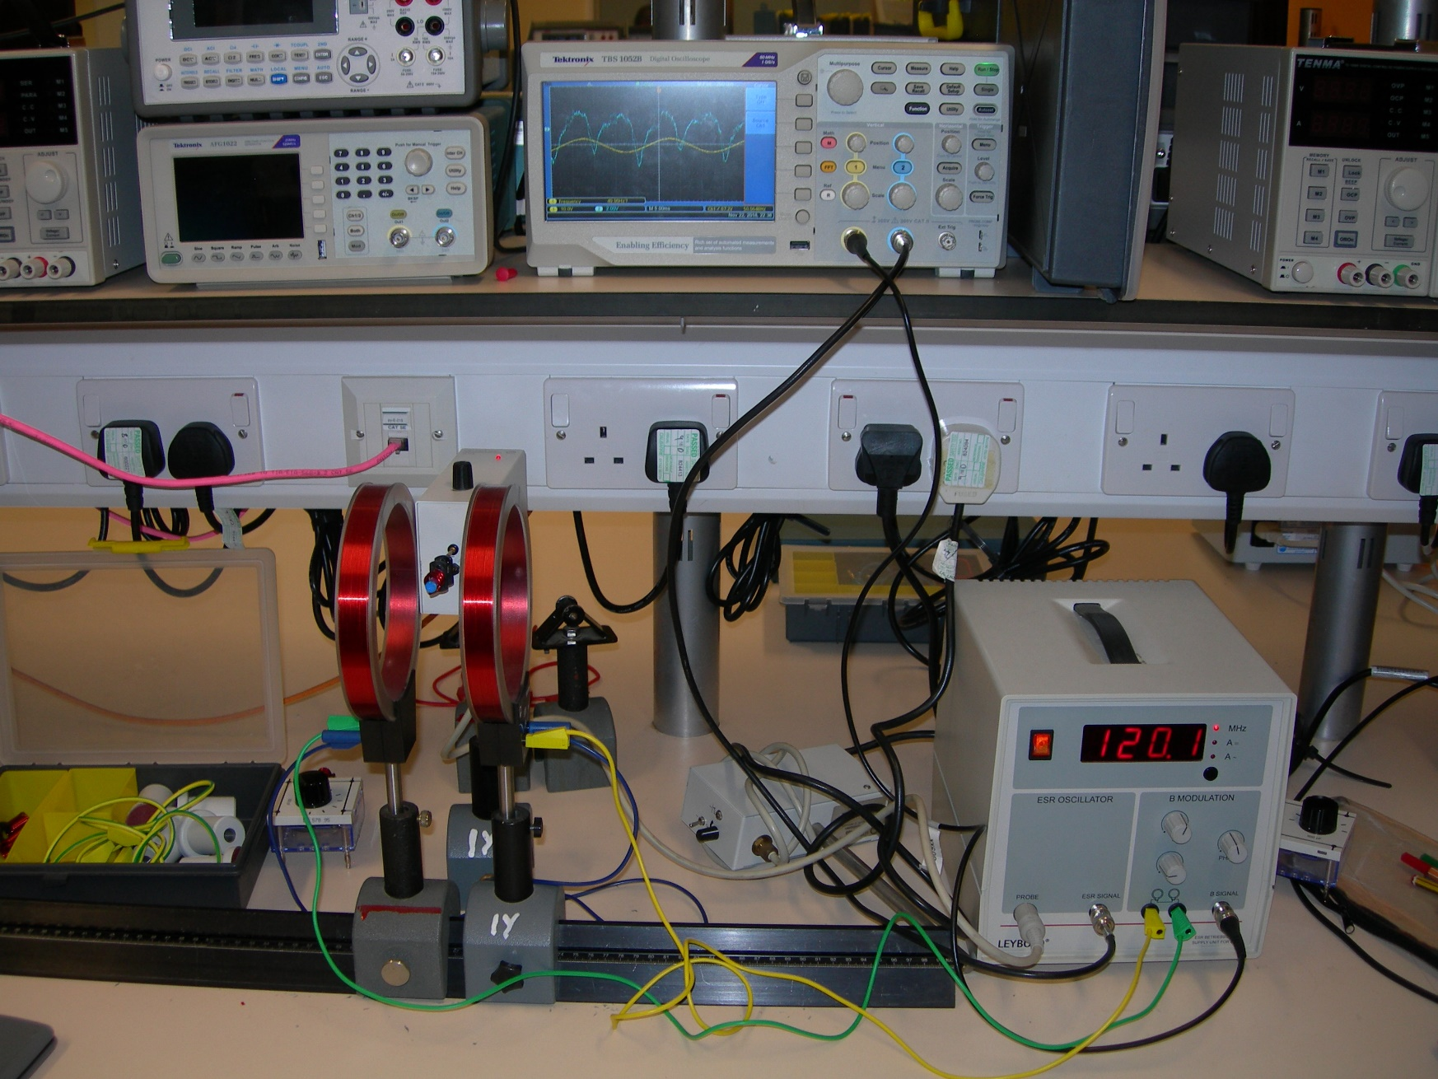
Radio Frequency Oscillator
Oscilloscope
DPPH Sample Inside Coil
Helmholtz Coils
Supply Unit For ESR

