Slide 1
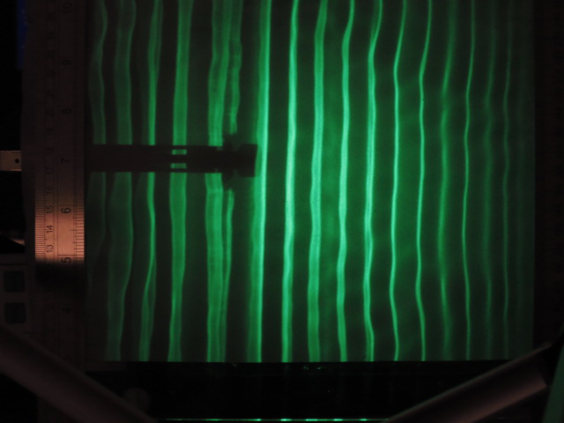


$$λ_{1}$$
$$λ_{2}$$
Decreasing Depth
20 Hz

