Slide 1
Mechanical and Electromagnetic Waves
Matt Evans
University of Exeter
College of Engineering, Mathematics and Physical Sciences
BSc Physics

Slide 2
Experimental Aims
The investigation of various mechanical wave properties using water waves in a ripple tank.
Studying diffraction and interference patterns of electromagnetic waves to devise a way of determining the wave length of light sources.
Comparing mechanical and electromagnetic interference properties.

Slide 3
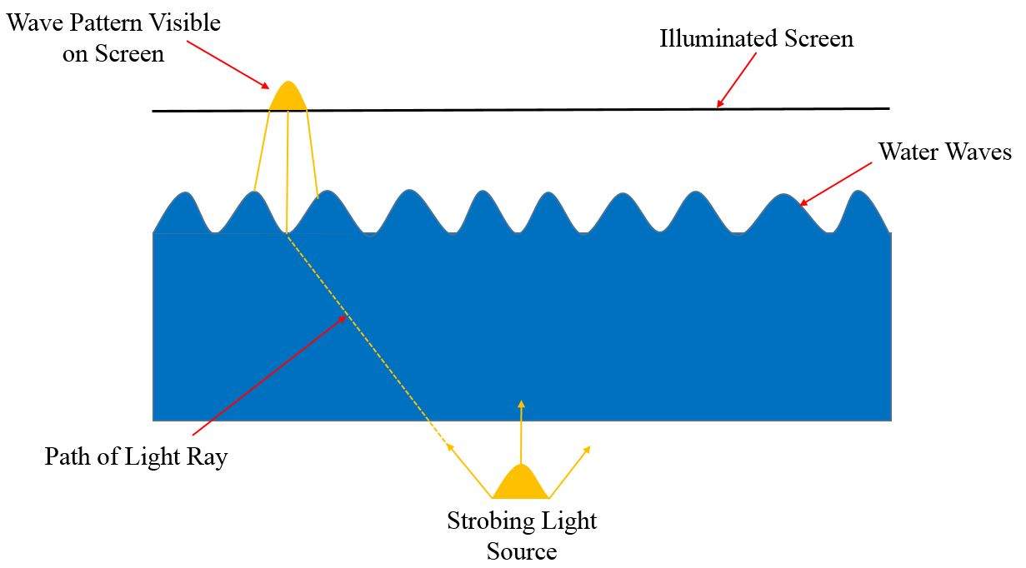
Mechanical Waves Method

Slide 4
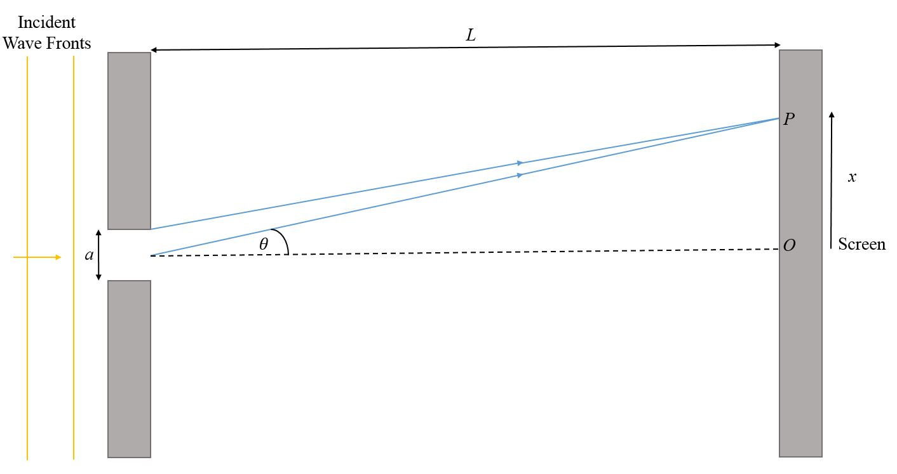
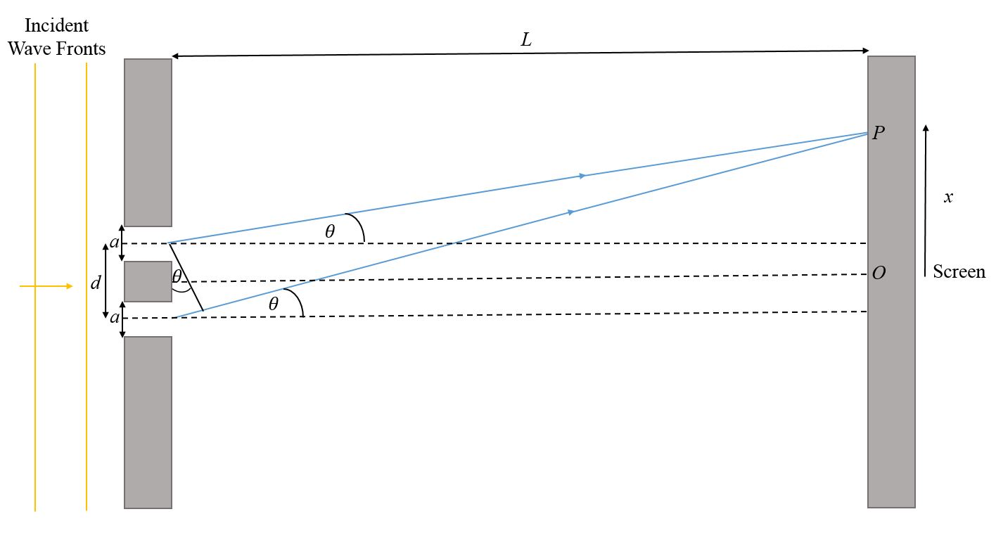
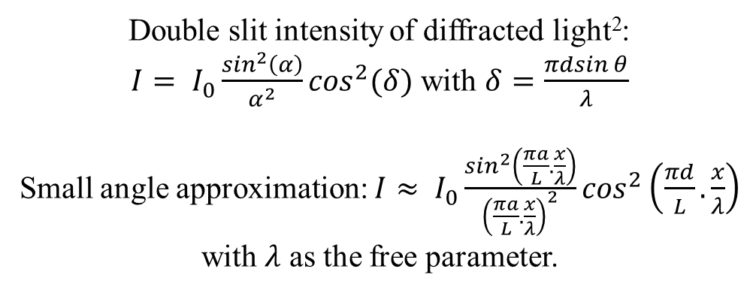
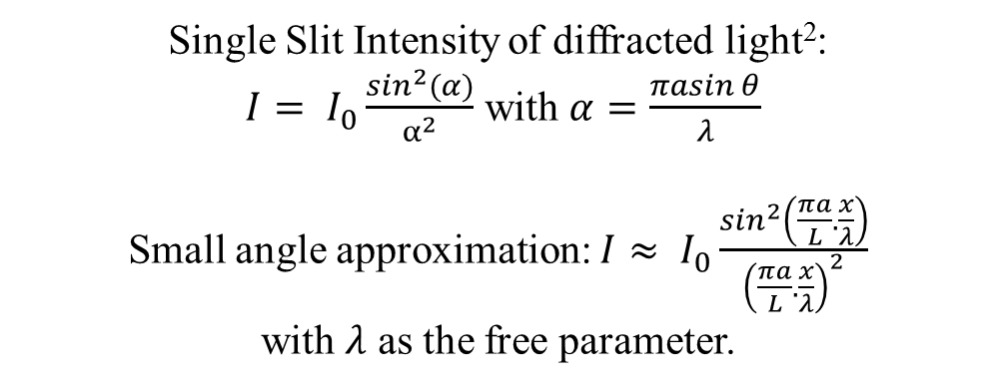
Electromagnetic Waves Method
L >> x
L >> x
Single Slit Intensity of diffracted light²:
$I= I_{0}\frac{\sin^{2}(α)}{α^{2}}$ with $α=\frac{πasin⁡θ}{λ}$
Small angle approximation: $I≈ I_{0}\frac{\sin^{2}\left(\frac{πa}{L}.\frac{x}{λ}\right)}{{\left(\frac{πa}{L}.\frac{x}{λ}\right)}^{2}}$
with $λ$ as the free parameter.
Double slit intensity of diffracted light²:
$I= I_{0}\frac{\sin^{2}\left(α\right)}{α^{2}}\cos^{2}(δ)$ with $δ=\frac{πdsin⁡θ}{λ}$
Small angle approximation: $I≈ I_{0}\frac{\sin^{2}\left(\frac{πa}{L}.\frac{x}{λ}\right)}{{\left(\frac{πa}{L}.\frac{x}{λ}\right)}^{2}}\cos^{2}\left(\frac{πd}{L}.\frac{x}{λ}\right)$
with $λ$ as the free parameter.

Slide 5
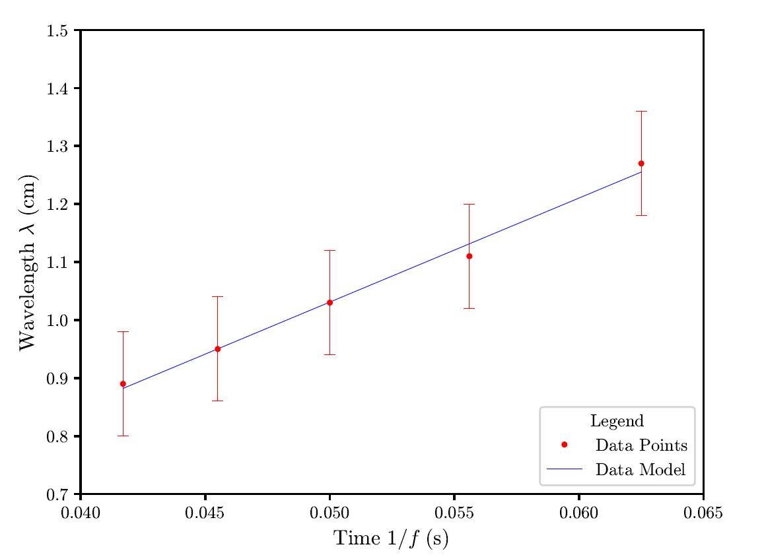
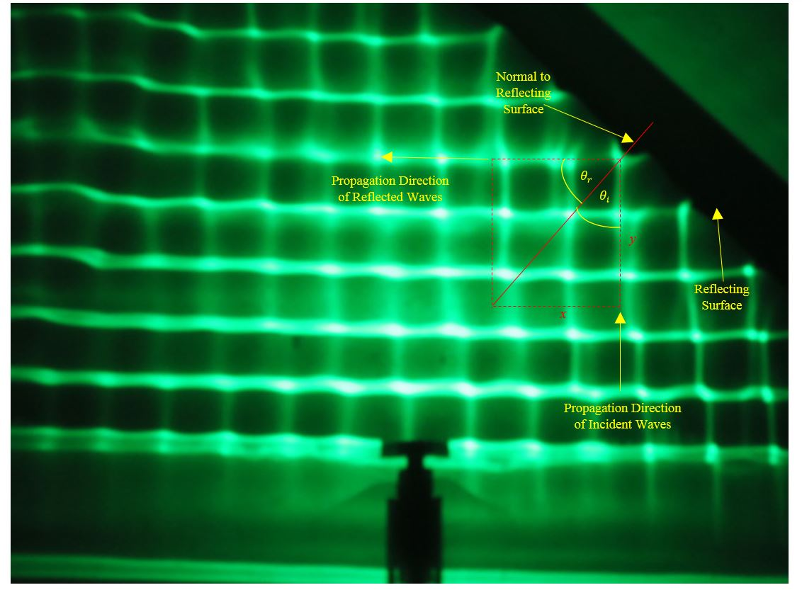


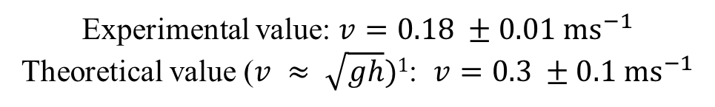

Speed and Reflection of Water Waves
$$λ=v/f$$
Speed of Water Waves: Fixed h, Varying Frequency
Reflection at a Barrier
$$λ=v/f$$
Experimental value: $v=0.18 ±0.01 {ms}^{−1}$
Theoretical value ($v ≈ \sqrt{gh})1$: $v=0.3 ±0.1 {ms}^{−1}$
A$ngle of Incidence: θ_{i}=41 ±2°$
A$ngle of Reflection:{ θ}_{r}=41 ±2°$

Slide 6
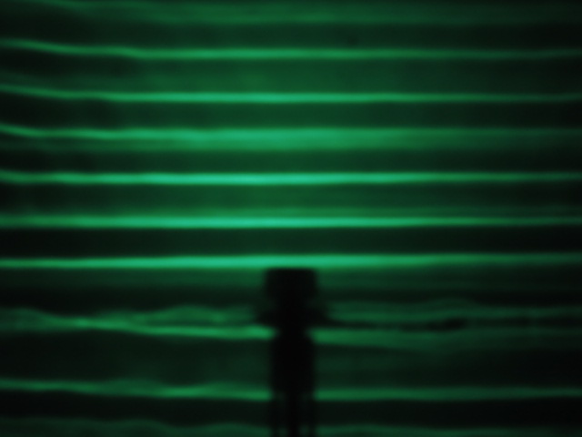
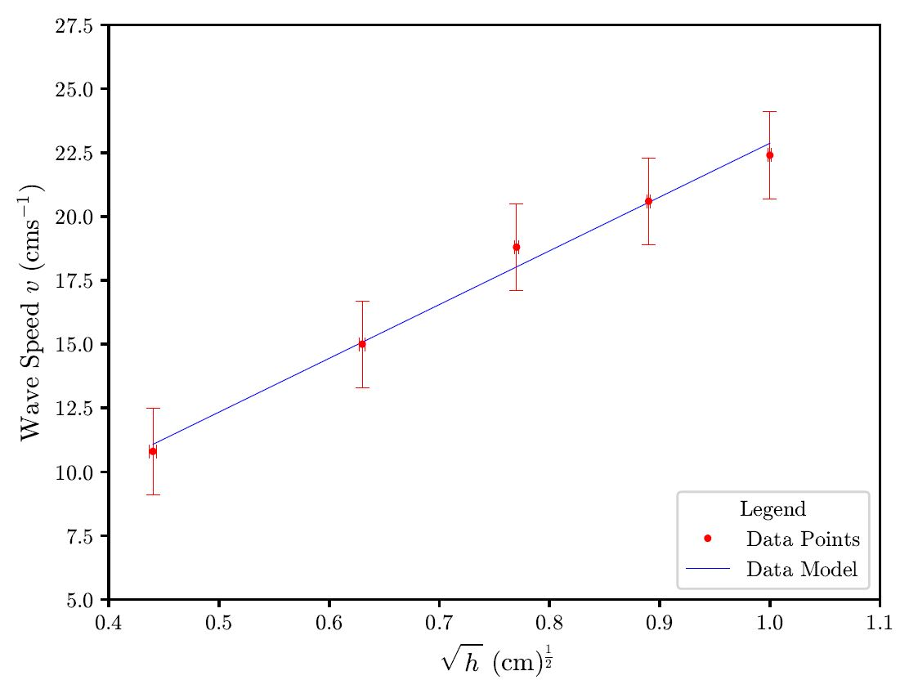
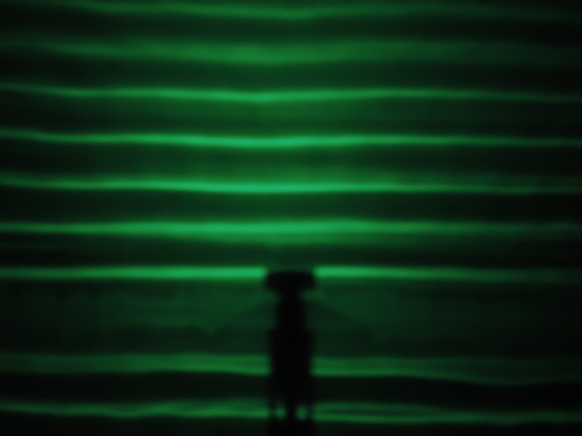

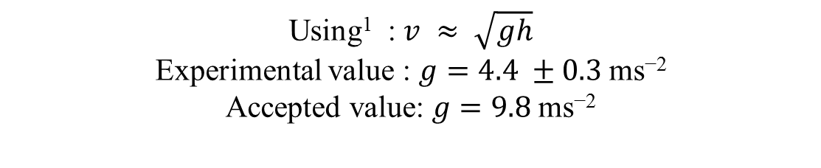
Speed of Water Waves at Varying Depths
$$v ≈ \sqrt{gh}$$
h = 6mm
Using¹ : $v ≈ \sqrt{gh}$
Experimental value : $g=4.4 ±0.\text{3} \text{ms}\text{−}\text{2}$
Accepted value: $g=9.8 \text{ms}\text{−2}$
h = 10mm

Slide 7
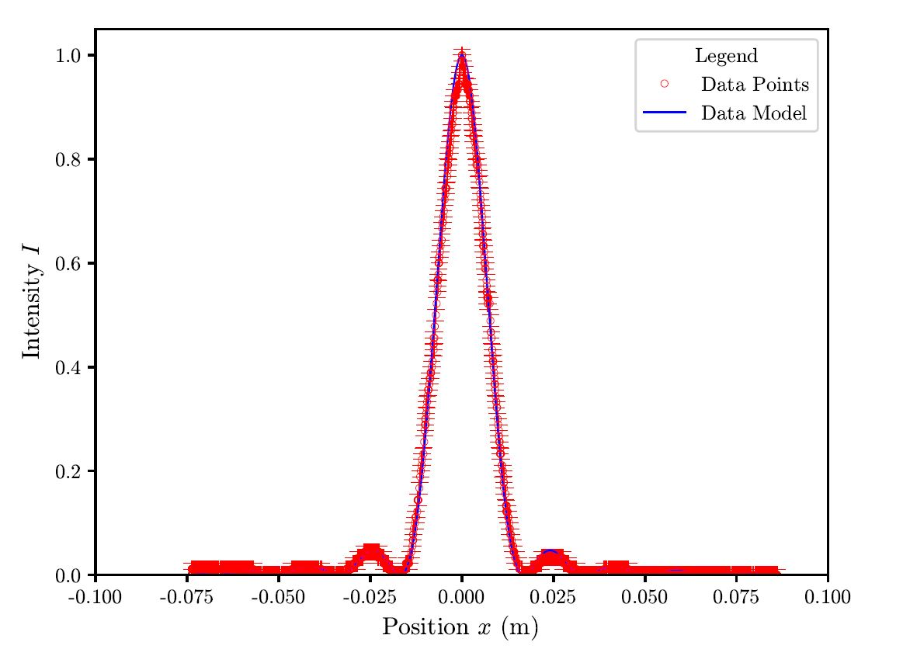
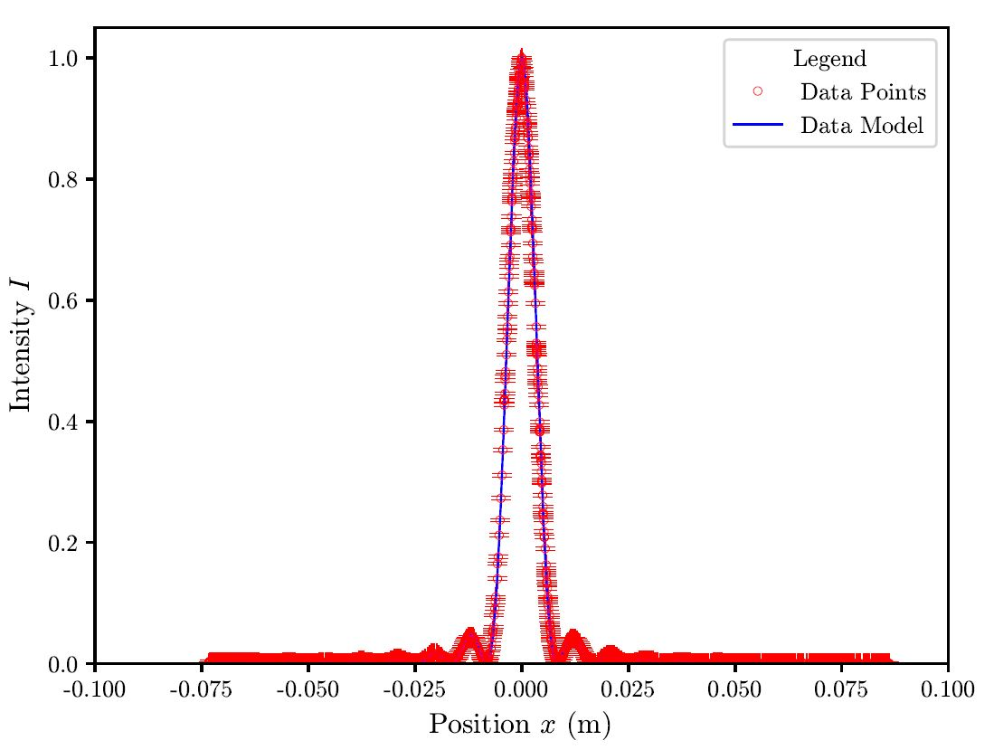
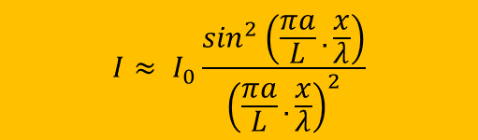
Single Slit Diffraction
$$I≈ I_{0}\frac{\sin^{2}\left(\frac{πa}{L}.\frac{x}{λ}\right)}{{\left(\frac{πa}{L}.\frac{x}{λ}\right)}^{2}}$$
1.0mm Aperture, a = 0.02mm
1.0mm Aperture, a = 0.04mm
Experimental Value:$λ=674 ±1$ nm
Experimental Value:$λ=662 ±1$ nm
Known Value³:$λ=650 ±10$nm

Slide 8
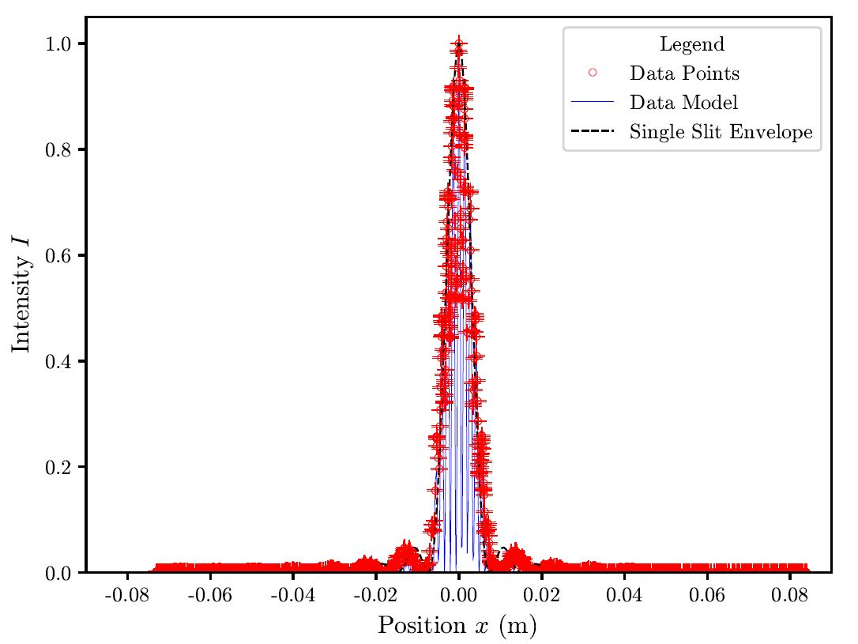
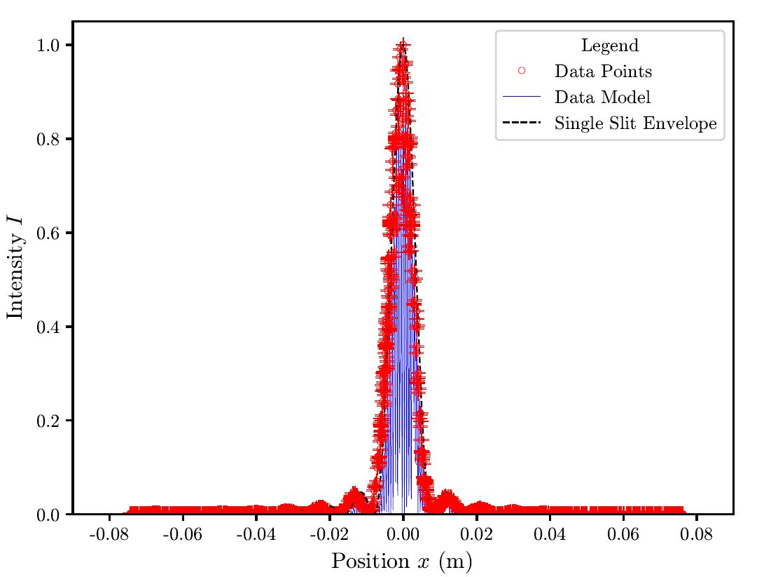
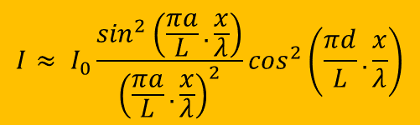
Double Slit Diffraction
$$I≈ I_{0}\frac{\sin^{2}\left(\frac{πa}{L}.\frac{x}{λ}\right)}{{\left(\frac{πa}{L}.\frac{x}{λ}\right)}^{2}}\cos^{2}\left(\frac{πd}{L}.\frac{x}{λ}\right)$$
1.0mm Aperture, a = 0.04mm and d = 0.25mm
1.0mm Aperture, a = 0.04mm and d = 0.5mm
Experimental Value:$λ=698 ±2$ nm
Experimental Value:$λ=617 ±1$ nm
Known Value³: $λ=650 ±10$nm

Slide 9
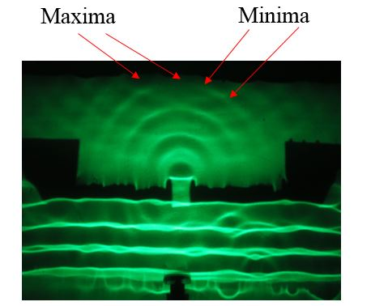
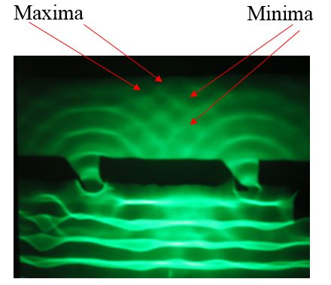
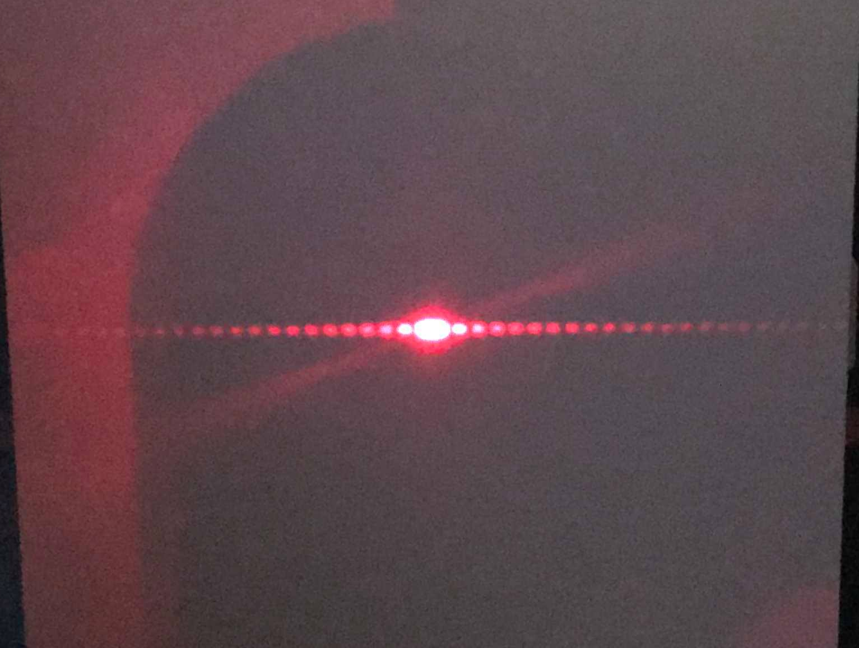
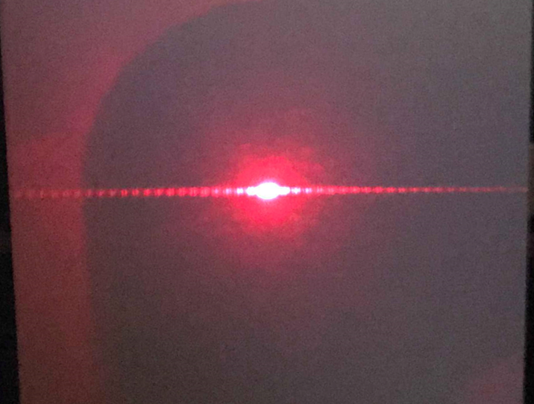
Interference of Mechanical & EM Waves
Single Slit Interference
Double Slit Interference
f = 20 Hz
f = 20 Hz
a = 0.08mm
a = 0.08mm d = 0.5mm

Slide 10
Summary
Water waves nicely demonstrate various properties of (mechanical) waves and water wave speed has been shown to vary with depth.
Using diffraction and interference of EM waves has been shown to determine the wavelength of a light source.
Mechanical and Electromagnetic interference patterns show strong similarities.

Slide 11
References
¹ Barber N.F, Water Waves, 1st Edition, Chapter 3, pages 36 - 55, 1969.
²College of Engineering, Mathematics and Physical Sciences, University of Exeter, PHY2026, Diffraction and Interference Worksheet (Accessed 8th February 2019).
³ Red Diode Laser – Basic Optics - OS-8525A https://www.pasco.com/prodCatalog/OS/OS-8525_red-diode-laser-basic-optics/index.cfm?fbclid=IwAR3gzuNSAoumEZpwYZQO6tX3j1nLhTtLYklX5U6V6HHw5xyHKdszO1ID00I (Accessed 15th March 2019).

