Slide 1
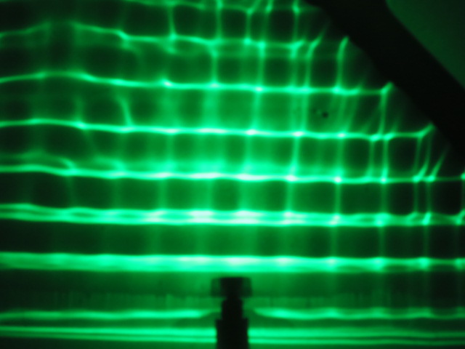
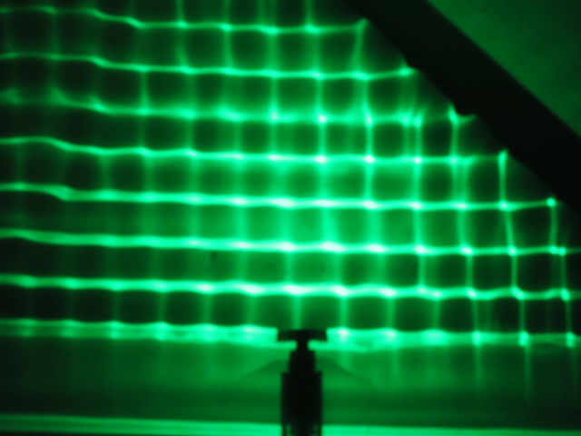
Incident Waves
Barrier
15 Hz
20 Hz
Reflected Waves

