Slide 1
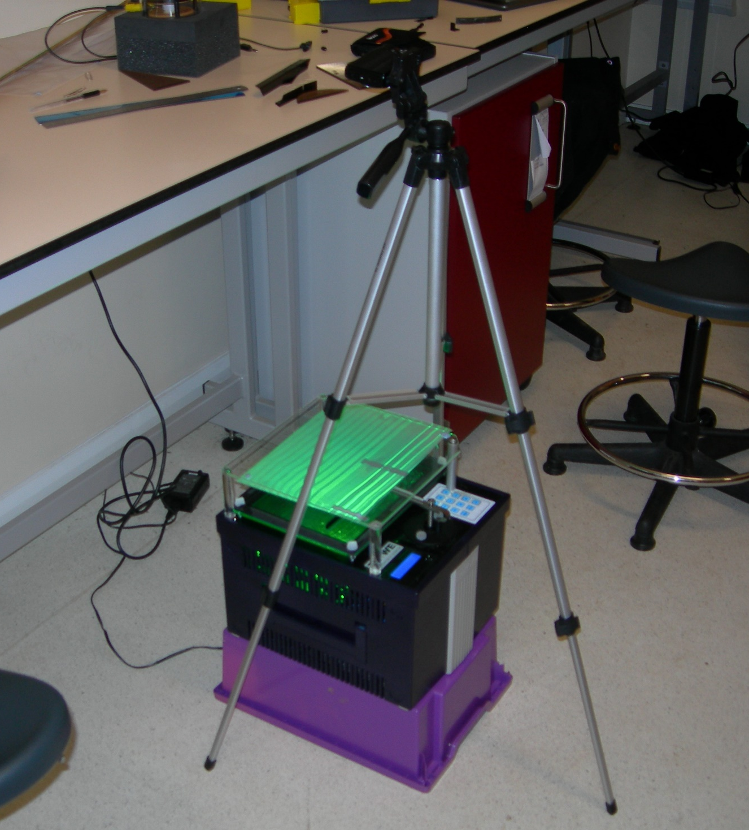
Camera
Tripod
Illuminated Wave Patterns
Ripple Tank
Up-turned Crate
Water Filled Tray

