Slide 1
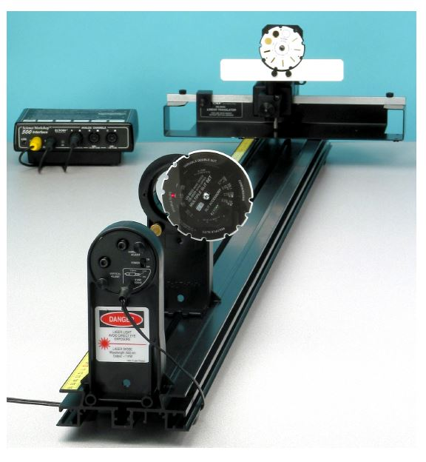
Interface Box
Light Sensor
Adjustable Slits
Linear Translator
Laser
Rotating Slit Wheel

