Slide 1
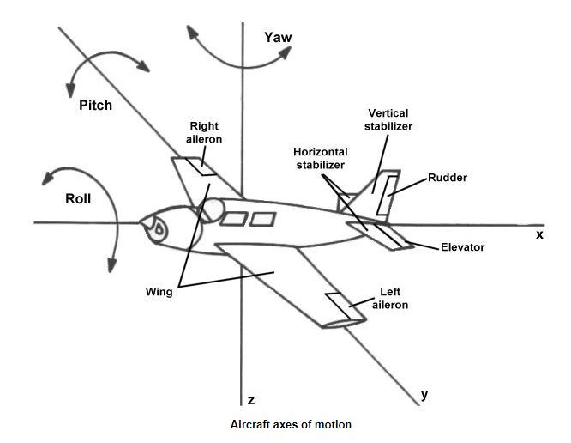





+
$$ψ$$
-
+
-
$$θ$$
$(x_{1},y_{1}{,z}_{1}$)
+
$$φ$$
-
$(x_{2},y_{2}{,z}_{2}$)

