Slide 1
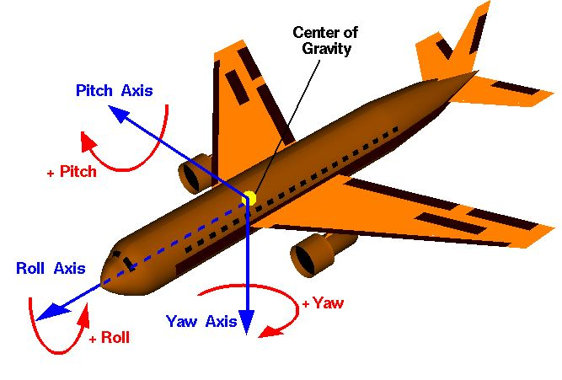





$$(x_{1},y_{1},z_{1})$$
x
Right Wing
y
z
$$θ$$
Fin
Left Wing
$$(x_{2},y_{2},z_{2})$$
$$φ$$
$$ψ$$

Slide 2
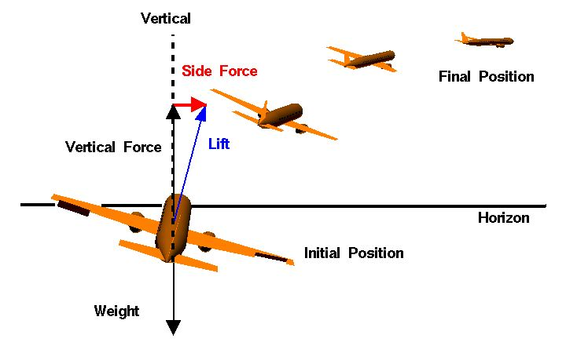

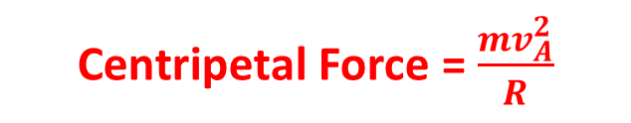



$$φ$$
$$= L_{F}$$
Radius, $R$
Centripetal Force = $\frac{mv_{A}^{2}}{R}$
$$=mg$$

