Slide 1
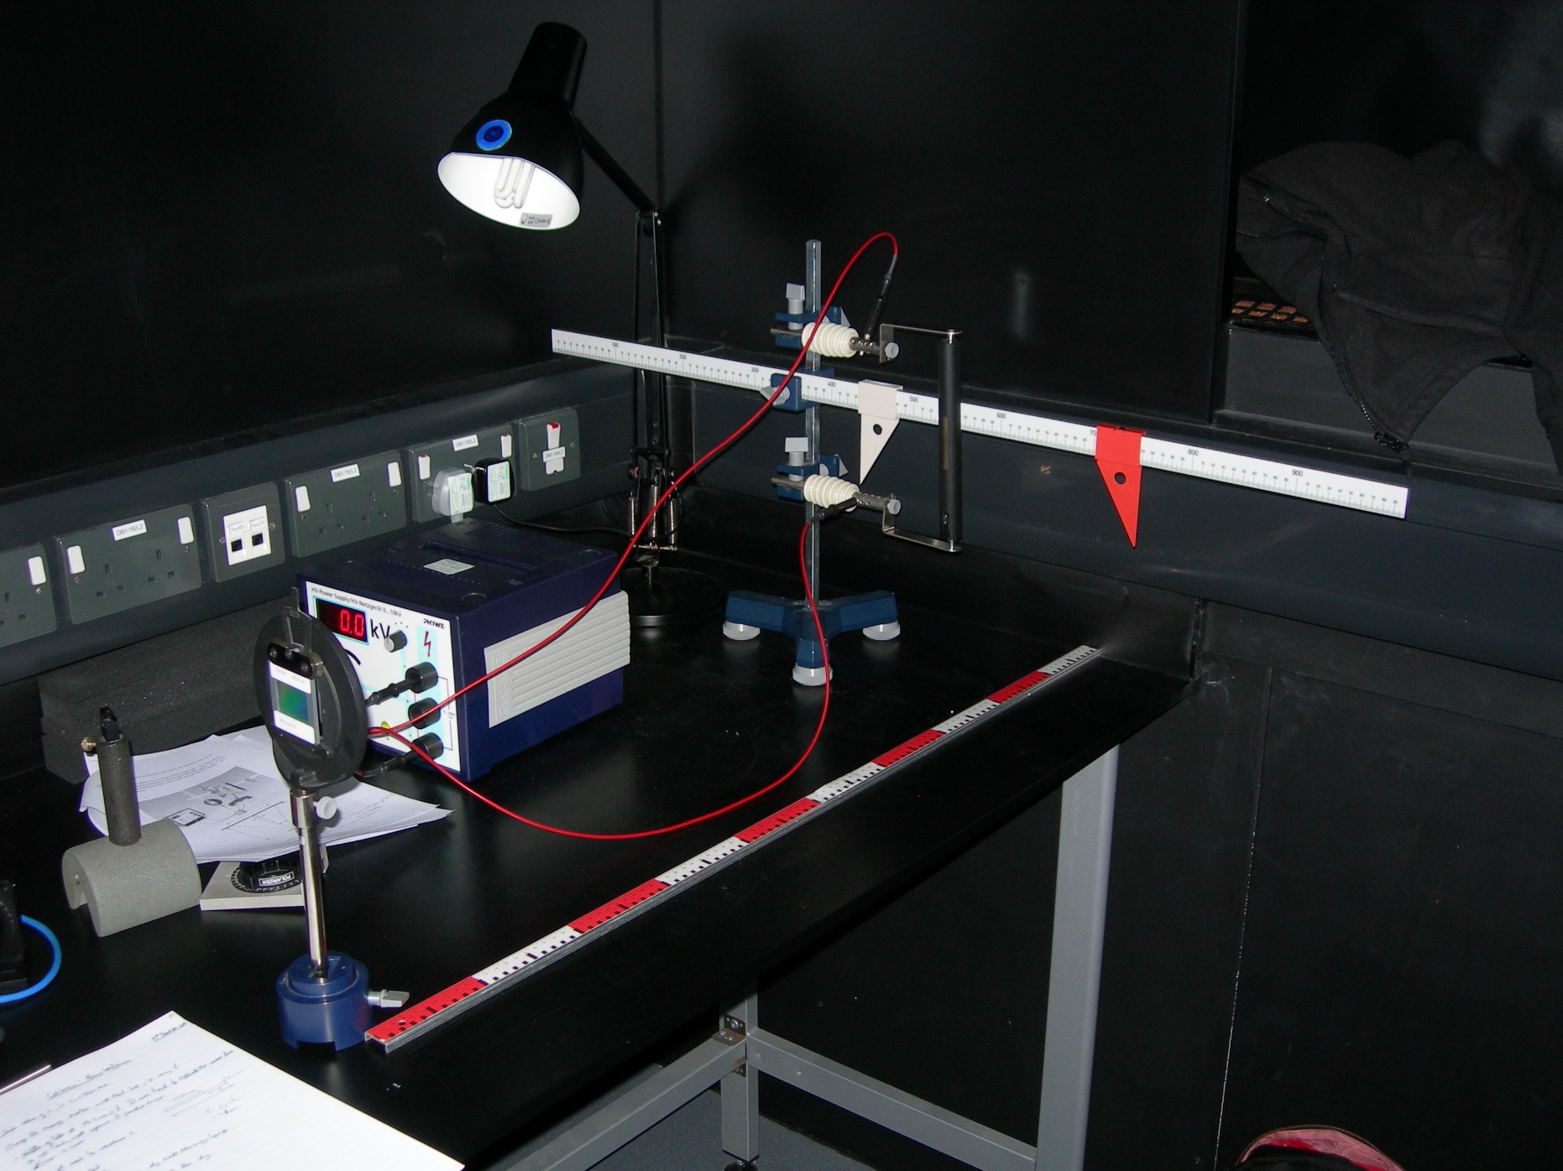
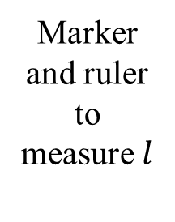
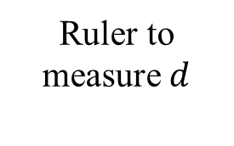
Marker and ruler to measure $l$
Voltage Source
Spectral Tube
Diffraction Grating
Ruler to measure $d$

