Slide 1
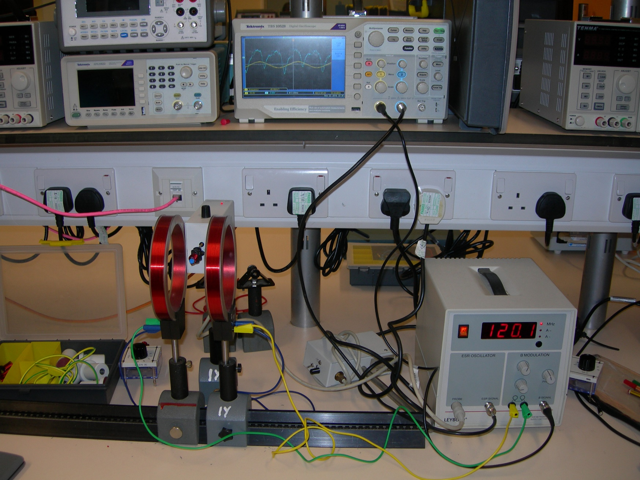
Radio Frequency Oscillator
Oscilloscope
DPPH Sample Inside Coil
Supply Unit For ESR
Helmholtz Coils

