Slide 1
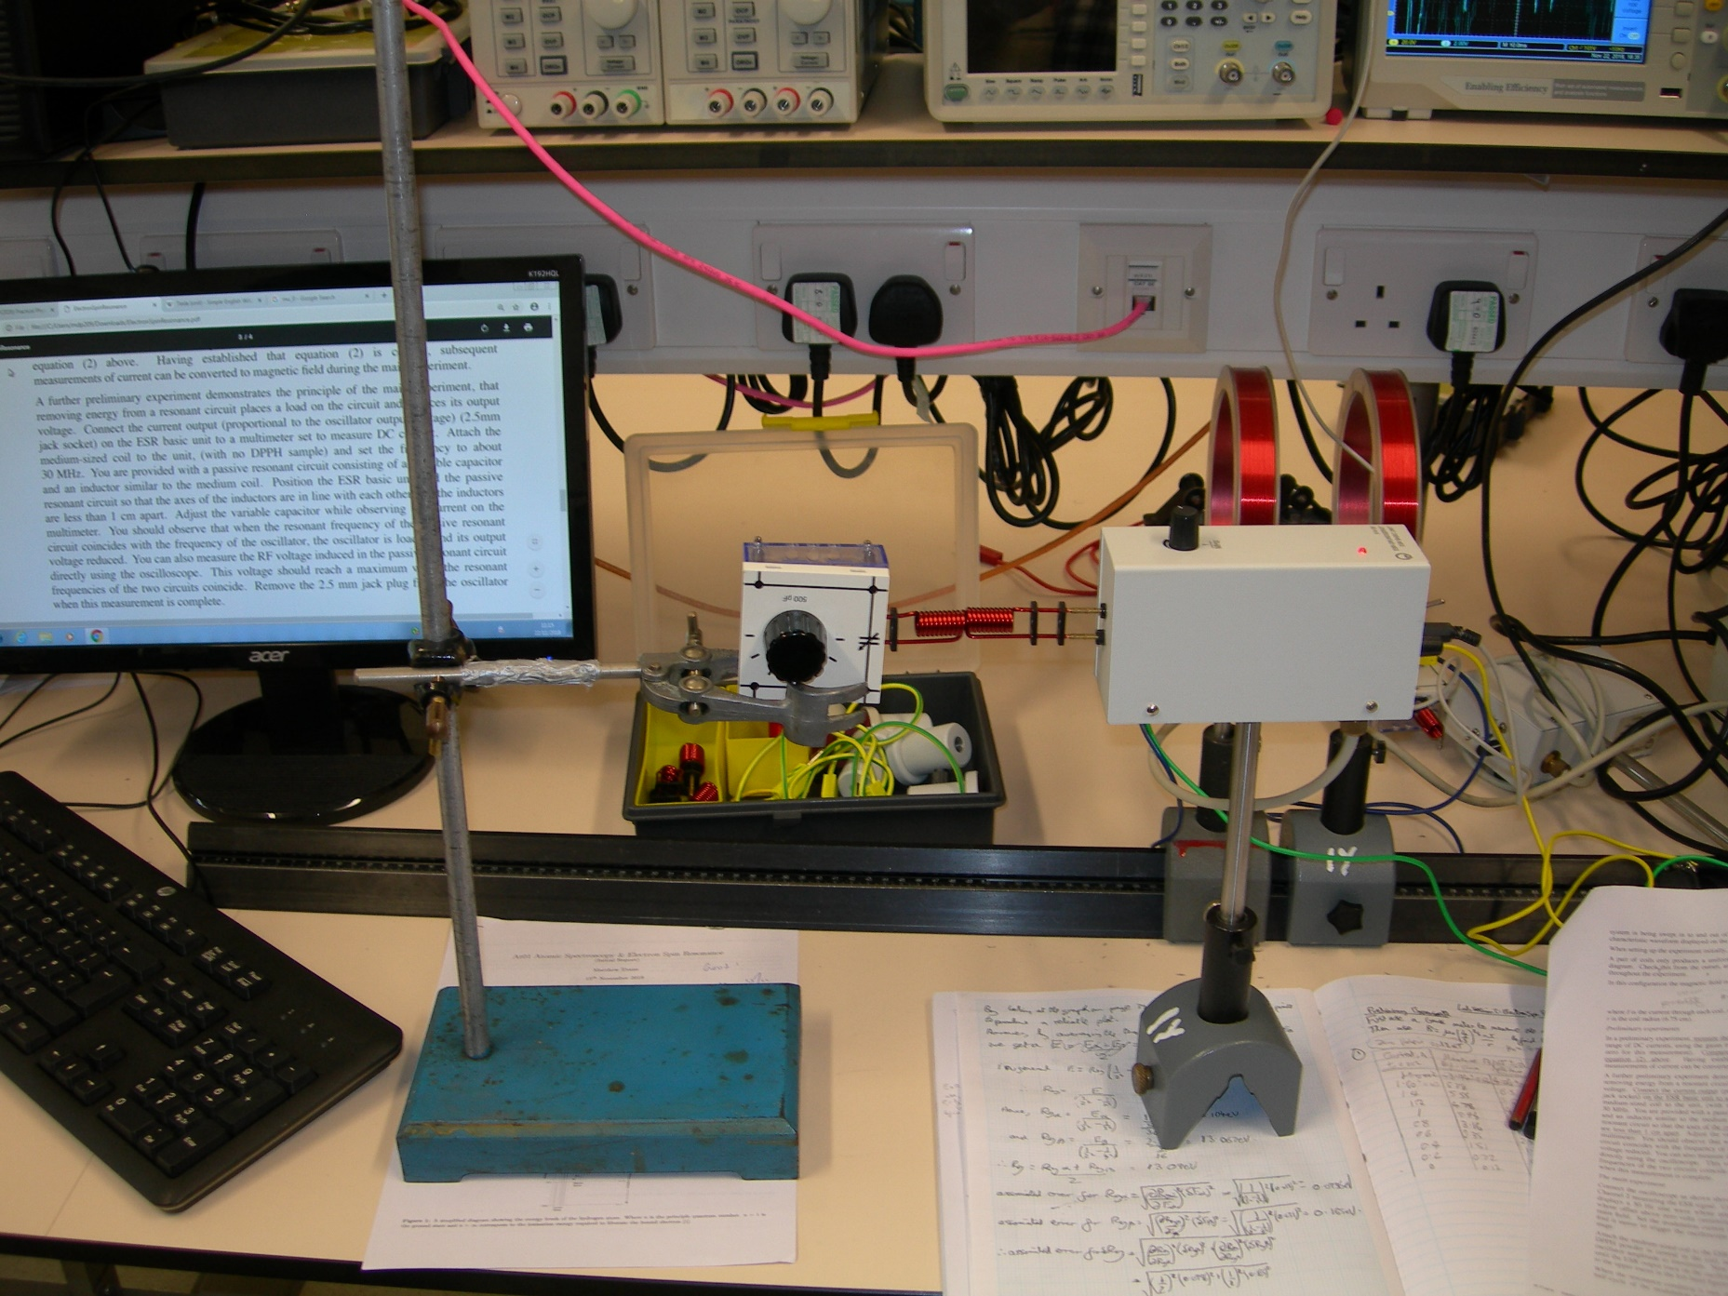
Inductors
Passive Resonant Circuit
Radio Frequency Oscillator
Frequency Adjustor

