Slide 1
Mechanical and Electromagnetic Waves
Matt Evans
University of Exeter
College of Engineering, Mathematics and Physical Sciences
BSc Physics

Slide 2
Experimental Aims
The investigation of various mechanical wave properties using water waves in a ripple tank.
Studying diffraction and interference patterns of electromagnetic waves to devise a way of determining the wave length of light sources.
Comparing mechanical and electromagnetic interference properties.

Slide 3
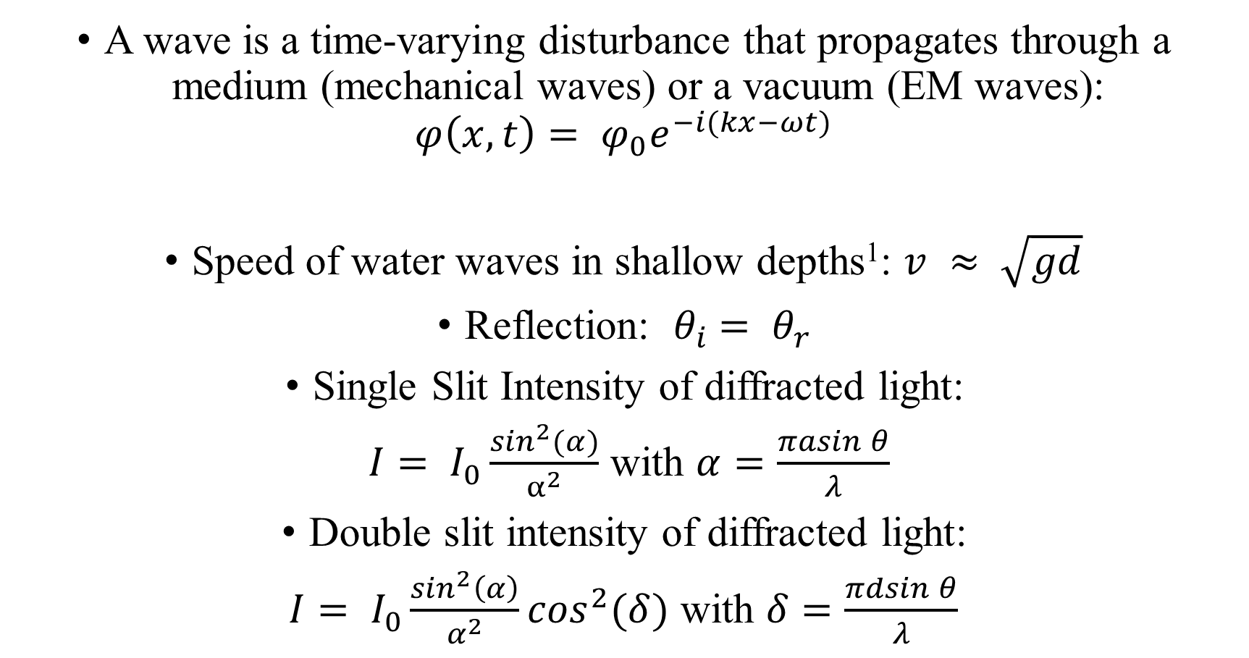
Wave Definitions
A wave is a time-varying disturbance that propagates through a medium (mechanical waves) or a vacuum (EM waves):
$$φ\left(x,t\right)= φ_{0}e^{−i(kx−ωt)}$$
Speed of water waves in shallow depths¹: $v ≈ \sqrt{gd}$
Reflection: $θ_{i}$ $= θ_{r}$
Single Slit Intensity of diffracted light:
$I= I_{0}\frac{\sin^{2}(α)}{α^{2}}$ with $α=\frac{πasin⁡θ}{λ}$
Double slit intensity of diffracted light:
$I= I_{0}\frac{\sin^{2}\left(α\right)}{α^{2}}\cos^{2}(δ)$ with $δ=\frac{πdsin⁡θ}{λ}$

Slide 4
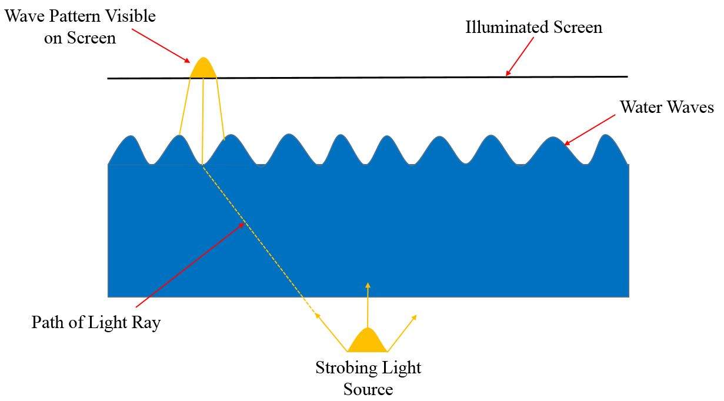
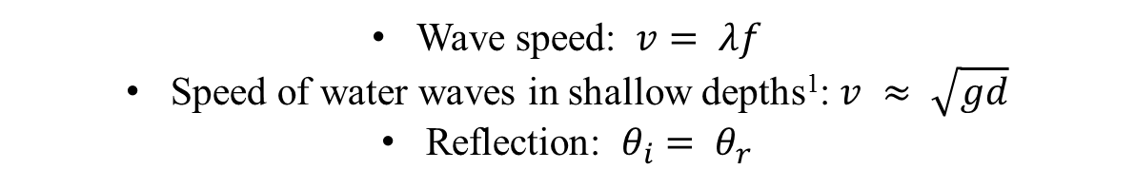
Mechanical Waves Method
Wave speed: $v= λf$
Speed of water waves in shallow depths¹: $v ≈ \sqrt{gd}$
Reflection: $θ_{i}$ $= θ_{r}$

Slide 5
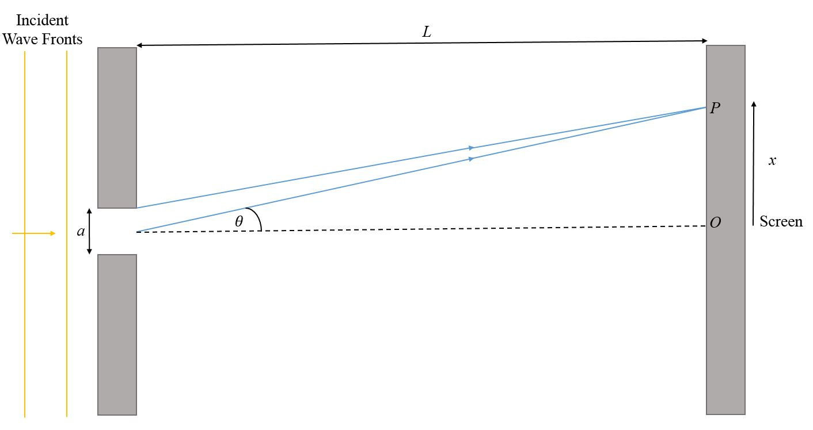
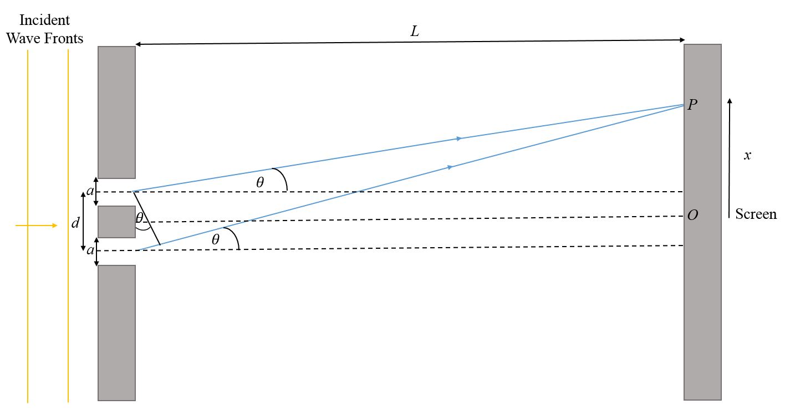
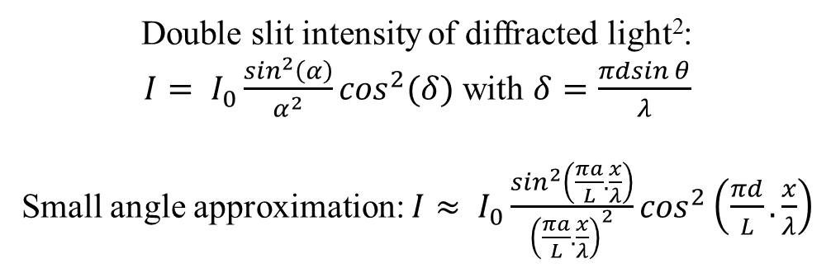
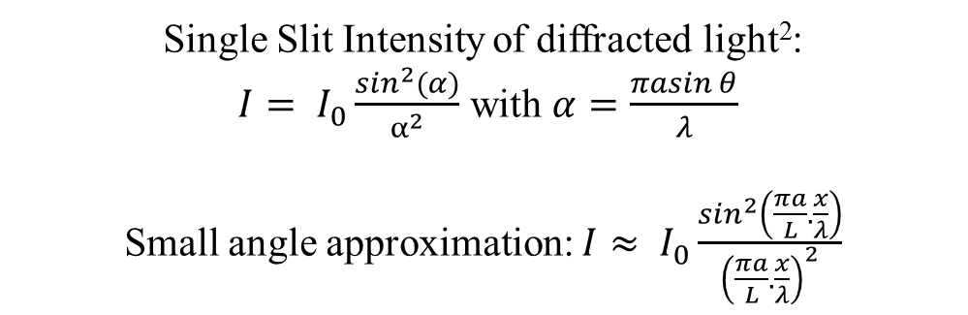
Electromagnetic Waves Method
L >> x
L >> x
Single Slit Intensity of diffracted light²:
$I= I_{0}\frac{\sin^{2}(α)}{α^{2}}$ with $α=\frac{πasin⁡θ}{λ}$
Small angle approximation: $I≈ I_{0}\frac{\sin^{2}\left(\frac{πa}{L}.\frac{x}{λ}\right)}{{\left(\frac{πa}{L}.\frac{x}{λ}\right)}^{2}}$
Double slit intensity of diffracted light²:
$I= I_{0}\frac{\sin^{2}\left(α\right)}{α^{2}}\cos^{2}(δ)$ with $δ=\frac{πdsin⁡θ}{λ}$
Small angle approximation: $I≈ I_{0}\frac{\sin^{2}\left(\frac{πa}{L}.\frac{x}{λ}\right)}{{\left(\frac{πa}{L}.\frac{x}{λ}\right)}^{2}}\cos^{2}\left(\frac{πd}{L}.\frac{x}{λ}\right)$

Slide 6
References
¹ Barber N.F, Water Waves, 1st Edition, Chapter 3, pages 36 - 55, 1969.
²College of Engineering, Mathematics and Physical Sciences, University of Exeter, PHY2026, Diffraction and Interference Worksheet, (Accessed 8th February 2019).

