Slide 1
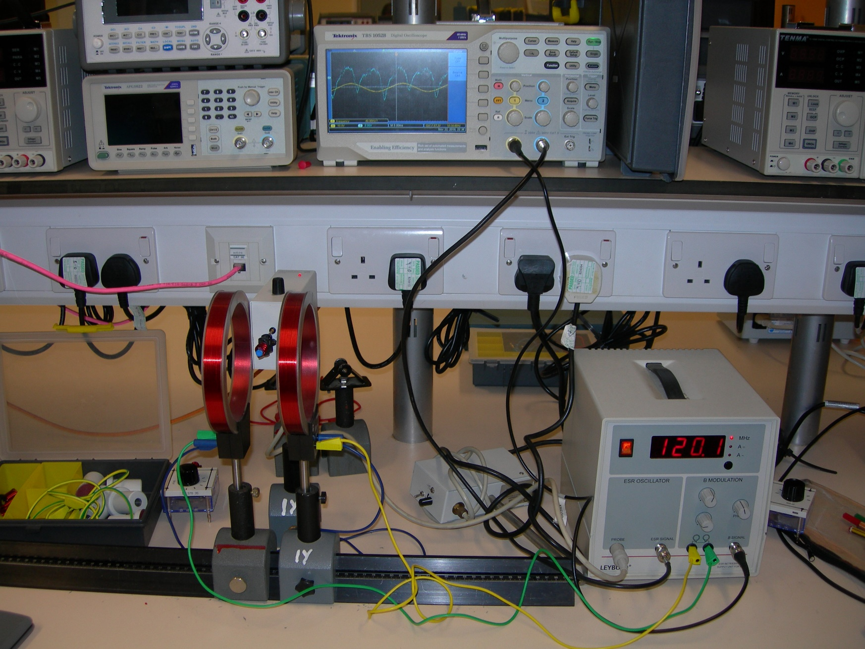
DPPH Sample Inside Coil
Oscilloscope
Helmholtz Coils
Radio Frequency Oscillator

