Slide 1
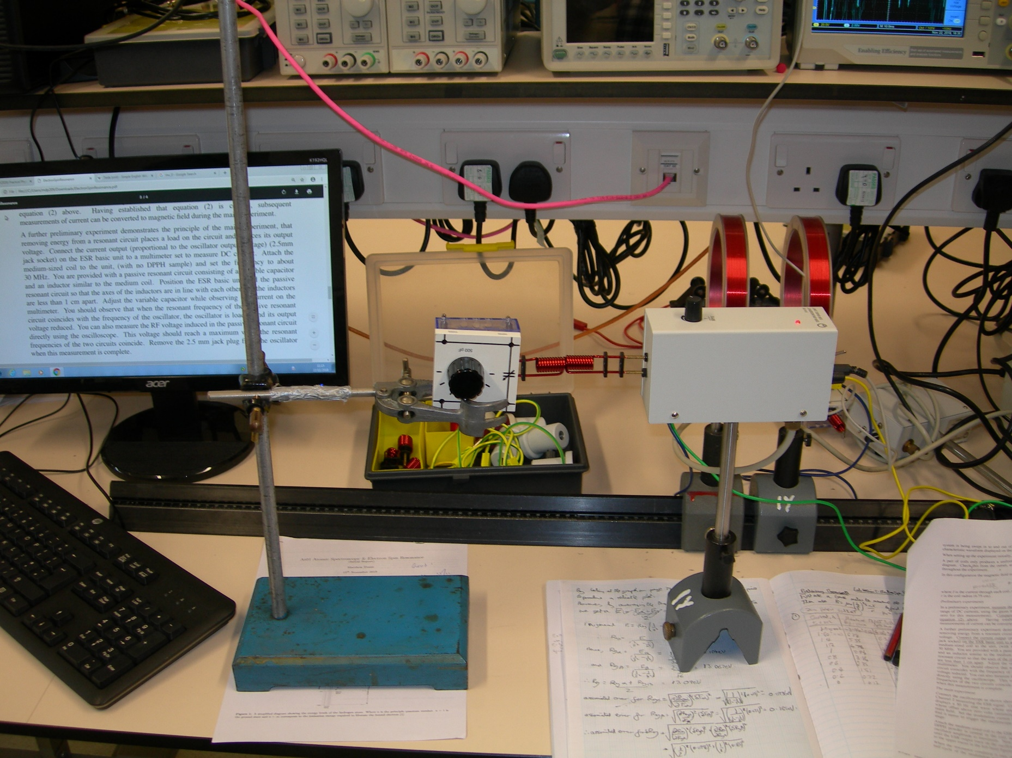
Inductors
Passive Resonant Circuit
ESR Basic Unit
Frequency Adjustor

