Slide 1
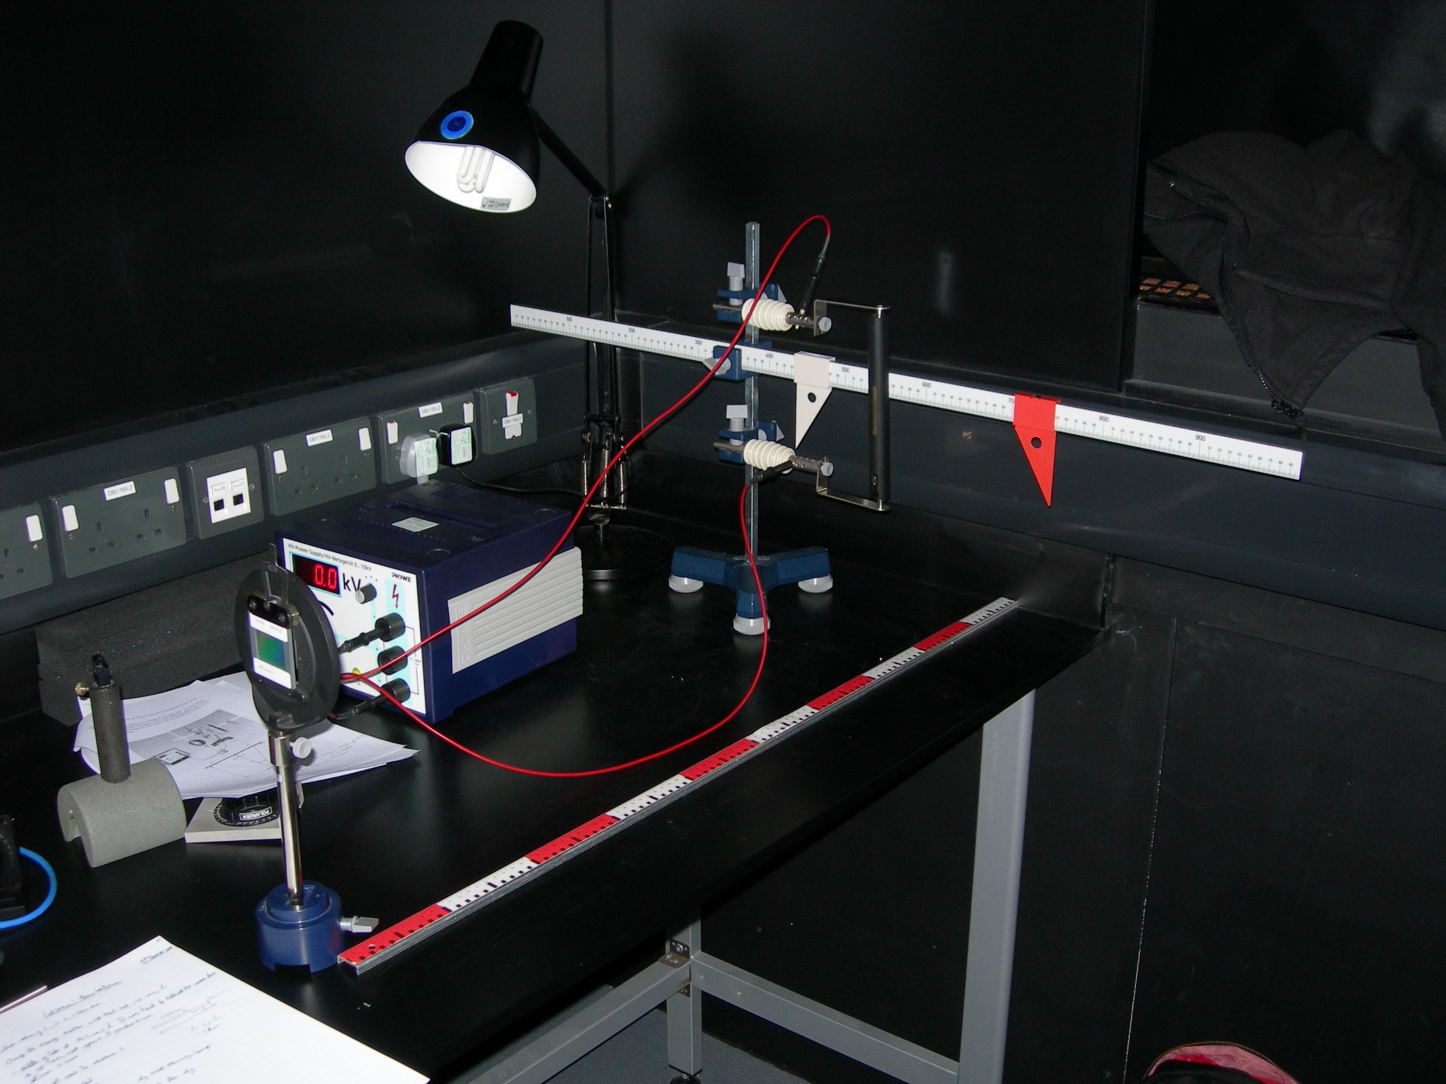
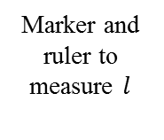

Voltage Source
Marker and ruler to measure $l$
Spectral Tube
Diffraction Grating
Ruler to measure $d$

