Slide 1
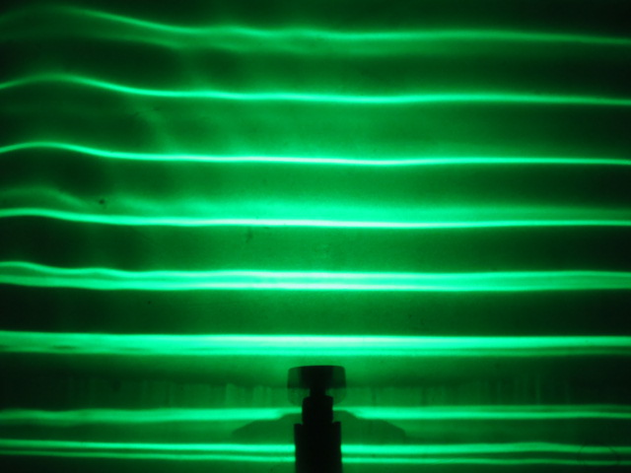
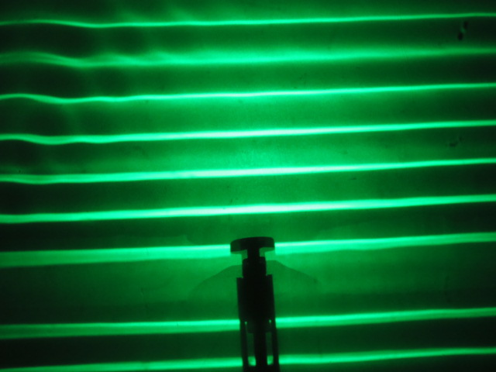
Wave Fronts
15 Hz
20 Hz
Wave Length

